Slide 1
Capstone Project
NYC Taxi Trip Time Prediction

Slide 2
Contents
Problem Statement
Dataset
Feature Engineering
Feature extraction
Exploratory Data Analysis
Map visualization
NYC taxi pickup location
NYC taxi drop-off location
Univariate Analysis
Trip duration
Passengers
Vendor
Speed
Store and forward flag
Trips per hour
Trips per weekday
Trips per month
Bivariate Analysis
Trip duration per hour
Trip duration per weekday
Trip duration per month
Trip duration per vendor
Trip duration v/s Flag
Distance per hour
Distance per weekday
Distance per month
Distance per vendor
Distance v/s Flag
Distance v/s Trip duration
Passengers per vendor
Correlation Analysis
Model
Multiple Linear Regression
Decision Tree Regressor
Random Forest Regressor
Conclusion

Slide 3
Data Summary
Problem Description:
Your task is to build a model that predicts the total ride duration of taxi trips in New York City. Your primary dataset is one released by the NYC Taxi and Limousine Commission, which includes pickup time, geo-coordinates, number of passengers, and several other variables.
Data Description:
Dataset size
Observation 1458644
Columns 11
Missing value 0
 | vendor id | passenger count | Pickup longitude | Pickup latitude | Drop-off longitude | Drop-off latitude | Trip duration
count | 1.458644e+06 | 1.458644e+06 | 1.458644e+06 | 1.458644e+06 | 1.458644e+06 | 1.458644e+06 | 1.458644e+06
mean | 1.534950e+00 | 1.664530e+00 | -7.397349e+01 | 4.075092e+01 | -7.397342e+01 | 4.075180e+01 | 9.594923e+02
std | 4.987772e-01 | 1.314242e+00 | 7.090186e-02 | 3.288119e-02 | 7.064327e-02 | 3.589056e-02 | 5.237432e+03
min | 1.000000e+00 | 0.000000e+00 | -1.219333e+02 | 3.435970e+01 | -1.219333e+02 | 3.218114e+01 | 1.000000e+00
25% | 1.000000e+00 | 1.000000e+00 | -7.399187e+01 | 4.073735e+01 | -7.399133e+01 | 4.073588e+01 | 3.970000e+02
50% | 2.000000e+00 | 1.000000e+00 | -7.398174e+01 | 4.075410e+01 | -7.397975e+01 | 4.075452e+01 | 6.620000e+02
75% | 2.000000e+00 | 2.000000e+00 | -7.396733e+01 | 4.076836e+01 | -7.396301e+01 | 4.076981e+01 | 1.075000e+03
max | 2.000000e+00 | 9.000000e+00 | -6.133553e+01 | 5.188108e+01 | -6.133553e+01 | 4.392103e+01 | 3.526282e+06
Notes:
Abc
Def
jhk

Slide 4
Exploratory Data Analysis

Slide 5
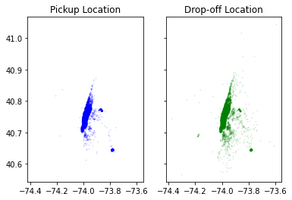
Map Visualization

Slide 6
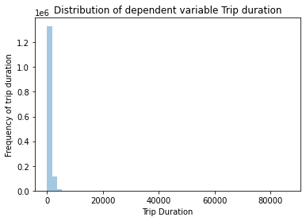
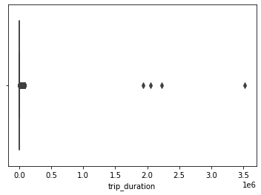
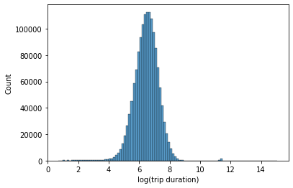
Analysis of Target variable Trip duration

Slide 7
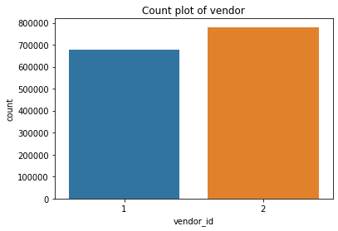
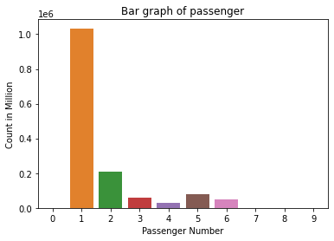
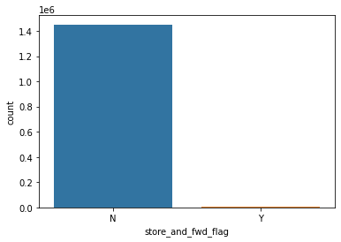
Combined analysis of features

Slide 8
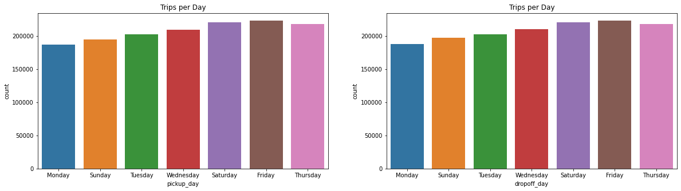
Trips per day

Slide 9
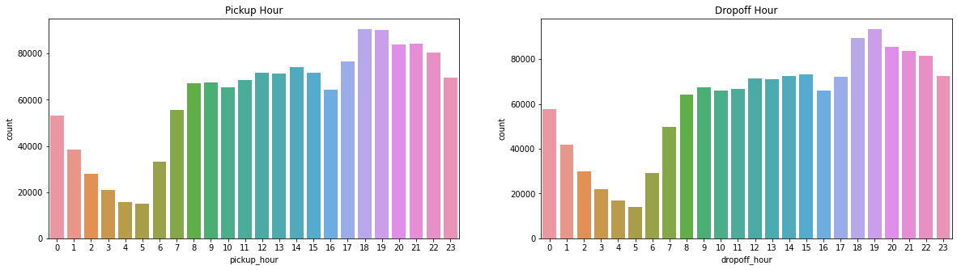
Trips per hour

Slide 10
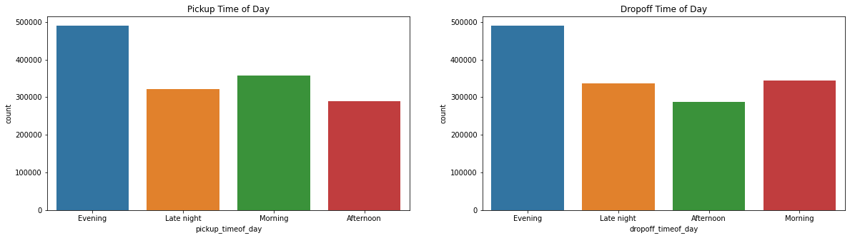
Trips per Time of the day

Slide 11
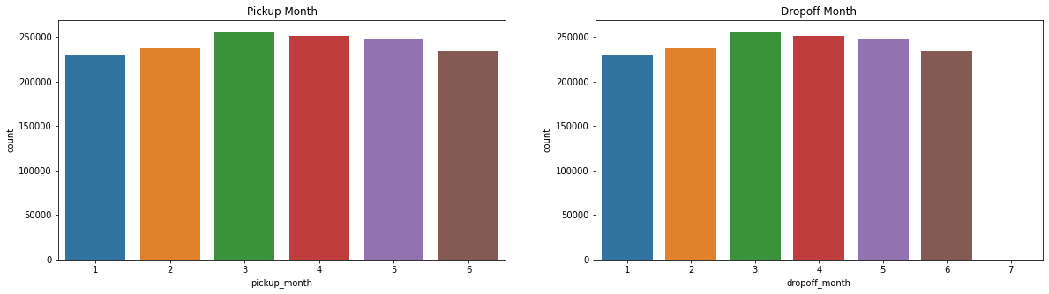
Trips per Month

Slide 12
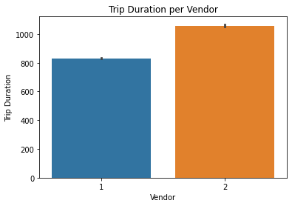
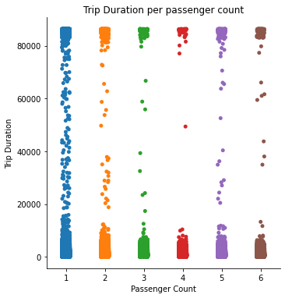
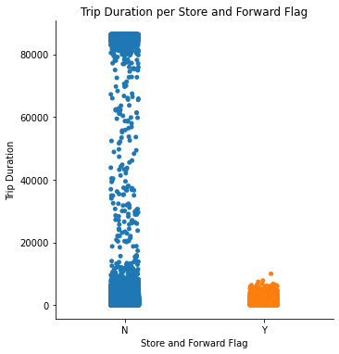
Analysis

Slide 13
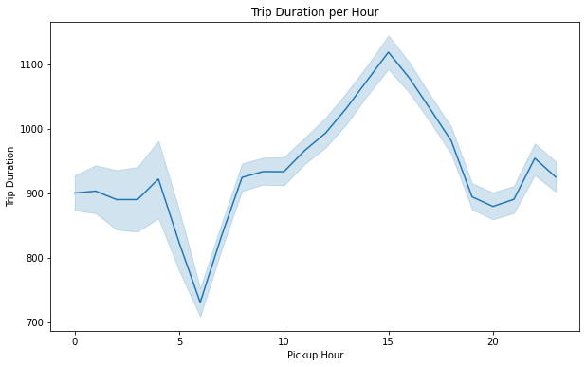
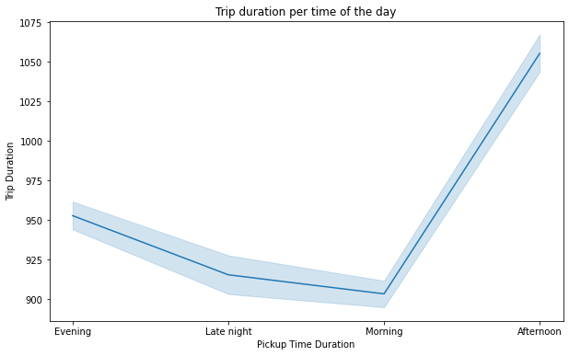
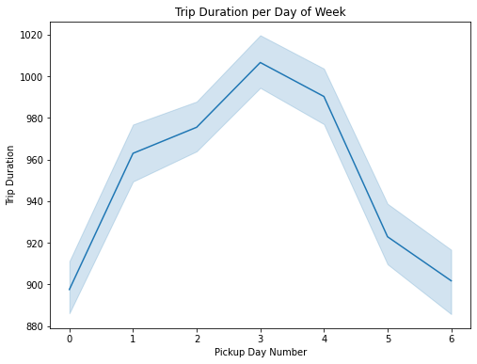
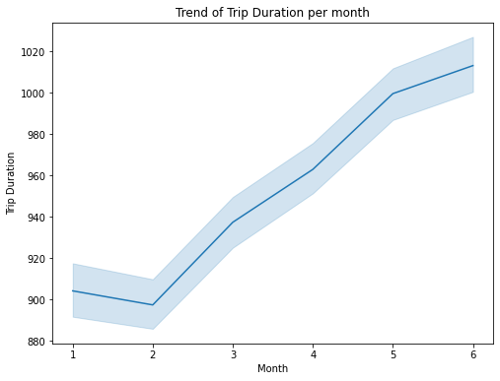
Trend of predictor variable with respect to different features

Slide 14
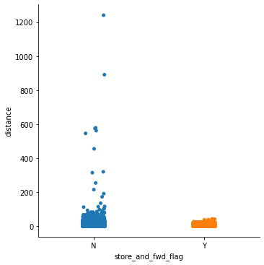
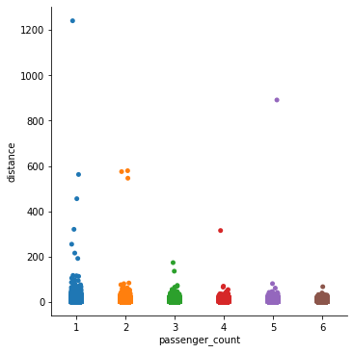
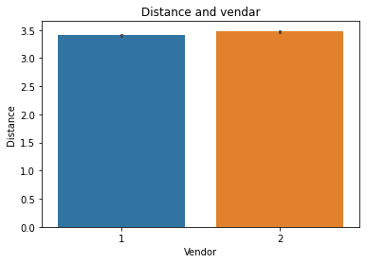
Analysis of distance variable with respect to different Features

Slide 15
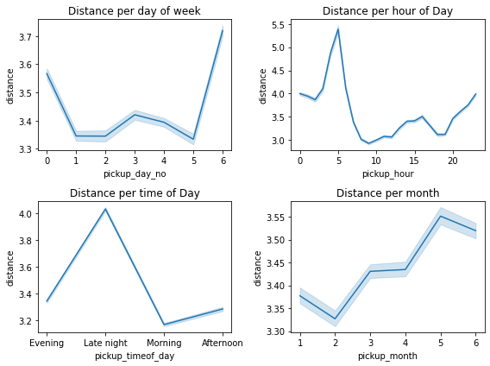
Trend of distance with respect to different features

Slide 16
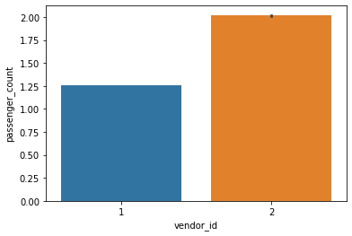
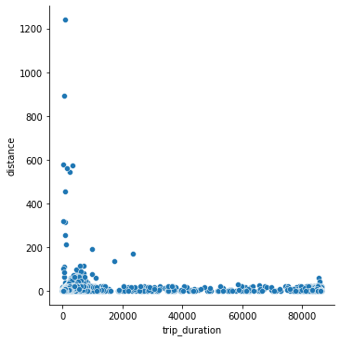
Analysis based on (passenger and vendor) and (distance and trip duration)

Slide 17
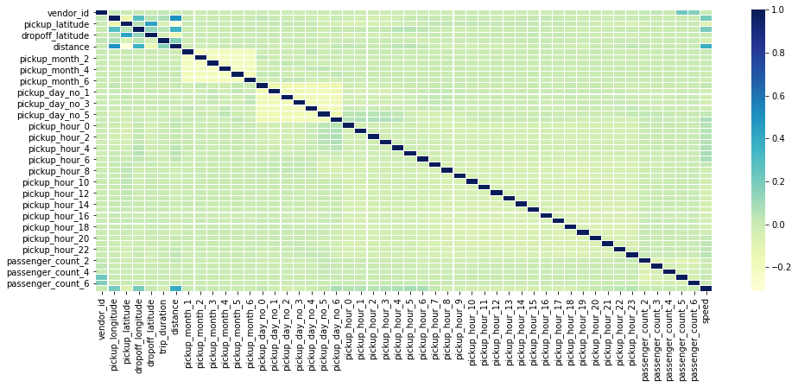
Correlation Analysis

Slide 18
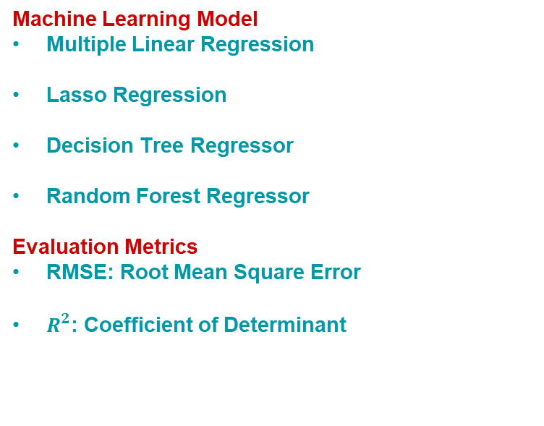
Model Analysis
Machine Learning Model
Multiple Linear Regression
Lasso Regression
Decision Tree Regressor
Random Forest Regressor
Evaluation Metrics
RMSE: Root Mean Square Error
$R^{2}$: Coefficient of Determinant

Slide 19
Multiple Linear Regression
Assumption:
Linearity
No Multicollinearity among Predictors
Normality of the Error Terms
No Autocorrelation of the Error Terms
Homoscedasticity

Slide 20
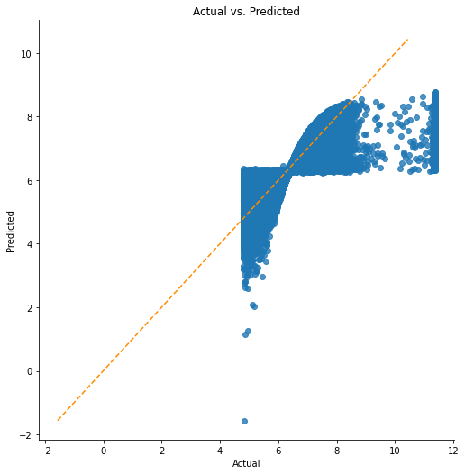
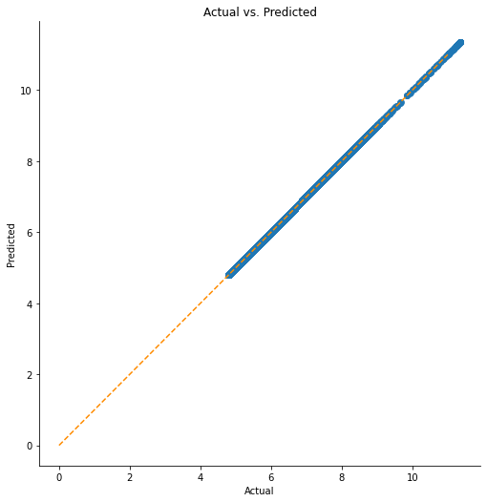
Linearity: Linear regression vs. Decision tree

Slide 21
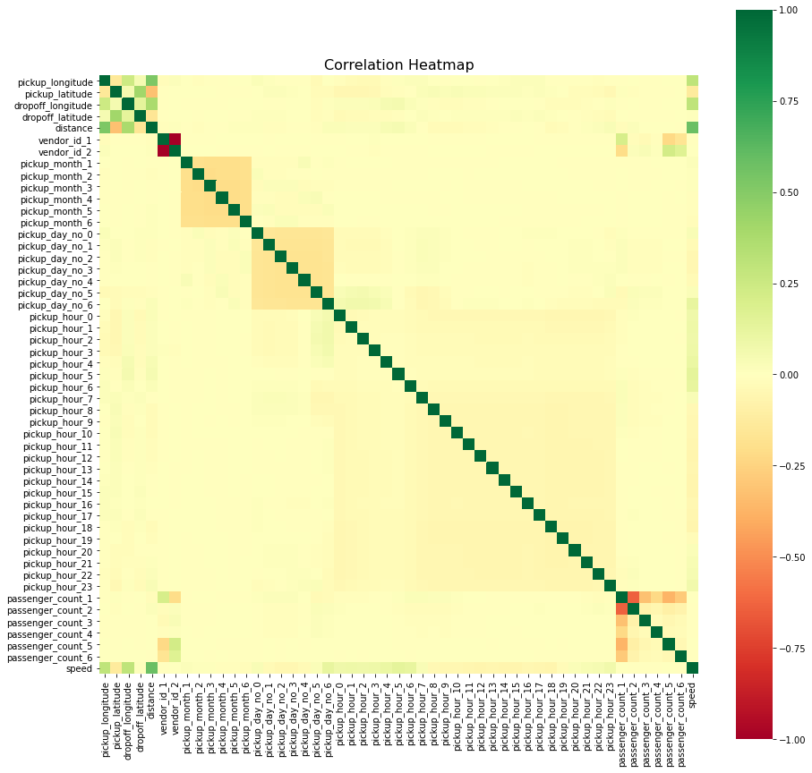
Multicollinearity
X1: 0.9999999999999845
X2: 1.447511847530974
X3: 1.3582440543566463
X4: 1.2597173786368652
X5: 1.2857840042549082
X6: 2.3636190602136966
X7: inf X8: inf X9: inf X10: inf X11: inf X12: inf X13: inf X14: inf X15: inf X16: inf X17: inf X18: inf X19: inf X20: inf X21: inf X22: inf X23: inf X24: inf X25: inf X26: inf X27: inf X28: inf X29: inf X30: inf X31: inf X32: inf X33: inf X34: inf X35: inf X36: inf X37: inf X38: inf X39: inf X40: inf X41: inf X42: inf X43: inf X44: inf X45: inf X46: inf X47: inf X48: inf X49: inf X50: inf X51: inf X52: 1.8477375443832231
45 cases of possible multicollinearity
45 cases of definite multicollinearity

Slide 22
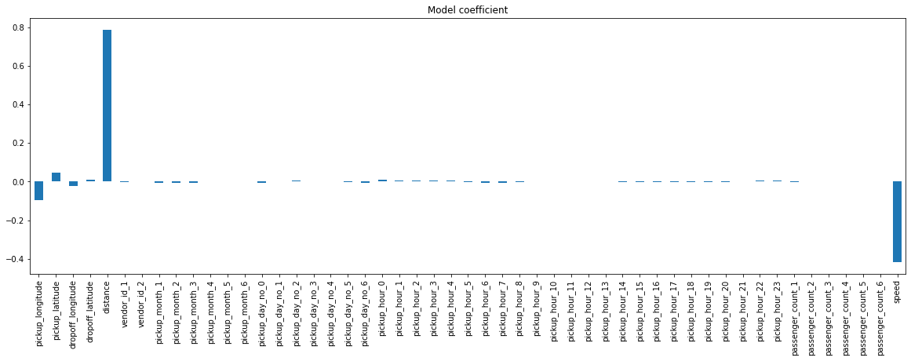
Assigning weight based lasso regression

Slide 23
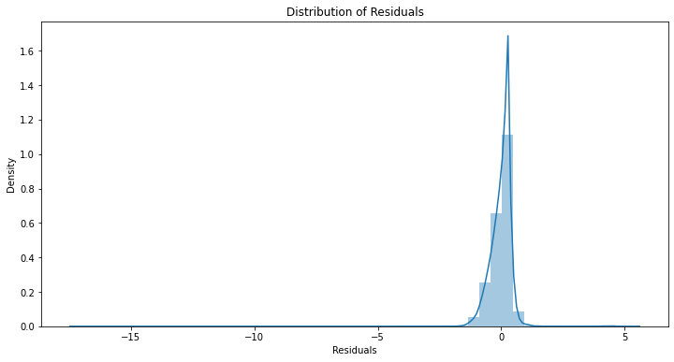
Normality of the Error Terms

Slide 24
No Autocorrelation of the Error Terms
Assumption 4: No Autocorrelation
Performing Durbin-Watson
Test Values of 1.5 < d < 2.5 generally show that there is no autocorrelation in the data
0 to 1.5< is positive autocorrelation >2.5 to 4 is negative autocorrelation
-------------------------------------
Durbin-Watson: 1.9992183795359815 no autocorrelation
Assumption satisfied

Slide 25
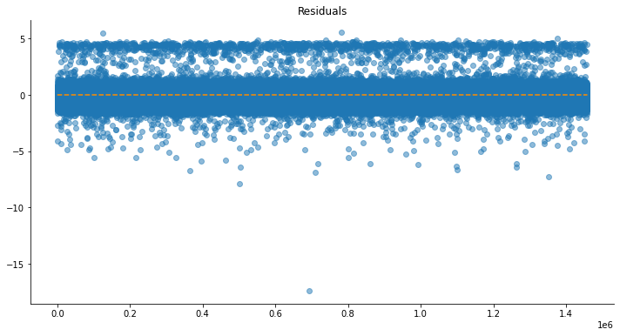
Homoscedasticity

Slide 26
Linear regression model
OLS Regression Results
Dep. Variable: | trip_duration | R-squared: | 0.661
Model: | OLS | Adj. R-squared: | 0.661
Method: | Least Squares | F-statistic: | 7.802e+04
Date: | Sun, 04 Jul 2021 | Prob (F-statistic): | 0.00
Time: | 04:09:58 | Log-Likelihood: | -5.4866e+05
No. Observations: | 998399 | AIC: | 1.097e+06
Df Residuals: | 998373 | BIC: | 1.098e+06
Df Model: | 25
Covariance Type: | nonrobust
RMSE score for the Multiple LR is : 0.42073555634991666
Variance score for the Multiple LR is : 0.66

Slide 27
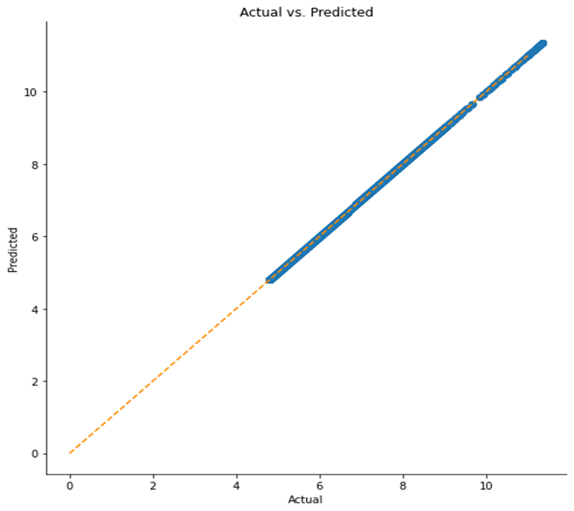
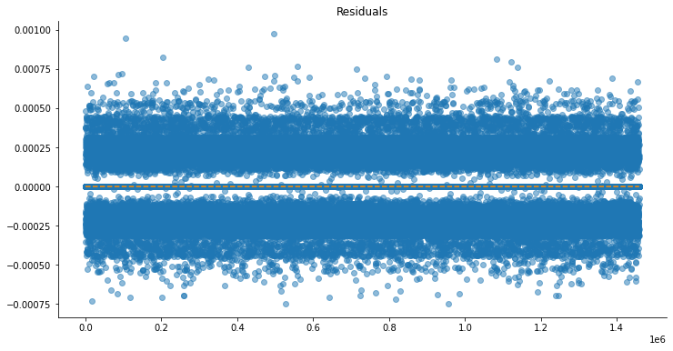
Decision tree Regressor

Slide 28
Evaluation of Model
observation | Actual | Predicted
21498 | 7.992607 | 8.019613
652096 | 6.167516 | 6.169611
1132549 | 7.301822 | 7.301822
164362 | 6.276643 | 6.274762
670666 | 6.192362 | 6.190315
... | ... | ...
380667 | 5.446737 | 5.451038
124764 | 7.002156 | 7.069874
770491 | 4.990433 | 4.990433
912700 | 5.030438 | 5.030438
984993 | 5.961005 | 5.961005
RMSE score for the Decision tree is : 0.011218690461249852
Variance score for the Decision tree is : 0.9998
Interesting find, There is very significant improvement on the RMSE score for the Decision tree regressor over the Linear regressor. Even the variance score is approx 1 which is a good score.

Slide 29
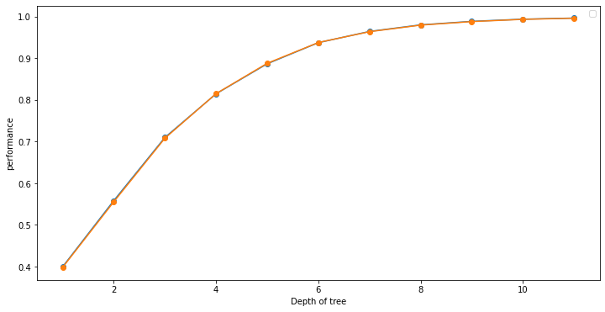
Checking Over-fitting in Decision Tree
max_depth | train_acc | valid_acc
1 | 0.399514 | 0.398015
2 | 0.558286 | 0.555450
3 | 0.710009 | 0.708168
4 | 0.814827 | 0.815193
5 | 0.886926 | 0.888077
6 | 0.937623 | 0.937955
7 | 0.964558 | 0.963998
8 | 0.980348 | 0.979781
9 | 0.988808 | 0.988242
10 | 0.994041 | 0.993626
11 | 0.996721 | 0.996318

Slide 30
Random forest model
observation | Actual | Predicted
21498 | 7.992607 | 7.995149
652096 | 6.167516 | 6.166568
1132549 | 7.301822 | 7.301473
164362 | 6.276643 | 6.275757
670666 | 6.192362 | 6.192011
380667 | 5.446737 | 5.447764
124764 | 7.002156 | 7.015599
770491 | 4.990433 | 4.991166
912700 | 5.030438 | 5.030944
984993 | 5.961005 | 5.961722
observation | Actual | Predicted
21498 | 7.992607 | 8.019613
652096 | 6.167516 | 6.169611
1132549 | 7.301822 | 7.301822
164362 | 6.276643 | 6.274762
670666 | 6.192362 | 6.190315
380667 | 5.446737 | 5.451038
124764 | 7.002156 | 7.069874
770491 | 4.990433 | 4.990433
912700 | 5.030438 | 5.030438
984993 | 5.961005 | 5.961005
observation | Actual | Predicted
21498 | 7.992607 | 7.286550
652096 | 6.167516 | 6.129898
1132549 | 7.301822 | 6.921704
164362 | 6.276643 | 6.159787
670666 | 6.192362 | 6.184760
380667 | 5.446737 | 6.147355
124764 | 7.002156 | 6.603579
770491 | 4.990433 | 5.839549
912700 | 5.030438 | 5.641543
984993 | 5.961005 | 6.231564
Random Forest
Decision tree
Multiple linear Regression
RMSE score for the Random Forest is : 0.01121869 Variance score for the Random Forest is : 1.00
RMSE score for the Decision tree is : 0.01121869
Variance score for the Decision tree is : 0.9998
RMSE score for the Multiple LR is : 0.420735556
Variance score for the Multiple LR is : 0.66

Slide 31
Conclusion
The given data is big so dealing with it can be tricky. Also there are trips which trip duration as short as 0 seconds and yet covering a large distance. And, trips with 0 km distance and long trip durations
We see Fridays are the busiest days followed by Saturdays. That is probably because it’s weekend. And Also March is the busiest.
We see the busiest hours are 6:00 pm to 7:00 pm and that makes sense as this is the time when people return from works. i.e. Evenings are the busiest.
The trip duration is the maximum around 3 pm which may be because of traffic on the roads. Trip duration is the lowest around 6 am as streets may not be busy. Trip duration is the maximum in the afternoon and lowest between late night and morning. Trip duration is the longest on Thursdays closely followed by Fridays
Some of the feature variables have a high correlation among them. And also target variable 'trip duration' is not highly linearly related to the features variable.
For the case of Multiple Linear Regression, most of the assumptions are violated. Like Linearity, Homoscedasticity and Non-normality of error term. Even evaluation metrics is quite low in this case.
Decision Tree and Random forest regressor are performing well on this dataset. Their evaluation metric are very high. RMSE close to 0.01 and Coefficient of determinant close to 0.99.

