Slide 1
Workshop
Computer Education
Workshop that makes you to think about your FUTURE
Computer is not a device only…
Its future of world
By Abhishek Pandey

Slide 2
About Institute
JIIT Institute
Founder: Jailendra Sir

Slide 3
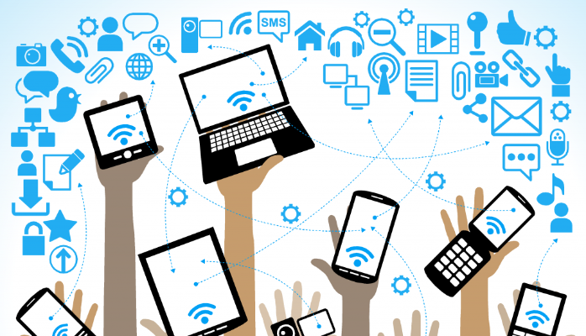
Today we will Talk about Computer Technology… How the computer help human and makes
it work easy

Slide 4

Examples of IT in our daily life
Social Sites
Video Calling & Audio
Online Transaction
Net Banking
Software uses
Education
Gaming
Entertainment
Etc

Slide 5
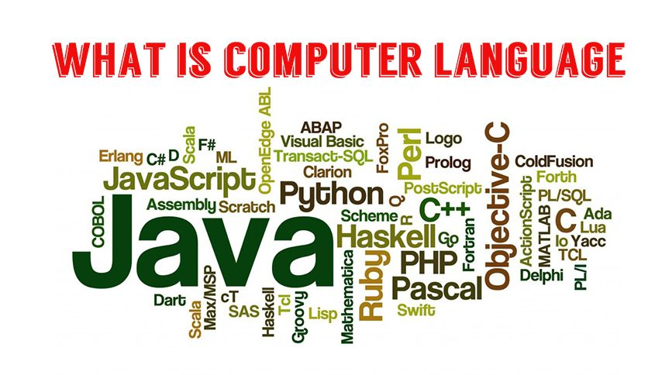
Technology List for Workshop
PUBG
Java
Python
Android
VFX
Asp.net
C language
C++ Language
Auto Cad
Normal Editing with Kine Master

Slide 6
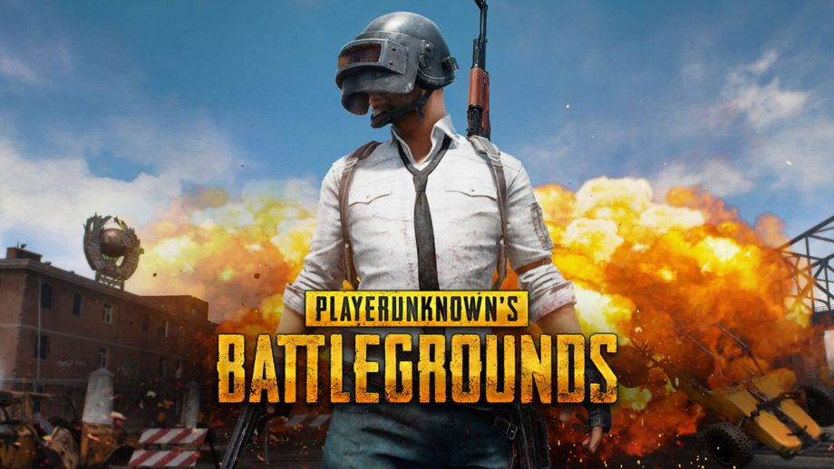
Famous Game PUBG

Slide 7
About Pub-G
Designer: Brendan Greene
Composer: Tom Salta
Composer: Tom Salta
Developers: PUBG Corporation, Krafton, Xbox Game Studios, Tencent Games
Did you know: "PlayerUnknown's Battlegrounds" is the fifth-best-selling
video game (50,000,000 units sold).

Slide 8
Technology used in Pub-G
UNREAL Engine 4. PubG is developed in special game engine IDE platform called
Unreal Engine 4 by Epic games. ...
Java. PubG is an cross-platform game which is available for PC as well as Mobile. ...
Python. The core of the PubG is developed in python.

Slide 9

Java the most popular language
Java is a general-purpose programming language that is class-based,
object-oriented, and designed to have as few implementation dependencies
as possible.
First appeared: May 23, 1995; 24 years ago
Designed by: James Gosling
Typing discipline: Static, strong, safe, nominative, manifest
Developer: Oracle Corporation
Filename extensions: java,.class,.jar

Slide 10
Popular Application used with Java
Nimbuzz Messenger
NewsHunt
EQO
Java Call Recorder
E Buddy Messenger
jQuery
JavaFX
ScriptThinkFree
Opera Mini
Google Chrome
Youtube

Slide 11
A programing Example With Java Language

Slide 12

Python Language
Python is an interpreted, high-level, general-purpose programming language
Designed by: Guido van Rossum
Stable release: 3.7.3 / 25 March 2019; 3 months ago; 2.7.16 / 4 March 2019;

Slide 13
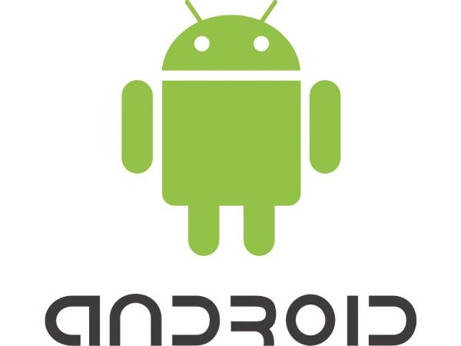
Popular Software with Python Language
Instagram
Google
Spotify
Netflix
Uber
Dropbox
Pinterest
Instacart
reddit
lyft

Slide 14
Android Technlogy
Android is a mobile operating system developed by Google.
Developer: Google, Open Handset Alliance
Written in: Java, C, C++, XML, Assembly language, Python, Shell script,
Go, Make, D

Slide 15
Android Course Structure
Java Core
Android

Slide 16
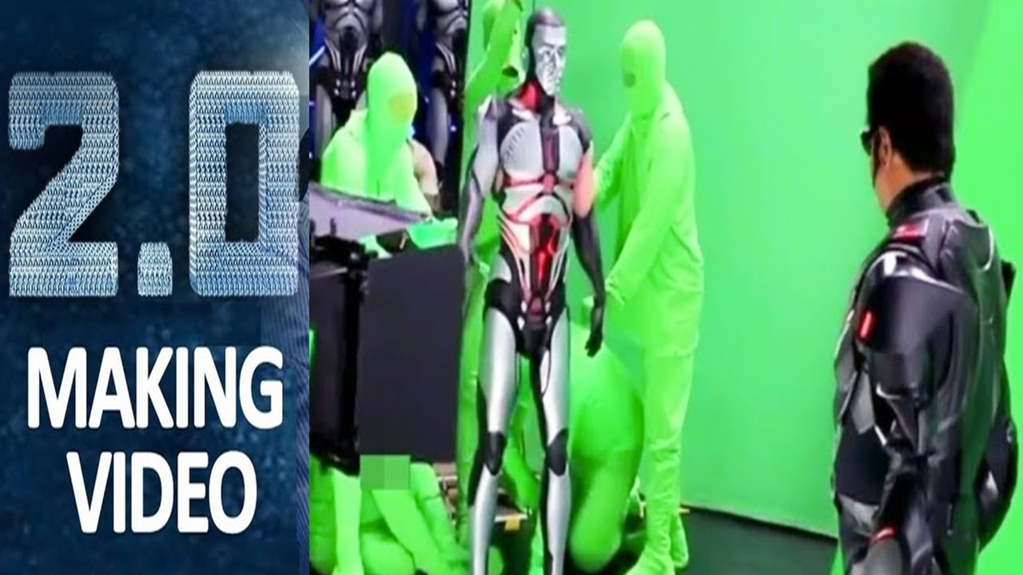
VFX Editing …..

Slide 17
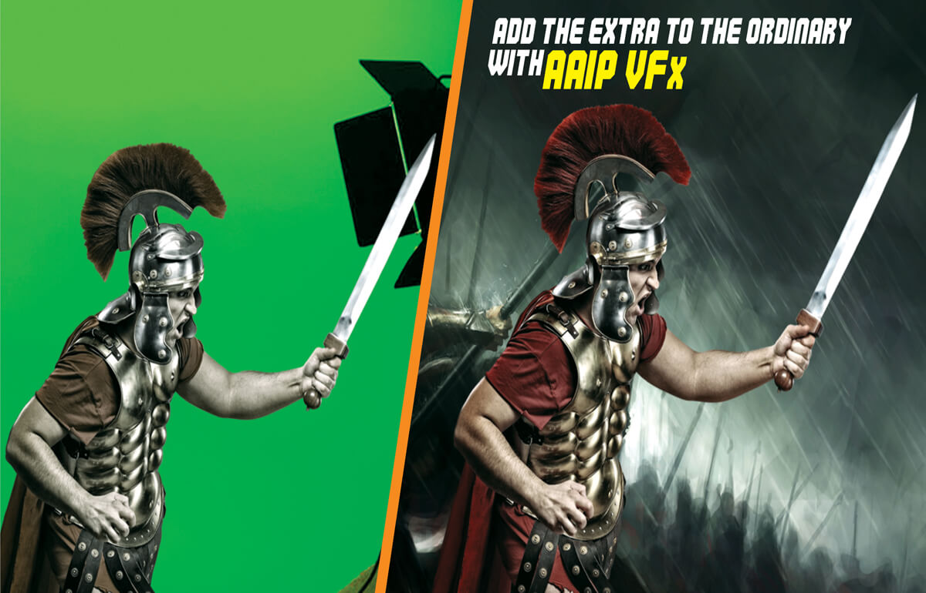

Slide 18
VFX ……
editing
With Kine Master

Slide 19
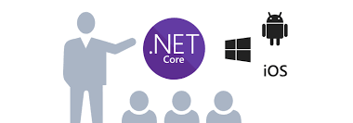
Asp.net
Website
ERP Software
Android Application

Slide 20
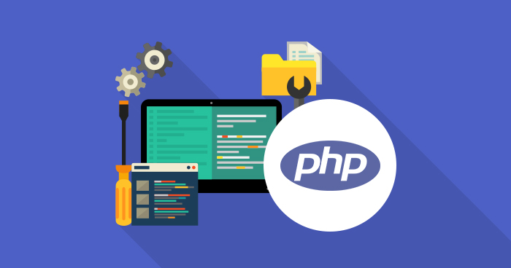
PHP programing Language …

Slide 21
How to Format Your Laptop or PC
Download Windows File , size approx. 3 GB
Makes Your PD bootable
Now Extract the download File of windows
Copy it and Paste into Pen Drive

Slide 22
How to make Bootable Pendrive
Diskpart
List disk
Select disk 1
Clean
Create primary partition
Format fs=ntfs quick
Active
Exit
Exit
Insert PD into Your Laptop
Open CMD with run as admin
Perform this querry on cmd

Slide 23
Digital India …
Cashless Technology
Net Banking

Slide 24
Thanks for gave your Precious Time for this WORKSHOP
Contact No: 9120197515 (Abhishek Pandey)
9650608195(JIIT Founder)

