Slide 1
Nonparametric Scene Parsing via Label Transfer
Abhishek Manoj Kumar

Slide 2
Overview
Annotated image database
Input /query image
Scene Retrieval
Nearest neighbors
Dense scene alignment
M voting candidates
Parsing result
Label Transfer
Notes:
Scene retrieval: Nearest neighbors are found using Euclidean distance of GIST and spatial pyramid histogram intersection of HOG.
Dense scene alignment: Sift flow is used and sift flow is able to establish semantically meaningful matches between 2 images.. M voting candidates are chosen.
Label transfer:The final step is to parse the input image by transferring the labels obtained from the M voting candidates to the input image. The M voting images which are chosen by the SIFT flow algorithm are combined and the input image is parsed and labelled accordingly..

Slide 3
Reproducibility Elements
Code: Made available and mostly is MatLab
Dataset: 2 datasets, datasetLMO and datasetSUN created using the LabelMe tool.
Documentation: good documentation for execution.
Notes:
datsetLMO has 2688 images, divided into 2488 training and 200 testing. All outdoor images.
datasetSUN has 9556 imges divided into 8556 for training and 1000 for testing. Both indoor and outdoor images.

Slide 4
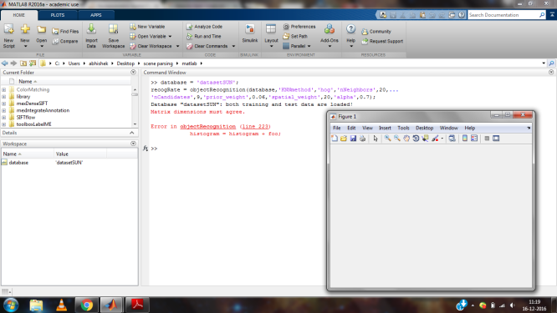
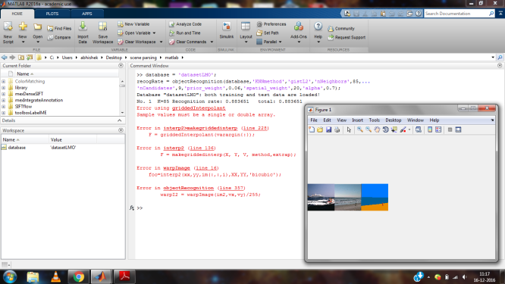
Experiments
Initial problems while trying to run the code.

Slide 5
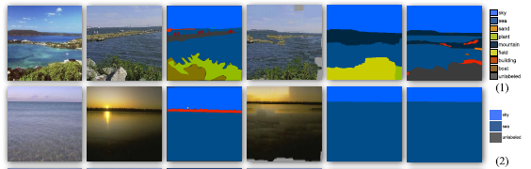



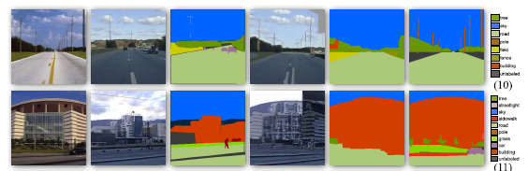

Experiment 1: Images with high recognition rates.
(a) (b) (c) (d) (e) (f)
Figure 1: Images mentioned on the paper vs the images obtained on my system. Similar results were obtained.

Slide 6
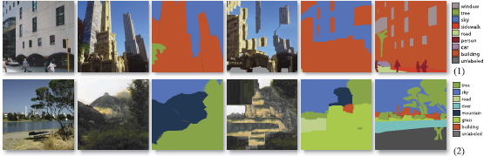


Experiment 2: Images with low recognition rates.
(a) (b) (c) (d) (e) (f)
Figure 2: Images with bad recognition rates(No good matches). Result mentioned on the paper vs results obtained on my system.

Slide 7
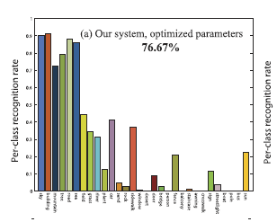
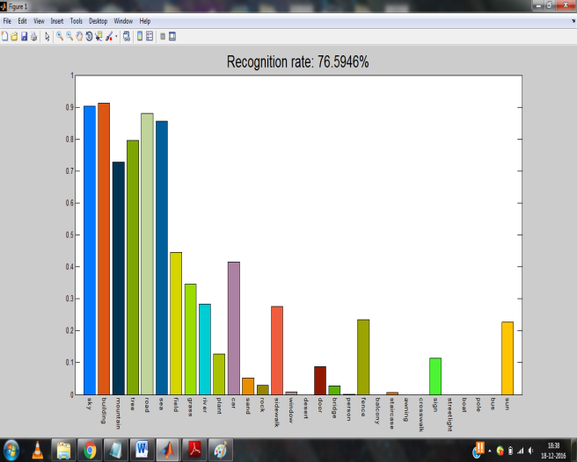
Experiment 3: Performance of system on various parameters.
Figure 3: Highest recognition rate mentioned in the paper for GIST method with optimal parameters and the recognition rate I could obtain on the same parameters.

Slide 8
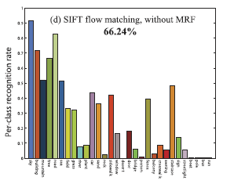
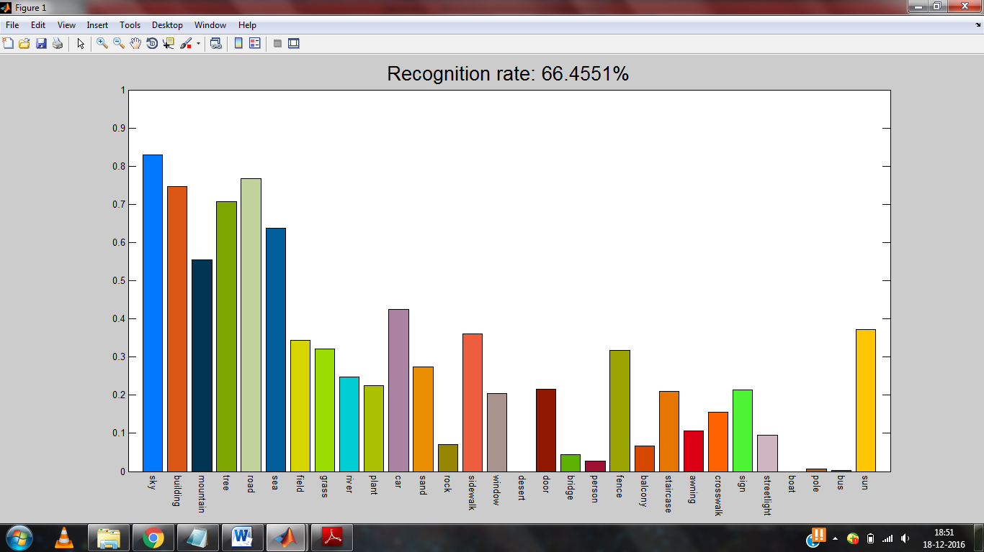
Figure 4: Recognition rate without MRF i.e. the prior and spatial terms.

Slide 9
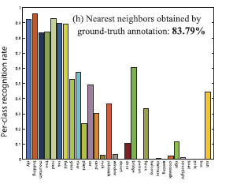
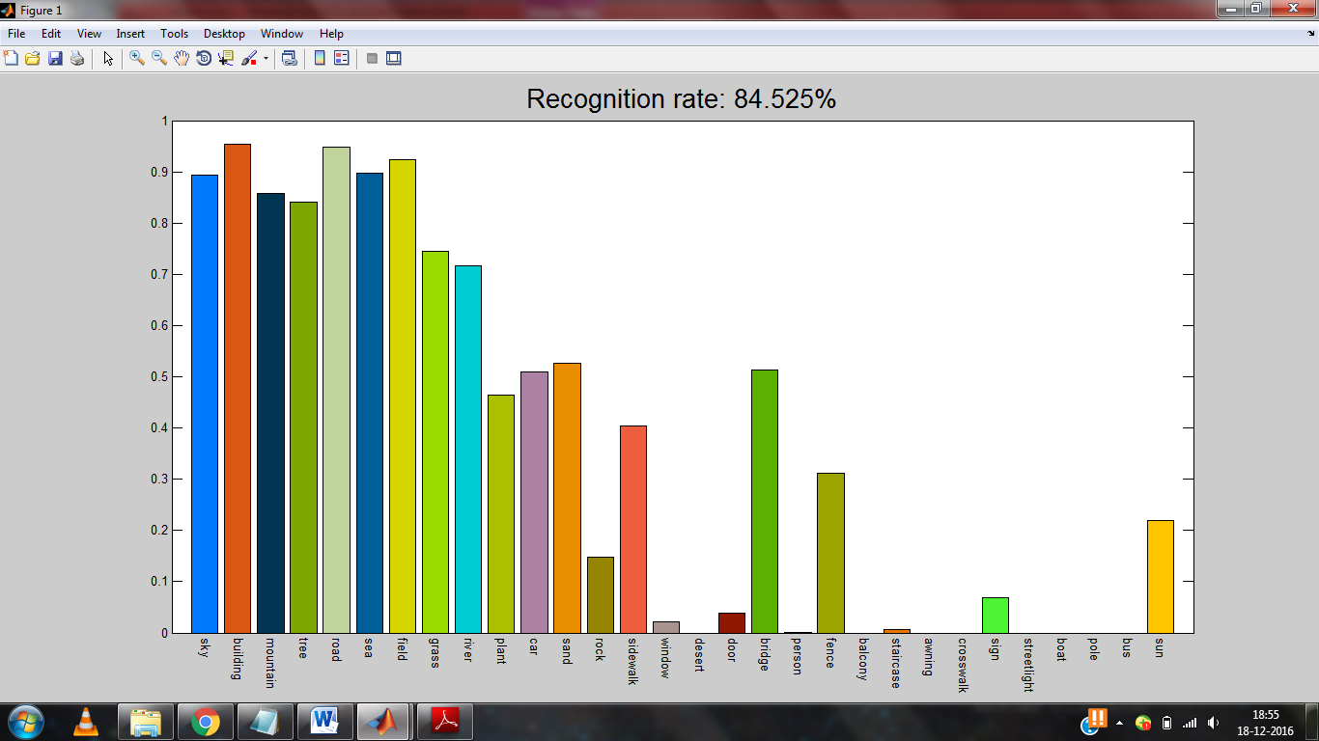
Figure 5: The upper limit recognition rate of the system given in the paper vs the recognition rate obtained for ‘all’ method.

Slide 10
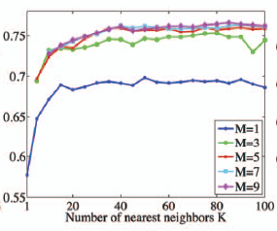
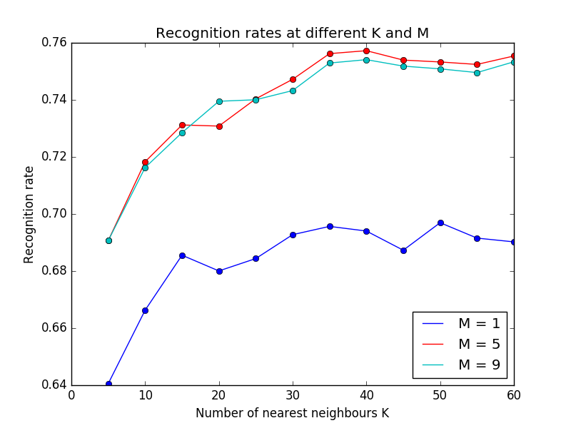
Experiment 4: Recognition rate by Varying K and M
Figure 6: results mentioned in the paper vs the result obtained by me.
Notes:
Overall the results increase when increasing K(nearest neighbours) and M(voting candidates) but after a certain point reduces because might include noise to label transfer.

Slide 11
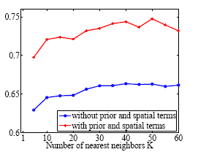
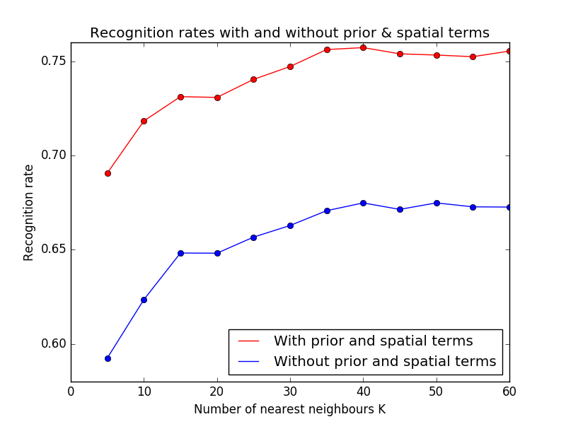
It can be observed in both the plots that the recognition rate is lower without MRF(prior and spatial smoothness).
Figure 7: Recognition rate with MRF and without MRF
Notes:
MRF: Markov random field

Slide 12
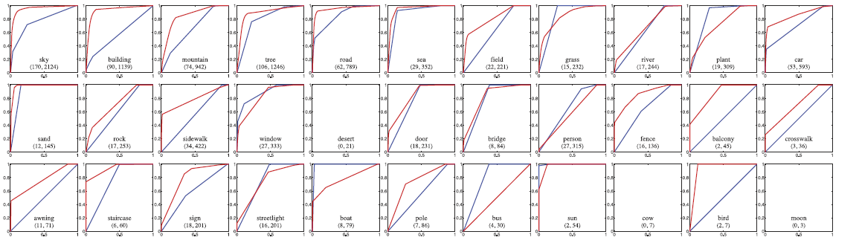
Figure which I could not reproduce.
Figure 8:This figure compares each object recognition rates of the non-parametric approach of the paper vs the classier based system of human detection.

Slide 13
Conclusion
I think proper documentation and availability of code and data contributed most towards reproducibility.
After trying to reproduce, I think the paper has all the right results as many of the results could be reproduced and were similar.

Slide 14
References
C. Liu, J. Yuen, A. Torralba, "Nonparametric scene parsing via label transfer", IEEE Transactions on Pattern Analysis and Machine Intelligence, vol. 33, no. 12, pp. 2368, 2011
C. Liu, J. Yuen, and A. Torralba, “Nonparametric Scene Parsing: Label Transfer via Dense Scene Alignment,” Proc. IEEE Conf. Computer Vision and Pattern Recognition, 2009.
N. Dalal and B. Triggs, “Histograms of Oriented Gradients for Human Detection,” Proc. IEEE Conf. Computer Vision and Pattern Recognition, 2005.

