Slide 1
Implementing Stokes Theorem to find flux through Surface using SYCL Abhishek Verma, Sriman To Instructor Abhishek Nandy
INTEL oneAPI
Presentation on

Slide 2
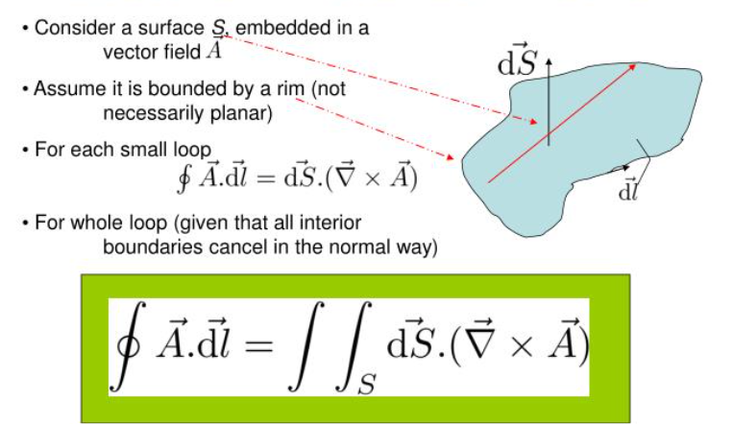
Stoke Theorem
The circulation of a vector field around a closed curve in space to the flux of the curl of the vector field through a surface bounded by the curve.

Slide 3
OneAPI
Comprehensive and unified portfolio of developer tools which include range of performance libraries spanning several workload domains to traget Hardware.
unified and simplified language and libraries for expressing parallelism
delivers uncompromised native high-level language performance across a range of hardware including __CPUs, GPUs, FPGAs.

Slide 4
WHY SYCL?
data-parallel programming for C++
enables code for heterogeneous processors to be written in a “single source”
host code and heterogeneous accelerator kernels can be mixed in same source files
Added Functionality-
queue for work targeting,
buffer for data management,
parallel_for for parallelism to direct which parts of the computation and data should be offloaded.

Slide 5
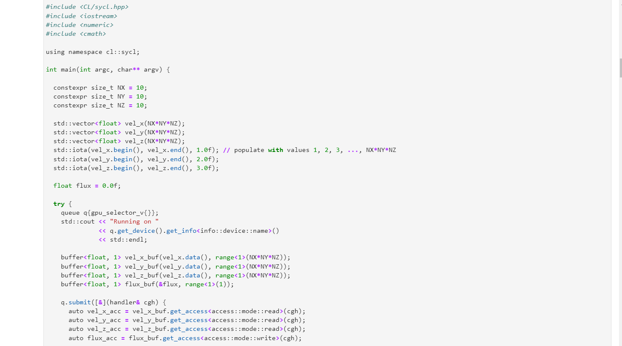
MY PROJECT-

Slide 6
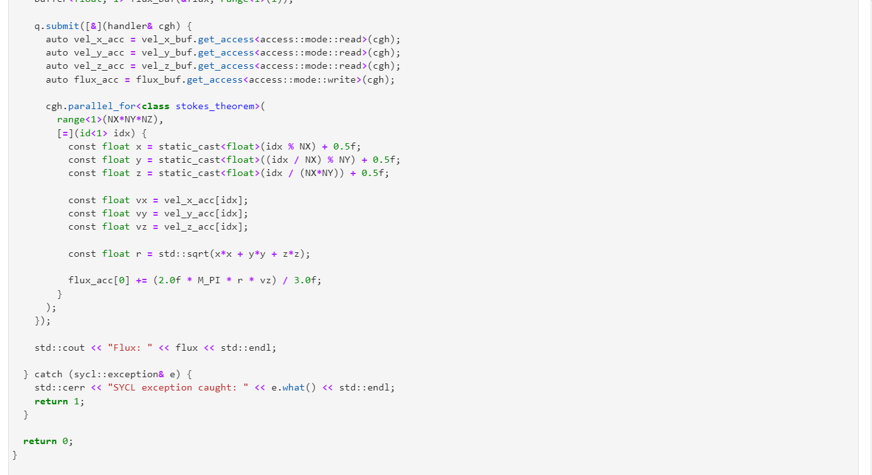

Slide 7
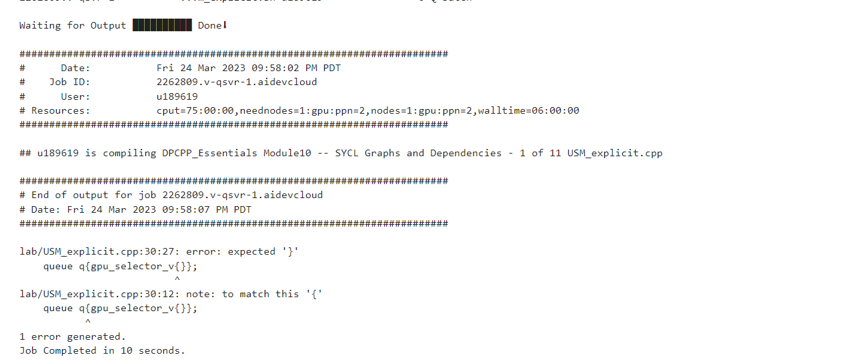
console

