Slide 1
Enabling Architecture Research on GPU Simulators for Deep Learning Inference
Abhishek Nikam
Graduate Student
Advisor- Dr. Hamed Tabkhi

Slide 2
Outline
Motivation
Contribution
Related Work
Optimized Open source Cuda GEMM Library
Architecture Modeling of GPUs
Results
Conclusion

Slide 3
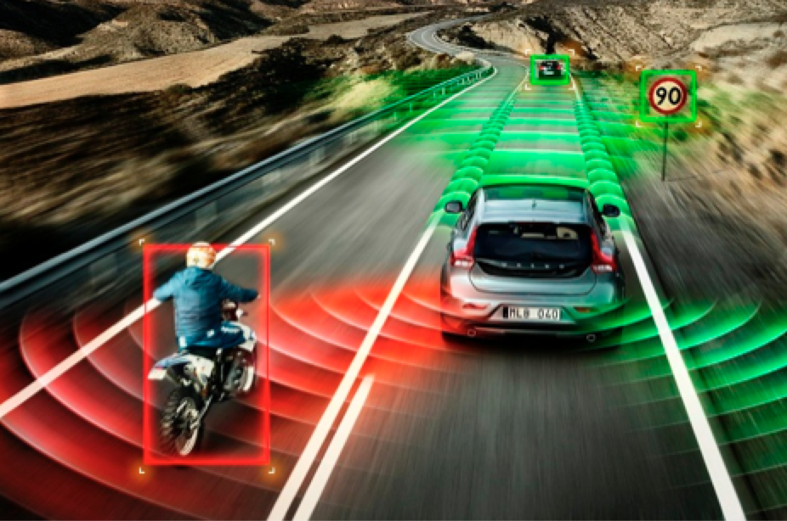
Motivation
Deep learning promises human-like understanding of the physical environment opening path for Autonomous control and Monitoring across a diverse set of applications.

Slide 4
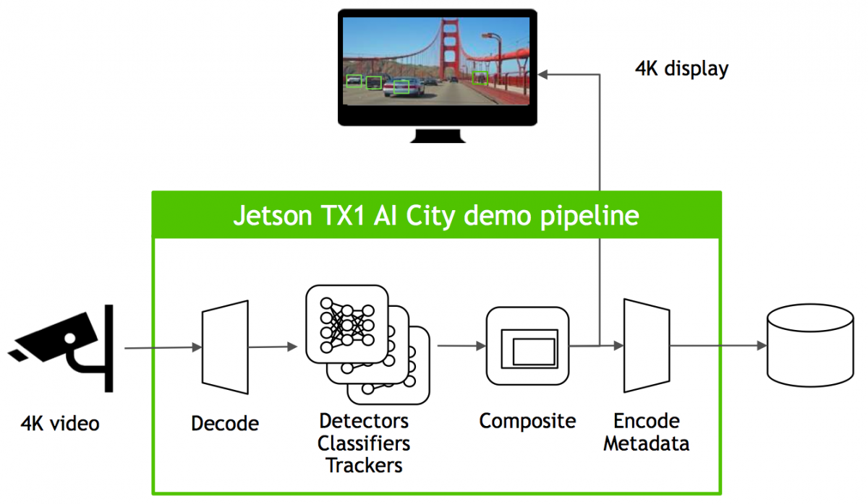
Embedded GPUs
As opposed to the server class or gaming GPU, Embedded GPUs are low power, light weight portable Gpus.
Notes:
The new Jetson TX2 production module can operate in two modes: "Max-P" for maximum performance and “Max-Q” for maximum energy efficiency.
The other benchmark that NVIDIA shared involved decode of one or multiple 4K-resolution (30 fps, H.265-encoded) video streams, followed by the detection, classification and tracking of various objects in those streams
The version of the demonstration running on the Jetson TX1, where it consumed 10 W of total module power, encompassed two parallel DNNs (deep neural networks), one dedicated to classifying objects such as vehicles, bicycles and people, and the other further identifying vehicles' types and colors.

Slide 5
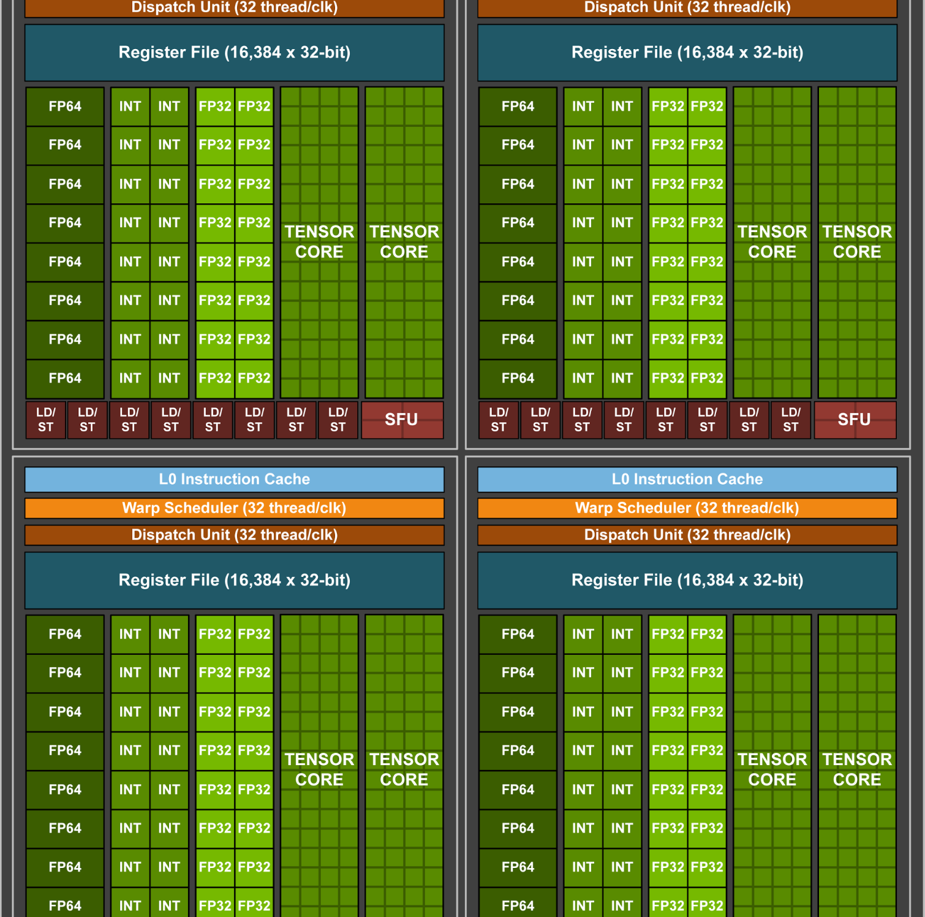
Nvidia Volta
As Embedded GPUs are low power and light weight devices they don’t have they don’t have the same number of cores or processing power as server GPU and hence they are not the ideal solution.
Notes:
New mixed-precision FP16/FP32 Tensor Cores purpose-built for deep learning matrix arithmetic;
Each Tensor Core provides a 4x4x4 matrix processing array which performs the operation , where , , , and are 4×4 matrices as Figure 7 shows. The matrix multiply inputs and are FP16 matrices, while the accumulation matrices and may be FP16 or FP32 matrices.
Each Tensor Core performs 64 floating point FMA mixed-precision operations per clock (FP16 input multiply with full-precision product and FP32 accumulate, as Figure 8 shows) and 8 Tensor Cores in an SM perform a total of 1024 floating point operations per clock. This is a dramatic 8X increase in throughput for deep learning applications per SM compared to Pascal GP100 using standard FP32 operations.
This is the reason we requi

Slide 6
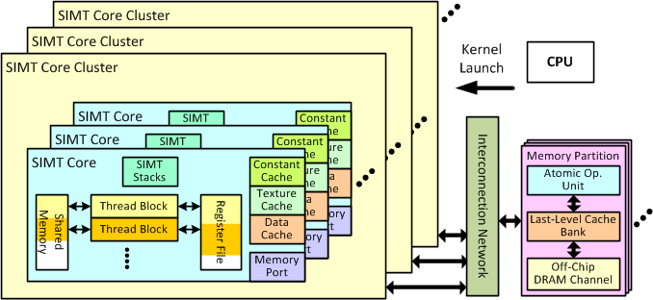
GPU Simulator
GPGPU-Sim 3.x, a cycle-level GPU performance simulator that focuses on "GPU computing" (general purpose computation on GPUs).

Slide 7
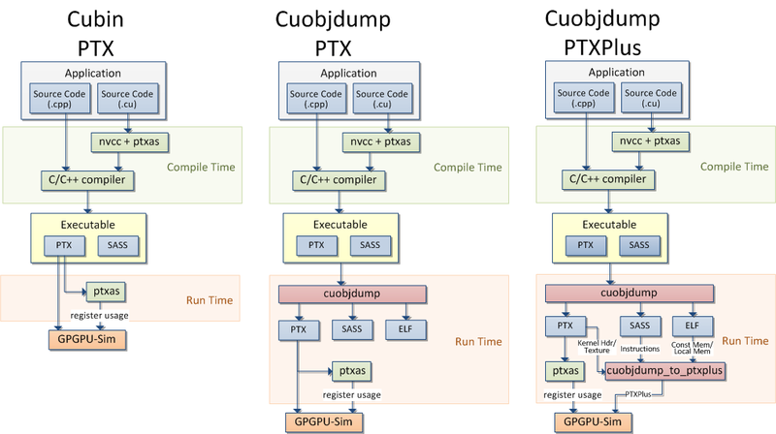
Problems
Gpu sim relies on extracting the PTX from cubin, but Nvidia’s closed source libraries do not allow PTX to be extracted using disassembler.
Notes:
GPGPU-Sim simulates the Parallel Thread eXecution (PTX) instruction set used by NVIDIA. PTX is a pseudo-assembly instruction set; i.e. it does not execute directly on the hardware. ptxas is the assembler released by NVIDIA to assemble PTX into the native instruction set run by the hardware (SASS). Each hardware generation supports a different version of SASS. For this reason, PTX is compiled into multiple versions of SASS that correspond to different hardware generations at compile time.
Cubin is Cuda Binary it is an elf file.
CUDA provides two binary utilities for examining and disassembling cubin files and host executables: cuobjdump and nvdisasm. Basically, cuobjdumpaccepts both cubin files and host binaries while nvdisasm only accepts cubin files; but nvdisasm provides richer output options
What is PTX or SASS anyway? NVidia’s PTX is an intermediate language for NVidia GPU’s. It is more closely tied to pure GPU assembly(SASS) but slightly abstracted. PTX is less tied to the specific hardware or a hardware generation which makes it more useful in most cases when compared to assembly. One item it abstracts is physical register numbers which makes it easier to use then assembly. PTX instructions are usually translated into one or more actual SASS hardware instructions. SASS is hardcore assembly. It is what the GPU actually runs and is directly translated into machine code.

Slide 8
Lack of Architecture Research Support for Embedded GPUs
There are only a few open source GPU simulators out there which accurately models a GPU Hardware.
Out of which only GPGPU sim supports latest version of CUDA.
There is no publicly available Architecture Modeling of Embedded GPUs on GPGPU sim which makes the Architecture Research on Embedded GPUs difficult.

Slide 9
Contributions
Development of an Open Source Cuda Optimized Library which are compatible with GPU simulator.
Architecture Modeling of the latest Nvidia Jetson TX1 and Jetson TX2 platform.
Comparing the performance of the Modeled Embedded GPUs with Actual GPUs.
Thus, Enabling Architecture Research for Embedded GPUs using Embedded GPUs specially for Deep Learning Applications.

Slide 10
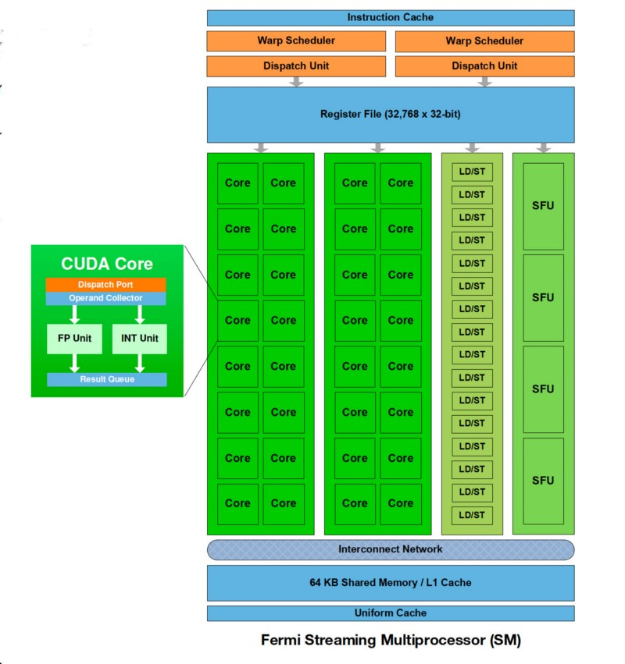
GPU Architecture
This Figure shows Fermi Streaming Multiprocessor Architecture.
Each SM has 32 single precision Cuda cores, 16 LD/ST units and 4 SFU cores.
It has 2 Warp scheduler to schedule warps from the active pool.
Registers are used to store the context of warps which help hide memory latency.
Each SM has its private Shared Memory.

Slide 11
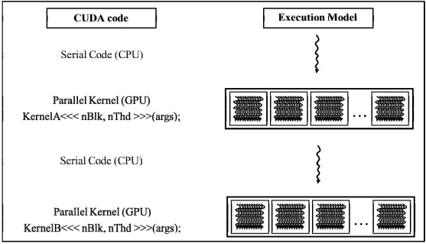
Cuda Program Execution
Nvidia GPUs work in a Single Instruction Multiple Thread fashion.
We need to specify the number of threads we want to launch in the launch parameters before we call a kernel.

Slide 12
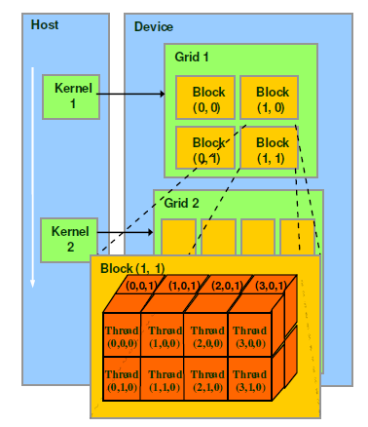
Cuda Kernel Launch Parameters
Func<<<Threadblocks, threads>>>(P1);
This is the prototype of a device function call in Cuda.
The threads are grouped into thread blocks and thread blocks are assigned to SM’s, a thread block can have a max of 1024 threads
Inside a thread block we have group of 32 threads which are called Warps.
Warps execute in a lock-step fashion.

Slide 13
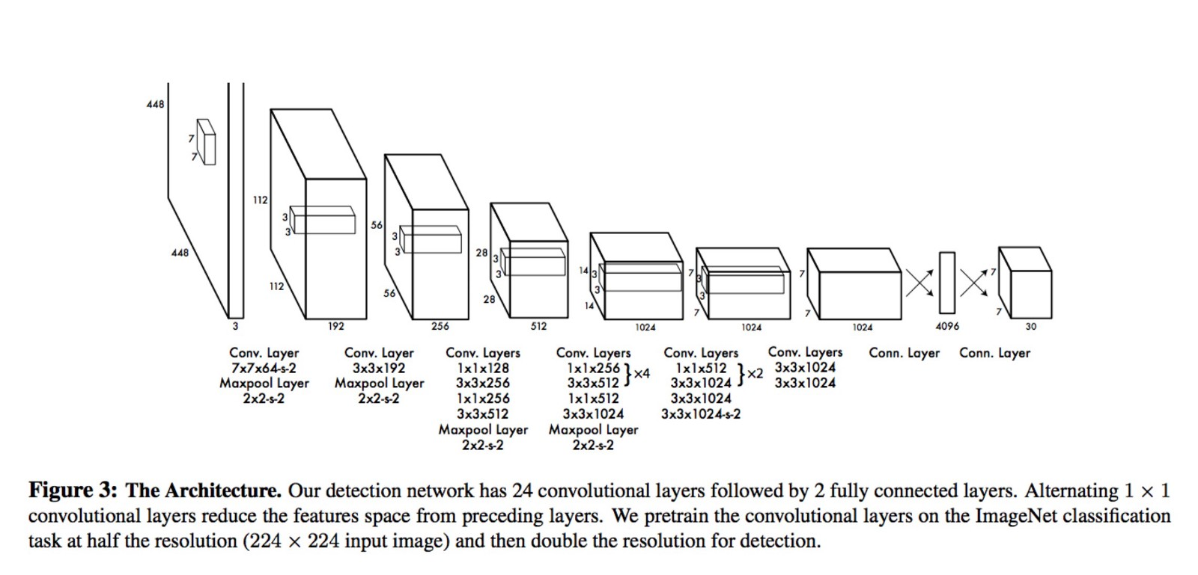
Yolo Net (You Only Look Once)
Yolo architecture is similar to FCNN (Fully convolutional neural network).
YOLO has 24 convolutional layers followed by 2 fully connected layer

Slide 14
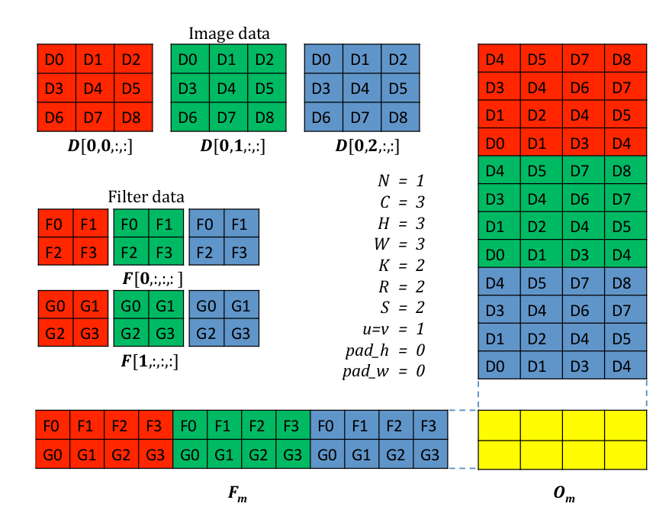
Introduction to General Matrix Multiplication(GEMM)
Yolo has 24 layers of convolution, no deep learning Framework uses direct convolution because of convolution code’s irregular access pattern.
Direct Convolution is converted into a Matrix Multiplication because it is well suited for GPU’s SIMT execution model

Slide 15
Optimized Open source Cuda GEMM Library
In previous slides we talked about Nvidia’s closed source libraries and it’s incompatibility with Gpu simulator.
Nvidia’s cuBLAS GEMM is one of those libraries which Darknet Framework uses.
So, we will be developing our own optimized GEMM kernel such that they are comparable with the GPU simulator.
Our main aim is not to match the performance of Nvidia’s cuBLAS GEMM.
Our aim is to provide functionally correct, fairly optimized, simulator compatible library.

Slide 16
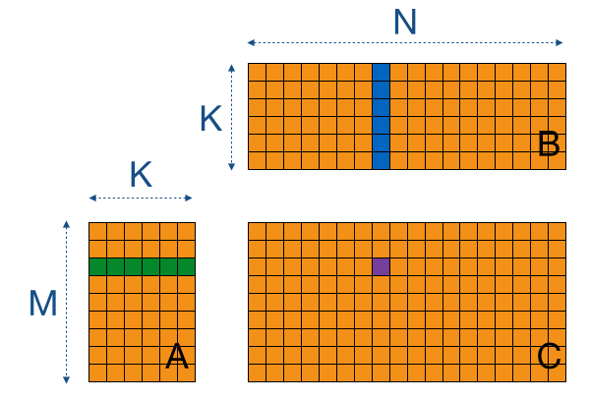
Baseline Model
In the Baseline Model we launch the same number of threads as the number of pixels in output matrix (m*n).
Each thread is responsible to loop over one row of A and one column of B to calculate 1 pixel of output Matrix.
Advantages: It is very fast than the CPU Gemm code
Disadvantages: It involves M*N*K*2 loads from global memory and M*N stores which kills the performance.

Slide 17
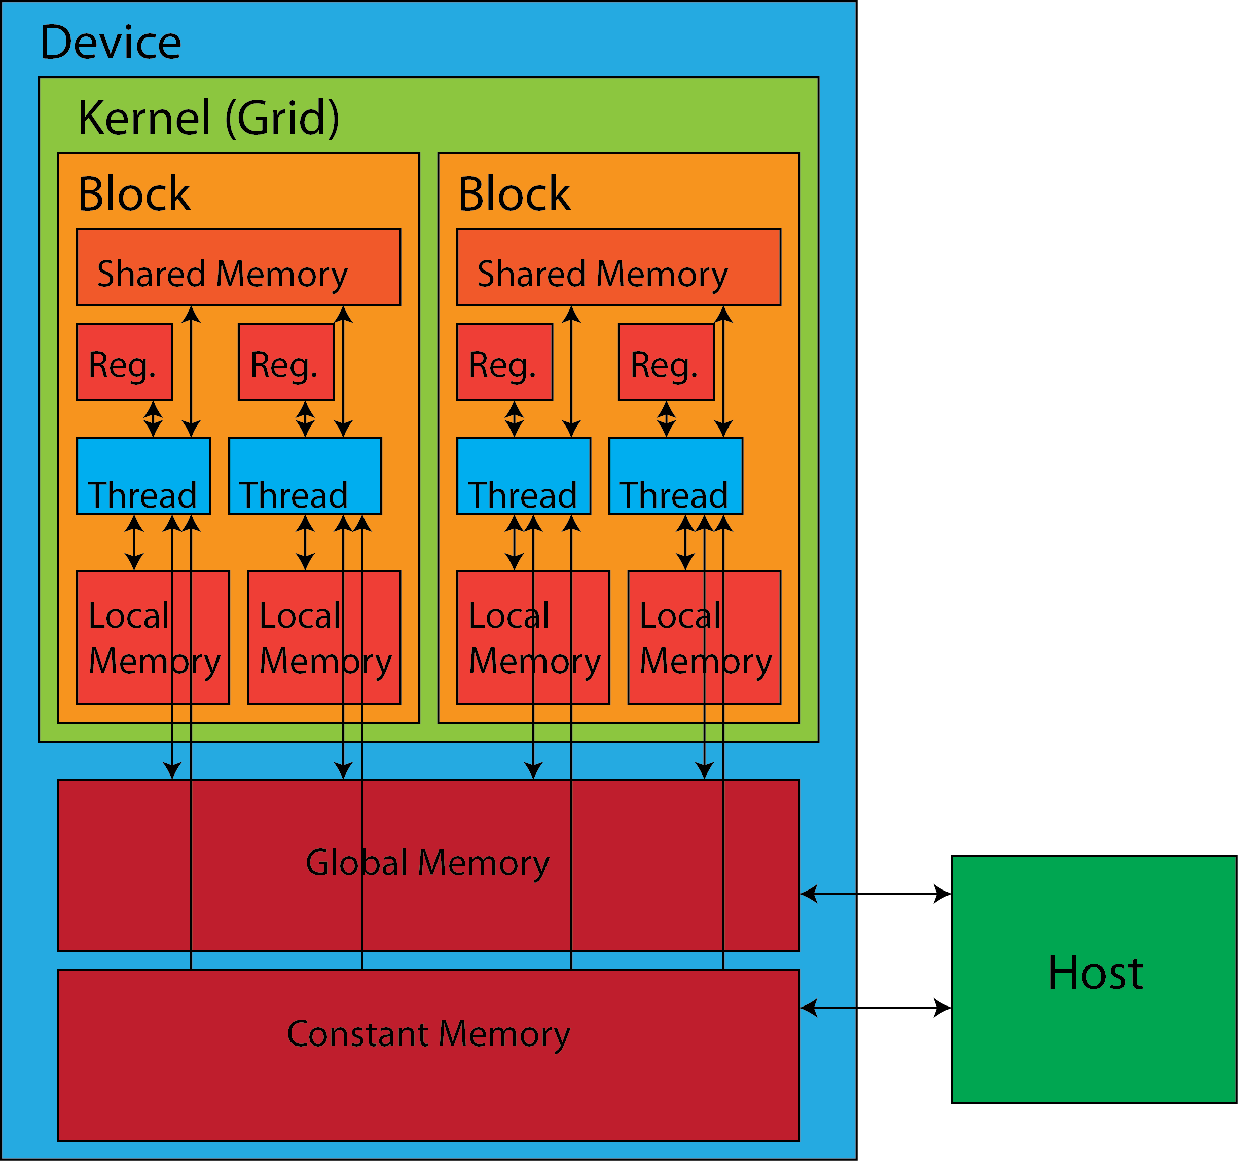
GPU Memory Hierarchy
Registers- Used to store context of warps
Shared Memory- Allocated per thread block, is On-chip memory with Low latency.
L1 Cache- It is an On chip low latency cache but not all architecture have it.
L2 Cache- Generally L2 Cache is shared between all the SM, it is an off chip memory.
DRAM- It is a higher latency off chip memory.

Slide 18
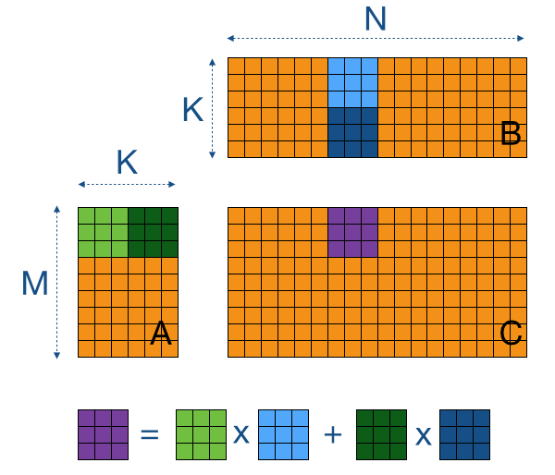
Optimization:1 Shared Memory Tiling
For this kernel again we launch the same number of threads as the number of pixels in output matrix (m*n).
But, In this kernel all the pixels are responsible in bringing the values from matrix A and B into the shared memory.
To compute a sub-block Csub of C, we bring in sub blocks of A and B, Multiply them in shared memory and add them.
Advantages- Lot of Data reuse in tiles, avoid going to shared memory for that.
Disadvantages- The Matrix Multiplication inside shared memory has too many unnecessary loads.

Slide 19
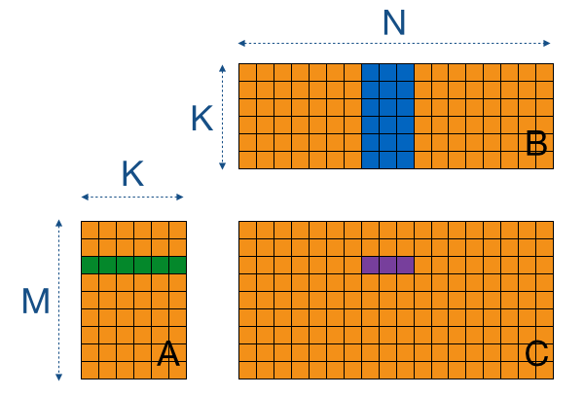
Optimization 3: More Work Per Thread
Unlike previous kernels, in this kernel we will reduce the amount of threads launch by a factor of WPT and will increase the work done per thread.
Advantages: With this approach we are reducing the access to local memory by a factor of WPT times.
Disadvantages: We have increased the amount of work in the column-dimension of C, similar can be done in row dimension of C, that technique is called 2d register tiling.

Slide 20
Architecture Modeling of Embedded GPUs
In this section we will go over the Hardware configuration of Jetson TX1 and Jetson TX2.
We will take a look at the Maxwell and Pascal Architecture.
We will also go over the GPU sim configurations we modeled for Jetson TX1 and TX2.

Slide 21
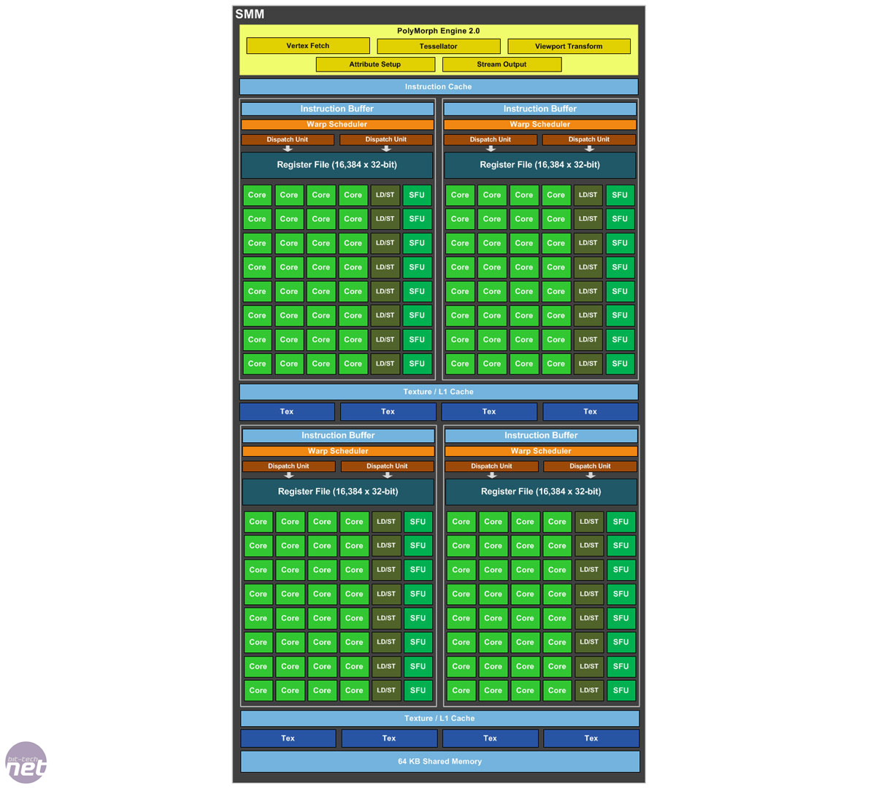
Jetson TX1
Latest Mobile Processor with Maxwell Architecture,
It has 256 Cuda Core Maxwell GPU.(Each SM has 128 cores)
It uses four high performance ARM Cortex A57 and A53 cores.
It has 8 Gb of Ram and its bus-width is 64 bit.
It has 4 warp scheduler per SM with 8 dispatch units.
The L2 Cache sizes is 256KB.
The register file size (64k 32-bit registers).
Shared Mem size is 64KB.
The Maximum thread block per SM is 32

Slide 22
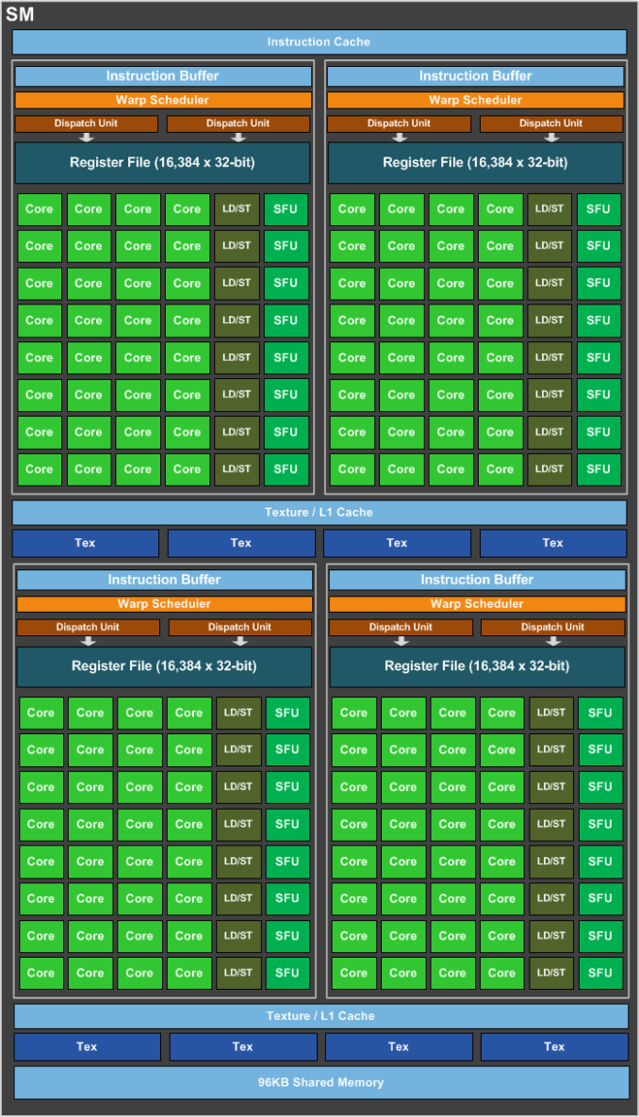
Jetson Tx2
Latest Mobile Processor with Pascal Architecture,
It has 256 Cuda Core Pascal GPU.(Each SM has 128 cores)
It has Denver and Cortex A-57 CPU cores
It has 16 gb of Ram with Memory Bus Width:128-bit
It has 4 warp scheduler per SM with 8 dispatch units.
L2 Cache Size: 524288 bytes
Total amount of shared memory per block: 48kb.
Total number of registers available per block: 32kb.

Slide 23
Jetson TX1 Architecture Modeling
Below are the Configuration we used for Modeling TX1 and TX2
Parameters | Jetson TX1 | Jetson TX2
-gpgpu-n-clusters | 2 | 2
-gpgpu-ncores-per-cluster | 1 | 1
-gpgpu-clock-domains | 1137.0:1137.0:1137.0:2700.0 | 1481.0:2962.0:1481.0:2750.0
-gpgpu-shader-registers | 65536 | 32768
-gpgpu-shader-core-pipeline | 2048:32 | 2048:32
-gpgpu-pipeline-widths | 2,1,1,2,1,1,2 | 4,1,1,4,1,1,6
gpgpu-num-sp-units | 8 | 4
-gpgpu-cache:dl1 | 32:128:4,L:L:m:N:H,A:32:8,8 | 64:128:6,L:L:m:N:H,A:128:8,8
-gpgpu-shmemsize | 65536 | 49152
-gpgpu-num-sched-per-core | 4 | 4
-gpgpu-scheduler | gto | gtp

Slide 24
Experimental Setup
For Deep Learning Inference we use the Yolo Net Architecture by Joseph Redmon.
The Deep Learning framework used was Darknet.
We profile our application for 1 layer, 3 layer and entire network
The reason behind choosing 1 and 3 layers is that we ran Yolo Net with 1 and 3 layers on GPU simulators.
GPU simulation tends and simulating entire Yolo Net architecture is not feasible.

Slide 25
Results
In this section we will compare the performance of our open source library with commercial libraries available in the market.
We will Integrate our GEMM Kernels in Darknet Framework and observe the time taken by those kernels across several layers.
We will also be reporting the IPC of our kernels across several layers.
Lastly, will compare the performance of our Yolo Net on actual Hardware and the simulator.

Slide 26
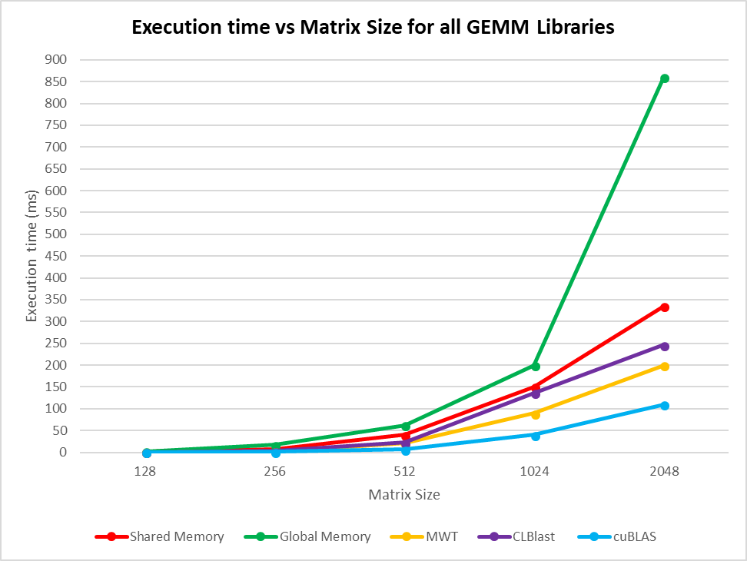
Comparison of GEMM libraries

Slide 27
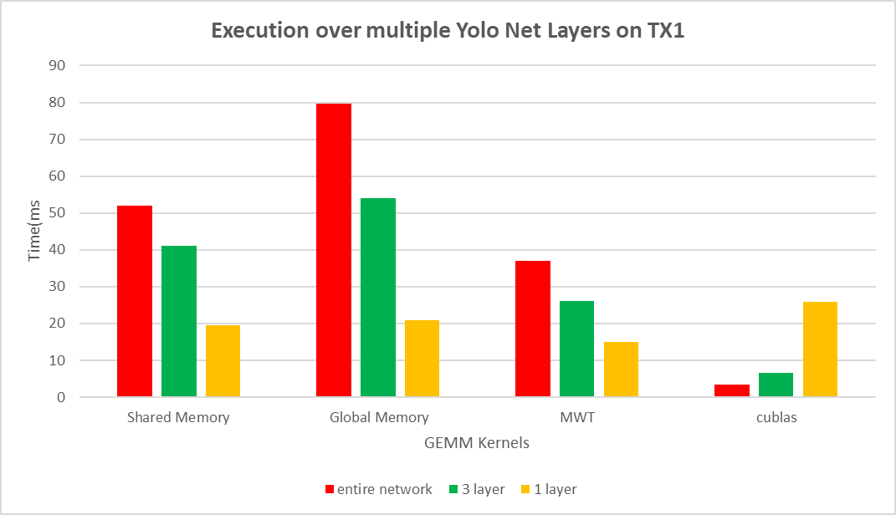
Execution over multiple Yolo Net Layers on TX1

Slide 28
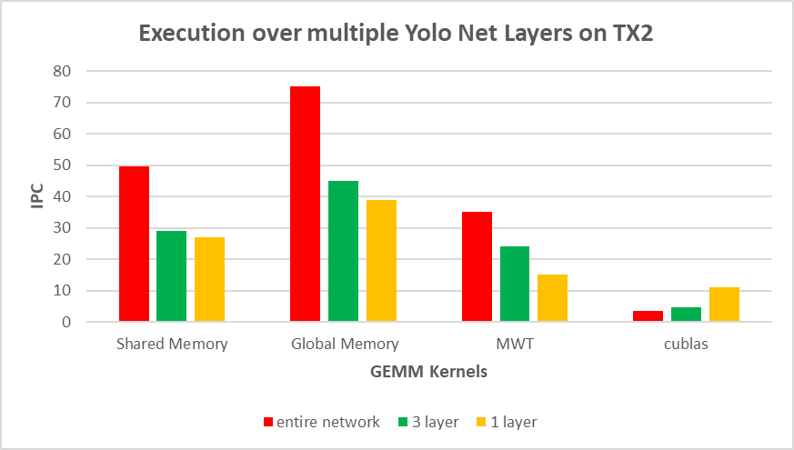
Execution over multiple Yolo Net Layers on TX2

Slide 29
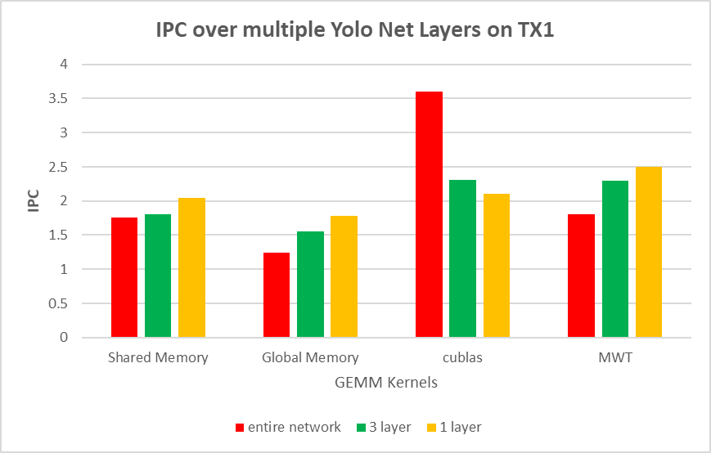
IPC over multiple Yolo Net Layers on TX1

Slide 30
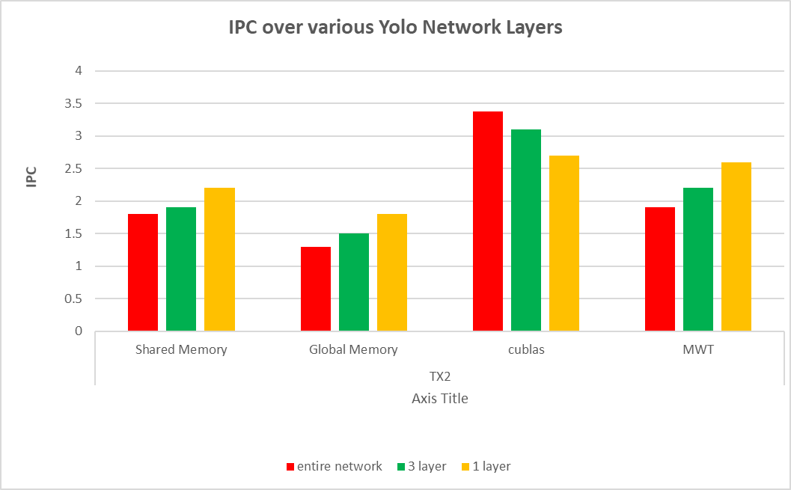
IPC over multiple Yolo Net Layers on TX2

Slide 31
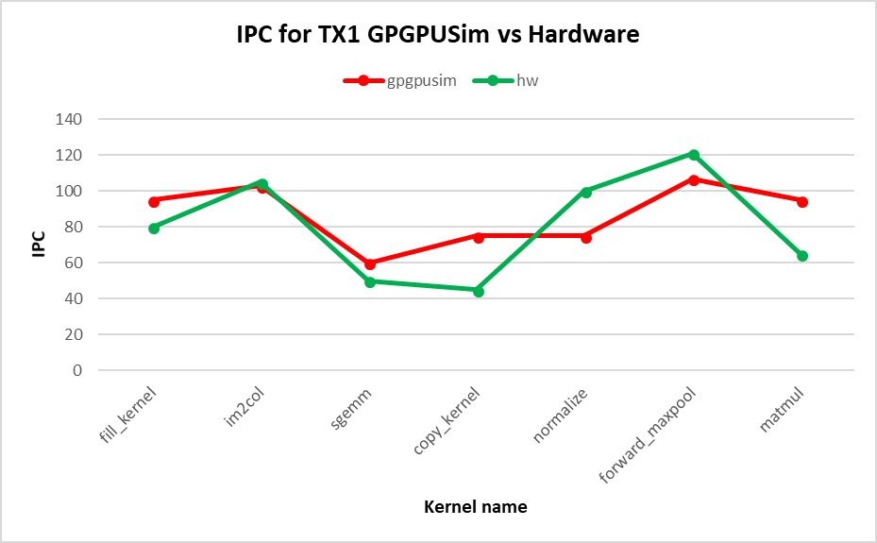
IPC Correlation between Hardware and Simulator for TX1

Slide 32
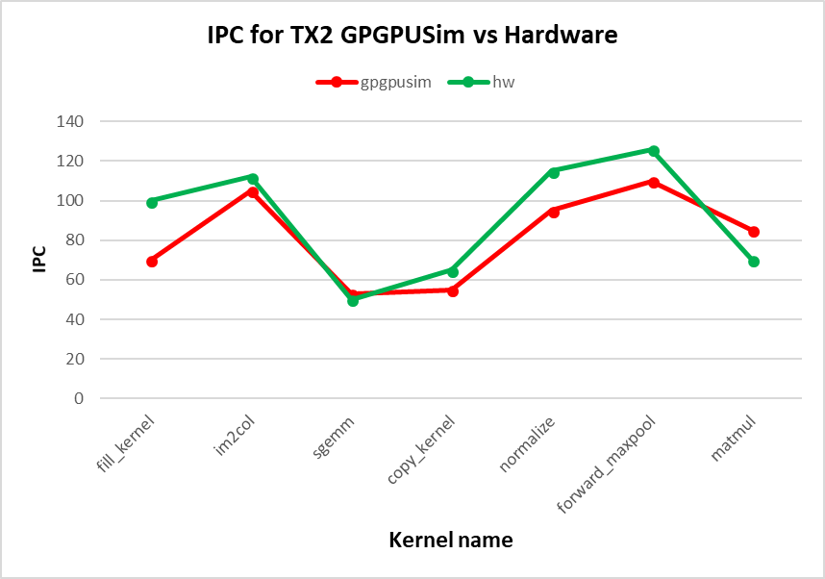
IPC Correlation between Hardware and Simulator for TX2

Slide 33
Conclusion
We were able to enable the Architecture Exploration for Embedded GPUs on GPU Simulators for Deep Learning Inference.
Our most optimized GEMM kernel was slower than the Nvidia’s cuBLAS GEMM but was comparable to Clblast.
The results obtained from the simulator were within (10-15%) of the actual hardware values.
This suggests out Architecture Modelling of Embedded GPUs was somewhat precise.

Slide 34
Future Work
For future we can always work on the Open source GEMM kernel and optimize it for performance.
The Architecture Modeling of Embedded GPUs can be made better by recording the various Instruction better and also scaling the pipeline better for including more cores.
Gpu sim support for latest GPU Architectures like Volta with special dedicated hardware for deep learning(Tensor Cores).

Slide 35
Acknowledgements
I would like to thank Dr.Tabkhi for his immense help and guidance throughout my entire Research and College Career.
Special thanks to the committee members for making time to attend this presentation.
Shruthi, who displayed an interest in my research and helped me collect results.
TecSAR members for constant encouragements.

Slide 36
References
Y. LeCun, L. Bottou, Y. Bengio, and P. Haner, Gradient-based learning
applied to document recognition, Proceedings of the IEEE, vol. 86, no. 11,
pp. 22782324, 1998.
T. Aaamodt and A. Boktor, Gpgpu-sim 3. x: A performance simulator for manycore
accelerator research, in International Symposium on Computer Architecture
(ISCA), http://www. gpgpu-sim. org/isca2012-tutorial, 2012.
J. Redmon, Darknet: Open source neural networks in c,http://pjreddie.
com/darknet, vol. 2016, 201

