Slide 1
AUTOMATED CUSTOMER TRANSACTION ANALYTICS INFRASTRUCTURE
Combining SQL Server, Python Pipelines, and the Power BI Modern Fluent Data Visual Mesh

Slide 2
Database Architecture Layer (Staging Optimization)
Staging Layer Setup: Built an isolated SQL Server staging environment using the CustomerTransactions table schema.
Pre-Aggregation Strategy: Implemented explicit computing of the LineTotal metric (Quantity * Price) at the database layer via Stored Procedures.
Performance Tuning: Reduced operational overhead and frontend lag in Power BI by moving heavy calculations away from the client presentation engine.

Slide 3
ETL Ingestion & Orchestration Middleware (Python Engine)
Robust Connection Handling: Implemented Python scripts leveraging the raw string prefix (r"...") to neutralize escape sequence warnings for SQL Server instance identifiers like .\SQLEXPRESS.
Pandas Transformation Core: Standardized typecasting for strict data integrity, handling datetime transformations for InvoiceDate, and converting CustomerID fields into clean textual strings.
Data Sanitation: Automated whitespace trimming across categorical fields (Country, Description) to eliminate string formatting errors inside front-end visual filters.

Slide 4
Database Architecture Layer (Staging Optimization)
Staging Layer Setup: Built an isolated SQL Server staging environment using the CustomerTransactions table schema.
Pre-Aggregation Strategy: Implemented explicit computing of the LineTotal metric (Quantity * Price) at the database layer via Stored Procedures.
Performance Tuning: Reduced operational overhead and frontend lag in Power BI by moving heavy calculations away from the client presentation engine.

Slide 5
Dashboard Visualization Matrix (Power BI UI Mapping)
Visual Target | Mapped Field Parameters | Configuration & Logic Details
Histogram | Invoice Buckets (Bins of LineTotal) | Displays distribution of transaction values. Built by creating custom numeric intervals on LineTotal, using distinct count of Invoice on Y-axis.
Pie Chart | Country (Legend), LineTotal (Values) | Illustrates global geographic revenue contribution across markets. Enhanced with descriptive data labels showing category and total percentages.
Donut Chart | IsActiveCustomer, Customer ID | Segments active versus inactive client base composition. Configured with a distinct count of CustomerID and tooltips showing Average Order Value.
Clustered Bar Chart | Description (Y-Axis), Quantity (X-Axis) | Identifies the highest volume inventory assets. Polished by executing a programmatic 'Top N' threshold filter to render the top performing products.

Slide 6
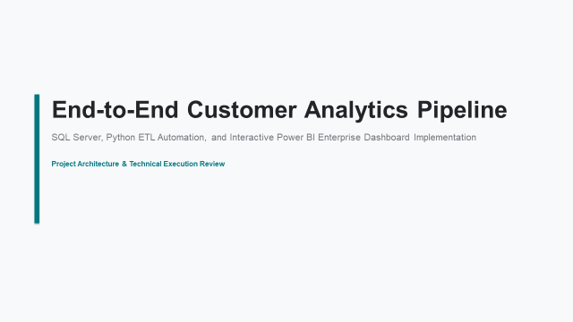

Slide 7
DATABASE LAYER & AGGREGATION
SQL Server Stored Procedure Optimization
Database Design Blueprint
• Staging Layer Layout: Structured 'CustomerTransactions' relational schema tracking core transactional properties natively.
• Performance Optimization: Implemented 'SET NOCOUNT ON' within runtime batches to minimize network transport footprints.
• Server-Side Transformation: Computes 'LineTotal' mathematically (Quantity * Price) directly inside database storage.
• Data Integrity Scrubbing: Stored procedure drops rows with NULL customer indices or negative quantity anomalies automatically.
Procedure Execution Command
EXEC [dbo].[GetProcessedCustomerData]
By shifting computational aggregation logic down into the database tier using modular relational execution groups, the enterprise pipeline shields frontend visualization tiers from processing overhead—enabling high performance even across dense datasets.

Slide 8
ETL ORCHESTRATION MIDDLEWARE
Python & Pandas Data Transformation Engine
01
Secure DB Connection
Establishes a pyodbc link utilizing a raw string modifier r"..." to fully neutralize special escape character warnings (e.g. \S in .\SQLEXPRESS) while leveraging Windows Trusted Authentication.
02
Pandas Structural Typecast
Natively ingest stored procedure tabular results into a Pandas DataFrame context. Explicitly maps datetime structures and casts relational keys like CustomerID safely into string values.
03
Whitespace & Ingestion Polish
Performs standard programmatic string stripping (.str.strip()) on text categories to purge blank padding, outputting clean columns seamlessly accessible inside Power BI runtime engines.

Slide 9
FRONTEND REPORT ARCHITECTURE
Power BI Visual Ingestion & DAX Analytics Matrix
TARGET VISUAL CHART | FIELD MAPPING: AXIS/LEGEND | FIELD MAPPING: VALUES/MEASURES | ANALYTICAL DESIGN GOAL
Histogram | LineTotal (Configured Into Numeric Bins of 50/100) | Distinct Count of Invoice | Visually maps transaction size distribution frequencies accurately.
Pie Chart | Country (Categorical Groupings) | Total Revenue Measure [Sum of LineTotal] | Highlights total geographical market share split between United Kingdom and France.
Donut Chart | IsActiveCustomer (Binary Filter States) | Distinct Count of CustomerID | Tracks customer base health segmentation; passes AOV inside active hover tooltips.
Clustered Bar Chart | Product Description (Categorical Rows) | Sum of Quantity Sold | Filters data dynamically using Top N configurations to surface Top 5 selling lines.

Slide 10
ADVANCED ANALYTICS CORE
Time-Intelligence & Value Modeling DAX Layout
Advanced Analytical DAX Measures
Average Order Value (AOV):
AOV = DIVIDE(SUM(LineTotal), DISTINCTCOUNT(Invoice), 0)
Month-over-Month (MoM) Revenue Growth:
MoM Growth =
VAR Curr = SUM(LineTotal)
VAR Prev = CALCULATE(SUM(LineTotal), DATEADD(InvoiceDate, -1, MONTH))
RETURN DIVIDE(Curr - Prev, Prev, 0)
Modeling Best Practices Implemented
• Divided Safe Math Protection: Utilizing the 'DIVIDE' operator universally to completely secure calculations against zero-denominator runtime crashes.
• Widescreen In-Memory Performance: Small historical row frameworks (e.g., 56 rows) execute instantaneously via Import Mode, pulling pre-compressed relational arrays.
• Dynamic Context Filtering: Time-intelligence calculations scale fluidly inside Power BI reporting layouts when sliced against dimensions like Country or Customer ID.

Slide 11
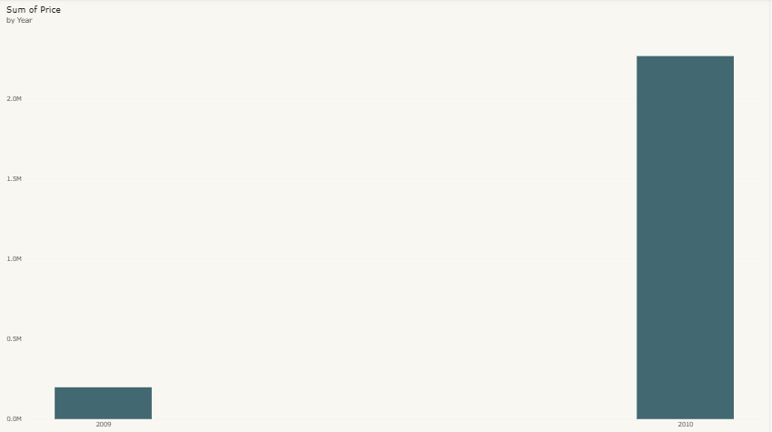
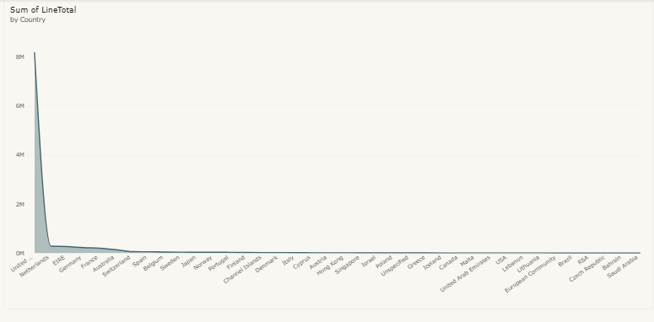
Sum of Price By Year
Sum Of Linetotal By Country

Slide 12
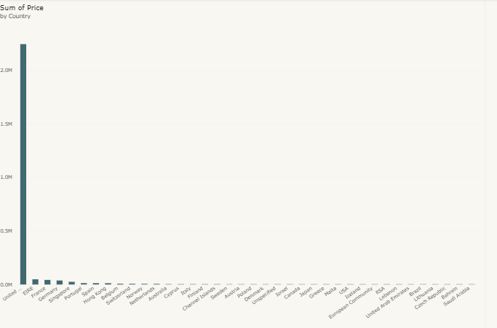
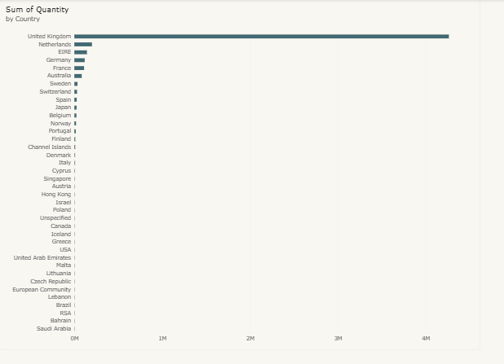
Sum of Price By Country
Sum of Quantity By Country

Slide 13
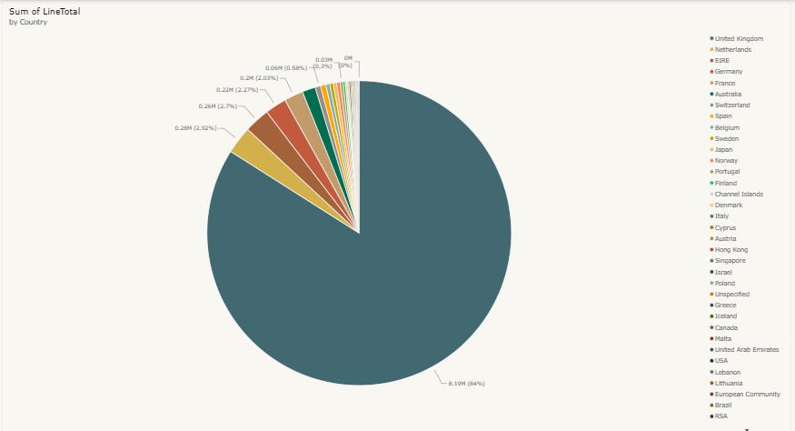
Sum of Line Total By Country

