Slide 1
Research Navigator – Ai powered research insight analyzer
Team-01:
Sathvik Samuel
Abhishek
Aryan Raj
Srija
Bhav Shishodia

Slide 2
Problem statement
The exponential growth of academic literature across scientific, technical, and social domains presents a significant challenge for researchers, students, and practitioners. Discovering relevant papers, understanding their core contributions, and identifying connections between seemingly disparate research areas often relies on keyword searches, which can be inefficient and miss nuanced relationships. This information overload can hinder interdisciplinary research and slow down the pace of innovation.
The "Research Navigator: Semantic Paper Analyzer" project aims to address this by developing an AI-powered system that semantically analyzes academic paper abstracts and full texts . This tool will automatically extract key concepts, research methodologies, and findings, enabling users to perform semantic searches that go beyond keywords, discover related research, and visualize the intellectual landscape of a topic. By providing a more intelligent way to navigate academic knowledge, this project will empower users to find insights faster and foster cross-disciplinary understanding.

Slide 3
Objectives
To develop an AI-based system that automatically analyzes and interprets research papers using advanced Natural Language Processing (NLP) techniques.
To generate concise summaries and key insights from lengthy academic documents, enabling faster understanding of research content.
To identify research trends, patterns, and gaps across various domains through intelligent data mining and semantic analysis.
To design an interactive dashboard for visualizing insights, keyword relationships, and topic distributions for effective decision-making.
To recommend relevant research papers and topics based on user interests using AI-driven search and recommendation algorithms.

Slide 4
Outcomes
Automated Information Extraction: Accurately extract key entities (e.g., research methods, datasets, theories, diseases, genes) and relationships from academic texts.
Semantic Search Capability: Allow users to query research papers using natural language, retrieving results based on meaning rather than just keyword matches.
Intelligent Paper Recommendation: Suggest related papers based on extracted semantic content, helping users discover relevant literature they might otherwise miss.
Conceptual Knowledge Overview: Provide a structured (though not necessarily visual graph) overview of how concepts and methods are connected within a research domain.
Scalable Data Processing: Designed to ingest and process large volumes of academic abstracts/papers from open-access repositories.
User-Friendly Interface: An intuitive platform for searching, browsing, and analyzing research papers.

Slide 5
modules
User Authentication and Profile Management:
User registration, login (standard email/password).
Basic user profile for managing saved searches and favorite papers.
Document Ingestion & Preprocessing Module:
Automated pipeline to collect academic paper abstracts/metadata from open-access APIs (e.g., ArXiv API, PubMed Central API).
Text cleaning, sentence segmentation, and tokenization.
NLP Analysis Module (Core):
Named Entity Recognition (NER): Identify and classify domain-specific entities (e.g., "Convolutional Neural Network," "CRISPR," "Monte Carlo Simulation," "COVID-19"). This will likely involve fine-tuning a pre-trained model or building a custom one.

Slide 6
MODULES
Relation Extraction: Identify relationships between extracted entities (e.g., "uses method," "studies effect of," "proposes theory").
Text Embedding Generation: Convert abstracts/papers and user queries into dense vector representations (embeddings) for semantic similarity calculations.
Semantic Search & Recommendation Module:
Implement a vector similarity search (e.g., using Faiss or Scikit-learn's NearestNeighbors on embeddings) to find semantically similar papers to a query or a given paper.
Develop a recommendation logic based on extracted entities and semantic similarity.

Slide 7
MODULES
Visualization & Reporting Module :
Display search results with relevance scores and highlighted extracted entities.
Present recommended papers.
Basic charts for distribution of methodologies or topics (e.g., using Matplotlib/Seaborn).
Admin Dashboard:
Monitoring of document ingestion and NLP pipeline performance.
Review and potential manual correction of extracted entities/relations (for model improvement).
Management of data sources and domain-specific dictionaries.

Slide 8
Hardware requirements
Component | Minimum | Recommended | Importance
Processor (CPU) | Intel i5 / AMD Ryzen 5 | Intel i7 / AMD Ryzen 7 | Handles text extraction & NLP tasks efficiently
RAM & Storage | 8 GB & 256 GB SSD | 16–32 G & 512 GB – 1 TB SSD | Needed for loading transformer models & large papers and
Storage | 256 GB SSD | 512 GB – 1 TB SSD | Stores research papers, embeddings, and models
GPU (for AI tasks) | Optional | NVIDIA RTX 3060 or above | Speeds up BERT/SciBERT model inference
Internet | Stable broadband | High-speed connection | For accessing online models, APIs, papers
OS | Windows 10/11 or Ubuntu 22.04 | Ubuntu 22.04 LTS | Stable environment for ML frameworks

Slide 9
Software requirements
Category | Tool / Library | Purpose / Function
Programming Language | Python 3.9+ | Core language for all project modules
NLP & AI Frameworks | Hugging Face Transformers, PyTorch | Enables BERT/SciBERT-based semantic analysis
PDF & Data Processing | PyMuPDF (fitz), Pandas, Scikit-learn | Extracts and preprocesses research paper data
Database | MongoDB / PostgreSQL | Stores papers, metadata, and embeddings
Web & API Framework | MongoDB / PostgreSQL | Builds backend and API interface
UI / Visualization | Streamlit / Gradio | Interactive research insight interface
Deployment & Version Control | Docker, Git & GitHub | Packaging, deployment, and version management

Slide 10
Technologies used
Category | Technology | Purpose
Natural Language Processing (NLP) | Transformers / Large Language Models (LLMs) — OpenAI GPT, BERT, RoBERTa, T5 | Understanding and summarizing research papers, question answering, keyword extraction, and topic modeling.
Text Summarization Models | BERT, Transformers | Generate concise summaries of research papers or abstracts.
Semantic Search / Embedding Models | Sentence-BERT, Hugging-Face transformers T5 | Enables semantic search—finding conceptually related papers, not just keyword matches.
Topic Modeling | BERTopic, LDA | Identify main research themes and trends from large document corpora.
Citation & Influence Analysis | Graph Neural Networks (GNNs) or NetworkX library | Detect influential research papers and relationships via citation networks.

Slide 11
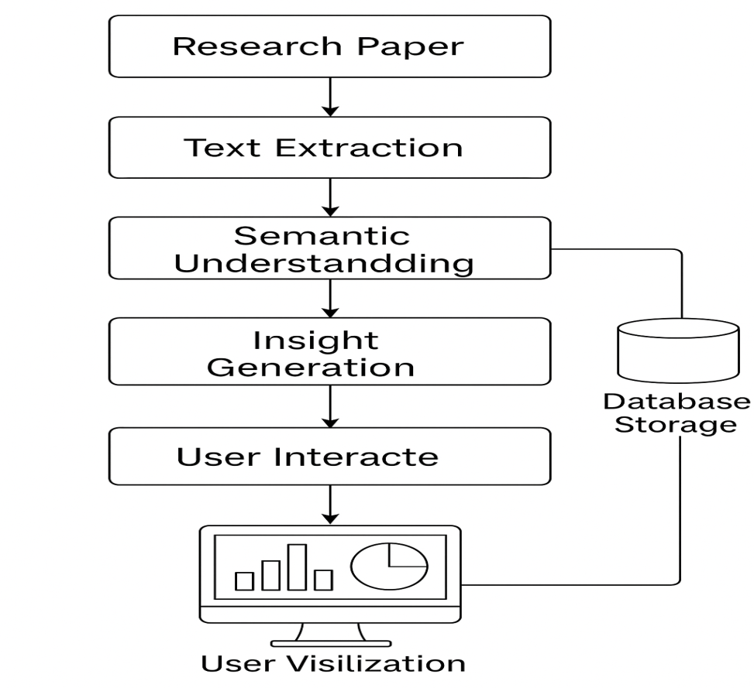
System flow diagram
The diagram illustrates the workflow of the Research Navigator system. It begins with uploading a research paper, followed by text extraction and semantic understanding to interpret content meaningfully. The system then performs insight generation, stores data in a database, and enables user interaction and visualization through an interactive dashboard for exploring extracted insights.

Slide 12
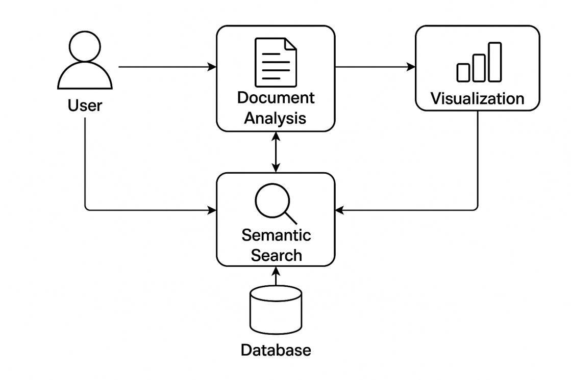
Dataflow diagram
The diagram represents the workflow of the Research Navigator’s semantic search system. The user inputs a document for analysis, which extracts and processes information stored in the database. The semantic search component retrieves meaningful insights, and the results are presented through visualization, enabling interactive exploration and understanding of research data.

Slide 13
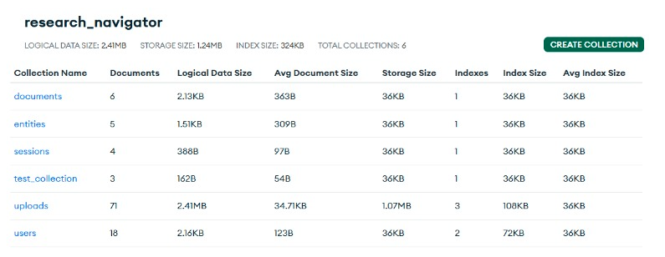
Database schema

Slide 14
System testing
Test Type | Purpose | Key Focus Areas
Functional Testing | Verify system functions as per requirements. | Uploads, searches, AI summarization accuracy, export features.
Performance Testing | Check speed, scalability, and response times. | Document ingestion speed, query latency, concurrency.
Security Testing | Validate data protection and access controls. | Authentication, encryption, secure API usage.
Integration Testing | Confirm smooth API and database interactions. | External data sources, cloud services.
AI Model Validation | Evaluate quality and accuracy of AI outputs. | Precision/recall of insights, bias detection, model explainability.

Slide 15
conclusion
The Research Navigator – Semantic Paper Analyzer successfully demonstrates the integration of advanced Natural Language Processing (NLP) and Artificial Intelligence to analyze, summarize, and extract meaningful insights from scientific research papers.
By utilizing models such as BERT and SciBERT, the system achieves semantic understanding beyond keyword matching — enabling deep context-based comprehension of research content.
It assists researchers, students, and academicians by automatically identifying key concepts, related studies, and generating concise summaries, thereby reducing the time and effort involved in literature review and knowledge discovery.

Slide 16
Future enhancements
In the future, Research Navigator can be enhanced with multimodal analysis to interpret text, tables, and figures using computer vision, and advanced language models like GPT or LLaMA for smarter summarization and question answering. Real-time research trend tracking and personalized recommendations will improve relevance, while collaborative workspaces will enable sharing and discussion. Integrating a conversational chatbot or voice assistant and deploying the system on the cloud will enhance accessibility, scalability, and overall research efficiency. These upgrades will make the platform more intelligent, context-aware, and user-centric, empowering researchers to gain deeper insights effortlessly. Ultimately, it will evolve into a comprehensive AI-powered research companion for the academic community.

Slide 17
references
AI Research Navigator — Fadaee, M., Gureenkova, O., Rejon Barrera, F., Schnober, C., Weerkamp, W., Zavrel, J. “A New Neural Search and Insights Platform for Navigating and Organizing AI Research.” arXiv preprint, 2020.
Research Horizon Navigator (by Clarivate Plc) — “Clarivate Launches Research Horizon Navigator to Pinpoint Future Breakthrough Areas.” PR Newswire, June 4 2024.
Insight Assistant (by Innopipe) — “Insight Assistant | AI-Powered Research & Innovation Insights.” Website.
InsightPaper — InsightPaper: AI-Powered Research Paper Assistant (website).
Knowledge Navigator — Katz, U., Levy, M., Goldberg, Y. “Knowledge Navigator: LLM-guided Browsing Framework for Exploratory Search in Scientific Literature.” ACL Anthology (2024).

Slide 18
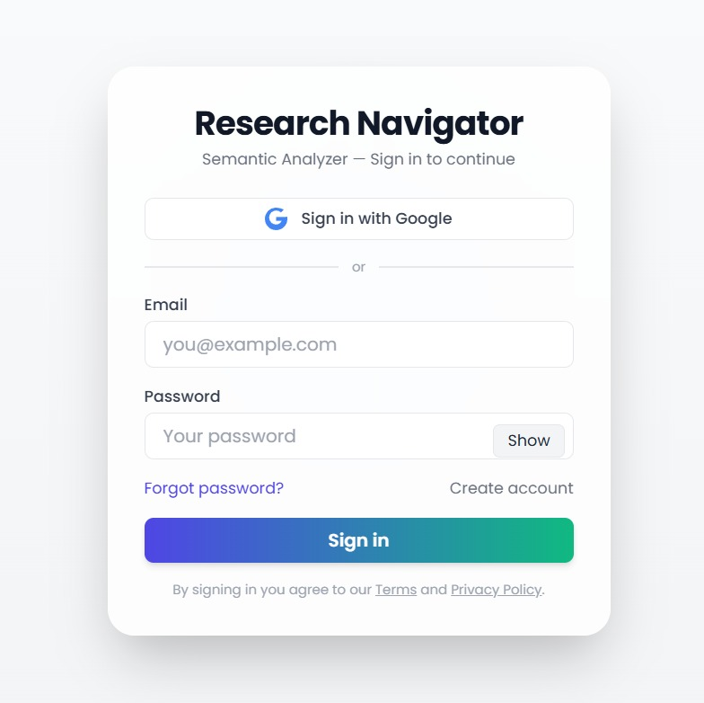
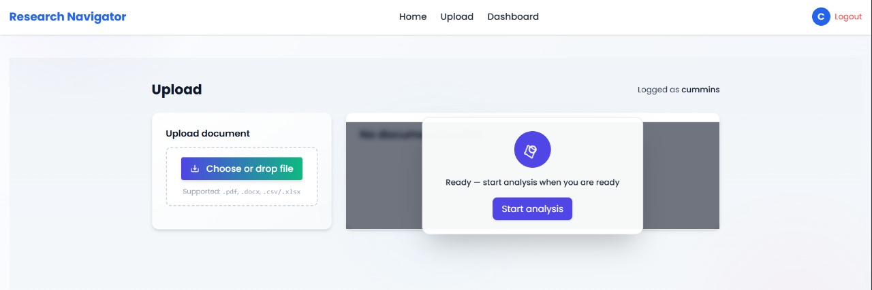
Project screenshots
Fig(1)-User Authentication Module
Fig(2) - Document Ingestion Module

Slide 19
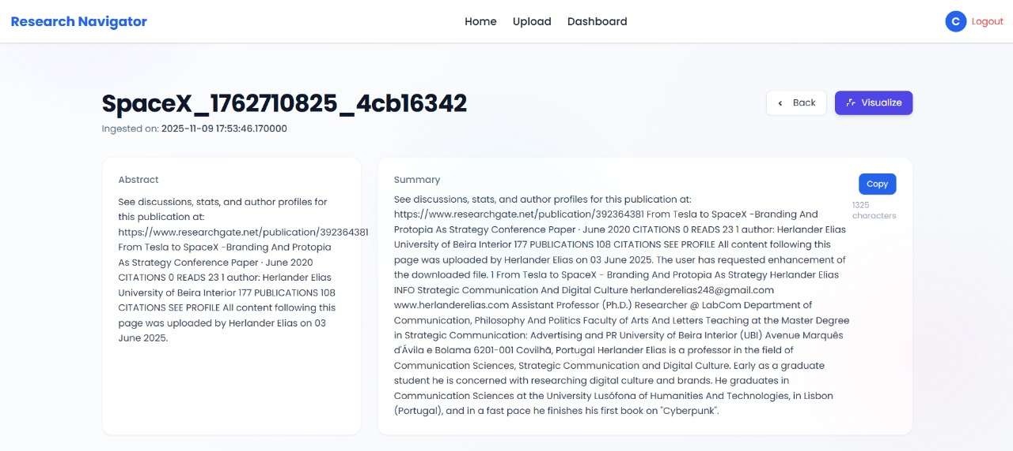
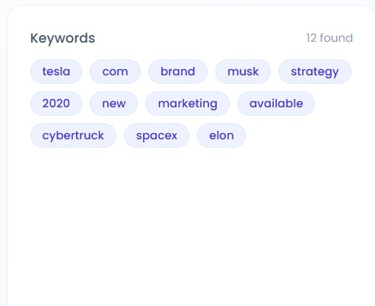
Project screenshots
Fig (3) – Semantic search module
Fig (4) – Keyword Extraction

Slide 20
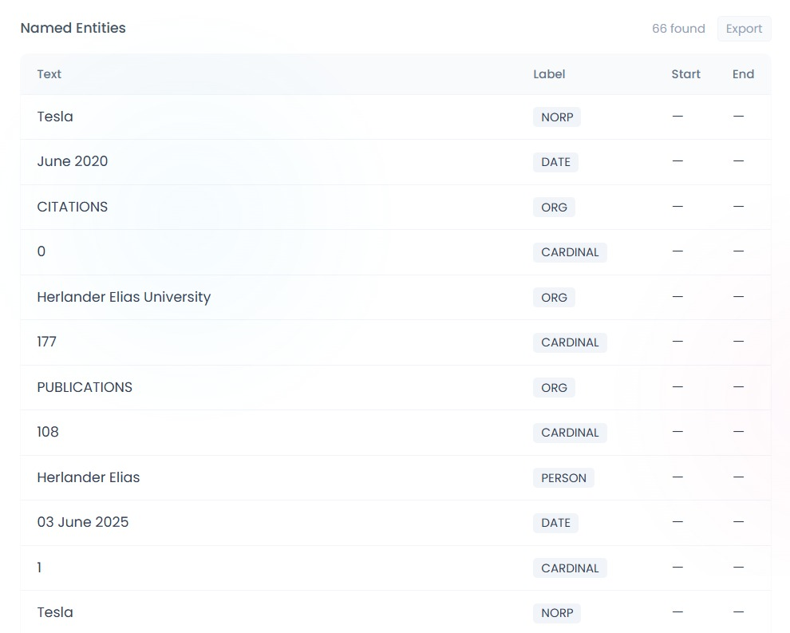
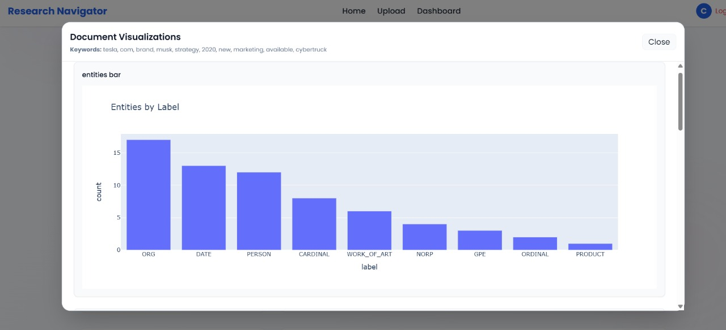
Project screenshots
Fig (5) – Named Entity Recognition
Fig (6) – Visualization Dashboard

