Slide 1

BCI-­Operated Media Player
Team members name and USN
Bhoomika Agarwal ­ 1PE12CS033
Sreekumar T. ­ 1PE12CS159
Ramesh M. ­ 1PE13CS416
Sowmya R. ­ IPE13CS426
Guide name
Saraswathi R Punagin
Department of Computer Science & Engineering
PESIT ­ BSC

Slide 2
Problem Statement
Our project aims to enable severely impaired patients interact with computers via BCI. We are using a media player as a sample Proof of concept. The idea can be extended further to other software.
The main idea is to establish a combination of binary digits, wherein left hand movement maps to a ‘0’ and right hand movement maps to a ‘1’, thereby creating a language. These strings are then mapped to inputs to the computer system.

Slide 3
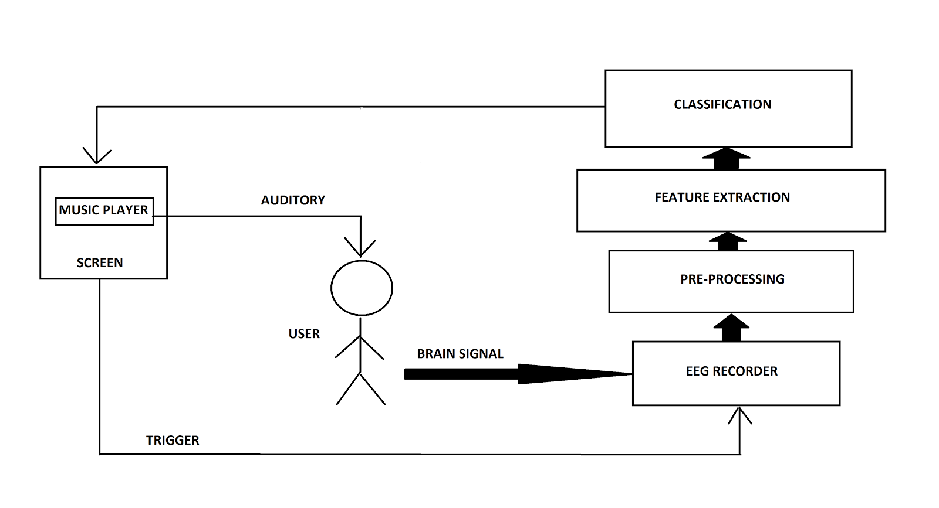
High level architecture
Figure 1: High-level overview of the MI Based BCI system

Slide 4
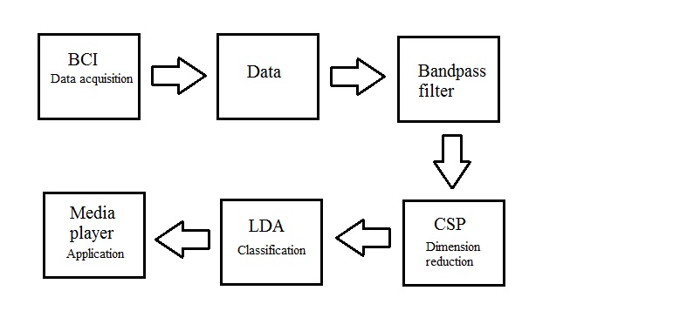
Flow diagram
Figure 2: Basic flow diagram

Slide 5
LDA
Linear Discriminant Analysis (LDA) is a classification method originally developed in 1936 by R. A. Fisher.
It is simple, mathematically robust and often produces models whose accuracy is as good as more complex methods
Linear classification methods, like Linear Discriminant Analysis (LDA), need less examples in order to obtain a reliable classifier
LDA is able to produce an output which is continuous in time as well as in amplitude.
LDA was also successfully applied to many different EEG parameters, like bandpower values (ERD), as well as common spatial patterns (CSP) and Adaptive autoregressive (AAR) parameters

Slide 6
CSP
CSP is a technique to analyse multichannel data based on recordings from two classes (conditions).
It is an approach closely related to PCA, except that the task condition labels are incorporated when determining W such that the corresponding components produce minimum variance for one condition and maximum variance for the other.
As the reduced CSP filters are already optimised for discriminating the task conditions, they can be directly used for feature extraction.
As with PCA and ICA, only the relevant components are retained

Slide 7
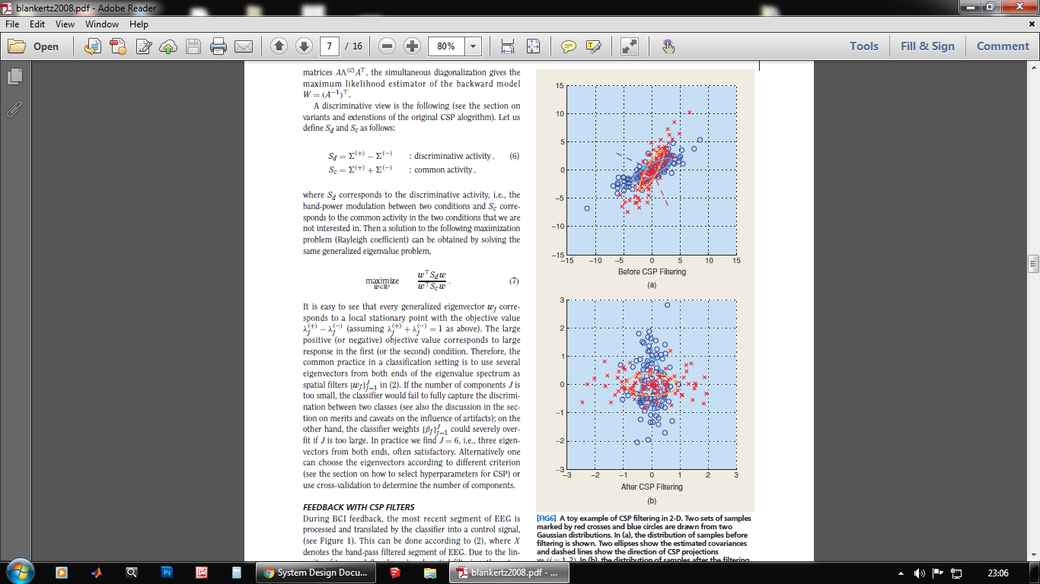
CSP

Slide 8
Module 1: Open BCI
This module is used to acquire signals from the patient. It is used for data acquisition.
Takes the feedback of the interpreted brain state.
Strive to decode brain signals into control commands.
Makes use of the classified signals to perform a task or actuation.
Designed to restore sensory function, transmit sensory information to the brain, or simulate the brain through artificially generated electrical signals.
OpenBCI has released an open-source application for use with the OpenBCI, written with Processing.

Slide 9
Module 2: Media Player
The Media player acts as a proof of concept for the project idea
Our application will have 4 functions:
1.Start
2.Stop
3.Previous
4.Next
The combination of right hand imaginary movement and left hand imaginary movement is used to control the player.

Slide 10
Module 3: Processing
This module is implemented entirely in software
There are 3 main tasks to be carried out in the processing stage:
1. Pre-processing- cleaning of data
2. Classification- determined if left hand or right hand imagery
3. Application- Media player application that makes use of the output
Uses various python modules and functions to implement these

Slide 11
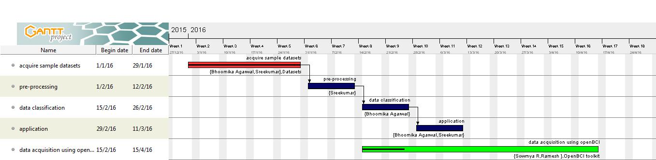
Gantt chart

