Slide 1




Slide 2
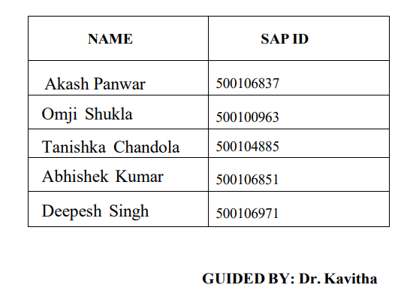
MUSIC RECOMMENDATION SYSTEM

Slide 3
Table of Contents
Introduction
Literature
Problem Statement
Research Gap
Problem Statement
Conclusion
References

Slide 4
1. Introduction
Developing an AI-powered music recommendation system for a streaming platform
Enhancing user experience, increasing engagement, and improving satisfaction
Python, Machine learning libraries (Scikit-learn, TensorFlow/PyTorch), and data processing tools (NumPy, Pandas)

Slide 5
2. Literature Survey
Patel R, Thakkar P and Ukani V. (2024). CNNRec: Convolutional Neural Network based recommender systems - A survey. Engineering Applications of Artificial Intelligence. 10.1016/j.engappai.2024.108062. 133. (108062). Online publication date: 1-Jul-2024.
Shuai Zhang, Lina Yao, Aixin Sun, and Yi Tay. 2019. Deep Learning Based Recommender System: A Survey and New Perspectives. ACM Comput. Surv. 52, 1, Article 5 (January 2020), 38 pages. https://doi.org/10.1145/3285029 1, Article 5 (January 2020), 38 pages. https://doi.org/10.1145/3285029
Heng-Tze Cheng, Levent Koc, Jeremiah Harmsen, Tal Shaked, Tushar Chandra, Hrishi Aradhye, Glen Anderson, Greg Corrado, Wei Chai, Mustafa Ispir, Rohan Anil, Zakaria Haque, Lichan Hong, Vihan Jain, Xiaobing Liu, and Hemal Shah. 2016. Wide &amp; Deep Learning for Recommender Systems. In Proceedings of the 1st Workshop on Deep Learning for Recommender Systems (DLRS 2016). Association for Computing Machinery, New York, NY, USA, 7–10. https://doi.org/10.1145/2988450.2988454
R. Mu, "A Survey of Recommender Systems Based on Deep Learning," in IEEE Access, vol. 6, pp. 69009-69022, 2018, doi: 10.1109/ACCESS.2018.2880197.
Hao Wang, Naiyan Wang, and Dit-Yan Yeung. 2015. Collaborative Deep Learning for Recommender Systems. In Proceedings of the 21th ACM SIGKDD International Conference on Knowledge Discovery and Data Mining (KDD '15). Association for Computing Machinery, New York, NY, USA, 1235–1244. https://doi.org/10.1145/2783258.2783273

Slide 6
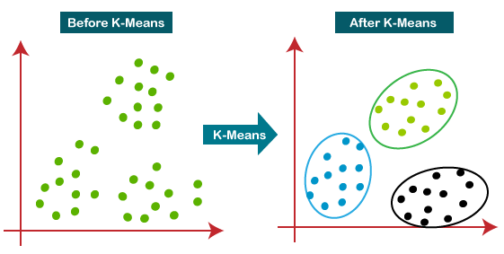
3. K-MEANS Diagram

Slide 7
4. K-MEANS Diagram

Slide 8
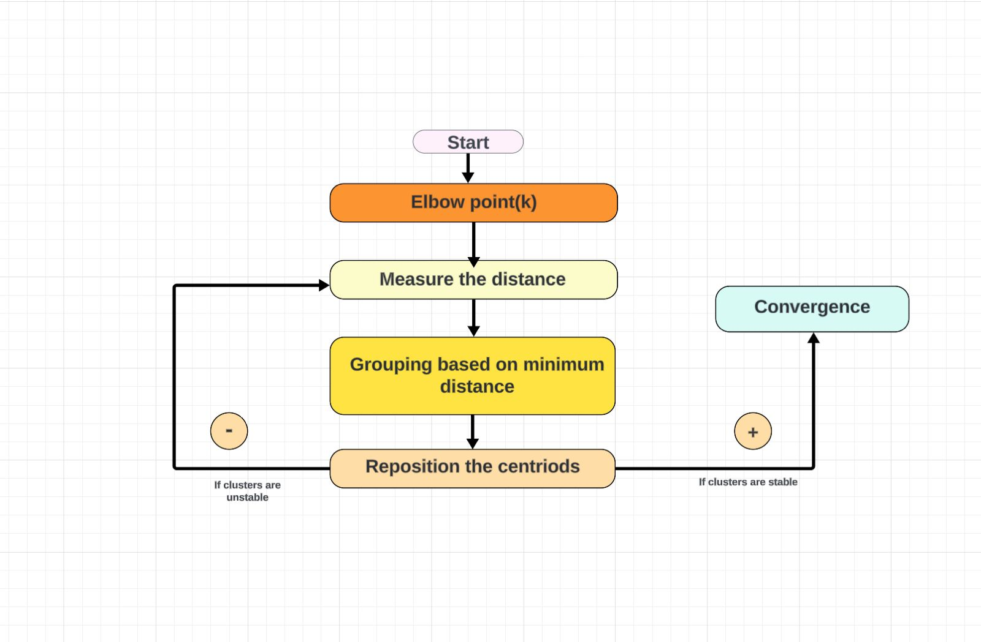
5. K-MEANS ARCHITECTURE

Slide 9
6. Problem Statement
PROBLEM STATEMENT
The current music streaming landscape lacks personalized recommendation systems that effectively leverage advanced AI algorithms to cater to individual user preferences
Users often struggle to discover new and relevant music content due to the limitations of existing recommendation systems

Slide 10
OBJECTIVE
Develop an AI-powered music recommendation system capable of delivering personalized suggestions based on user preferences and behavior
Implement advanced machine learning algorithms to analyze user interactions and generate tailored recommendations in real-time
Enhance user satisfaction and engagement by providing diverse and relevant music content through the recommendation system

Slide 11
RESEARCH GAP
Identification of gaps in existing literature regarding the incorporation of advanced machine learning techniques in music recommendation systems
Lack of research on the integration of real-time user feedback mechanisms to enhance recommendation accuracy and relevance

Slide 12
7. Conclusion
The AI-powered music recommendation system presents a pivotal advancement in enhancing user engagement within the streaming platform.
Leveraging sophisticated machine learning techniques, the system delivers personalized recommendations, amplifying user satisfaction and content discovery.
Continuous refinement and optimization are imperative to uphold the system's efficacy and adaptability in the evolving realm of music streaming platforms.

Slide 13
8. Reference
https://doi.org/10.1145/3285029
https://doi.org/10.1145/2988450.2988454
https://doi.org/10.1145/2783258.2783273
TensorFlow Documentation. (n.d.). Retrieved from https://www.tensorflow.org/
PyTorch Documentation. (n.d.). Retrieved from https://pytorch.org/
Redis Documentation. (n.d.). Retrieved from https://redis.io/documentation
pytest Documentation. (n.d.). Retrieved from https://docs.pytest.org/en/latest/
Last.fm API Documentation. (n.d.). Retrieved from https://www.last.fm/api
MusicBrainz API Documentation. (n.d.). Retrieved from https://musicbrainz.org/doc/Development/XML_Web_Service/Version_

Slide 14
Questions ?

Slide 15
THANK YOU

