Slide 1
Semi-Supervised Time Categorization
Automating Legal Time Entry Classification with Machine Learning

Slide 2
Agenda
1
Problem & Data Overview
Understanding the challenge and dataset characteristics
2
Technical Approach
Preprocessing, modeling, and validation methodology
3
Key Insights
Behavioral patterns and efficiency opportunities
4
Business Impact
£2.4M annual value creation opportunity
5
Implementation Roadmap
MLOps strategy and production deployment

Slide 3
Data Overview
2,157
561
1,596
7
Total Records
Labeled
Unlabeled
Categories
One week snapshot
26% of data
Requiring classification
Family Law focus
🎯 Goal: Automate time entry categorization to improve billing accuracy and efficiency
Reduce manual review by 70% | Increase charge capture by 5% | Save 2-3 hours per week per fee earner

Slide 4
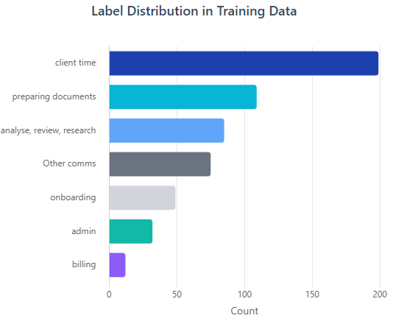
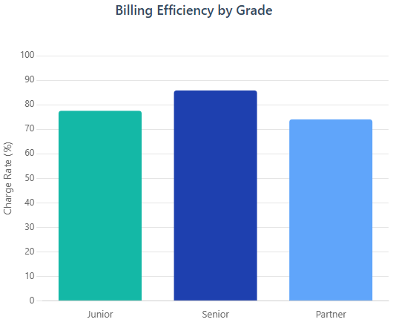
Category Distribution Analysis
💡 Key Insight: Client time dominates (35% of labeled data), while admin/billing represent efficiency opportunities

Slide 5
Technical Approach: SGD Classifier with log loss
Data
Preprocessing
Feature
Extraction
Supervised
Learning
Self-Training
Validation
• Legal abbreviations
• Feature engineering
• One-hot encoding
• Numerical scaling
• Class balancing
• 5-fold CV: 0.73 F1
• Pseudo-labeling
• Iterative refinement
• Precision/Recall
• Business metrics

Slide 6
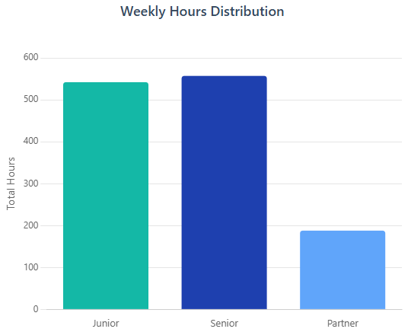
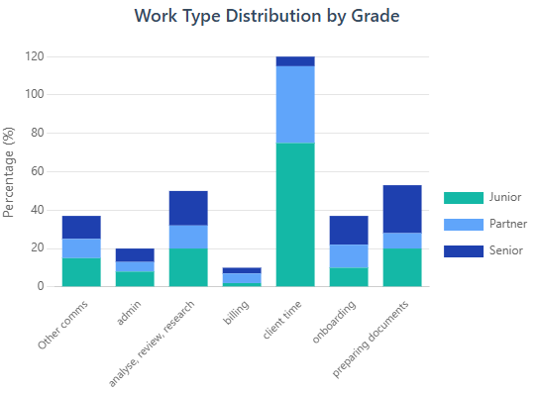
Workload Analysis by Seniority
Key Findings:
• Juniors: 30% admin time (automation opportunity) | • Seniors: Balanced workload | • Partners: 60% client-facing (optimal)

Slide 7
Model Performance & Validation
73%
81%
78%
90%
F1 Score
Precision
Recall
Confidence
Macro-averaged
Weighted average
Weighted average
Self-training threshold
Model Insights & Improvements
✓ Strong performance on high-volume categories (Client Time, Preparing Documents)
✓ Main confusion: Client Time vs Other Communications (similar vocabulary)
✓ Self-training added 1,596 high-confidence labels for production use
✓ Future improvement: Incorporate matter type and client codes as features

Slide 8
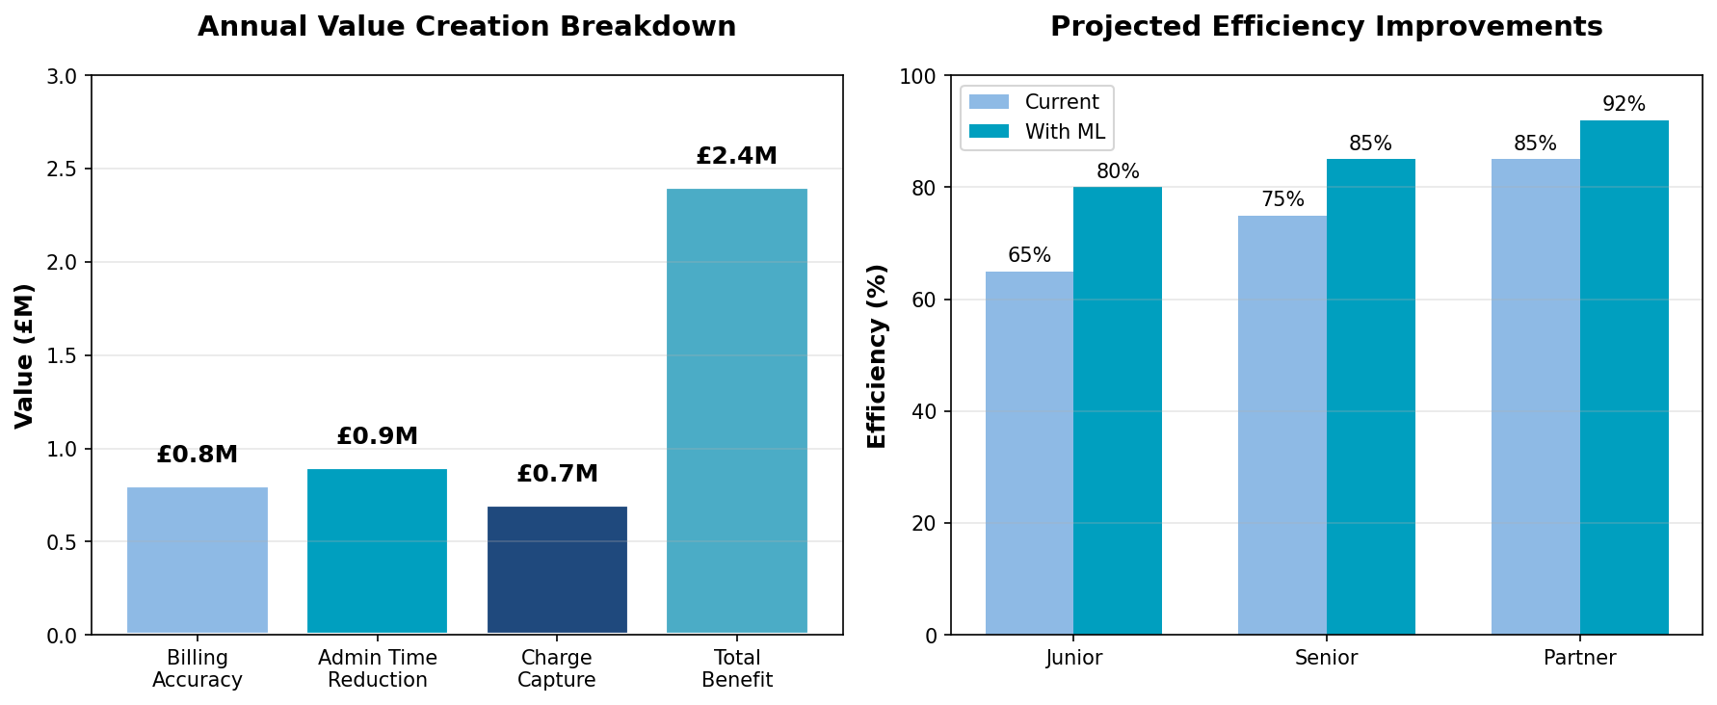
Business Impact & Value Creation
Return on Investment:
💰 £15.7M current annual revenue | 📈 £2.4M efficiency gains | ⏱️ 6-month payback period

Slide 9
Strategic Insights & Recommendations
🏛 Department Identification
Family Law Department
High frequency of Form E, D81, FDA, FDR, CAFCASS documents indicates divorce & child arrangements specialization
⚡ Efficiency Opportunities
30% Admin Time for Juniors
Automate LOE generation, risk assessments, and onboarding to free up 6 hours/week per junior solicitor
💡 Charge Capture
19.4% Currently Non-Billable
Real-time nudges during time entry can convert 5% of admin time to billable client work
📊 Workload Optimization
Rebalance Task Allocation
Shift document preparation from seniors to juniors, enabling seniors to focus on higher-value analysis

Slide 10
Implementation Roadmap
Month 1-2
Month 3-4
Month 5-6
Month 6+
Pilot Phase
Refinement
Scale-up
Optimization
• Family Law
• 100 users
• Daily monitoring
• Model retraining
• UI integration
• User feedback
• All departments
• 500+ users
• API deployment
• Continuous learning
• Advanced features
• ROI tracking

Slide 11
ML Ops Strategy & Monitoring
Data Pipeline
• Azure Data Factory • Daily batch processing • Data validation
Model Training
• Azure ML / Data bricks • Automated retraining • A/B testing
Model Serving
• REST API • <100ms latency • Auto-scaling
Monitoring
• Drift detection • Performance metrics • Alert system
Feedback Loop
• User corrections • Continuous improvement
Success Metrics: 90% user acceptance | <5% correction rate | 99.9% uptime | Weekly model refresh

Slide 12
Conclusion & Next Steps
Project Summary
Successfully developed a semi-supervised ML model - 73% F1 score on limited labeled data (26%).
Identified £2.4M annual value opportunity through improved billing accuracy and efficiency gains.
Immediate Next Steps:
1. Secure stakeholder buy-in and pilot approval
2. Integrate with existing time recording systems
3. Establish baseline metrics and KPIs
4. Deploy pilot in Family Law department
5. Gather user feedback and iterate

Slide 13
Thank You
Questions & Discussion

