Slide 1
REDDIT DATA EXTRACTION
INFO 5502
Principles and Techniques for Data Science
GROUP - 7
Abhishek Puppala (11596928)
Yaswanth Maddipati (11591722)
Sreemanth Sirivella (11609915)

Slide 2
What is Data Extraction?
The process of collecting or retrieving disparate types of data from a variety of sources, many of which may be poorly organized or completely unstructured.
Data extraction is the first step in both ETL (extract, transform, load) and ELT (extract, load, transform) processes. ETL/ELT are themselves part of a complete data integration strategy.
When we try to extract the data from a website, this process is known as Web Data Extraction and Web Scrapping.

Slide 3

REDDIT
Reddit is an American social news aggregation, content rating, and discussion website. Registered users submit content to the site such as links, text posts, images, and videos, which are then voted up or down by other members.
To Scrap the reddit data, we use scrapping tool called PRAW, which is Python reddit’s API, that helps to convert or extract the data from Reddit Website to CSV(Comma separated values) or Dataset.

Slide 4
PRAW
PRAW stands for Python Reddit API Wrapper, it is a Python module that provides a simple access to Reddit’s API. PRAW is easy to use and follows all of Reddit’s API rules.
To install PRAW, we run the following pip script on the terminal command prompt.
Command: pip install praw.
To extract the data, it is mandatory to sign up for reddit account and register an application.
The applications are of 3 types:
Web application
Script application
Installed application

Slide 5
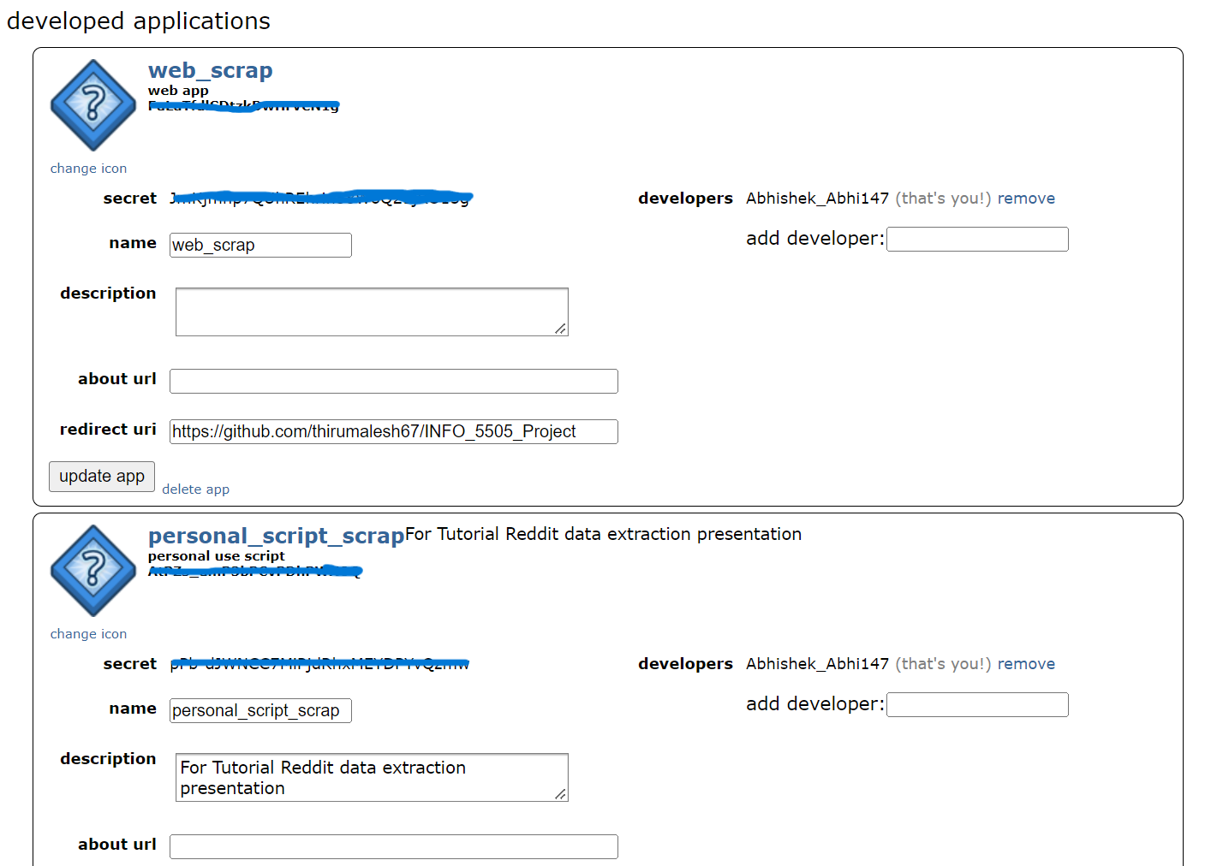
Authorization Access
To get the authorized access to scrap the reddit website using praw. We need to include client_id, client_secret, username and password.
We can find the id and secret in registered application. For reference, please see below image.
Syntax: reddit=praw.Reddit(clientId,secret,username,password)

Slide 6
Basic Operations
We can fetch the data through the topic names in different types. Using data = reddit.subreddit(topic_name).
There are total 5 operations which sorts the data.
Top: is sorted by highest score, i.e upvotes minus downvotes.
Hot: mean the post has an overwhelming number of upvotes, suggesting it’s well-liked.
New: regarding recently reshared posts.
Controversial: posts that have very even amounts of up/downvotes and a lot of activity.
Rising: means that a post is accumulating upvotes quickly even though it's new.

Slide 7
Basic Operations
Comment: Fetches the comments data from posts. Using reddit.subreddit(TopicName).comments.
Submission: It is a post on reddit. Acts similar to subreddit function.
SubReddit: It is a specific forum on Reddit where users can submit posts about a particular topic.

Slide 8
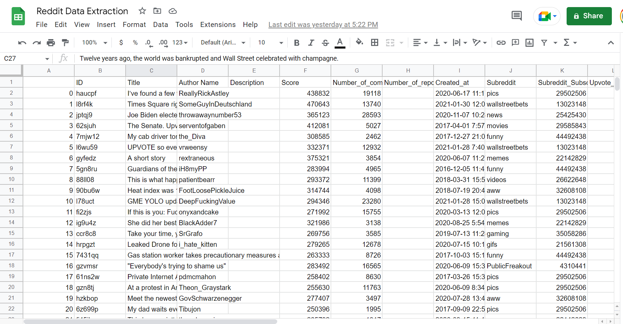
Dataset
Sample dataset fetched from reddit.

Slide 9
Advantages
PRAW is used for scraping the data from Reddit website for various posts and topics.
Used to analyze trending topics or posts in Reddit website.
Dis-advantages
While fetching the data, each time, it calls the api, for each post or comment, which takes more time to compute to get the response and makes it slower to fetch larger dataset.

Slide 10
Contribution of team members
Abhishek Puppala(54.25%): played major role in jupyter notebook part, execution and provided contribution towards documentation.
Yaswanth Maddipati(23.38%): contributed towards presentation and helped in coding part, by handling some errors, while execution
Sreemanth Sirivella(22.38%): collected information regaring data extraction and contributed towards execution by helping towards handling errors, discussion part and for preparing presentation.

Slide 11
Thank You !

