Slide 1


Team Details
sustAInX
Workflow Rescue
Team leader name: [Registered team leader name]
Problem Statement: Recover interrupted enterprise workflows while preserving customer intent, permissions and a verifiable outcome.
Notes:
Theme: Future of Work & Enterprise Productivity. Team spelling must remain sustAInX. The registered leader name must be confirmed before submission. All payment, inventory and order services are synthetic.

Slide 2

Note: Please download this template to make your edits and submit the final version.
To download, go to File > Download > Microsoft PowerPoint (.PPTX). Kindly refrain from sending edit requests.
Notes:
Original organizer download instruction retained unchanged. Hidden from the submitted presentation.

Slide 3
Brief about the idea
Workflow Rescue is an operator's recovery workspace for an order stranded between services.
A timeout is
not the truth.
Reconstruct
Read payment, stock and dispatch evidence.
The charge succeeded. The reservation expired. The customer still expects the original item.
Recover within authority
Gemini proposes; code controls each write.
“Same item. No extra charge. Two days late is fine.”
Prove the result
Independent checks verify or request review.
Synthetic business services. No production customer data.
03
Notes:
An adopting business supplies scoped permissions to its own service APIs. This prototype cannot intervene in a bank or another company's transactions. The customer mandate is reviewed structured scenario data, not unrestricted natural-language interpretation.

Slide 4
Opportunities
An evidence-linked recovery layer for the operator who must decide what happens next.
How different is it?
How does it solve it?
USP of the solution
Beyond a retry button: a stock conflict triggers fresh evidence and a revised proposal.
Designed to complement existing workflow engines.
Join customer permission, authoritative receipts and guarded execution in one incident.
Uncertainty becomes an explicit handoff.
Every attempted action has evidence. Every completed recovery has independent checks.
Operators and reviewers inspect the same record.
Target users: order operations • finance reconciliation • engineering reliability • internal control review
Retries, idempotency and compensation already exist. Incremental AI benefit needs broader evaluation.
04
Notes:
Stripe documents duplicate webhook delivery and idempotent retries. Temporal documents sagas and compensation. These sources establish the engineering problem, not product ROI. A broader deterministic planner can also solve these six fixtures.

Slide 5
List of features offered by the solution
One incident, from customer intent to an inspectable business outcome.
01 Your own incident
02 Evidence gathering
03 Adaptive proposal
Edit stock, payment and permissions, or import a validated JSON incident.
The controller reads payment, inventory and order evidence before planning.
Request fresh evidence after a stock-version conflict.
04 Guarded execution
05 Independent outcome
06 Inspectable record
Check typed tools, evidence, versions and idempotency.
Verify state or hand off when payment or dispatch is uncertain.
Replay real events, open receipts and export the run's JSON audit.
Replay is read-only playback of recorded events. A fresh run makes new model calls.
05
Notes:
The incident lab accepts editable synthetic service states and explicit permission toggles, or a schema-validated JSON incident. Imported records do not grant authority over any real service. Customer notes do not override explicit reviewed permissions. Replay remains separate from starting a fresh model run. This is JSON incident import, not arbitrary document ingestion.

Slide 6
Process flow diagram or Use-case diagram
The controller gathers mandatory evidence; Gemini chooses a recovery and adapts to change.
1 Incident + mandate
2 Controller observes
3 Gemini proposes
Operator edits or imports
a synthetic incident.
Mandatory payment, stock
and dispatch reads.
Recovery action based on
the observed evidence.
Blocked stale proposal → refresh evidence → replan
6 Verify or hand off
5 Execute bounded tool
4 Controller checks
Independent ledger checks
plus exportable audit.
Receipt confirms the write.
Changed state is observed.
Permissions • versions
evidence • idempotency
Bounded proposal loop. Unknown payment or irreversible dispatch leads to operator review.
06
Notes:
Three mandatory controller reads gather payment, inventory and dispatch before Gemini is called. Gemini then chooses the recovery action and can request fresh evidence or replan after a conflict. The stock race occurs between observation and reservation. The first proposed reservation can be rejected because its inventory version is stale. A fresh observation can reveal incoming stock within the approved delay. Do not imply the model authorizes itself or independently certifies the result.

Slide 7
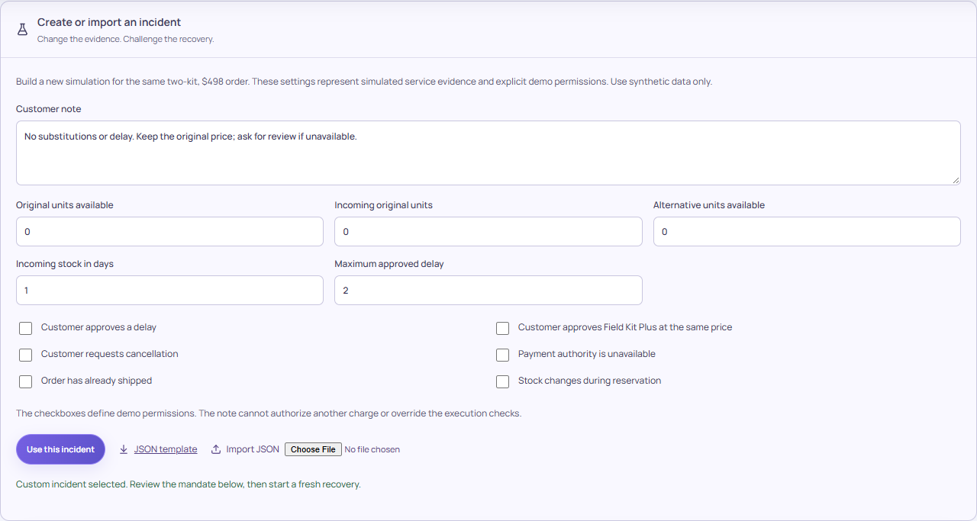
Wireframes/Mock diagrams of the proposed solution (optional)
Implemented incident lab: change evidence, review explicit permissions, then run a new recovery.
Orient
Home introduces the incident and service state.
Act
Edit or import an incident; start a fresh run.
Review
History and receipts reconstruct each run.
Actual application screenshot. Imported JSON is schema-validated; a customer note cannot override permission controls.
07
Notes:
This is an actual incident-lab capture, not a designed mock. Operators can change stock, payment availability and reviewed permissions, or import a JSON incident. Animation is a state projection and cannot make a failed run pass. Desktop and mobile browser checks were run locally.

Slide 8
Architecture diagram of the proposed solution
Solid boxes: implemented application path. Google deployment status is stated separately.
React + Three.js
FastAPI controller
Gemini API
Incident desk
Evidence and audit UI
Bounded agent loop
Authority + verification
Structured recovery proposals
API key stays server-side
Firebase: pending
Synthetic connectors
Firestore: runtime pending
Cloud Run: pending
Payment ledger • inventory
Order and dispatch
Audit persistence is separate from the simulated business services.
Current backend: temporary Google Cloud Shell demo. Persistent Cloud Run hosting is not yet deployed.
08
Notes:
Google deployment roles: Firebase Hosting for a static submission portal and prototype entry link; Cloud Run is planned for the FastAPI runtime; Firestore for durable audit documents; Gemini API for reasoning. Status badges reflect only confirmed deployment evidence. The static submission portal does not keep the Cloud Shell backend alive. A Firestore database write/read probe passed, but application-runtime persistence is pending until its credentials and save/load path have been verified. Do not call the in-memory simulator a durable distributed transaction engine. {"firebase_verified": false, "firestore_verified": false, "cloudrun_verified": false}

Slide 9
Technologies to be used in the solution
The Google services have distinct roles; the pitch does not treat planned services as deployed.
Gemini API
Evidence-linked recovery proposal and conflict replanning
Live suite passed
Firebase Hosting
Public submission portal and prototype entry link
Pending deployment
Firestore
Persist completed run evidence for later review
Runtime check pending
Cloud Run
Managed runtime for the FastAPI service
Pending deployment
React / Three.js
Responsive recovery desk, service views and replay
Implemented
FastAPI / Pydantic
Typed proposals, execution guards and verification
Implemented
Verified model: gemini-3.5-flash-lite. No automatic fallback to a paid model.
Only explicit, verified status flags mark a deployment complete. Secrets never enter the frontend or deck.
09
Notes:
The current Gemini free-tier API is different from paid Vertex AI. Billing is not linked to the selected GCP project. Cloud Run free allowances are not a guaranteed zero-spend deployment. Public evaluation availability remains a delivery requirement.

Slide 10
Estimated implementation cost (optional)
Constrain prototype spend; validate business value with a real operations pilot.
Prototype cost boundary
ILLUSTRATIVE ANNUAL CAPACITY VALUE
Build scope: 2–3 day prototype target.
Gemini: user's confirmed Free tier.
Current hosting: free Cloud Shell session; temporary availability.
Persistent hosting and integration costs still need validation.
$250,000
10m orders × 1% recovery incidence
× 50% assisted × 10 minutes saved
× $30/hour ÷ 60
Hypothetical inputs, before cloud, integration and review costs. Released capacity is not automatically cash saved.
No measured ROI, customer adoption or global savings claim. A pilot must validate every assumption.
10
Notes:
Formula: annual orders times manual recovery incidence times useful coverage times net minutes saved divided by 60 times fully loaded hourly staff cost. The illustration equals $250,000 gross annual staff capacity. It is not a market estimate, a tested saving, or a budget reduction. Production costs include integration, durable data, access controls, observability, inference, hosting and review effort.

Slide 11
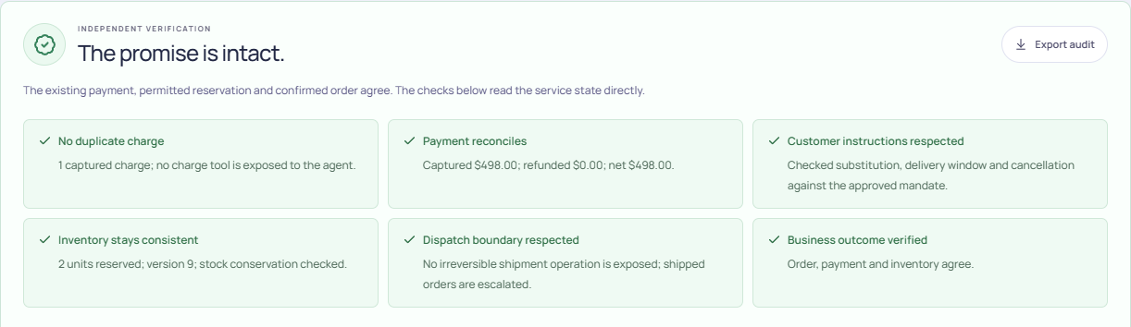
Snapshots of the prototype
The interface exposes the underlying record; a green animation alone is never proof.
Local deterministic rehearsal; no Gemini calls in this image.
Selected verification checks from an actual run; the caption identifies the provider used.
11
Notes:
Local deterministic rehearsal; no Gemini calls in this image. This is a capture of the application's computed verification results. The provider and scenario must match its audit record. Never relabel rehearsal evidence as Gemini evidence.

Slide 12
Prototype Performance report/Benchmarking
Six reviewed development fixtures; useful coverage evidence, not a held-out accuracy benchmark.
6/6 live Gemini
82 Python tests
8 JavaScript tests
Scenario
Expected
Gemini outcome
Model calls
stock race
recovered
recovered
4
straight recovery
recovered
recovered
2
cancel order
cancelled
cancelled
3
unknown payment
escalated
escalated
1
approved substitute
recovered
recovered
2
already dispatched
escalated
escalated
1
Rehearsal: 6/6. Baseline escalates on stock conflict; a broader rules engine can solve these fixtures.
gemini-3.5-flash-lite • 0 safety-check failures • 3 controller reads before each model run. Artifact: 2026-10-18T17:13:33.284+00:00
12
Notes:
The deck reads artifacts/evaluation-gemini.json at build time. It shows unsuccessful cases as red rather than substituting provider results. The initial Gemini 3.8 Flash run exhausted its model's free daily allowance. The operator explicitly selected Gemini 3.5 Flash-Lite; there is no silent provider fallback. The new six-case deployed suite passed. Three controller preflight reads are distinct from the listed model-call counts. Stock-race recovery used four model calls and took about 60 seconds including free-tier pacing; do not present inference-only latency as end-to-end runtime. Live and mocked tests answer different questions. No finalist probability or superiority claim is inferred from six development fixtures.

Slide 13
Additional Details/Future Development (if any)
What must happen before real customer orders enter the system.
1 Delivery readiness
2 Customer pilot
3 Production controls
Persistent, publicly accessible hosting.
Validate every required Google integration.
Publish source and a working 3–4 minute demo.
Use an owner's sandbox APIs with scoped authority.
Broaden instruction and incident variation.
Measure handling time and safe handoff coverage.
Service-owned idempotency and durable state.
Tenant identity, access controls and retention.
Tamper-evident records and human approval gates.
Prototype audit is inspectable, but not immutable, certified or independently attested.
13
Notes:
The latest submission instructions supplied by the user require a 3 to 4 minute video. This supersedes the older public FAQ and the template's legacy 3-minute label for this preparation. The application must remain functional throughout evaluation; the temporary Cloud Shell link does not meet that durability requirement.

Slide 14
Provide links to your:
Public repository, 3–4 minute demonstration, and deployed working product.
GitHub Public Repository — publication pending
https://github.com/abhi14dodiya/workflow-rescue-sustainx
Demo Video Link (3–4 minutes) — upload pending
https://gen-lang-client-0915819772.web.app/downloads/workflow-rescue-demo.mp4
Final Product Link
https://federation-php-architecture-blocked.trycloudflare.com
The current product URL is a temporary session demo, not a durable evaluation deployment.
All links must work without the evaluator signing into the team's private accounts.
14
Notes:
Link targets are editable text hyperlinks in the PPTX and exported PDF. A nonempty link is not evidence of durable availability. Source publication and video upload must be independently checked while signed out.

Slide 15
Evidence, assumptions and scope
Our claim is controlled, inspectable recovery of synthetic incidents. The pilot must establish business value.
Stripe webhook guidance
Duplicate events establish why recovery must reconcile authoritative state.
Stripe idempotent requests
Safe request retries are an established engineering control.
Temporal sagas and compensation
Partial workflows and application-specific compensation predate this prototype.
Primary technical sources checked 18 October 2026. These sources do not substantiate a product savings figure.
15
Notes:
All official template headers, footers, cover artwork and closing artwork are preserved. Slide 2 remains as a hidden organizer note. This extra evidence slide occupies the original blank branded slide. Savings assumptions are documented in docs/IMPACT.md. Full controller and provider evidence is in the repository artifacts.

Slide 16

Workflow Rescue · sustAInX
Recover the workflow.
Preserve the customer's intent.
Notes:
Thank you. Invite the evaluator to inspect the working recovery, the underlying evidence and the source code. Do not promise competition qualification or claim production readiness.

