Slide 1


Team Details
sustAInX
Workflow Rescue
Team leader name:Abhishek Dodiya
Team member: Tapaswini Palo
Problem: Payment succeeded, but the order stalled. Recover it using verified evidence and the customer's permissions.
Theme: Future of Work & Enterprise Productivity
Notes:
Workflow Rescue by sustAInX helps an enterprise operations team recover an interrupted order within explicit customer permissions. The working prototype uses synthetic payment, inventory and order services, with real Gemini reasoning and an inspectable audit trail.

Slide 2
Brief about the idea
Workflow Rescue is an operator's recovery workspace for an order stranded between services.
Payment received.
Order interrupted.
Reconstruct the facts
Read payment, stock and dispatch.
An operations agent must reconcile the payment, find permitted stock and confirm what happened.
Recover within authority
Gemini proposes; code controls writes.
Verify the outcome
Demo mandate: original item, same price, at most one day late.
Confirm the state or request review.
Synthetic business services. No production customer data.
02
Notes:
The recorded example begins with two original Field Kits and one existing payment of $498. The customer permits a delay of at most one day, but no substitution or extra charge. The reservation has expired, and stock changes during recovery. The task is to find a permitted recovery from the actual evidence.

Slide 3
Opportunities
An evidence-linked recovery layer for the operator who must decide what happens next.
How different is it?
How does it solve it?
USP of the solution
Beyond a retry button: a stock conflict triggers fresh evidence and a revised proposal.
Designed to complement existing workflow engines.
Join customer permission, authoritative receipts and guarded execution in one incident.
Uncertainty becomes an explicit handoff.
Writes require valid evidence. Completed recoveries pass independent checks.
Operators and reviewers inspect the same record.
Target users: order operations • finance reconciliation • engineering reliability • internal control review
Adoption requires the app owner's scoped API permissions. No authority over third-party transactions.
03
Notes:
Interrupted workflows leave operations, finance and engineering teams reconstructing events across services. Workflow Rescue brings evidence, permissions, attempted actions and final checks into one reviewable record. Its intended benefit is less manual reconstruction and clearer handoffs; handling-time savings and business value still require a customer pilot.

Slide 4
List of features offered by the solution
One incident, from customer intent to an inspectable business outcome.
01 Custom incidents
02 Evidence gathering
03 Adaptive recovery
Edit synthetic evidence and permissions, or import JSON.
Read payment, inventory and dispatch before planning.
Refresh evidence and replan when stock changes.
04 Execution guards
05 Outcome checks
06 Audit and history
Enforce evidence, permissions, versions and idempotency.
Verify the business state or escalate for review.
Inspect receipts, replay events and export the audit.
Replay is read-only playback of recorded events. A fresh run makes new model calls.
04
Notes:
An operator can edit a synthetic incident or import validated JSON, then start a fresh model run. Explicit permission fields govern the allowed mutations. The interface exposes evidence, rejected proposals, executed receipts, verification and an exportable audit. Replay shows an existing run without making new model calls.

Slide 5
Process flow diagram or Use-case diagram
The controller gathers mandatory evidence; Gemini chooses a recovery and adapts to change.
1 Incident + mandate
2 Controller observes
3 Gemini proposes
Operator edits or imports
a synthetic incident.
Mandatory payment, stock
and dispatch reads.
Recovery action based on
the observed evidence.
Blocked stale proposal → refresh evidence → replan
6 Verify or hand off
5 Execute allowed step
4 Controller checks
Independent ledger checks
plus exportable audit.
Record the write receipt.
Observe the changed state.
Permissions • versions
evidence • idempotency
Bounded proposal loop. Unknown payment or irreversible dispatch leads to operator review.
05
Notes:
The controller first reads payment, inventory and dispatch. Gemini chooses a recovery action using those observations. The controller checks evidence, permissions, inventory versions and idempotency before execution. A rejected stale-stock proposal prompts fresh evidence and replanning. Independent state checks determine the final outcome.

Slide 6
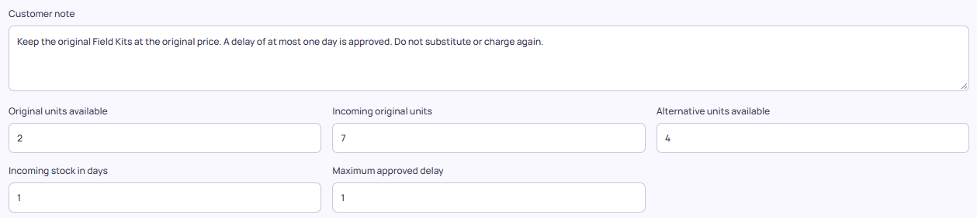
Wireframes / implemented interface
The incident editor accepts new inputs. Permissions are explicit, separate from the customer note.
Evidence: original stock 2 → incoming stock 7 → approved delay 1 day
Explicit permissions: delay allowed; substitution forbidden; stock conflict enabled
Cropped views of the actual editor using the video's incident. All service records are synthetic.
06
Notes:
This editor contains the same custom input used in the video: two units available, seven incoming units, incoming stock after one day, a maximum permitted delay of one day, no substitution, and a stock race enabled. The imported values are visible and editable; the capture itself starts no recovery.

Slide 7
Architecture diagram of the proposed solution
Gemini proposes actions. The backend enforces authority and verifies the resulting state.
React + Three.js
FastAPI controller
Gemini API
Incident desk
Evidence and audit UI
Bounded agent loop
Authority + verification
Structured recovery proposals
API key stays server-side
Firebase: verified
Synthetic connectors
Firestore audit store
Cloud Run: pending
Payment ledger • inventory
Order and dispatch
Saved report restored
after server restart
Current backend: temporary Google Cloud Shell demo. Persistent Cloud Run hosting is not yet deployed.
07
Notes:
The React interface communicates with a FastAPI controller running in Google Cloud Shell. Gemini supplies recovery proposals, and Firestore persists completed audits. Firebase Hosting serves the public submission materials and prototype entry link. Cloud Run is not deployed, and the Cloud Shell runtime remains temporary.

Slide 8
Technologies to be used in the solution
Current implementation and deployment status.
Gemini API
Evidence-linked recovery proposal and conflict replanning
Live suite passed
Firebase Hosting
Public submission portal and prototype entry link
Verified
Firestore
Persist completed run evidence for later review
Verified
Cloud Run
Managed runtime for the FastAPI service
Pending deployment
React / Three.js
Responsive recovery desk, service views and replay
Implemented
FastAPI / Pydantic
Typed proposals, execution guards and verification
Implemented
Verified model: gemini-3.5-flash-lite. No automatic fallback to a paid model.
Firebase hosts the materials page; the interactive backend currently runs in Cloud Shell.
08
Notes:
Gemini handles recovery proposals and replanning, while Pydantic validates the proposed action structure and the controller enforces execution rules. React and Three.js provide the interface and evidence views. Firestore save and restore were verified across an API restart. The public Firebase materials portal is separate from the temporary application runtime.

Slide 9
Estimated implementation cost (optional)
A free-tier prototype today; a metered pilot budget before any production rollout.
Prototype resources
Pilot cost model
Gemini Developer API: confirmed Free tier.
Firebase and Firestore: free allowances, project billing disabled.
Cloud Shell: temporary development host.
One-time: connector development, permissions and operational testing.
Recurring: inference, hosting, storage and human review.
Price after measuring pilot volumes.
Cloud Run is not deployed. A free allowance is not a hard spending cap; no production cost estimate is claimed.
09
Notes:
The current Google project has billing disabled, uses the confirmed Gemini Free tier, and has a free Firebase materials portal and Firestore database. The application runs in a temporary Cloud Shell session. A durable production cost estimate must include hosting, inference, integration, storage and operator review; these costs have not been validated in a customer deployment.

Slide 10
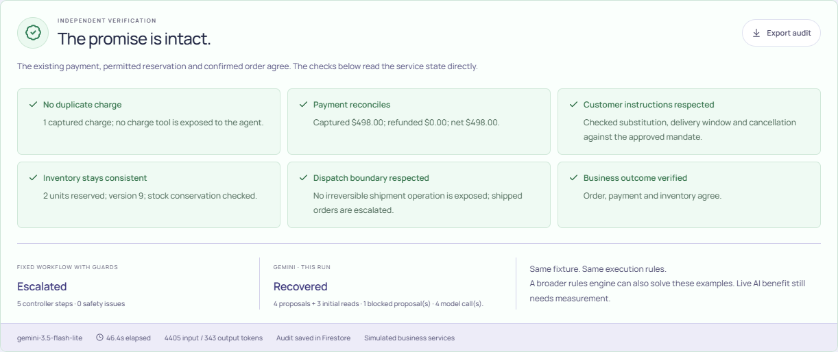
Snapshots of the prototype
Actual video run: stale stock rejected, original item recovered, audit saved in Firestore.
Gemini 3.5 Flash-Lite • 4 model proposals + 3 initial reads • 1 blocked proposal • 46.4 seconds including pacing.
10
Notes:
This is the actual custom Gemini run shown in the video. It used four Gemini proposals after three initial controller reads, rejected one stale-stock proposal, and completed six independent checks. End-to-end time was 46.4 seconds including free-tier pacing. Its audit was saved in Firestore.

Slide 11
Prototype Performance report/Benchmarking
Six reviewed synthetic scenarios, plus automated controller and interface checks.
6/6 live Gemini
83 Python tests
8 JavaScript tests
Scenario
Expected
Gemini outcome
Model calls
stock race
recovered
recovered
4
straight recovery
recovered
recovered
2
cancel order
cancelled
cancelled
3
unknown payment
escalated
escalated
1
approved substitute
recovered
recovered
2
already dispatched
escalated
escalated
1
Unknown payment and dispatched orders correctly require review. Recovery is not always the safe outcome.
Gemini 3.5 Flash-Lite • 0 safety-check failures in these runs. Development cases, not a held-out accuracy benchmark.
11
Notes:
Gemini 3.5 Flash-Lite produced the expected outcome on all six reviewed development fixtures with zero failed safety checks. Separately, 83 Python tests and eight JavaScript tests passed. These fixtures are not a held-out accuracy benchmark. The guarded fixed baseline escalates on the stock conflict; a broader deterministic planner can also solve these examples.

Slide 12
Additional Details/Future Development (if any)
Move from a controlled demonstration to a measurable customer pilot.
1 Delivery readiness
2 Customer pilot
3 Production controls
Deploy the backend to durable hosting.
Cloud Run remains pending.
Monitor availability throughout evaluation.
Use an owner's sandbox APIs with scoped authority.
Broaden instruction and incident variation.
Measure handling time and safe handoff coverage.
Service-owned idempotency and durable state.
Tenant identity, access controls and retention.
Tamper-evident records and human approval gates.
Prototype audit is inspectable, but not immutable, certified or independently attested.
12
Notes:
The immediate delivery gap is persistent backend hosting for evaluation. A customer pilot would then connect the owner's sandbox APIs under scoped authority and measure handling time, coverage, safe handoffs and cost. Production use also needs service-owned idempotency, tenant access controls, retention and tamper-evident records.

Slide 13
Provide links to your:
Public source and narrated demonstration. The current prototype link is temporary.
GitHub Public Repository
https://github.com/abhi14dodiya/workflow-rescue-sustainx
Demo Video Link (3–4 minutes)
https://gen-lang-client-0915819772.web.app/downloads/workflow-rescue-demo.mp4
Product Link — temporary preview
https://federation-php-architecture-blocked.trycloudflare.com
The current product URL is a temporary session demo, not a durable evaluation deployment.
All links must work without the evaluator signing into the team's private accounts.
13
Notes:
The source repository, 3 minute 30 second narrated demonstration and pitch materials are publicly accessible. The prototype link opens the Google Cloud Shell application through a temporary public tunnel. Its availability depends on that session; the materials portal does not make the backend durable.

Slide 14
Business value: a pilot hypothesis
Reduce the time operators spend reconstructing an incident, while making every permitted recovery inspectable.
Evidence behind the problem
ILLUSTRATIVE STAFF CAPACITY
$250k / year
Stripe webhook guidance
Stripe idempotent requests
10m orders × 1% incidents × 50% assisted
× 10 minutes saved ÷ 60 × $30/hour
Temporal sagas and compensation
Measure handling time, safe coverage and review effort in a pilot.
Hypothetical inputs; not measured savings. Gross staff capacity excludes integration, cloud and review costs.
14
Notes:
Stripe documents duplicate webhook delivery and idempotent requests, while Temporal documents partial workflows and compensation. These sources establish the engineering problem and existing controls. They do not establish product adoption, financial savings or superiority over conventional orchestration. The prototype demonstrates bounded recovery of synthetic incidents. The illustrative $250,000 annual staff-capacity figure assumes 10 million orders, one percent requiring recovery, half assisted successfully, ten minutes saved and a $30 hourly staff cost. These inputs are hypothetical and exclude integration, cloud and review costs. It is a scenario calculation, not measured savings.

Slide 15

Workflow Rescue · sustAInX
Recover the workflow.
Preserve the customer's intent.
Notes:
Workflow Rescue combines adaptive recovery proposals with explicit execution boundaries and inspectable outcomes. Its central promise is to help an authorized operations team recover the workflow while preserving the customer's reviewed permissions.

