Slide 1

Digital Grampanchayat
Submitted By:
Suraj Chechare 220943020103
Sanket Huljute 220943020038
Abhishek Varma 220943020107
Diksha Upadhyay 220943020027
Guided By:
Mrs. Snehal Somvanshi

Slide 2
Outline
Introduction
Technologies and Software used
Problem Statement
System Architecture
People Associated
Main Features of User
Main Features of Admin
Main Features of PDO
Screenshot of Flow
Conclusion & Future Scope

Slide 3
Introduction
Digital Gram Panchayat is a web application that is specially, designed to establish an environment, wherein villagers can easily communicate with the village councils. Our application features: Administrator, PDO (Panchayat Development Officer) and village public. Administrator will handle the whole website and manage the activities of users. PDO will update panchayat services, application, payments and complaints filled by public. The village public will register to the application and avail for the facilities. This post has complete information of Digital Gram Panchayat Project Documentation.
Notes:
Hive and Hive QL statements have been used for querying the data.
For future scope, various different Machine Learning algo0rithm will be implemented on different flight delay datasets.

Slide 4





Technologies and Software used
Technologies
Software
Visual Studio Code
Spring Tool Suite
For Front-End: React JS
For Back-End: Springboot
For DataBase: MySql
Notes:
Hive and Hive QL statements have been used for querying the data.
For future scope, various different Machine Learning algo0rithm will be implemented on different flight delay datasets.

Slide 5
Problem Statement
A. Analysis the Problem :
Today we have various scheme by the government which are dope manually still most of the work in gram panchayat is done on paper ,most of the document issued by gramsevak are on paper ,to store all those documents or paper are big challenge or problem for gramsevak or panchayat servants. Document and information related to the scheme related to villagers may be lost ,and the villager will have to apply again for that. These all increase the workload of gramsevak and also create problems for the villagers .By using digital gram panchayat service we can solve the problem.

Slide 6
B. Problem Definition:
Gram Panchayat office plays an important role in villagers life .Villagers mainly depend on the gram panchayat office for all the information. Gramsevak is the only person who gives the information related to scheme & documents the most of gram panchayat done their work on paper and there is time consuming process if villager wants any documents and any information related to government scheme because for these information villagers should reach gram panchayat and request to gramsevak . Government provides different schemes /services to support villagers ,under which villagers get money or equipment the information which is provided by gramsevak to the villagers there is no assurance that information is correct .villagers do not know whether scheme money or any other gram panchayat related money transfers his account or not. In the offline process there are many chances for villagers or users to get cheated by others.

Slide 7
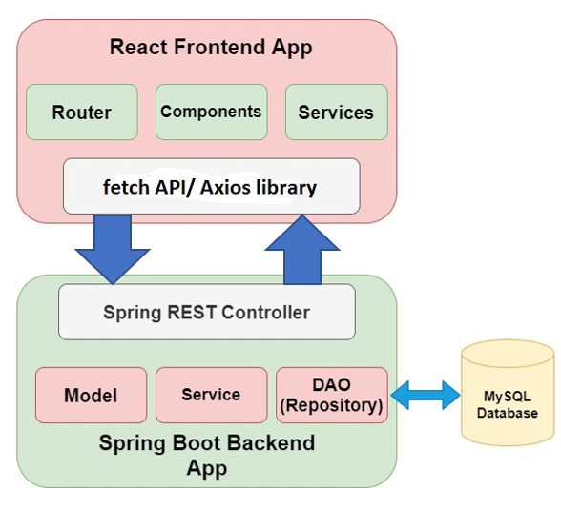
System Architecture

Slide 8
Main Features of User
• Villager can register and create his own account.
• Villager can register problems he is facing in his area.
• Villager can view his problems .
• Villager can remove his problem from listing.
• Villager can browses the schemes and apply for the same.

Slide 9



People Associated
User
Admin
PDO

Slide 10
Main Features of Admin (Gramsevak)
• Gramsevak has its own login credentials.
• Gramsevak can upload schemes.
• Gramsevak can view the uploaded schemes.
• Gramsevak can remove the scheme.
• Gramsevak can upload the problem status.
• Gramsevak can register the reports of the work done to the PDO.

Slide 11
Main Features of PDO
• PDO can upload schemes.
• PDO can view uploaded schemes.
• PDO can check reports uploaded by Gramsevak.

Slide 12
Screenshot Flow

Slide 13
Conclusion and Future Scope
Conclusion:
This web based application will be helpful to the villagers of that village; it will bring transparency, accountability, and efficiency in administration. Document and their related record will be available on this application. It helps to make administration more accountable as well as more transparent. The above survey and proposed system will help the Gram panchayat system to work efficiently. This system provides ID and password for the villager. Both analysis and evaluation results confirm that the proposed web base system can provide an effective solution for submitting the services/schemes that are useful for the villagers in online mode. This will help to minimize corruption in the system, and also save the effort and time of common man and government officers.

Slide 14
B. Future Scope:
This system has been designed keeping in mind the requirements of gram panchayat staff and enables the admin of panchayat to make entries in the database about villagers, personal details, and their related services. This system also provides him the authority to manipulate his account . we can add much more feature in the system i.e., alert system ,receive notification to user and gram panchayat staff about some action ,we can provide a transaction system in which all the money related work handled will save time and will reduce corruption. By using this system data collected from different gram panchayats will be helpful for implementing different schemes and will help in natural calamities and data can be useful in other fields.

Slide 15
Thank you for Your Attention!!!

