Slide 1


Twitter Account Analysis of Online Auto Portals in India
Abhishek kumar
Praxis Business School

Slide 2
Outline
Business Problem
Analysis of Cardekho Twitter Account
Analysis of Carwale Twitter Account
Summary & Industry Practices
Other Recommendations

Slide 3
Business Problem
Understand the tweeting patterns of Cardekho and carwale
Find Industry Best Practices
Make valuable suggestions to improve Twitter ops based on Findings

Slide 4
Analysis of Cardekho Twitter Account
@Cardekho

Slide 5
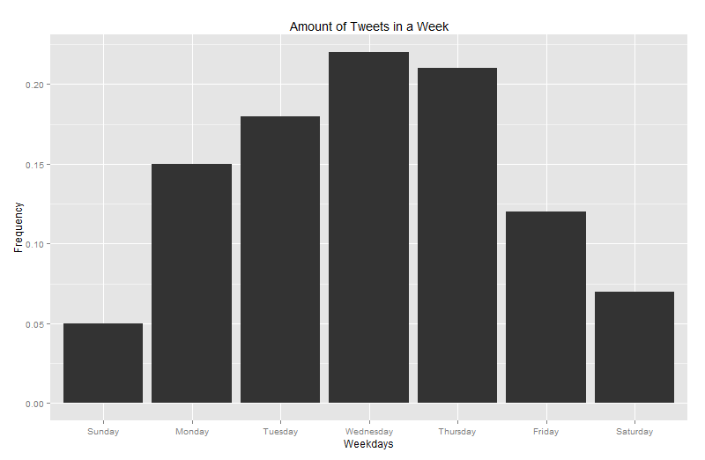
Amount of Tweets in a Week
Most tweets were made during Wednesday, Thursday, Tuesday resp.
Least tweets were made during Sunday, Saturday, Friday

Slide 6
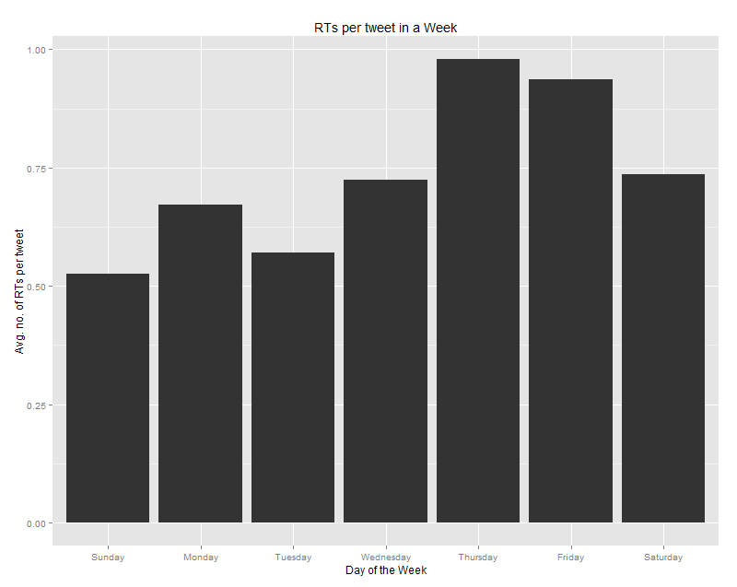
Avg. RTs per Tweet in a Week
Most RTs (for original content) received during Thursday, Friday, Saturday & Wednesday resp
Least RTs received during Sunday

Slide 7
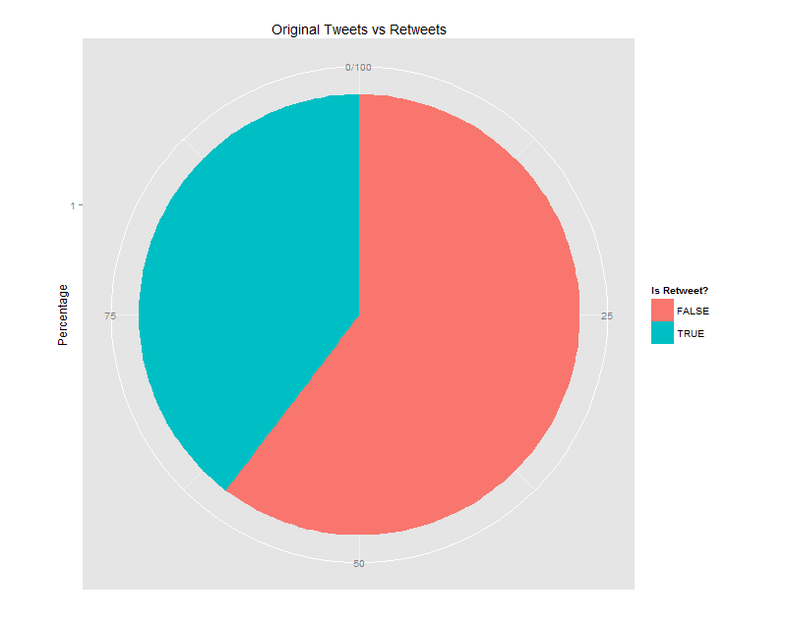
Tweets vs Retweets
Only 60% of the tweets are original tweets and the rest 40% of the tweets are RTs

Slide 8
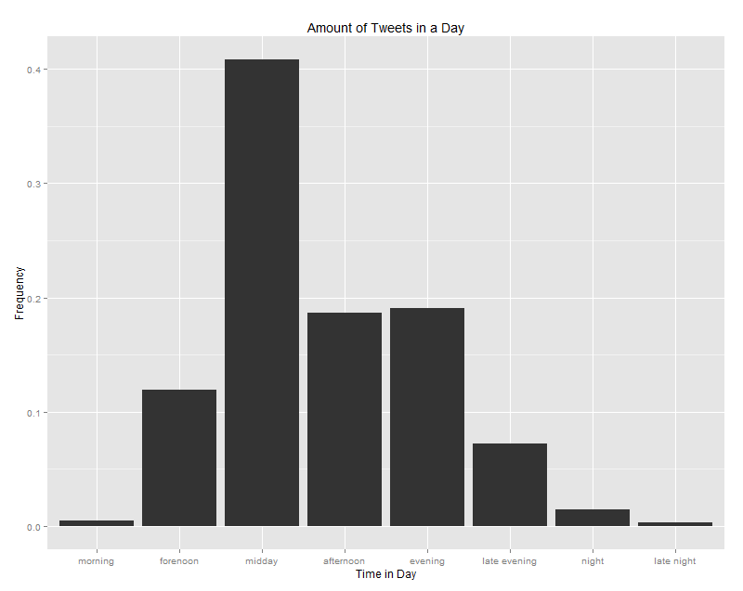
Amount of Tweets in a Day
More than 40% of tweets were made during Midday, followed by evening and afternoon (20% approx.) resp.
Morning,Night and Late night were least utilized time period
Morning(5:00-9:30), Forenoon(9:30-11:30),Midday(11:30-13:30),Afternoon(16-19),Evening(19-21),Night(21-00),Late Night(00-05)

Slide 9
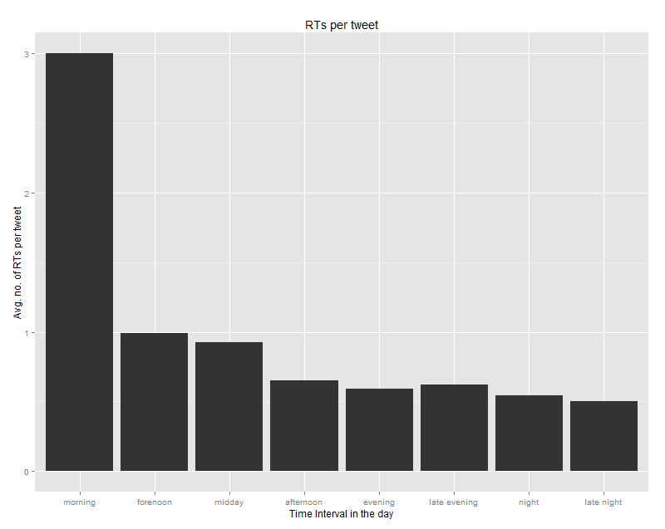
Avg. RTs per tweet in a day
Most RTs (for original content) received during for Morning Tweets than any other, followed by Forenoon and Midday
Late Night tweets received the least no. of RTs.
Morning(5:00-9:30), Forenoon(9:30-11:30),Midday(11:30-13:30),Afternoon(16-19),Evening(19-21),Night(21-00),Late Night(00-05)

Slide 10
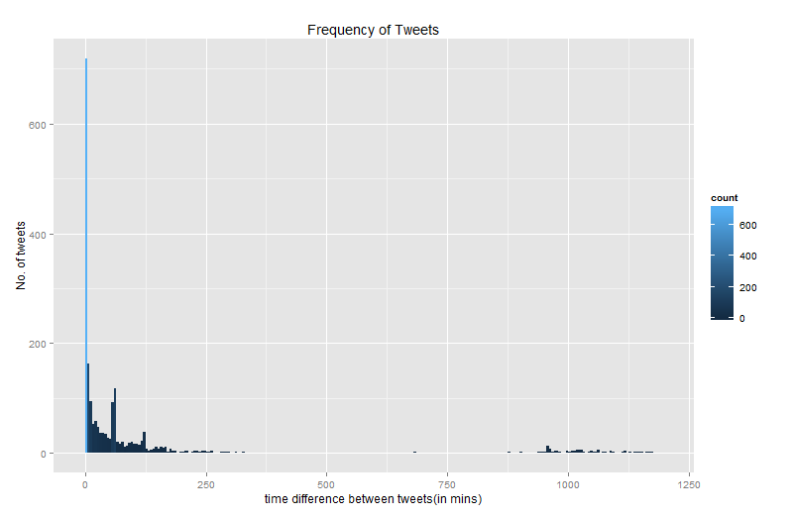
Tweet Frequency in a day (24 hrs timeframe)
Some tweets were made almost 13 hrs after the previous tweet.

Slide 11
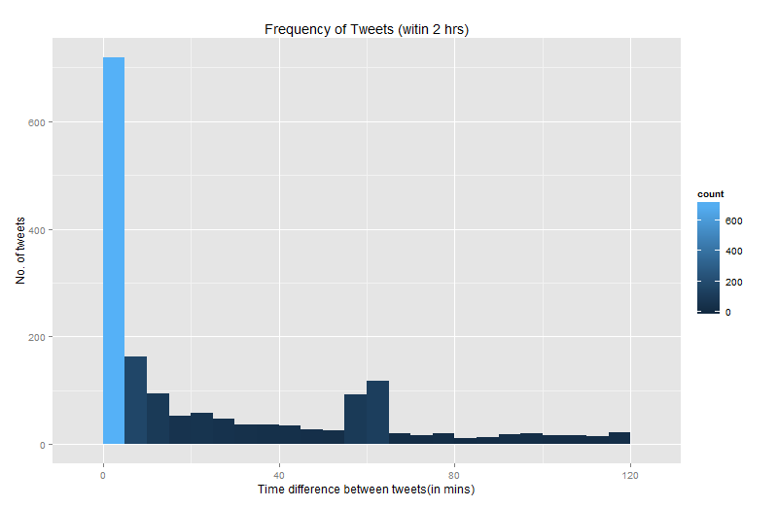
Tweet Frequency in a day (2 hrs timeframe)
Very high number of tweets were made within 10 minutes of the previous tweet

Slide 12
Analysis of Carwale Twitter Account
@Carwale

Slide 13
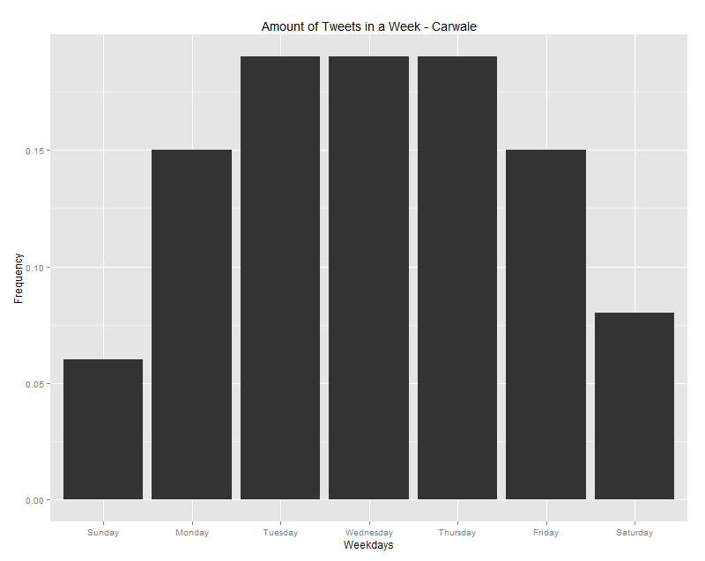
Amount of Tweets in a Week
Almost equal no. of tweets were made during Tuesday, Wednesday and Thursday
Least tweets were made during Sunday and Saturday

Slide 14
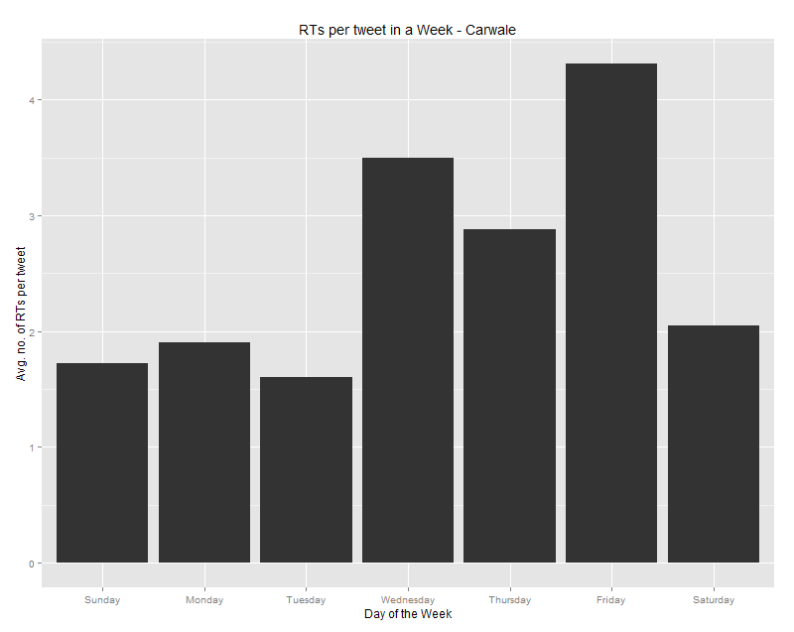
Avg. RTs per Tweet in a Week
Most RTs received during Friday, Wednesday, Thursday resp.
Least RTs received during Tuesday, Sunday, Monday

Slide 15
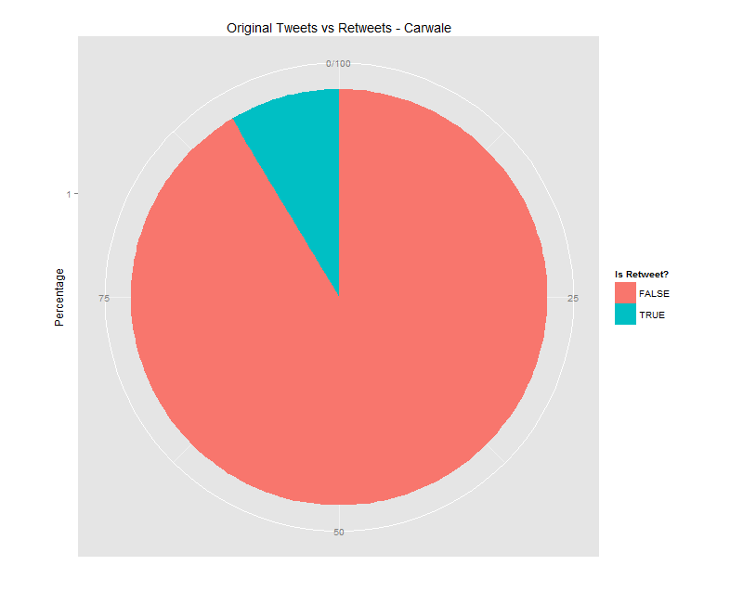
Tweets vs Retweets
Only 8.5% of the tweets are RTs and the rest 91.5% of the tweets are Original

Slide 16
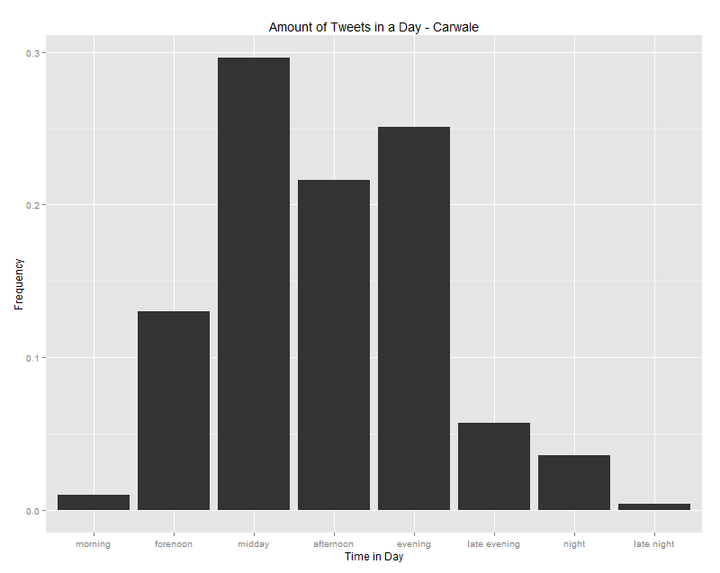
Amount of Tweets in a Day
Around 30% of tweets were made during Midday, followed by evening and afternoon.
Morning, Late night and Night were least utilized time period
Morning(5:00-9:30), Forenoon(9:30-11:30),Midday(11:30-13:30),Afternoon(16-19),Evening(19-21),Night(21-00),Late Night(00-05)

Slide 17
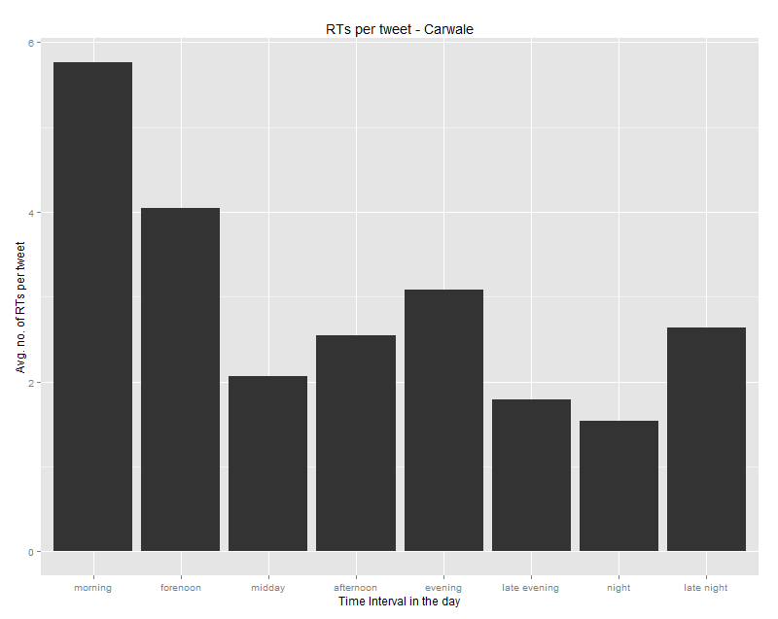
Avg. RTs per tweet in a day
Morning tweets received more RTs than any other, followed by Forenoon and Evening
Night tweets received the least (more than 1) no. of RTs.
Morning(5:00-9:30), Forenoon(9:30-11:30),Midday(11:30-13:30),Afternoon(16-19),Evening(19-21),Night(21-00),Late Night(00-05)

Slide 18
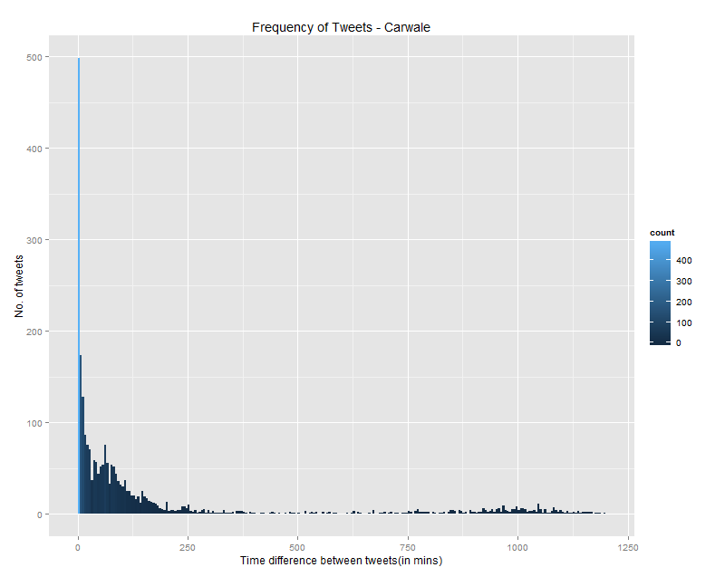
Tweet Frequency in a day (24 hrs timeframe)
A significant amount of tweets were made almost14 hrs after the previous tweet.

Slide 19
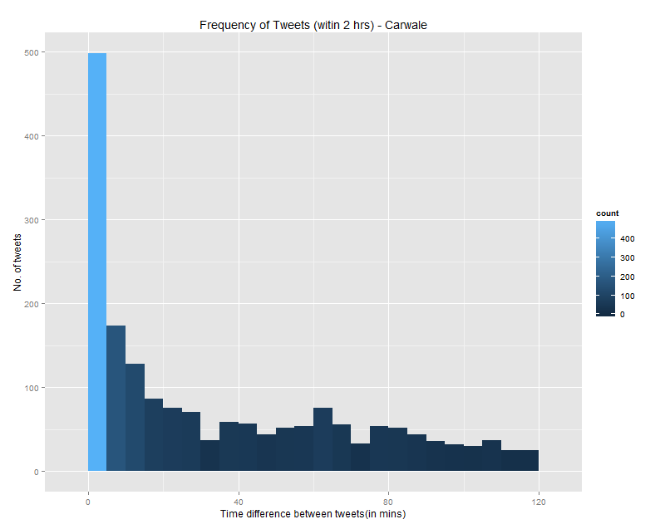
Tweet Frequency in a day (2 hrs timeframe)
Huge number of tweets were made within 5 minutes of the previous tweet

Slide 20
Summary of Analysis
RT vs Tweet proportion:
Cardekho’s proportion is not so balanced and have to be fixed. Original contents are much appreciated
Best Day:
Thursday & Friday are the two best days for more tweets
Tweets during weekends have to be increased as they get more RTs per tweets

Slide 21
Summary of Analysis
Best Time:
Morning tweets get more RTs hence more original content has to be tweeted during that time
Forenoon, and Night tweets get decent engagement for both Cardekho and competition hence tweets during those period must be increased
Tweet Frequency:
Time gap between two tweets is not well managed both by Cardekho and competition
Except in situations like Product Launch or Live Blogging, two tweets should never be tweeted within 30 minutes

Slide 22
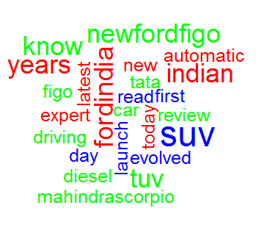
Summary of Analysis
Top RTed Tweets Wordcloud
Best Content:
New/Latest Cars
Modern Cars (SUV,Sports)
Launch
Expert Review
Supporting a cause like #MakeinIndia

Slide 23
Industry Practices
Upto 14 tweets per day is good as number of tweets are highly correlated with number of RTs received (Cardekho’s avg tweets per day is 5.5)
‘Back to Work’ and ‘Happy Weekend’ – themed tweets at right time perform well
Tweets with GIF, Vine or Video perform well than a standard link/image tweet

