Slide 1
Vault

Slide 2
What is Vault?
Vault is a tool for securely storing / accessing secrets.
A secret is anything that you want to tightly control access to, such as API keys, passwords, or certificates.
Vault provides a unified interface to any secret, while providing tight access control and recording a detailed audit log.
Provides access to a multitude of secrets.
Provides key rolling, secure storage, encryption policies, Integration and detailed audit logs.
Provides database credentials, API keys for external services, credentials for service-oriented systems, containerized services,etc

Slide 3
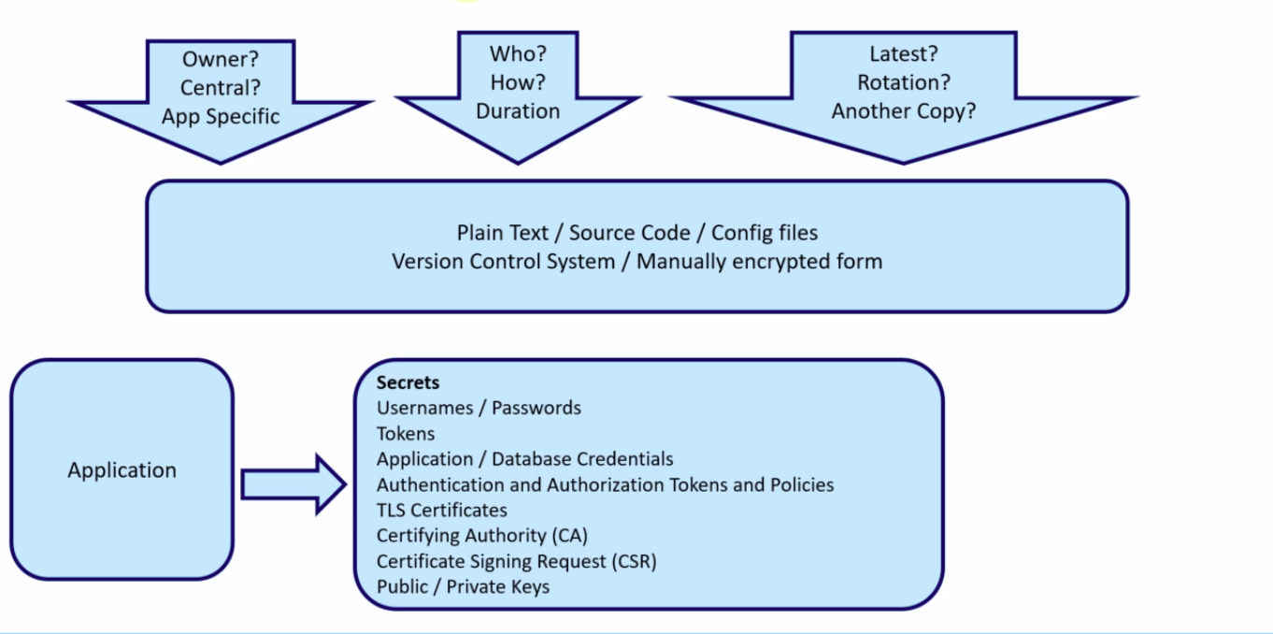

Slide 4
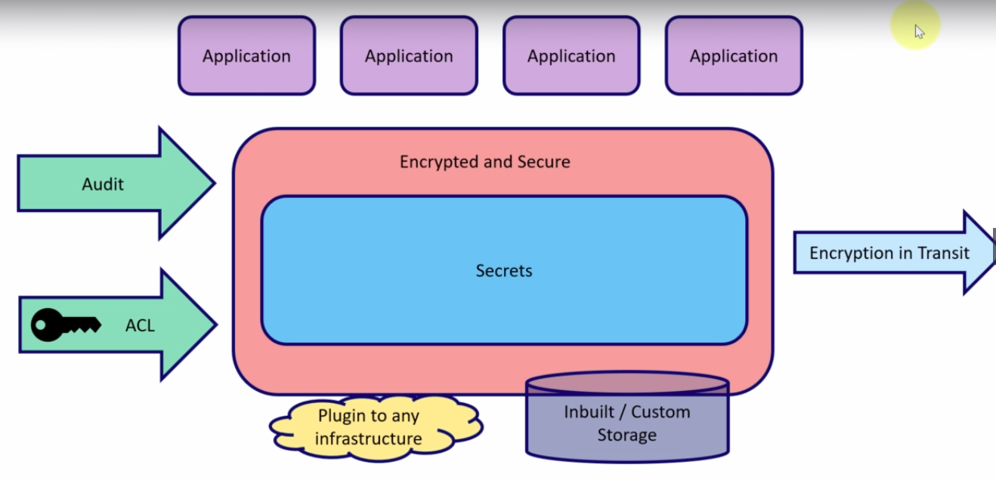

Slide 5
Key Features of Vault
Secure Secret Storage - Arbitrary key/value secrets can be stored in Vault after encryption
Dynamic secrets – Vault can generate secrets on demand. Provides with a lease period
Data Encryption – Vault can encrypt and decrypt data as service
Leasing and Renewal – All secrets in vault have a lease associated with them.Vault will automatically revoke at the end of the lease. Leases can be renewed as well.
Revocation – Vault can revoke not only single secrets, but a tree of secrets. Revocation assists in key rolling as well as locking down systems in the case of an intrusion.

Slide 6
Vault Server
“Dev Mode”
The Dev server is a built-in, preconfigured server
Useful for local development, testing, and exploration
Not very secure
Everything is stored in-memory
Vault is initialized by default and automatically unsealed

Slide 7
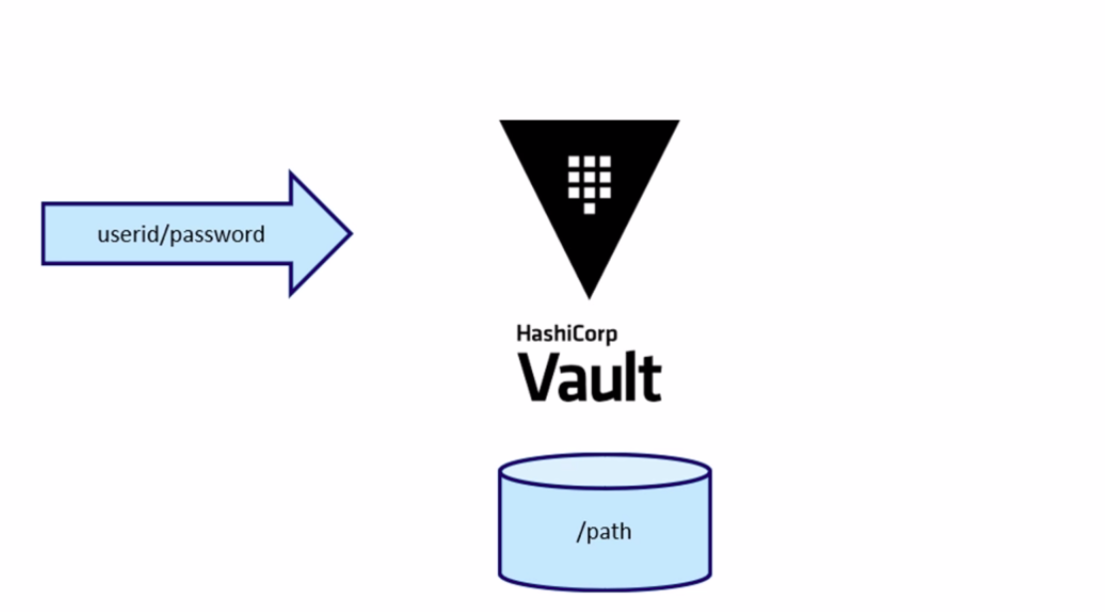
Key Value Secret Engine

Slide 8
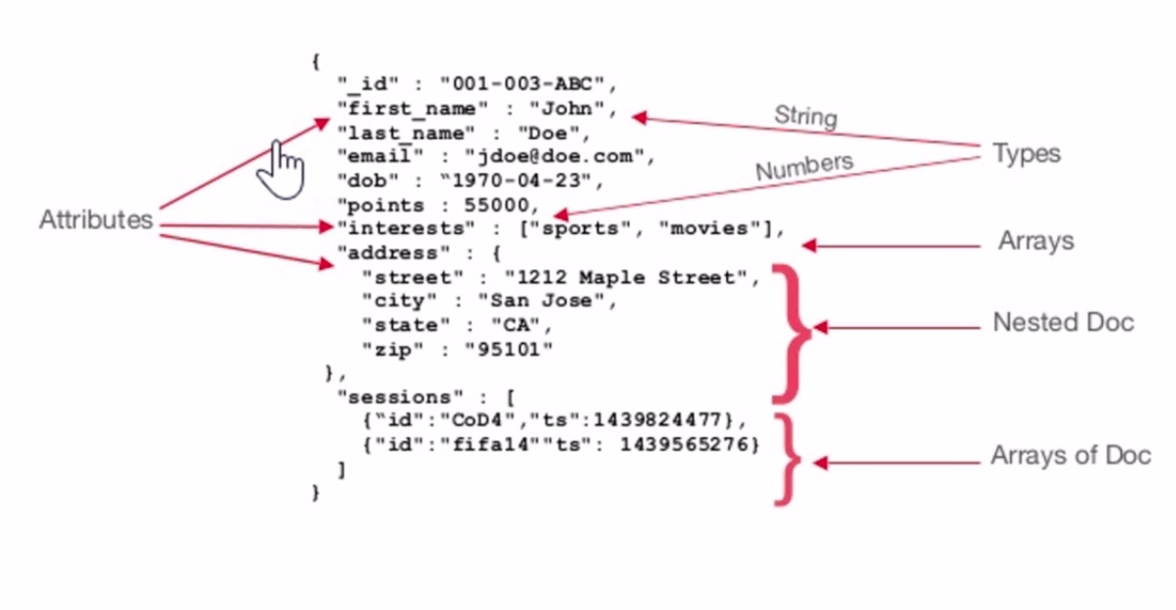

Slide 9
KV Secrets Engine
KV Version 1 (kv)
Only the most recently written value for a key will be preserved
The benefits of non-versioned kv is a reduced storage size
For each key since no additional metadata or history is stored
Performance will be better. There will be fewer storage calls and no locking

Slide 10
KV Secrets Engine
KV Version 2 (kv-v2)
Key can retain a configurable number of versions
This defaults to 10 versions
The older versions’ metadata and data can be retrieved
Check-and-set operations can be used to avoid overwriting data unintentionally.
When a version is deleted the underlying data is not removed, rather it is marked as deleted
Deleted versions can be undeleted
All versions and metadata for a key can be deleted by deleting on the metadata command
Each of these operations can be ACL’
Restrictions can be added on who has permissions to soft delete, undelete, or fully remove data.

Slide 11
Configuration file
Uses HCL(HashiCorp Configuration File) or JSON
Will be used to start the vault
“vault server -config <location>
Can be stored anywhere. As standard will be part of /etc/vault.d/vault.hcl
Has 2 major components Stanzas and Parameters

Slide 12
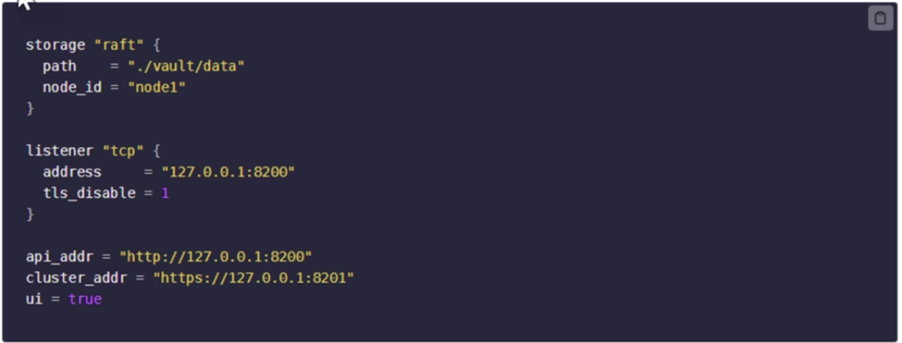

Slide 13
Initialize Vault Operator
Initialization is the process by which Vault‘s storage backend is prepared to recieve data
Vault generates an in-memory master key and applies Shamir‘s secret sharing algorithm
Master key is diassembled into a configuration number of key shares
These unseal keys will be distributed and used to unseal the vault

Slide 14
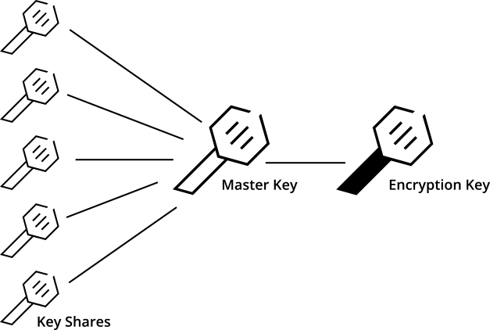
Seal/Unseal
Every initialized vault server starts in the sealed state
When the Vault is initialized it generates an encryption key which is used to protect all the data
That key is protected by a master key
By default, Vault uses a technique known as Shamir's secret sharing algorithm to split the master key into 5 shares, any 3 of which are required to reconstruct the master key
Unsealing is the process of getting access to the master key

Slide 15
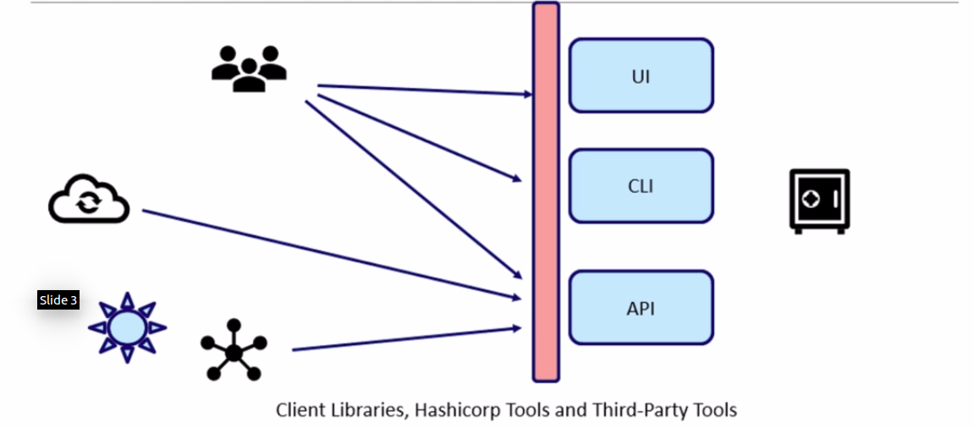
Accessing the Vault

Slide 16
API Access
Vault HTTP API gives full access to Vault via HTTP
Vault CLI uses the HTTP API to access Vault
All API routes are prefixed with /v1/
Provides access to
Secret engine
Authentication and Authorization
System backend

Slide 17
HTTP Headers
X-Vault-Token – Authorization
X-Vault-Namespace – Access a specific namespace
Content-Type - Eg: application/json – To set the content type of the request

Slide 18
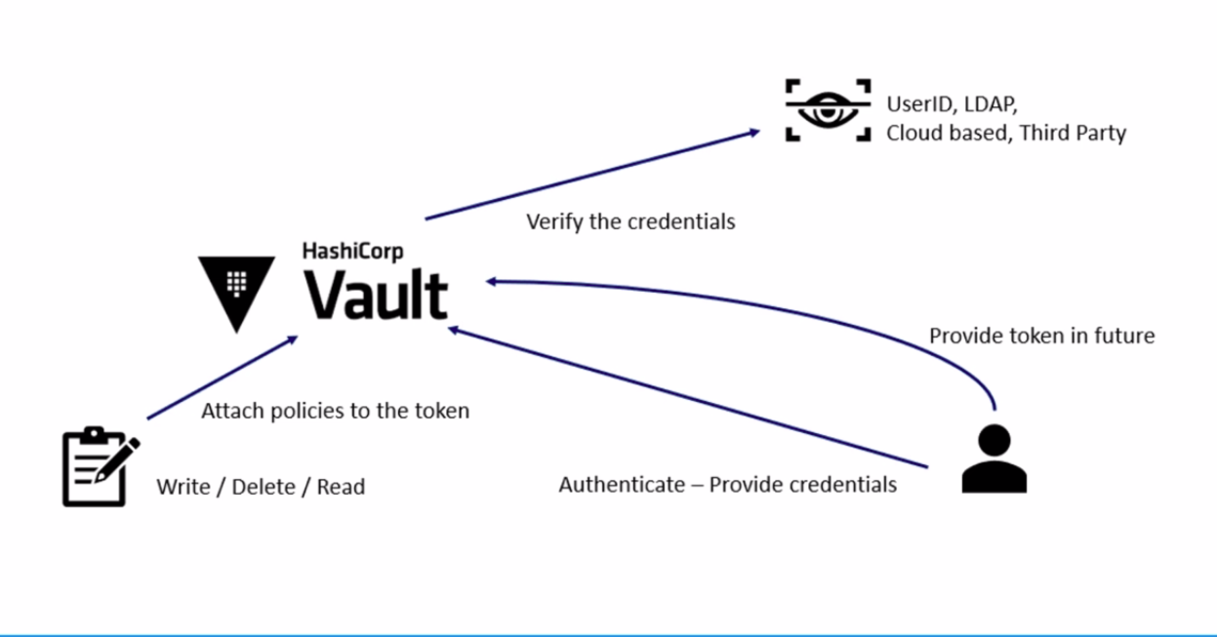
Authentication Authorization overview

Slide 19
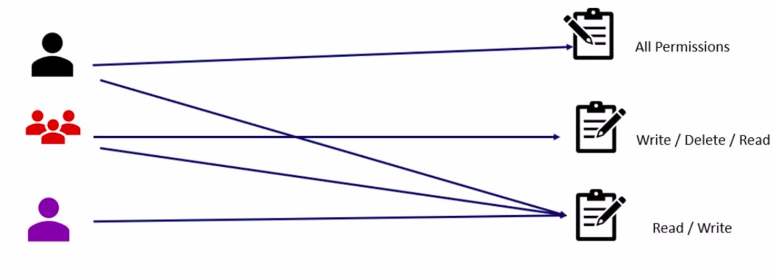
Role Based Access Policy(RBAC)

Slide 20
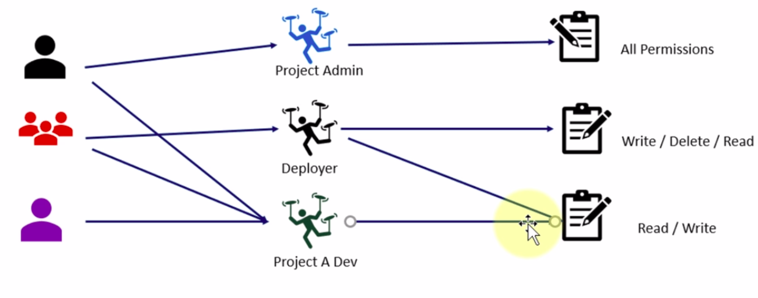
Role Based Access Policy(RBAC)

Slide 21
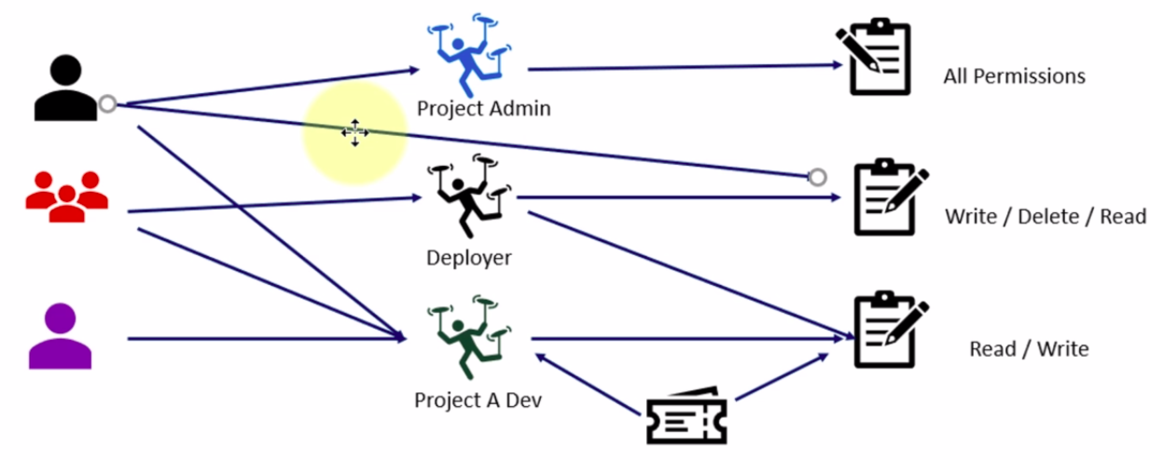
Role Based Access Policy(RBAC)

Slide 22
Policies
Policies to govern the behavior of clients and instrument Role-Based Access Control(RBAC)
RBAC are provided by specifying access privileges(authorization)
Initialize vault – the root policy gets created by default
Root policy is a special policy that gives superuser access to everything in Vault
Root policy allows the superuser to set up the initial policies, auth methods, etc.
Another built-in policy, default, also gets created
The default policy is attached to all tokens and provides common permissions
Everything in vault is path based, and admins write policied to grant or forbid access to certain paths and operations in Vault.
Vault operates on a secure by default standard, and as such, an empty policy grants no permissions in the system.

Slide 23
Policies in HCL format
path “<PATH>“{
capabilities = [“<LIST_OF_CAPABILITES>“]
}
The path can have a wildcard(“*“) at the end or “+“ for a single directory
“secret/training_*“ matches path starting with ‘secret/training_“
“secret/app/+/stage matches “secret/app/ver1/stage“,“secret/app/ver2/stage“

Slide 24
Example
path “mysecretpath/data/*“{
capabilities = [“create“,“update“]
}
path “mysecretpath/data/forviewonly“{
capablities = [“read“]
}

Slide 25
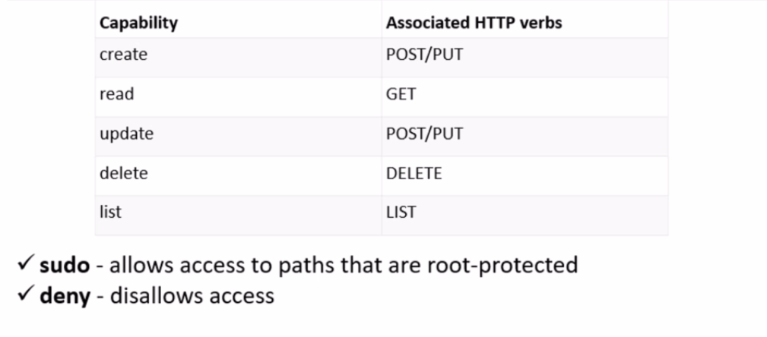
Capabilities

Slide 26
Tokens
Types
Service Token - Persisted
Batch Token - Not Persisted(generated as blob)
Token Store - Responsible for creating and storing tokens
Root token
Initial token generated during init operation
Can be generated using init, by another root token, generate root operator
Never expires
It has root policy attached to it

Slide 27
Token Hierarchies and Orphan Tokens
Tokens are created as childrens of the original token
When a parent token is revoked, all of its child token(along with their lease)
Orphan tokens have no parent
Orphan tokens are root of their parent tree

Slide 28
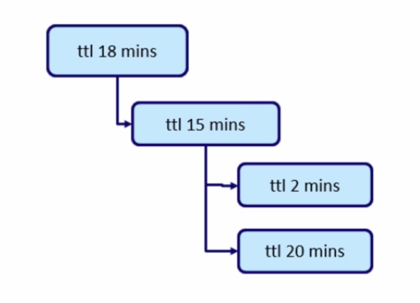
Token Hierarchies

Slide 29
Token Accessors
Accessor is a value that acts as a reference to a token and can only be used to perform limited actions
Look up a token’s properties
Look up a token’s capabilities on a path
Renew the token
Revoke the token

Slide 30
Time To Live(TTLs)
Time-to-live(TTL) - current period of validity since either the token’s creation time or last renewal time
Root token ttl will be 0 (Never expires)
If the token is renewable, token can be renewed and the TTL will be set accordingly
Default max TTL is 32 days

Slide 31
Periodic Token
At every renewal time, the TTL will be reset back to this configured period. Have a TTL(Validity period), but no max TTL
As long as the token is successfully renewed, it will never expire
Generally used by the systems. Useful for long running services that cannot handle regenerating a token
Active systems keeps renewing on regular interval

Slide 32
Batch Tokens
Batch tokens are encrypted blobs that carry enough information within itself
Batch token cannot be a root token, cannot create child token, cannot renew, cannot be a periodic token, will not have accessor
Gives better performance and scales better
No storage cost

Slide 33
Audit Devices
Audit devices are the components in Vault
Keeps a detailed log of all requests and response to Vault
Audit log contains every authenticated interaction with Vault, including errors
Multiple audit devices can be enabled
By default, all the sensitive information is first hashed before logging in the audit logs.
Audit logs contain the full request and response objects for every interaction with Vault.

