Slide 1


Project Presentation on
Bullseye Detection
by Akshat Goel

Slide 2
Project Problem Statement
To use CV to detect a red and white bullseye image

Slide 3
Initial approaches to the PS
Manually collected some bullseye images on the web (around 120 images).
Annotated them using web-software CVAT.
Wrote the code to train the model on the images. However, the model was not working properly - maybe due to the smaller number of images the model was trained on.

Slide 4
Later...
Discovered Roboflow: a website containing open-source image datasets for machine learning
Found the required dataset consisting of 799 red and white bullseye images. Added my collected images to it.
Augmented the final image dataset using roboflow to give about 2200 images.

Slide 5
Results
Used this dataset to train my model on three epochs, with training metrics registering a high accuracy of 0.995.
My model successfully detected red and white bullseye images and even rejected images containing blue and white bullseyes.
Training on a larger number of epochs would make the model even better.

Slide 6
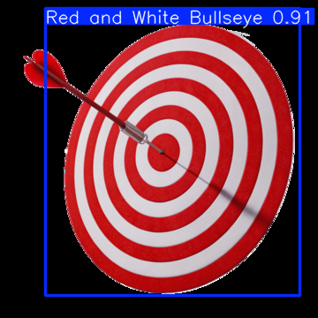
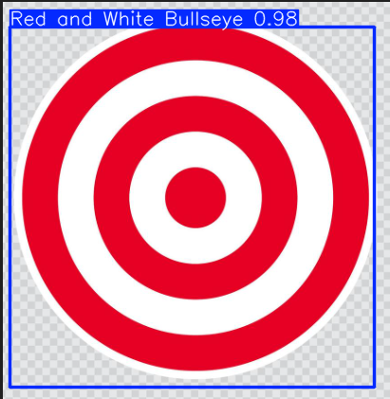

Results
Detected✅
Detected✅
Not-Detected❌

Slide 7
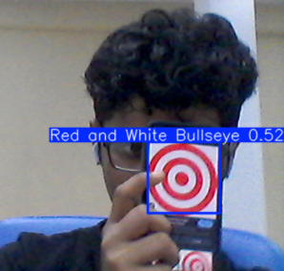
Live- feed detection
Implemented live-feed detection of bullseyes at about 0.6m from the laptop webcam.

Slide 8
Learnings from the project
Learnt how to annotate an image dataset using CVAT.
Learnt how to train YOLO on an image datadet to detect required images.
Implemented the model on to detect bullseye on images and livestream.

Slide 9
Thank You!

