Slide 1

Deep Asteroid

Slide 2
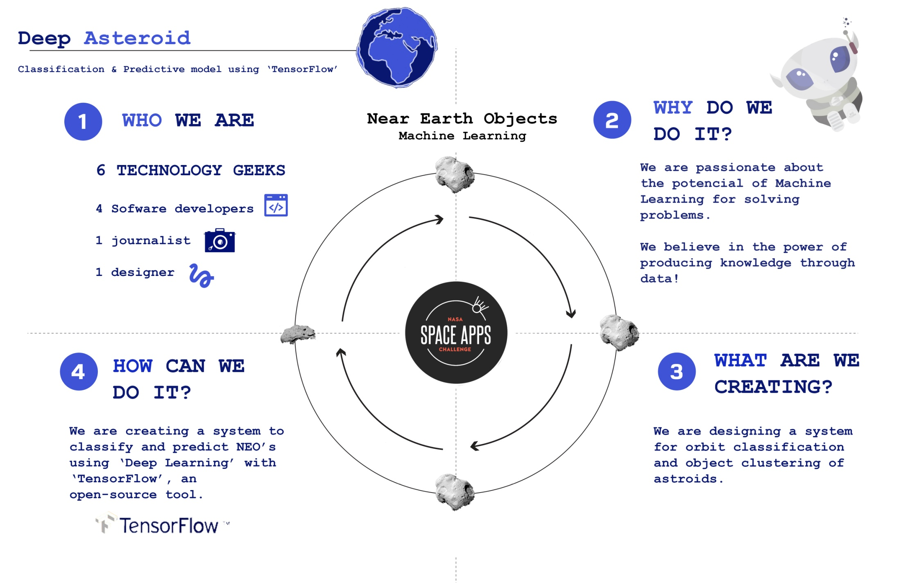

Slide 3
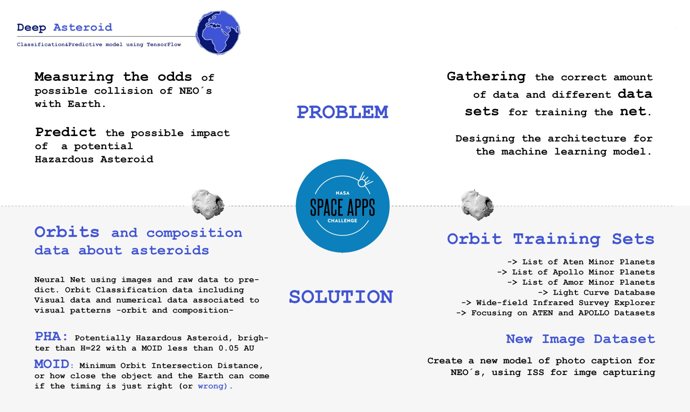

Slide 4
