Slide 1

CERTIFAKE

Slide 2
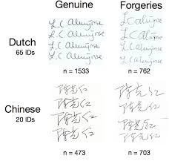
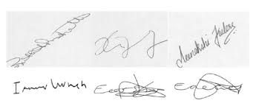
WHATS THE SYSTEM ABOUT ?
Certifake is a system which basically detects any illegal or forged document through Digital Image Processing and Deep Learning

Slide 3
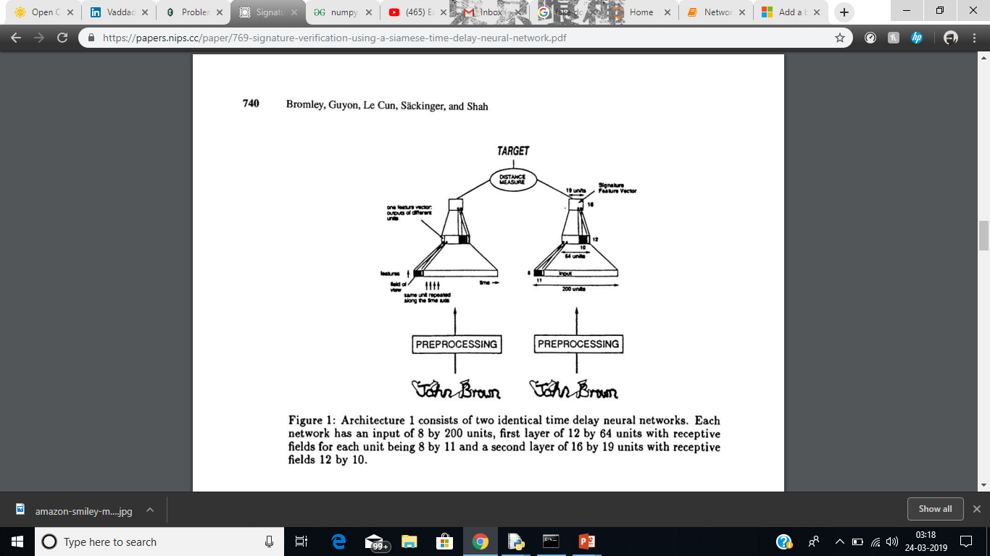
WORKING OF THE SYSTEM
The Working of the system is divided into 2 modules :
Fake Signature Detection
Tampered Pixels detection which have been Photoshoped
FAKE SIGNATURE DETECTION
Datasets consisting of forged signatures and
genuine signatures are pre-processed and passed
through Siamese Network
One shot Prediction is expected with high accuracy

Slide 4
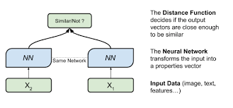
DETECTION OF TAMPERED PIXELS :
Here a fake image is scanned and passed through the Siamese network
Distance function is computed between the input image and pre –trained data .
If the Distance function is greater than threshold , Pixels are tampered and Certificate is “Forged”
Else the Certificate is genuine

Slide 5
Why Siamese Model ? 1. The Dataset used is of a small scale. 2. Two identical subnetworks are used to process the two inputs, and another module will take their outputs and produce the final output. 3. Sharing weights across subnetworks means fewer parameters to train for, which in turn means less data required and less tendency to overfit.

Slide 6
