Slide 1
ANALYZE THE CHINOOK MUSIC STORE DATA BASE

Slide 2
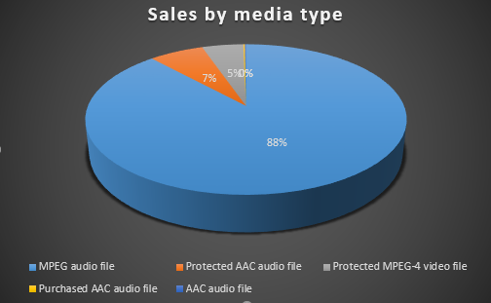
Q1.What are the total sales by media type?
We can see that MPEG has the most sales according to the media type sales it has 88% of total sales.
MPEG is used mostly because most of the devices offers support playback for this media type.
As we can see that AAC has only 7% of sales but it offers better quality and it is default for the Apple.

Slide 3
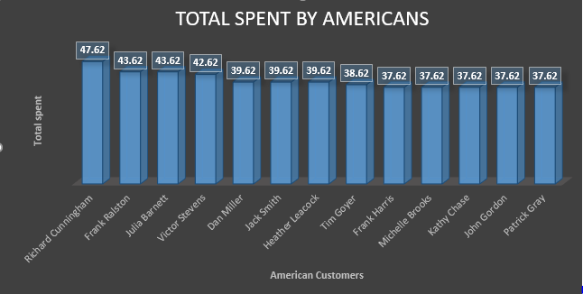
Q2.How much did Americans spent total?
We can observe that Richard Cunningham has spent maximum in America in total American sales.
According to the chart other people than Richard also has spent same as of him .
Total spent by American average of 40.23 which is good amongst other countries.

Slide 4
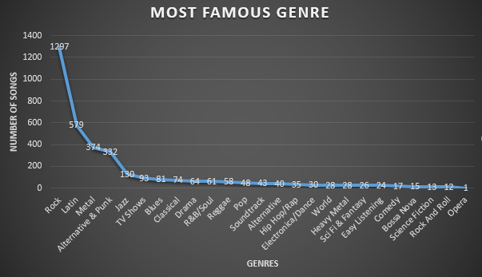
Q3.How many songs produced per genre? And most famous genre amongst others?
The most popular genre is Rock. From char we can see that 1297 song were produced in this genre.
After Rock Latin, Metal and then Alternative & Punk has popularity in producing songs.
So to increase the sales producers should make more song according to this genre chart.

Slide 5
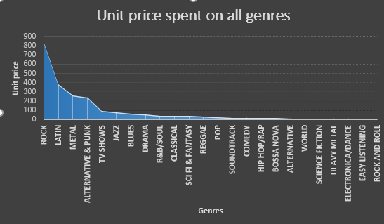
Q4.How much spent overall on all genres?
From earlier slides we already know that Rock genre is most famous amongst other genres for producing the songs.
In this slide also we can observe that rock has most unit price spent on to produce music.

Slide 6
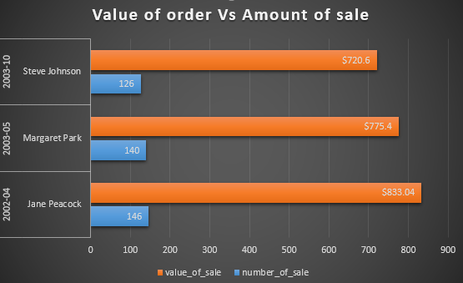
Q5. Which agent has most sales?
Jane has the most sales of 833.04$ compared to Steve and Margaret.
Steve and Margaret has almost same sales, but Steve is most junior but made least sales compared to other.
The managers should use the Jane’s selling strategy to get more sales.

