Slide 1

MACHINE LEARNING APPLIED TO DRUG-RESISTANCE PREDICTION FOR MYCOBACTERIUM TUBERCULOSIS IN HIGH-TB BURDEN COUNTRIES
A presentation submitted in fulfilment of the requirements for the award of the degree of MASTER OF SCIENCE IN DATA SCIENCE
Abhinav Sharma
A.Sharma@2020.ljmu.ac.uk
abhi18av@outlook.com

Slide 2
1. INTRODUCTION-1
TB is an infectious disease affecting millions of individuals globally, every year.
WHO has set the year 2035 as the target for its “End TB” strategy.
The rise of drug resistance in MTB is a major threat.
The traditional gold standard test takes weeks for profiling a clinical sample.
Ineffective drug regimen and delayed drug resistance profile worsens the problem of DR-TB.

Slide 3
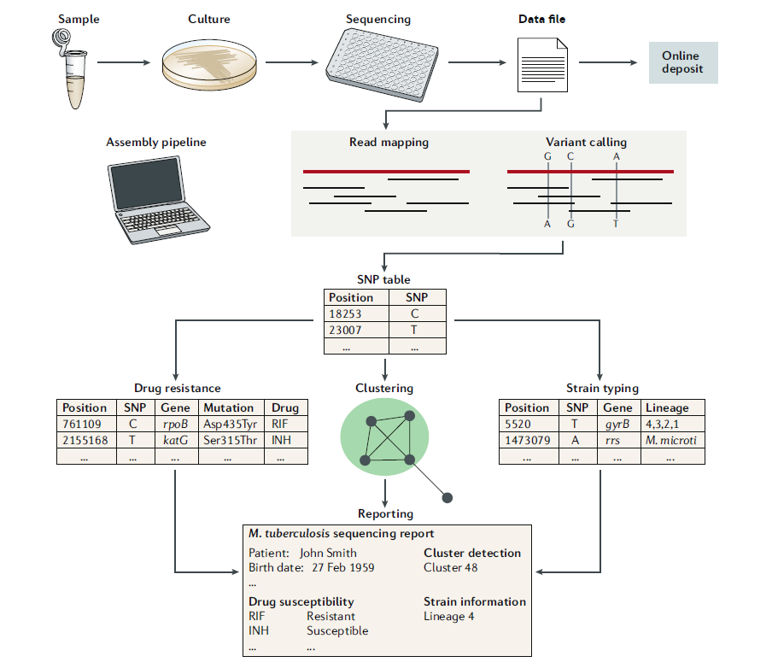
1. INTRODUCTION-2
Modern genome sequencing has revolutionized life sciences.
Once the sample is sequenced, it can be used for multiple studies.
The sequencing is relatively cheaper and shows promise as foundation of predicting drug-resistance profile.
Successful sequencing based DRP can allow low-income countries to directly switch to this mode of testing.

Slide 4
2. PROBLEM STATEMENT-1
The direct association technique relies on pre-documented resistance-conferring mutations.
The discovery of new resistance-conferring mutations is a slow process.
The biological factors which can confer resistance is still not understood exhaustively.
Machine learning offers a way to algorithmically discover new relationships and determine drug resistance profile.

Slide 5
2. PROBLEM STATEMENT-2
Different classes of ML algorithms model dependent and independent mutations differently.
It is worth exploring the Stacked Ensemble technique which combines heterogenous algorithms together.

Slide 6
3. AIM AND OBJECTIVES
• To compare the various algorithms used in state-of-the-art techniques for DRP of clinical MTB isolates.
• To propose a suitable and clinically applicable ensemble algorithm for DST profiling.

Slide 7
4. LITERATURE REVIEW-1
Reference | Algorithm common to the present study | Metric | Remarks | Sample size
Yang et al. (2018) | Logistic Regression; Random Forest | AUC: 0.97; 0.97 | RIF resistance; Loci-oriented; Known mutations | 1,839
Chen et al. (2019) | Multilayer Perceptron; Logistic Regression; Random Forest Classifiers | AUC: 0.994; 0.994; 0.986 | RIF resistance; Loci-oriented; Known mutations | 3,601
Jamal et al. (2019) | Naïve bayes; Artificial Neural Network | AUC: 0.92; 0.99 | rpoB gene; RIF resistance; Structural features; Known mutations | 754
Carter et al. (2019) | Linear Regression; Neural Network | AUC: 0.89; 0.885 | PZA resistance; Structural features; Known mutations | 33,087
Deelder et al. (2019) | Linear Regression; Gradient Boosted Tree | AUC: 0.953 ;0.951 | RIF resistance; Known mutations for LR; Genome wide SNPs for GBT | 16,688
Chowdhury et al. (2019) | Base learners: GLM, C5.0, SVM; Meta-learner: GLM | Accuracy: 0.8125 | CAP resistance; Protein sequences; Stacked ensemble | 8,777
Kouchaki et al. (2018) | Logistic Regression; Random Forest; Gradient Boosted Tree | AUC: 0.9796; 0.9767; 0.9771 | RIF resistance; Known mutations | 13,402
Kouchaki et al. (2020) | Single-label Random Forests | AUC: 0.9384 | RIF resistance; Known mutations | 13,402

Slide 8
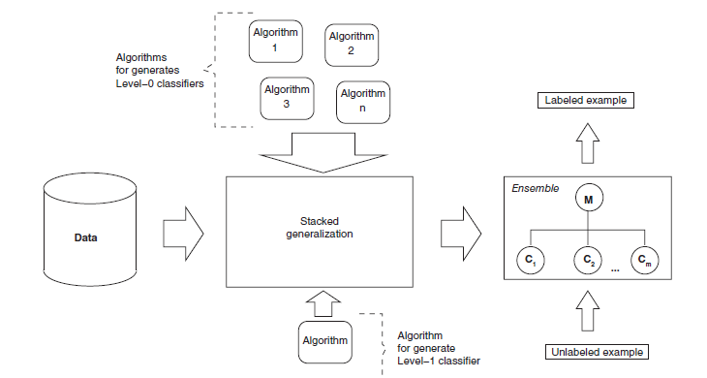
4. LITERATURE REVIEW-2
Stacked ensembles can combine multiple heterogenous base-learners using a meta-learner algorithm.
These models can achieve performance, at least as good as the best base learner.
STEN models have been favorably applied in multiple domains already.

Slide 9
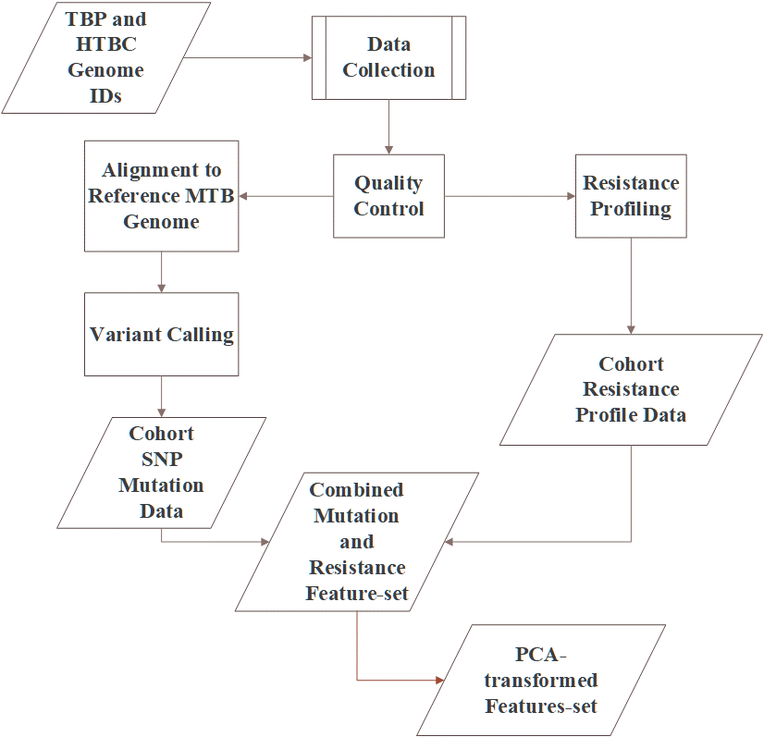
5. METHODOLOGY-1
Before ML algorithms could be applied, genomic pre-processing is necessary to find the mutation data.
The mutation data for the cohort was merged with the cohort resistance profile.
The resultant large, sparse matrix was then binarized to form the first feature-set for ML.
Feature-set 1 was transformed into reduced feature-set 2 using PCA.
The datasets were split with HTBC as validation data and TBP as training data.

Slide 10
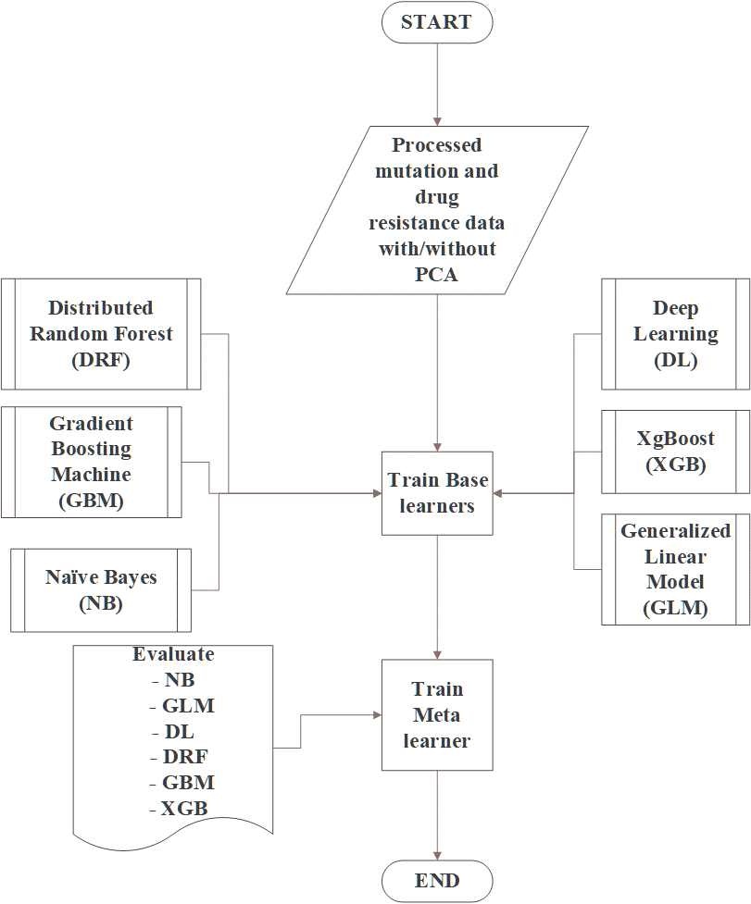
5. METHODOLOGY-2
Models were trained using cross-validation on training data.
A grid search was conducted to find the best model from each class of algorithms.
The top-performer were used as meta-learner algorithms as well.

Slide 11
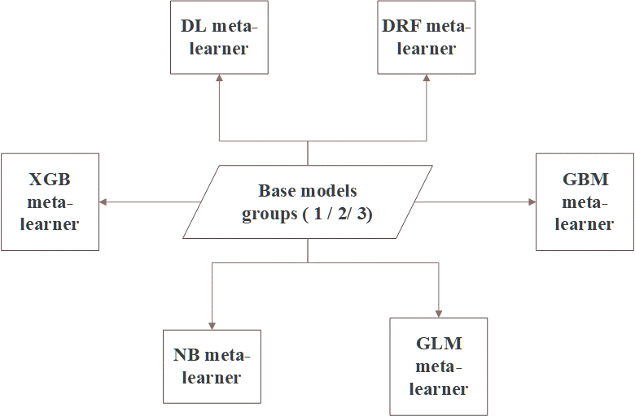
5. METHODOLOGY-3
To find minimal effective base models, the base models were divided into three groups: Base_1, Base_2 and Base_3.
Base_1 had all of the base learners, Base_3 only had 3 base learners.
The performance metrics for AUC, accuracy and training time were collected for all the models.

Slide 12
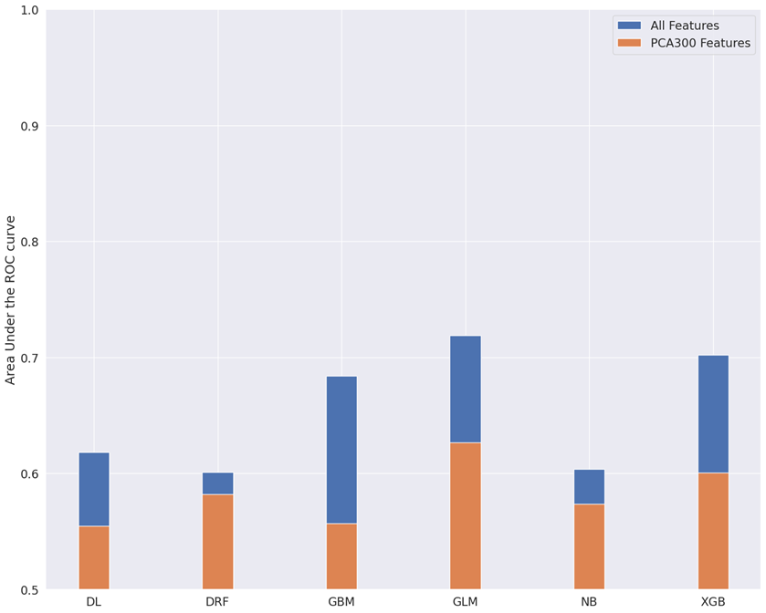
6. RESULTS-1
GLM and XGB are the top performing base learners.
All models performed better on feature-set 1 as compared to the PCA transformed features.

Slide 13
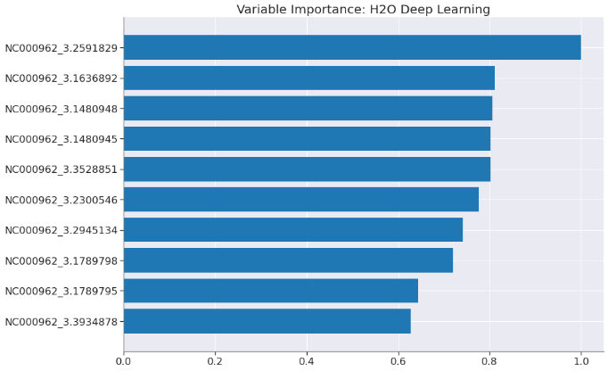
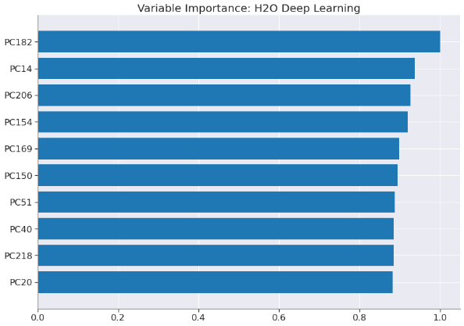
6. RESULTS-2
The benefit of PCA transformation is reduction in training time, however it obscures the biological interpretation.

Slide 14
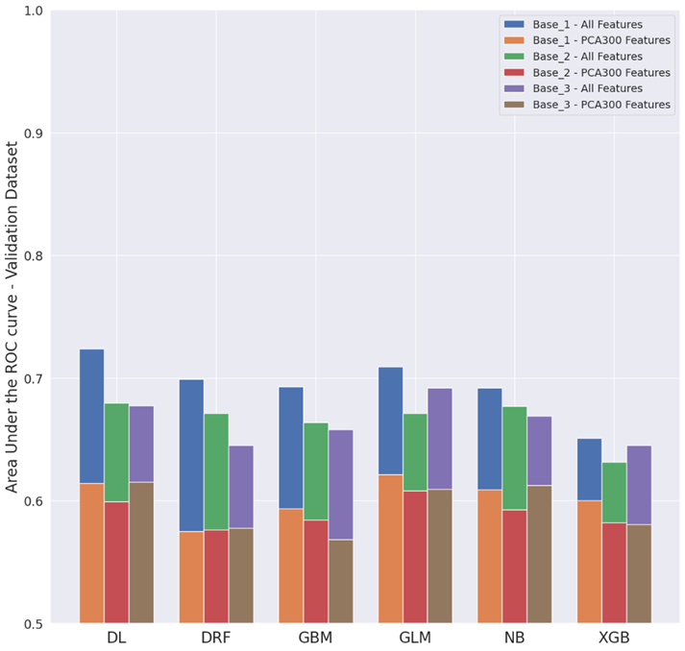
6. RESULTS-3
Compared to Base_1 STEN models, STEN models with Base_3 group didn’t display a significant fall in performance.
DL and GLM were the top-performing meta-learners, followed closely by tree-based models such as DRF, GBM and XGB
The performance of STEN with GLM meta-learner even improved with Base_3 group.

Slide 15
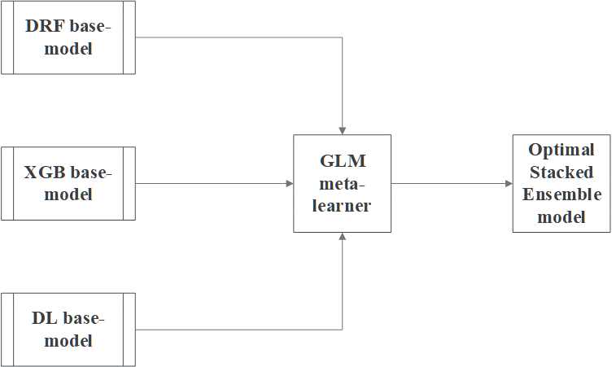
7. CONCLUSIONS AND RECOMMENDATIONS
Out of all the base learners DRF, XGB and DL were well suited as foundation for the STEN model.
The optimal STEN model can be constructed linear GLM model as a meta-learner.
It is recommended that future studies should apply a more biologically informed feature engineering technique.

Slide 16
Thank you!
The accompanying video recording for this presentation can be downloaded from this public onedrive folder.

