Slide 1




Drug Resistance Prediction using WGS data
Hackathon Attendee Name (Abhinav Sharma)
Institution (Liverpool John Moores University)
Notes:
Project Repository: https://github.com/abhi18av/drug-resistance-prediction-cambiohack

Slide 2
About the Project and the Team
The project is vital towards the rapid identification and control of TB in a cost-effective manner.
Cost of WGS has drastically reduced over the years and it is now possible to predict characteristics of a pathogen using WGS; it also paves the way towards individualized and precision medicine.
The project was proposed and lead by Abhinav Sharma (abhi18av@outlook.com)
Edourd, Davis and James, volunteered and contributed substantially.
Notes:
Edourd - elukyamuzi2010@gmail.com
Davis - kiberu.i.davis@gmail.com
James - jb2094@cam.ac.uk

Slide 3
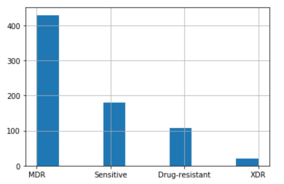
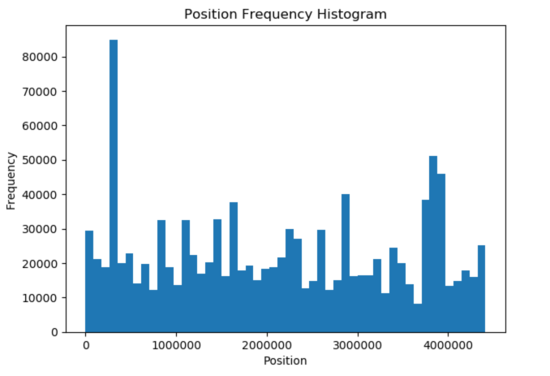
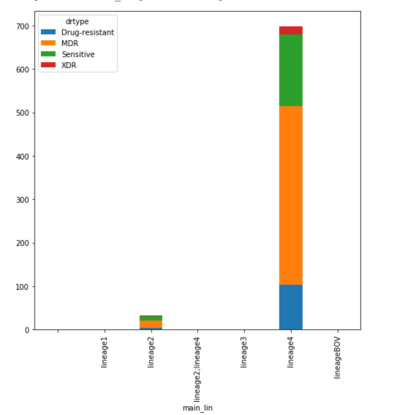
Data Visualization
Edourd and Davis have worked on Data Visualization for the available WGS samples and their Drug Resistance profiles.

Slide 4
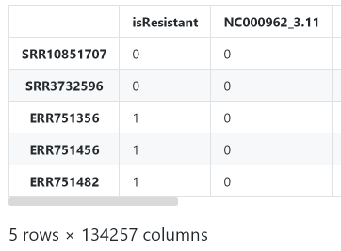
Feature Engineering
James and Abhinav have worked on establishing the foundation for the machine learning algorithm.
The feature matrix for the ML algorithm is based on the Single Nucleotide Polymorphism (SNPs), which are observed from the variant calling analysis.

Slide 5
Thank you!
Notes:
Project Repository: https://github.com/abhi18av/drug-resistance-prediction-cambiohack

