Slide 1
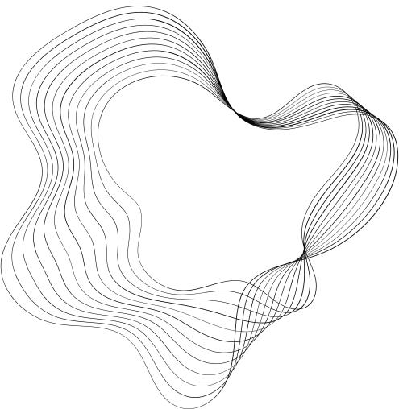

IOT-BASED FINANCIAL
FRAUD DETECTION
WWW.REALLYGREATSITE.COM

Slide 2
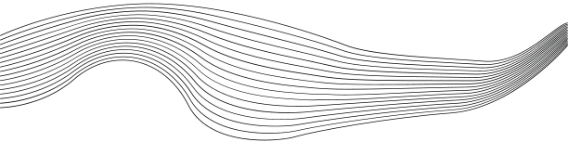
CONTENT
01
INTRODUCTION
02
UNDERSTANDING IOT IN FINANCIAL TRANSACTIONS
03
STRATEGY
04
IMPORTANCE OF USER BEHAVIOR ANALYSIS
05
DATA COLLECTION AND PREPROCESSING
06
MACHINE LEARNING ALGORITHMS FOR FRAUD DETECTION
07
FUTURE TRENDS AND INNOVATIONS
08
CONCLUSION

Slide 3


Introduction
Financial fraud under IoT environment refers to the unauthorized use of mobile transaction using mobile platform through identity theft or credit card stealing to obtain money fraudulently.For understanding the real world
scenario a highly accurate process of financial fraud detection under IoT environment is needed since financial fraud causes financial loss.

Slide 4
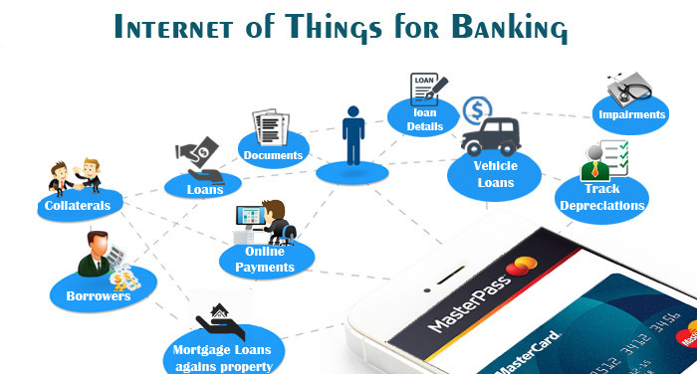
Understanding IoT in Financial Transactions
IoT can gather real-time data on clients' assets.
IoT can track customer behaviour and transaction in real-time and also support
financial institution verify user’s identities.
Scaling up finance strategies and allocating funds more effictively.
Sending alerts to sales and finance teams when they deal with high risk customers.

Slide 5
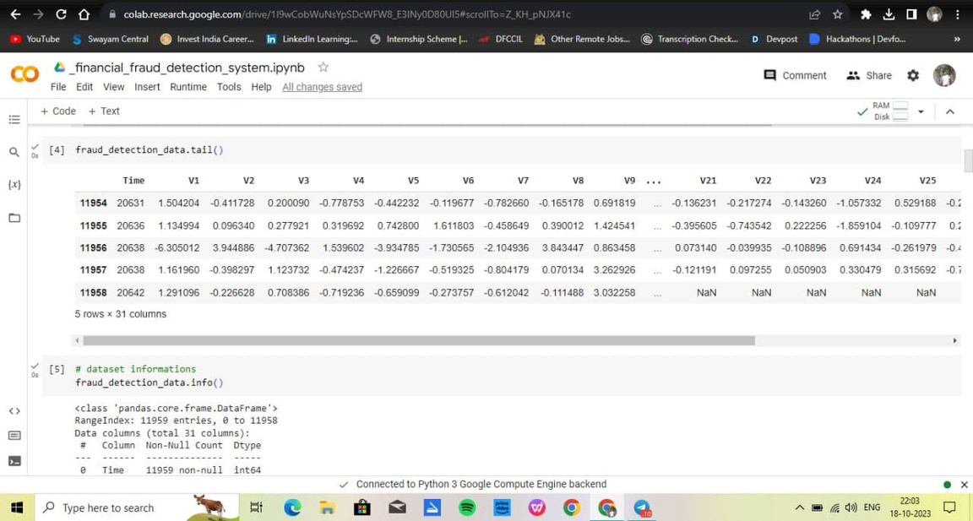
Strategy
Use IoT data and advanced analytics to identify fraudulent patterns.
Continuously monitor transactions and activities to catch fraud as it happens.
Educate users about fraud risks and how to protect their accounts.
Regularly update machine learning models to adapt to evolving fraud techniques.
Investigate fraud incidents and continuously improve the detection system.

Slide 6
Importance of User Behavior Analysis
uses machine learning algorithm to examine all the pertinent data regarding a transaction and assigns a risk score to the transaction. In summary, user behavior analysis in IoT-based financial fraud detection we can instrumental identifying and preventing fraudulent activities , It's a dynamic and adaptive approach that aligns security measures with the specific behaviors of each user, making it a powerful tool in the fight against financial fraud.

Slide 7
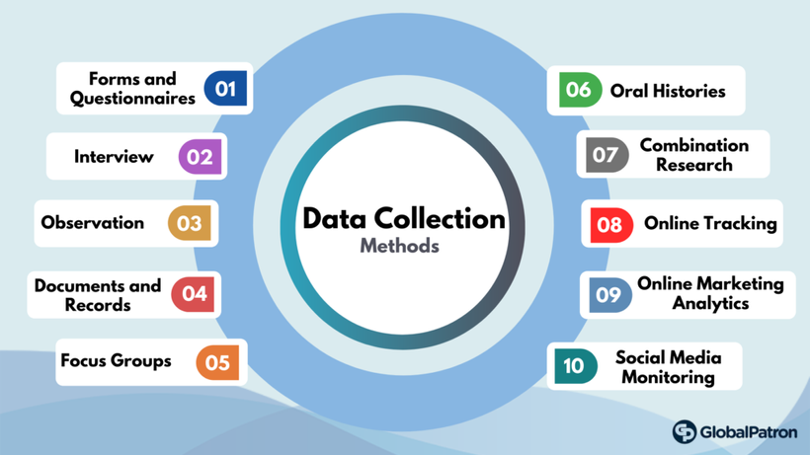
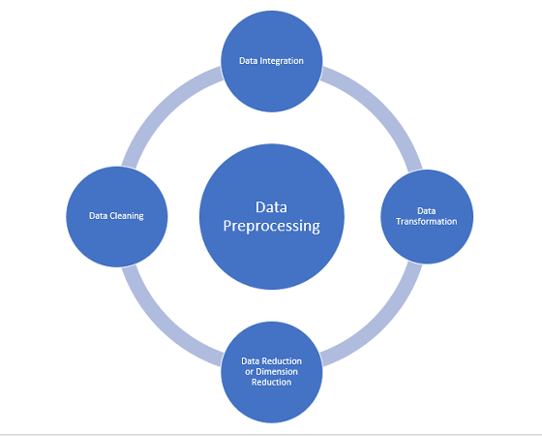
Data Collection and Preprocessing
Data collection
Gather data (both real-time and historical data ) from a variety of sources including financial transactions ,user interactions devices . real-time data is used for fraud detection,while historical
Data is used for trend analysis and model training.
Data Preprocessing
Clean, transform, and engineer features to prepare the data for analysis. Balance classes, split data, and ensure data security.

Slide 8
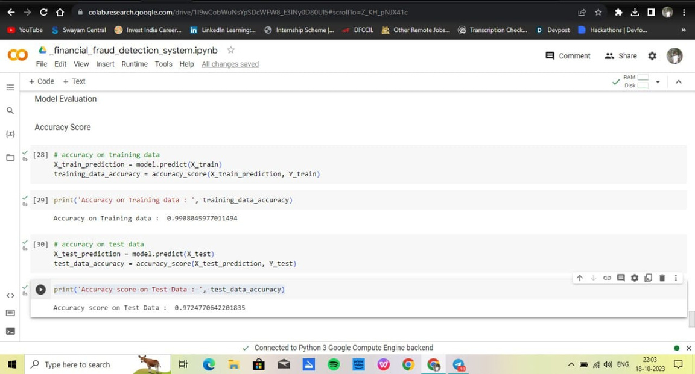
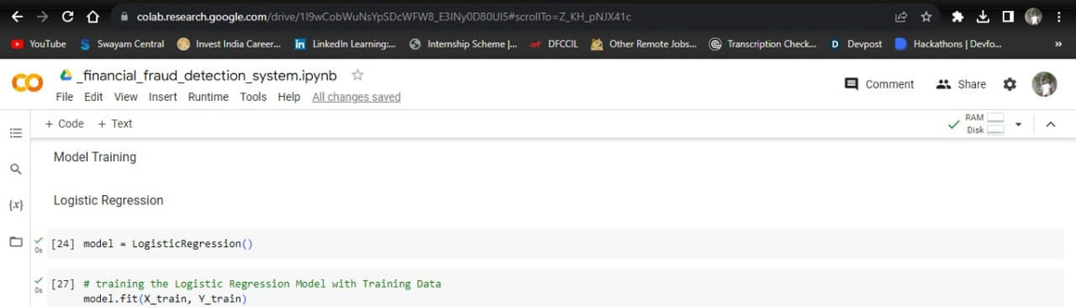
Machine Learning Algorithms for Fraud Detection
Logistic regression
A statistical technique that analyzes the relationship between dependent and independent variables

Slide 9
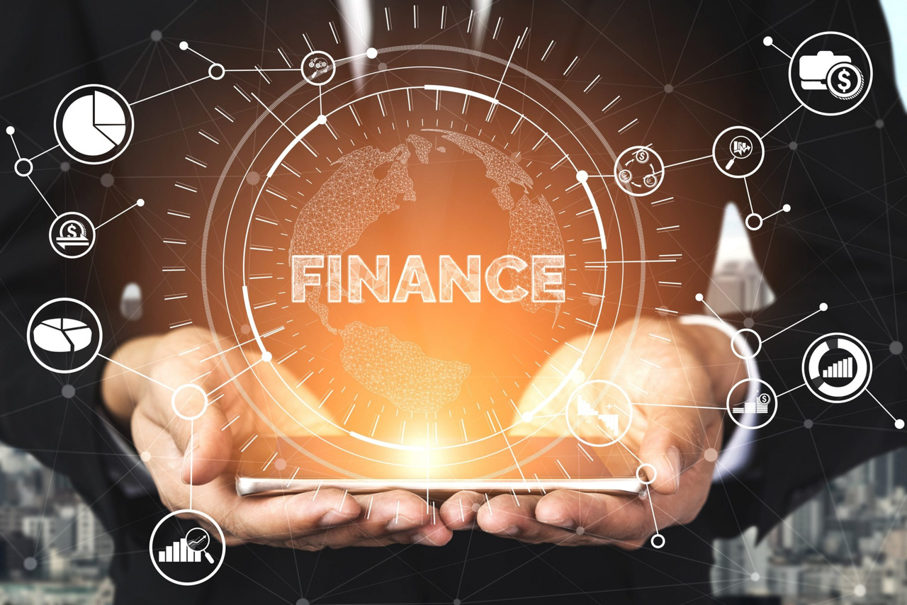
Future Trends and Innovations
The humongous amount of data collection from current IoT solutions and upcoming devices will become the future of the banking industry
Advanced AI and Machine Learning for real-time detection.
Increased use of blockchain and DLT for secure transactions.
Secure machine-to-machine communication in IoT.
Improved real-time data analysis capabilities

Slide 10
Conclusion
In summary, IoT-based financial fraud detection relies on a combination of data sources, advanced analytics, and user behavior analysis to safeguard financial transactions. Security, compliance, and continuous adaptation are essential for success. Looking ahead, future trends emphasize real-time analysis, user-centric security, and collaboration within the IoT ecosystem, promising increased effectiveness and protection against evolving fraud tactics in the financial sector.

