Slide 1
Prototype For Qualifier challenge : STAMP Kochi Team Name – Ranters_<Army Institute of Technology>
Understanding of problem statement:-
Tourist is looking for navigations(maps and suggestions) for travelling.
Tourist wants to travel like local.
Providing suggestions which reduces carbon footprint.
Make best use of her time in city and explore different places.
Solution-abstract:-
Used current location of Angela(tourist).
Then estimated closest locations for each accomodation, cultural ,gastronomy, recreation and religious establishments.
Then take her input for destination location from the estimated locations.
Then provided suggestion for optimal mode of transport with minimum carbon footprint and for location closest to her current location.

Slide 2
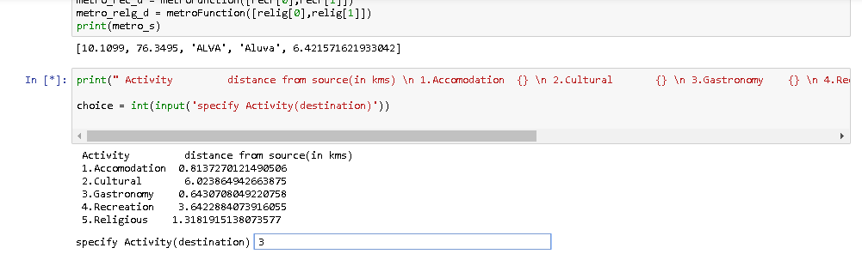
Here Angela is prompted with 5 choices .
The associated distance from her current location to selected choice(place she wants to explore) is also displayed respectively.
Angela then, selects the place she wants to visit(choice).
The visualization model then predicts optimal mode of transport with minimum carbon footprint for location closest to her current location.

Slide 3
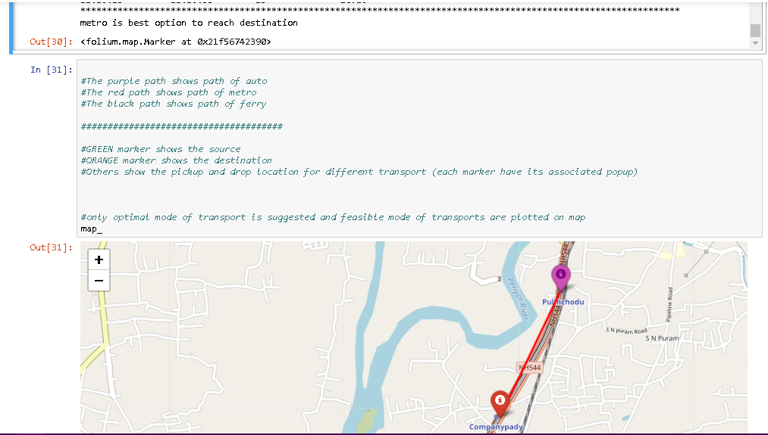
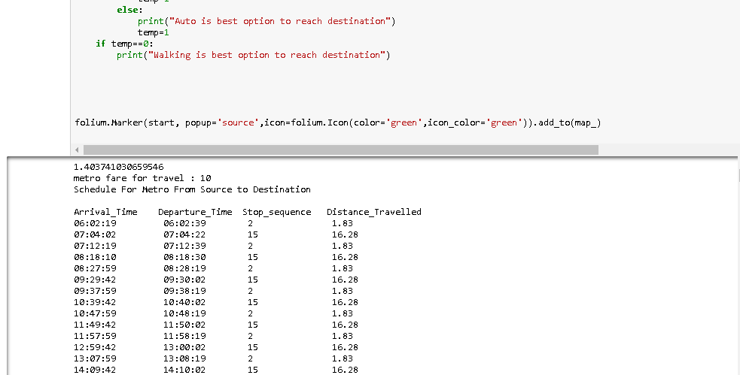
Initially, consider the source point(lat,long).
Then,the output is the suggested mode of transportation ,considering minimum carbon footprint and the distance from source to transports pickup locations.
Then plot,the suggested optimal mode of transportation path on the map using Folium(python package).
Example:-
In the attached pictures, metro is selected as optimal transport for Angela , it is plotted on the map.
Schedule and Fare of the metro is also prompted for Angela as suggestion.

Slide 4
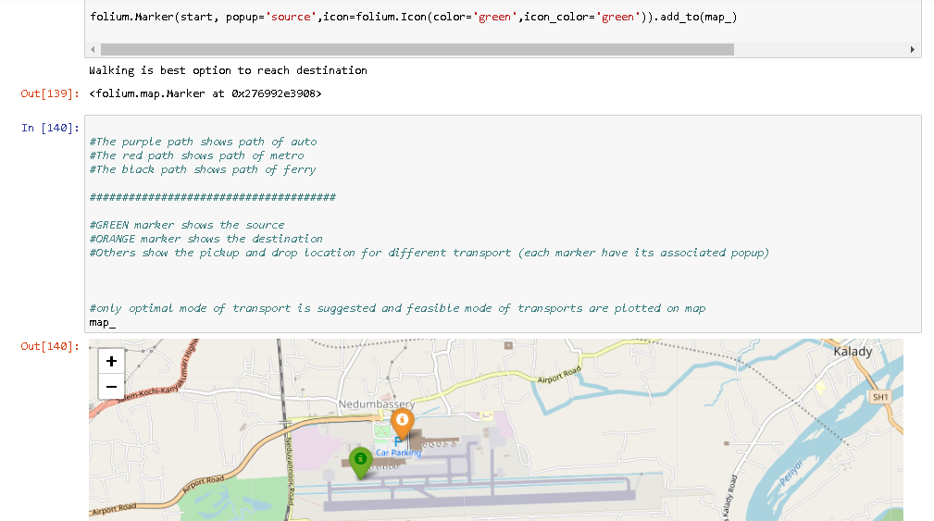
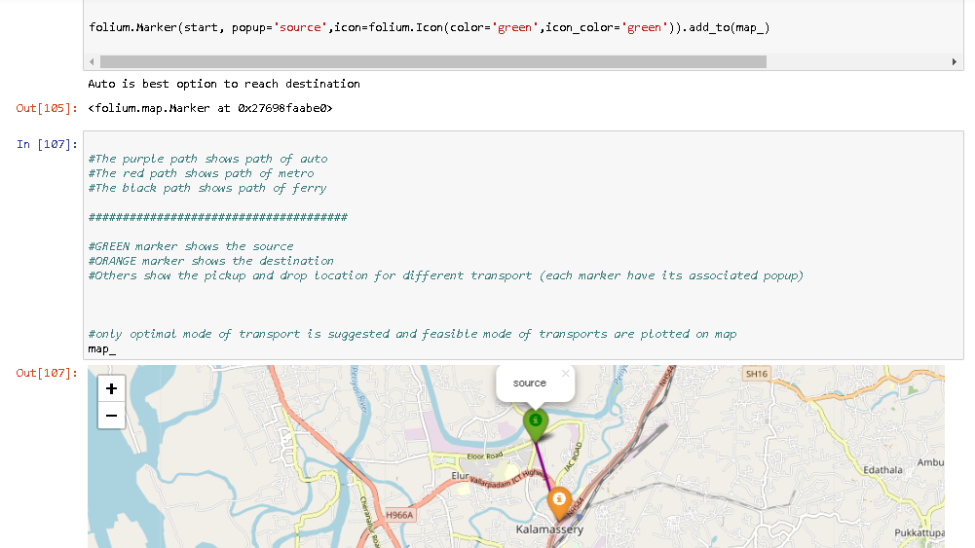
Here different cases are considered having unique start co-ordinates.
In the first picture, walking is suggested for Angela as the destination is at walking distance(reducing carbon footprint and taking care of her budget).
In the second picture, Auto is suggested for Angela as a mode of transport(considering her time constraint and nearest available transport).

Slide 5
Future Scope:-
Here, The proposed visualization notebook uses manually entered source co-ordinates.
This can be integrated with an application which provides real time source co-ordinates for tourist using GPS and give more precise navigations and suggestions.
Notebook Link- http://bit.ly/2SZVI05
Team Name – Ranters_<Army Institute of Technology>
Members –
Pawan Phalak
Email – pawanphalak_17927@aitpune.edu.in
Mobile – 7770002052
Abhijeet Singh
Email – abhijeetsingh_16689@aitpune.edu.in
Mobile- 8698567256

