Slide 1
FiniteState Machines
VHDL
Made By-: Dinky Kukreja (05516412819)
Abhinav Jha (04516412819)

Slide 2
Finite State Machine
FSM are sequential circuit used in digital system to control the behaviour of systems and dataflow paths.
A finite state machine (FSM) is a digital circuit whose state change depends on both the current state (of the FSM) and the current inputs.
The outputs of a FSM are functions of the current state (Moore Model) --or– functions of the current state and current inputs (Mealy Model)
Synchronous FSMs change their state with respect to a clock input and maintain their state (store their state) in flip-flops

Slide 3
Conceptual Definition of a Finite State Machine
The system must be describable by a finite set of states.
The system must have a finite set of inputs and/or events that can trigger transitions between states.
The behavior of the system at a given point in time depends upon the current state and the input or event that occur at that time.
For each state the system may be in, behavior is defined for each possible input or event.
The system has a particular initial state.

Slide 4
A finite state machine consists of
State Memory (it stores current state the FSM is in)
Next State Logic (determines the next state for FSM and it depends on current state it is in and input signals)
Output Logic (generate required output signals from controller for controlling what we want
The number of states is fixed; when an input is executed, the state is changed and an output is possibly produced.
FSM is only one state at a time. The state it is in at any given time is called current state. It can change from one state to another only after a triggering event or a condition.

Slide 5
Checklist for FSM
Port declaration
Declaration of current state and next state variable
Binary encoding of state
Next state logic
Output logic if any
Synchronisation of current state to next state

Slide 6
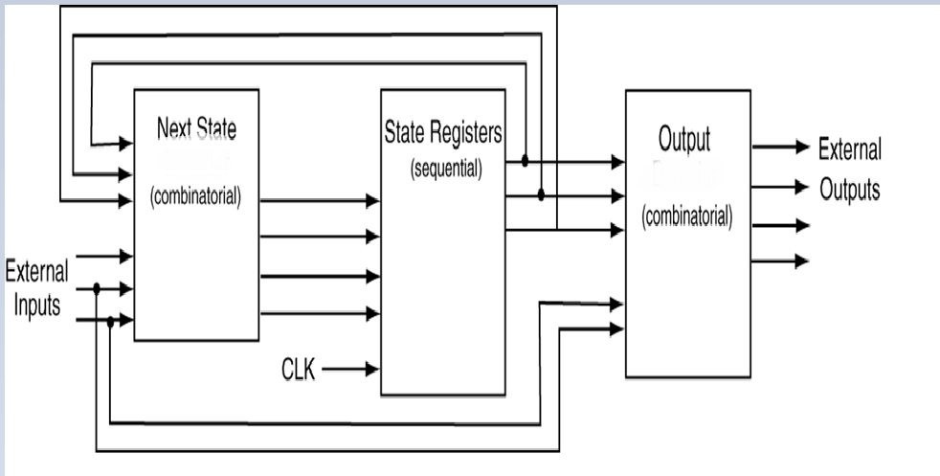
FSM Block Diagram
logic
logic

Slide 7
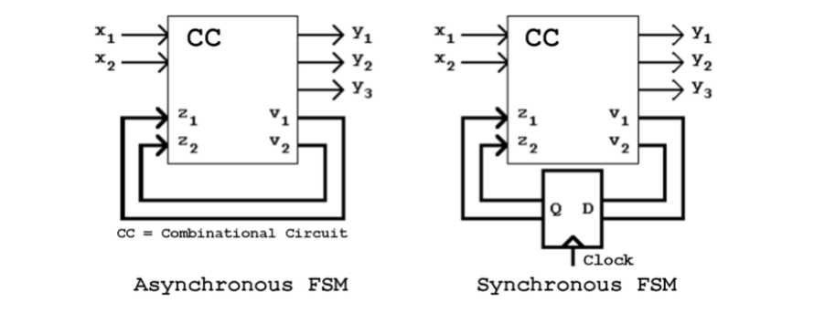
Synchronous and Asynchronous FSM

Slide 8
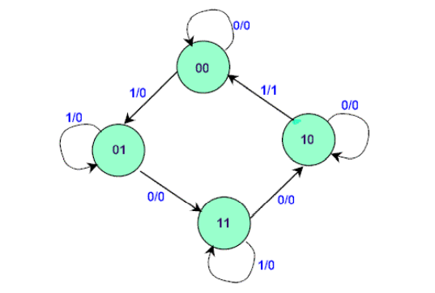
State Diagram
The binary number inside each circle identifies the state the circle represents. The directed lines are labelled with two binary numbers separated by a slash (/). The input value that causes the state transition is labelled first. The number after the slash symbol / gives the value of the output. For example, the directed line from state 00 to 01 is labelled 1/0, meaning that, if the sequential circuit is in a present state and the input is 1, then the next state is 01 and the output is 0. If it is in a present state 00 and the input is 0, it will remain in that state. A directed line connecting a circle with itself indicates that no change of state occurs. The state diagram provides exactly the same information as the state table and is obtained directly from the state table.

Slide 9
Types of State Machine
Mealy FSM
Moore FSM

Slide 10
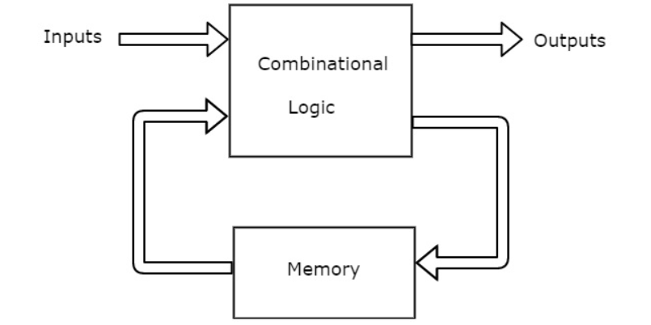
Mealy FSM
A Mealy Machine is an FSM whose output depends on the present state as well as the present input.
It can be described by a 6 tuple (Q, ∑, O, δ, X, q₀) where −
Q is a finite set of states.
∑ is a finite set of symbols called the input alphabet.
O is a finite set of symbols called the output alphabet.
δ is the input transition function where δ: Q × ∑ → Q
X is the output transition function where X: Q × ∑ → O
q₀ is the initial state from where any input is processed (q₀ ∈ Q).

Slide 11
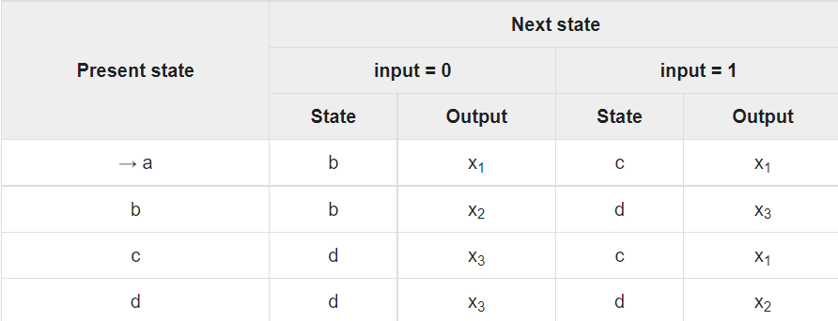
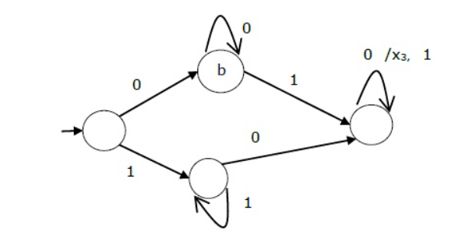
State Table
State Diagram

Slide 12
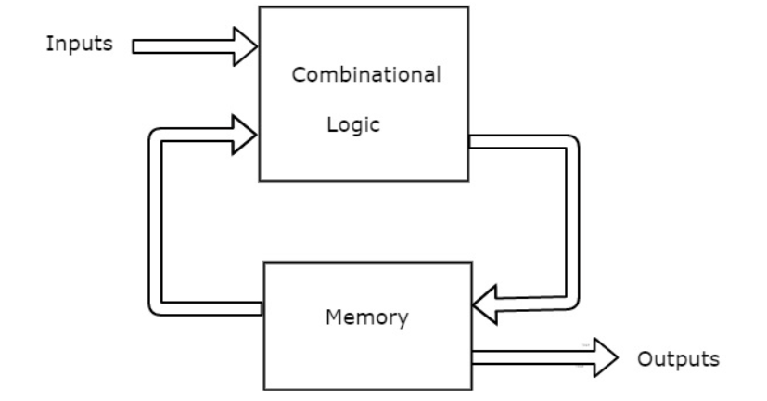
Moore FSM
Moore machine is an FSM whose outputs depend on only the present state.
A Moore machine can be described by a 6 tuple (Q, ∑, O, δ, X, q₀) where −
Q is a finite set of states.
∑ is a finite set of symbols called the input alphabet.
O is a finite set of symbols called the output alphabet.
δ is the input transition function where δ: Q × ∑ → Q
X is the output transition function where X: Q → O
q₀ is the initial state from where any input is processed (q₀ ∈ Q).

Slide 13
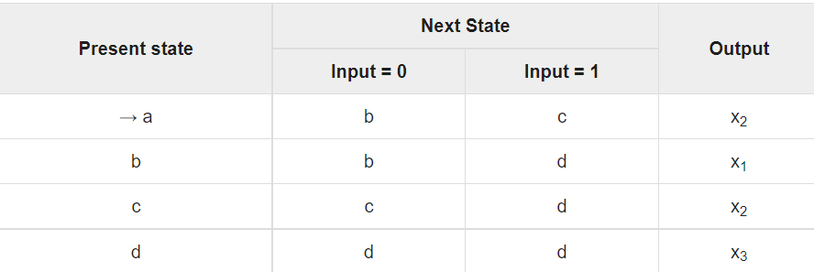
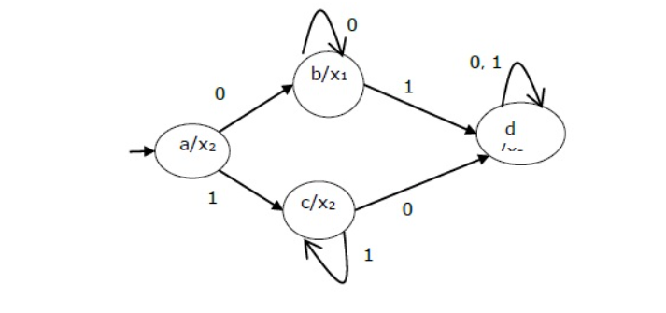
State Table
State Diagram

Slide 14
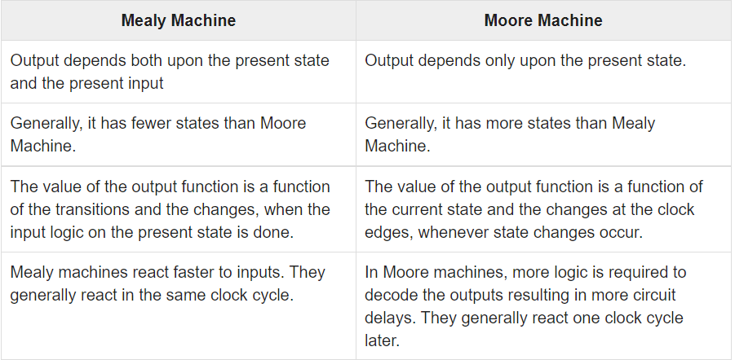
Comparison between Mealy and Moorey FSM

Slide 15
FSM In VHDL
ARCHITECTURE mysolution OF myFSM IS
SIGNAL Q1, Q0: STD_LOGIC;
BEGIN
PROCESS (clk,Q1, Q0, offon, breakin )
BEGIN
IF (rising_edge(clk)) THEN
Q1 <= next state equation for Q1;
Q0 <= next state equation for Q0;
END PROCESS;
alarm <= output equation for alarm signal;
armed <= outputequation for armed signal;
END mysolution;

Slide 16
Thank You

