Slide 1

Gold Prices Forecast
Team Name: Team 4
Mentor Name: Sir. Harshal & Ma’am Munmun
Date: 22/01/2022

Slide 2
Business Problem:
Daily Gold price of from 4 march 2020 to 4 march 2022
Objective:
The objective is to understand the underlying structure in your dataset and come up with a suitable forecasting model which can effectively forecast gold prices for next 30 days.

Slide 3
Project Architecture / Project Flow
Collecting the Data
Understand the Time Series Data
EDA / Pre-process Data
Apply Forecasting Algorithms
Evaluate & Compare Performance
Finalize a Model & Implement Forecast System
Deployment of the System

Slide 4
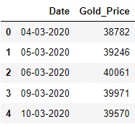
Data set details
Shape : Dataset contains 523 rows and 2 columns
Unique values : 501 unique values
Columns Names : “ Date ”and “ Gold_Price ”
Na values : No Na values
Missing datapoints : As initially the date range frequency is Business, so our
dataset doesn’t have data of Saturday and Sunday .
Data type : Date - object, Gold_Price - integer
(later we convert Date into DateTime .)

Slide 5
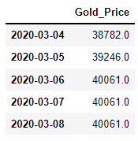
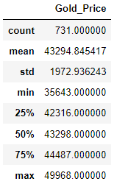
Exploratory Data Analysis (EDA)
  Date is of object datatype in our dataset
  steps : we converted Date into DateTime datatype
  The date range which was given in dataset was having Business frequency that is all the dates of Saturday and Sunday was missing
  steps : very firstly we changed the frequency of given date range to daily so the
  Saturday Sunday dates were filled with NA .next we filled
  those NA with previous dates values .
New Data
Description of Gold Price

Slide 6
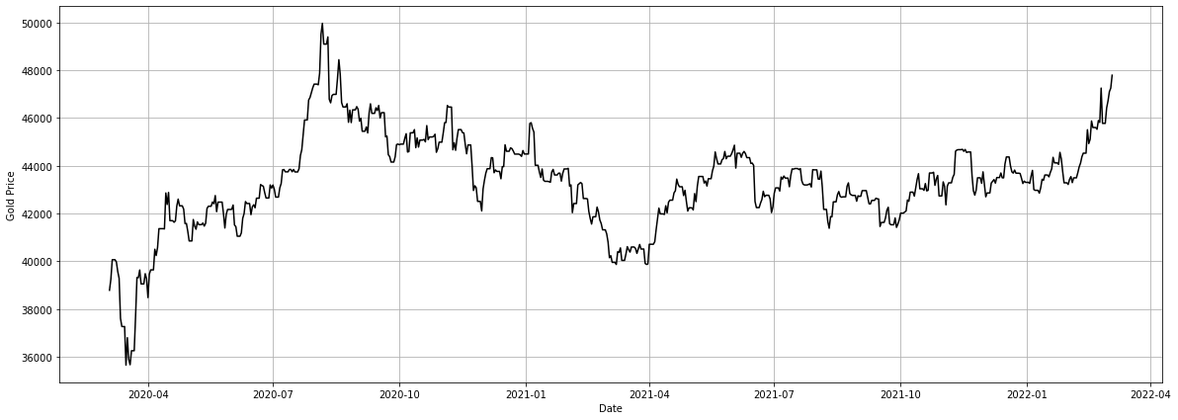
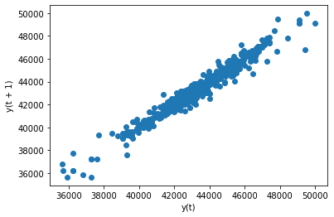
EDA
From the line plot we can conclude that there is no trend and seasonality in our data. so data is stationary
Line Plot
Lag Plot
lag plots shows that there is positive liner relation between variable and its own lag variable

Slide 7
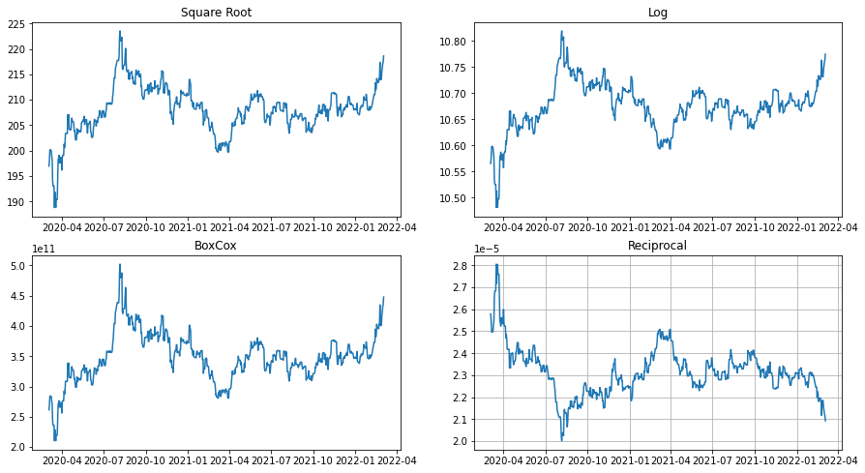
Transformation
The Distribution of Transformed data is similer to the distribution of original data ,so we conclude that there is no need of transformation on this data as data is stationary

Slide 8
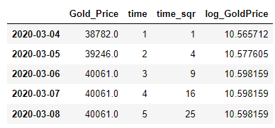
Data modification
In order to build linear models for this data . Columns i.e “ time “, “ time_sqr “ and “ log_GoldPrice “ as been added.
All the above mentioned columns has also been added to the transformed data.
Training Set : Training Set contains First 550 rows .
Testing Set :
Testing Set contains last 181 rows
Original Data after Adding Columns

Slide 9
Model Building
Naives Model
Simple Average
Moving Average
Simple Exponential
Holts Exponential
Simple Liner model
Exponential Linear model
ARIMA
RNN

Slide 10
Model Building
RNN
DATA | Errors
Original Data | 2.976663740129396
Log Transformed Data | 1.758831007969265
Square Root Transformed Data | 1.217505026112874
BoxCox Transformed Data | 16.524090140669294
Reciprocal Transformed Data | 12.660466558621259

Slide 11
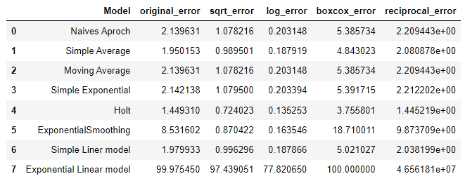
Model Building
ARIMA
Initially we decided to build model on Holts method with log transformation as it is giving least error but it was not performing well on complete data so later we build model on Exponential smoothing
We got least P-value for log transformed data
Used Auto ARIMA for (p,d,q) value
Finally we got RMSE score of 0.4924

Slide 12
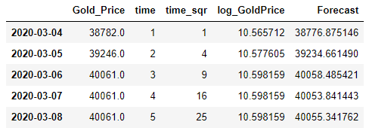
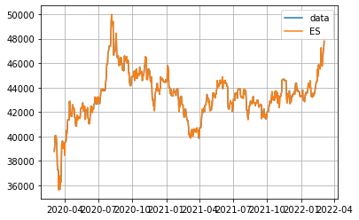
Model Predictions
Exponential smoothing

Slide 13
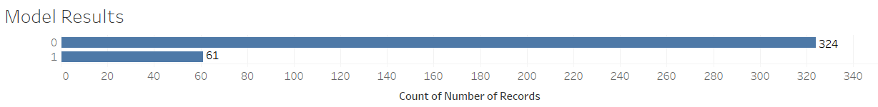
Model Results
Example
Model generated the output for the transaction data set in which 324 transactions are genuine(0) claims and 61 transaction are fraudulent(1)

Slide 14
Challenges faced?
The major challenge was to find the best model for th given data
How did you overcome?
We used all the transformation technique and fitted it in various model and the model with highest accuracy was chosen as final model

Slide 15
Thank you

