Slide 1
PREDICTIVE ANALYTICS WITH MACHINE LEARNING
Stock Price Prediction & Twitter Sentiment Classification
Artificial Intelligence Internship Project Presentation
Abhi Sidhu | AI Intern, Codec Technologies Pvt. Ltd. | 29 Jul – 30 Aug 2026

Slide 2
AGENDA
What This Presentation Covers
01
Internship & Deliverables
Scope of the two selected projects
02
Project 1 — Stock Price Predictor
Regression on historical price data
03
Project 2 — Sentiment Analysis on Twitter Data
NLP text classification
04
Learnings & Future Scope
What's next for both pipelines
2

Slide 3
CONTEXT
Internship Overview
Role: Artificial Intelligence Intern at Codec Technologies Pvt. Ltd.
Duration: 29 July 2026 – 30 August 2026 (Hybrid, Pan-India)
Deliverable: select and complete two assigned ML projects, publish with documentation
Selected projects: Stock Price Predictor + Sentiment Analysis on Twitter Data
Both delivered as complete, runnable pipelines — data → features → model → evaluation → visualization
DESIGNATION
Artificial Intelligence Intern
PROGRAM
AICTE & ICAC Approved
MODE
Hybrid · Pan India
DURATION
1 Month
3

Slide 4
Project 1
Stock Price Predictor — forecasting next-day closing price

Slide 5
PROJECT 1
Problem Statement & Objectives
Historical price data carries trend, momentum and volatility signal that can be used to estimate near-term future prices.
Build a multi-ticker historical daily price dataset (Open, High, Low, Close, Volume)
Engineer time-series features: lags, moving averages, volatility, momentum
Train a Linear Regression baseline
Train a Gradient Boosting Regressor as the advanced technique
Evaluate with R², RMSE, MAE, MAPE on a chronologically held-out test set
5

Slide 6
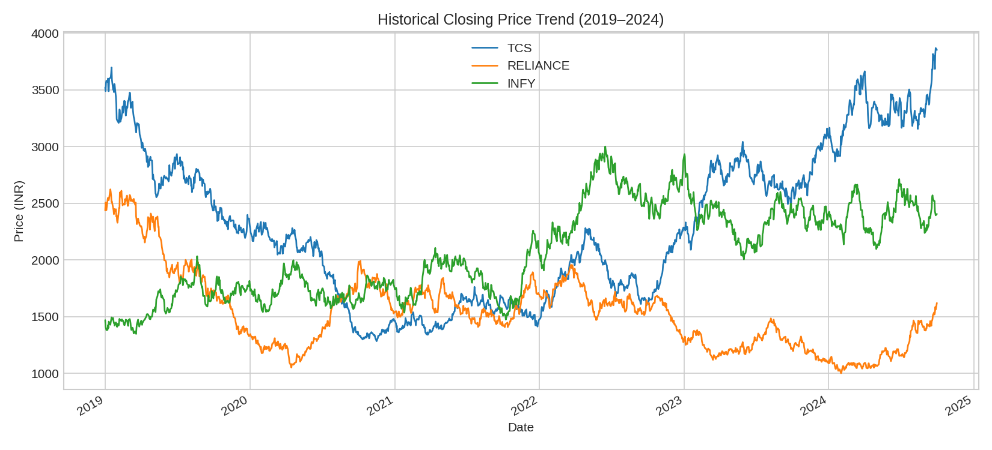
PROJECT 1
Dataset & Methodology
4,500 daily records · 3 tickers · 2019–2024
Features: lagged closes, MA(5/10/20), volatility, momentum
Chronological 80:20 split per ticker (no lookahead leakage)
Models: Linear Regression + Gradient Boosting (300 trees)
Figure: Historical closing price, 3 tickers (2019–2024)
Live data note: offline sandbox → calibrated GBM price simulator used; swap-in ready for real Yahoo Finance/NSE data.
6

Slide 7
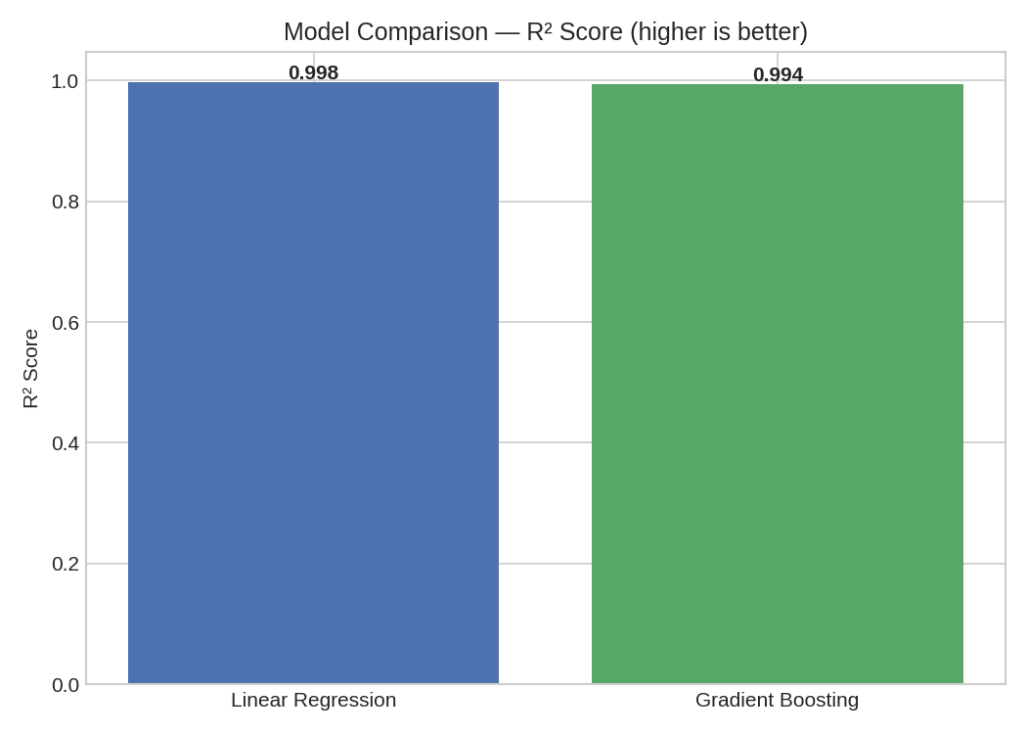
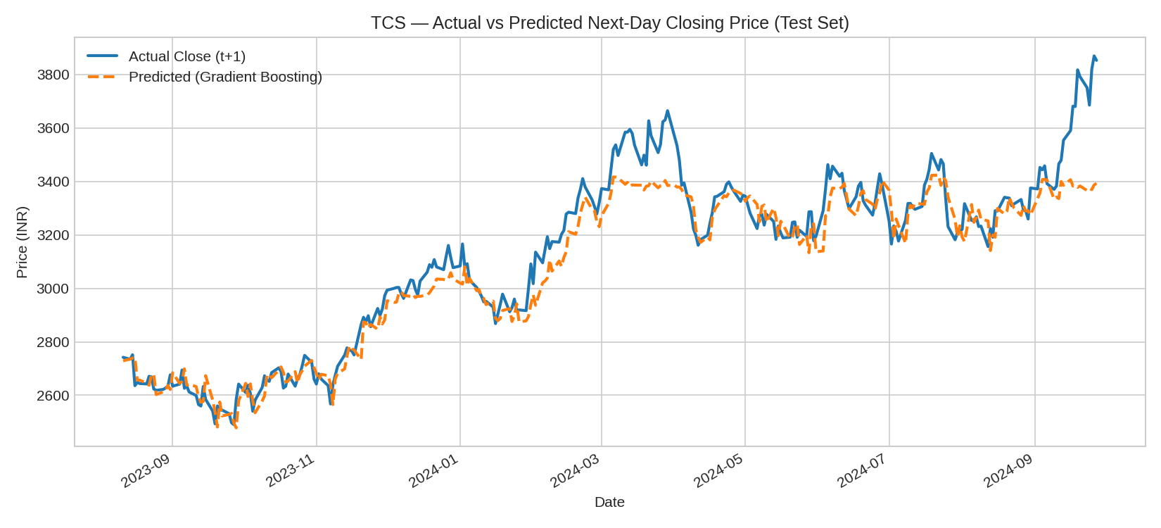
PROJECT 1
Results & Evaluation
0.998
₹39.4
1.30%
1.76%
R² — Linear Regression
RMSE (₹), Linear Regression
MAPE, Linear Regression
MAPE, Gradient Boosting
TCS test-period: actual vs. predicted next-day close
7

Slide 8
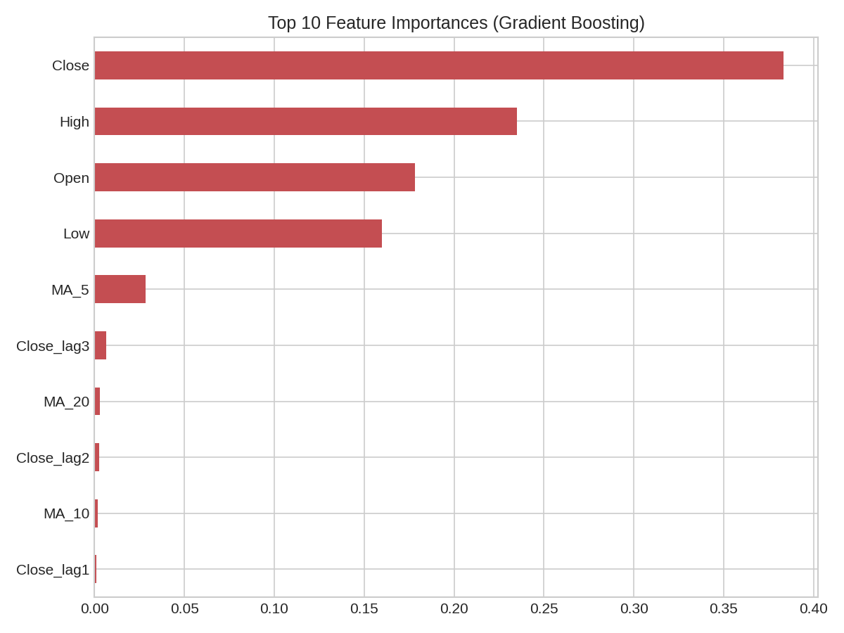
PROJECT 1
Key Takeaway
Linear Regression matched (and slightly beat) Gradient Boosting.
Next-day close is close to a linear function of today's Open/High/Low/Close — a simple model already captures most of the signal.
Same-day Close, High, Open and Low account for over 95% of feature importance.
Both models scored under 2% MAPE — strong short-horizon accuracy, driven by high day-to-day price autocorrelation.
8

Slide 9
Project 2
Sentiment Analysis on Twitter Data — classifying tweet sentiment

Slide 10
PROJECT 2
Problem Statement & Objectives
Social text is informal, short and noisy — but carries strong signal about public opinion once cleaned and modeled correctly.
Assemble a labeled tweet-style dataset across 20 topics, 3 sentiment classes
Clean text: lowercase, strip mentions/emoji/punctuation, normalize hashtags
Vectorize with TF-IDF (unigrams + bigrams)
Train and compare Logistic Regression vs. Multinomial Naive Bayes
Evaluate with accuracy, precision, recall, macro F1, confusion matrix
10

Slide 11
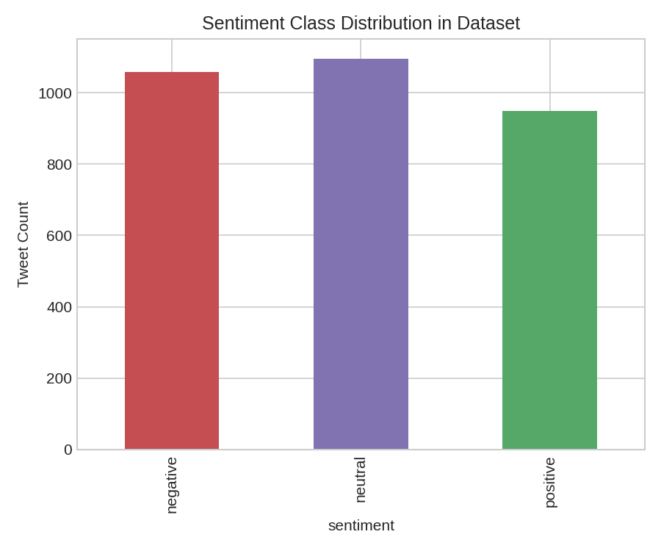
PROJECT 2
Dataset & Methodology
3,104 tweet-style texts · 20 topics · 3 sentiment classes
Deliberate ambiguous examples: negation, sarcasm-lite, mixed sentiment
8% simulated label noise (mirrors real annotator disagreement)
TF-IDF: 3,000 features, uni+bigrams, min_df=2
Stratified 80:20 split · Logistic Regression + Naive Bayes
Live data note: offline sandbox → template + lexicon generator used; swap-in ready for real Sentiment140/X API data.
11

Slide 12
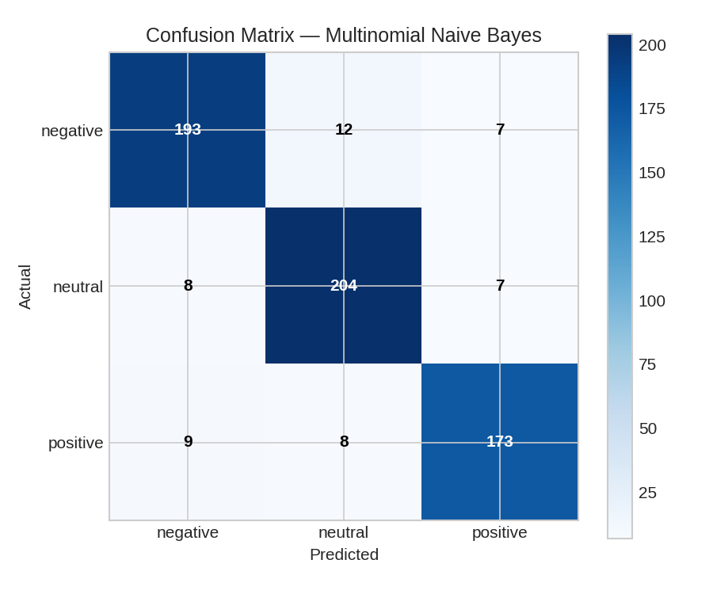
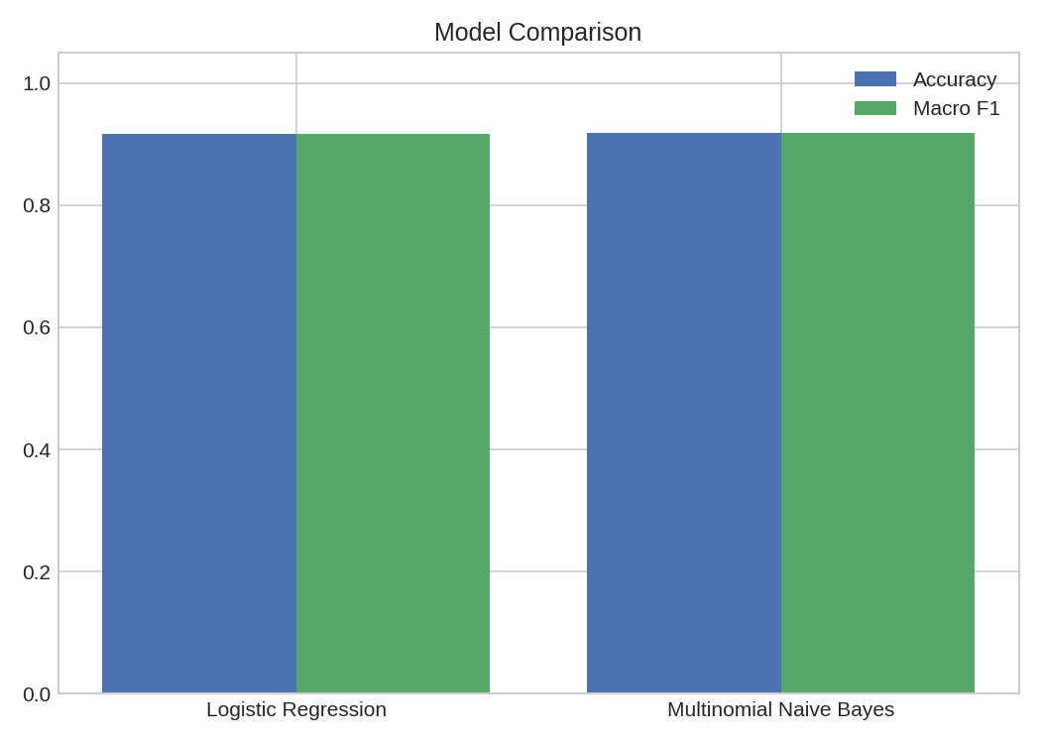
PROJECT 2
Results & Evaluation
91.8%
0.918
91.6%
0.916
Accuracy — Naive Bayes
Macro F1 — Naive Bayes
Accuracy — Logistic Reg.
Macro F1 — Logistic Reg.
12

Slide 13
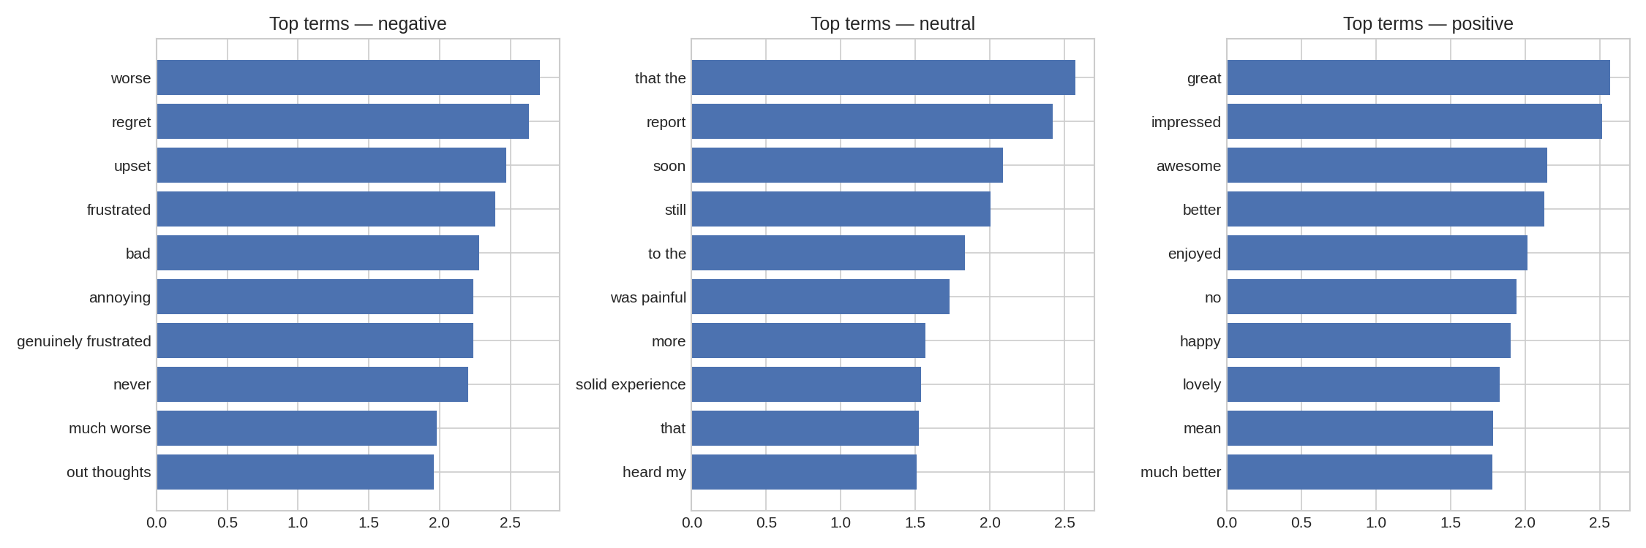
PROJECT 2
Key Takeaway
Top TF-IDF terms driving each sentiment class (Logistic Regression coefficients)
Both classifiers land at ~92% accuracy — positive/negative are rarely confused with each other
Nearly all errors involve the neutral class and the deliberately-injected ambiguous examples (negation, sarcasm)
Expected limitation of bag-of-words models: they don't capture word order, so "wasn't bad" reads like "bad"
13

Slide 14
WRAP-UP
Learnings & Future Scope
KEY LEARNINGS
FUTURE SCOPE
End-to-end pipeline design: data → features → model → evaluation
Chronological splits are essential to avoid time-series leakage
Simple models can match complex ones when relationships are linear
Bag-of-words NLP struggles with negation and sarcasm
Swap in live Yahoo Finance/NSE data and real Twitter/Sentiment140 data
Add technical indicators (RSI, MACD) to the price model
Explore LSTM/GRU sequence models for both projects
Use transformer embeddings (BERT) for negation-aware sentiment
Deploy both as live dashboards
14

Slide 15
Thank You
Both projects — code, generated datasets, evaluation results and charts — are available as internship submission artifacts.
Abhi Sidhu | Artificial Intelligence Intern | Codec Technologies Pvt. Ltd.

