Slide 1
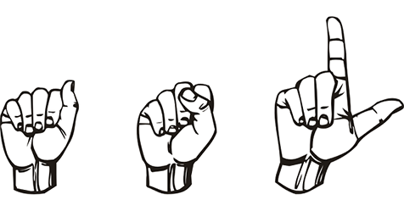
Sign langunage to Speech
Presented by :-
Sachin kumar - 21051162
Abhinav bisht - 21051705
Aditya Raj - 21051709
Arnav kumar - 21051801
Nitin kumar - 21051828
Presented to - Banchhanidhi Dash

Slide 2
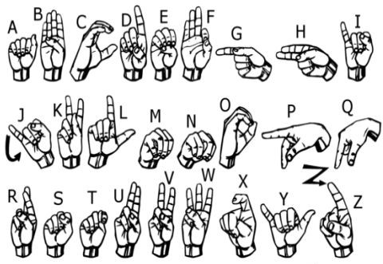
Introduction
We’ve been working on that focuses on generating finger spelling from American Sign Language.
Deep learning
Computer vison
CNN

Slide 3
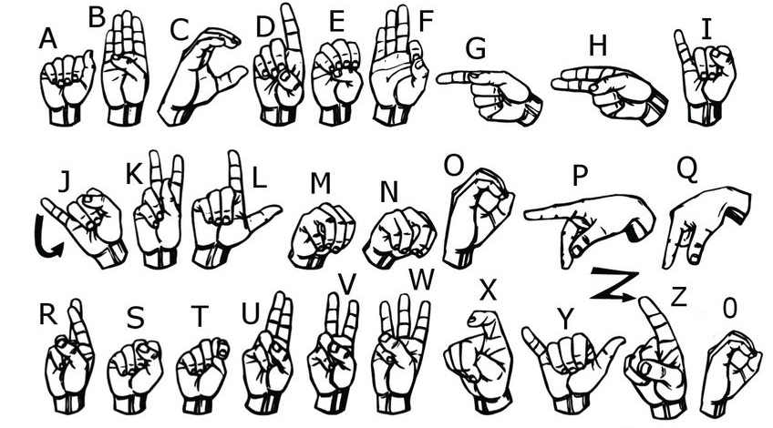
DataSet Generation
The dataset used in this project consists of a diverse collection of sign language gestures captured in various settings and contexts. It includes video recordings of individuals performing sign language gestures, covering a wide range of vocabulary and expressions commonly used in everyday communication.
The dataset used in this project consists of a diverse collection of sign language gestures captured in various settings and contexts. It includes video recordings of individuals performing sign language gestures, covering a wide range of vocabulary and expressions commonly used in everyday communication.

Slide 4
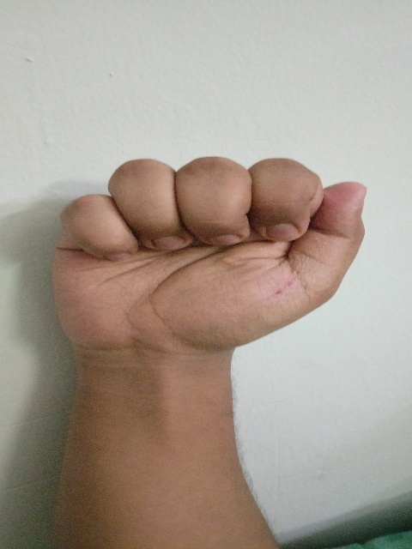
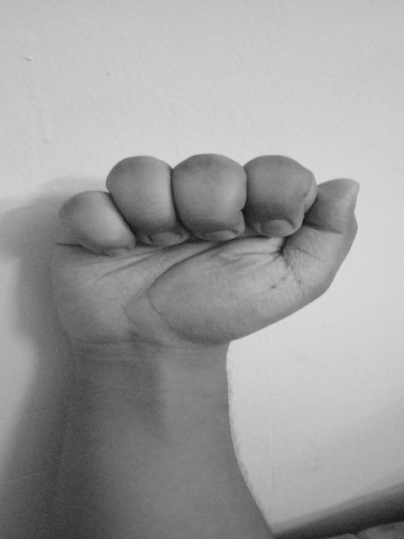
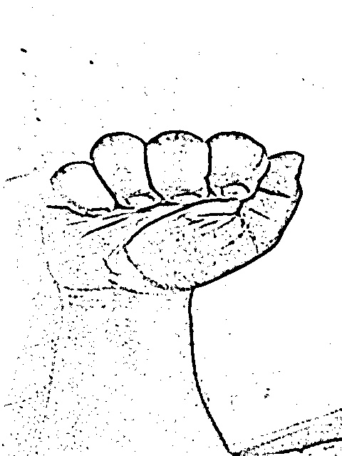
Removing noise (OpenCV)
Original image
Gray scale
Resized image
(128X128)
Gaussian blur
(5X5)
Adaptive threshold
(Final image)

Slide 5
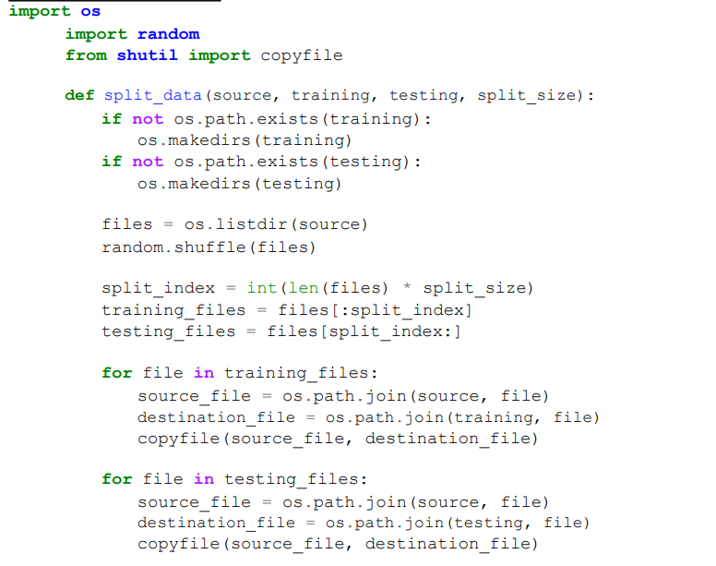
Train Test split
Imporatance
The train-test split is vital in machine learning, dividing data for training and testing to evaluate model performance, prevent overfitting, and ensure generalization to new data.

Slide 6
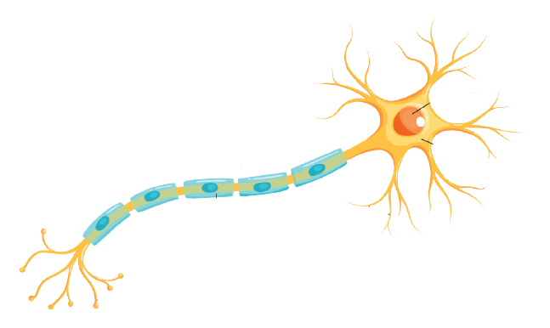
What is Neural Network ?
A neural network is a machine learning program, or model, that makes decisions in a manner similar to the human brain, by using processes that mimic the way biological neurons work together to identify phenomena, weigh options and arrive at conclusions.
Y1
W1
X1
Output
Relu
f(x)=max(0,x)
X2
Y
Y2
Axon
Nucleus
W2
Cell
body
Myelin sheath
Dendrites
Summation
Axon Terminal
Transfer function
F(S)
Yn
Xn
Wn
Neuron
Artifical Neural Network

Slide 7
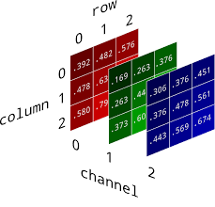
Sequence model implementation
Hidden
layer 2
Input
Hidden
layer 1
Output

Slide 8
Keypoints:
optimizer: an optimizer is a crucial element that fine-tunes a neural network’s parameters during training. Its primary role is to minimize the model’s error or loss function, enhancing performance.(stochastic gradient descent){ it finds model parameters that correspond to the best fit between predicted and actual outputs.
Softmax : Softmax is an activation function that scales numbers/logits into
probabilities,it help to get the highest value.

Slide 9
Drawback of sequence model
The model attains a commendable accuracy rate of around 96% on test data. However, it encounters challenges with alphabet images characterized by substantial differences in starting and ending coordinates. In these instances, the model's predictive performance suffers due to the variations in pixel values resulting from spatial disparities.
Adaptive measure to overcome this drawback :-
Instead of opting for a sequential model like an artificial neural network (ANN), it's more advisable to utilize a convolutional neural network (CNN). CNNs are tailored to effectively manage spatial relationships within images, making them a superior choice for tasks such as alphabet recognition where spatial variations play a crucial role in accurate predictions.

Slide 10
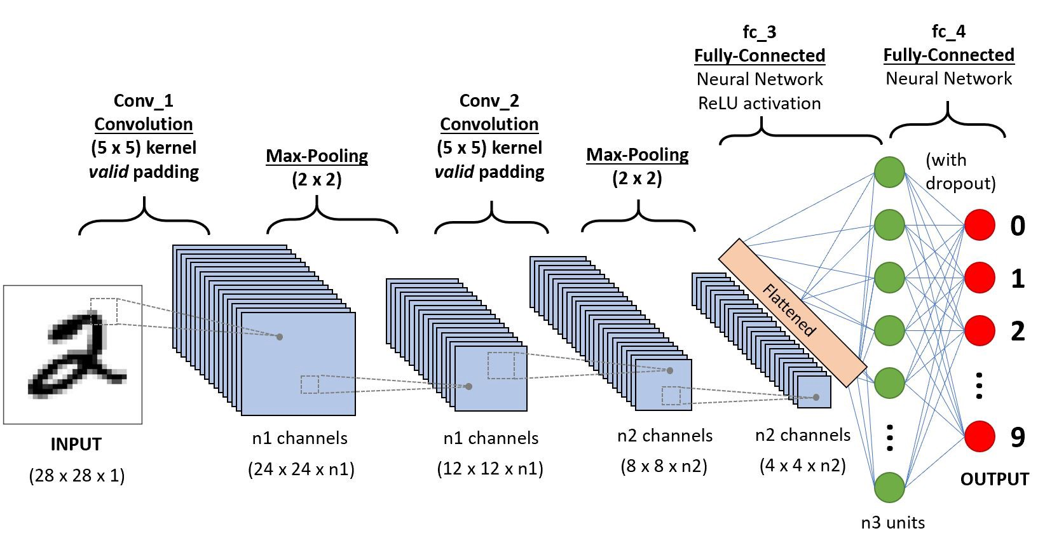
CNN
What is CNN(Convolution Neural Network)
It is a class of deep learning.
Convolutional neural network (ConvNet's or CNNs) is one of the main categories to do images recognition, images classifications, objects detections, recognition faces etc.,
It is similar to the basic neural network, CNN also have learnable parameter like neural network i.e., weights, biases etc.
CNN is heavily used in computer vision
There 3 basic components to define CNN
* The Convolution Layer
* The Pooling Layer
* The Output Layer (or) Fully Connected Layer
Architecture

Slide 11
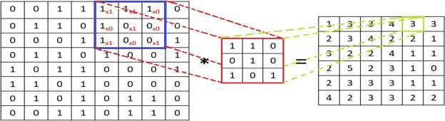
Convolution layer
Convolution layers in CNNs apply learnable filters to input data, extracting features by sliding and computing dot products. This process enables the network to recognize complex patterns, crucial for tasks like image classification and object detection. Convolutional architectures leverage these layers to achieve translation invariance and parameter sharing, optimizing performance in various computer vision applications.

Slide 12
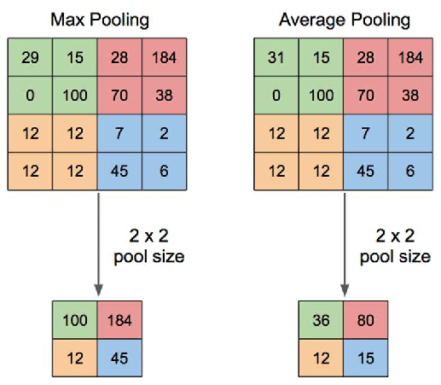
Pooling layers in CNNs reduce the spatial dimensions of feature maps while preserving important information. By downsampling through operations like max or average pooling, they enhance computational efficiency and introduce spatial invariance, aiding tasks like image classification and feature extraction.

Slide 13
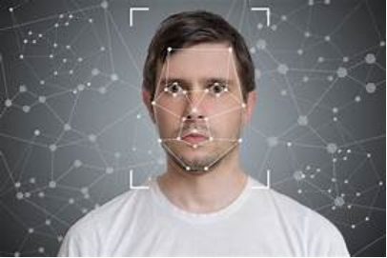
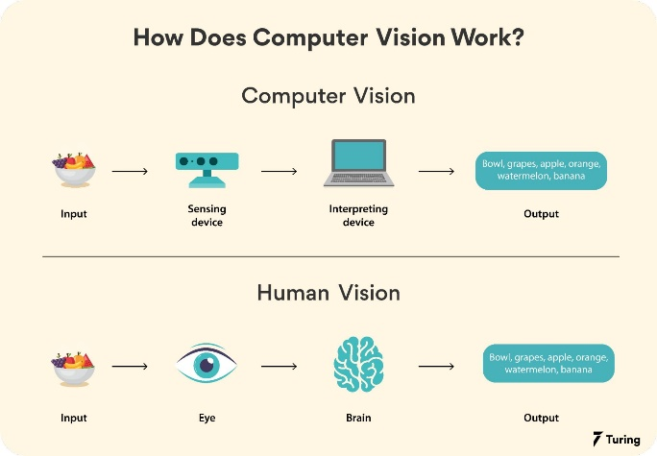
Computer vision
Computer vision is a field of artificial intelligence (AI) and computer science that focuses on enabling computers to interpret and understand visual information from the real world, much like humans
The process of computer vision involves acquiring, processing, analyzing, and understanding digital images or videos to extract meaningful information.
This is achieved using machine learning algorithms, particularly deep learning models, to recognize patterns and features within visual data through training on large datasets

Slide 14
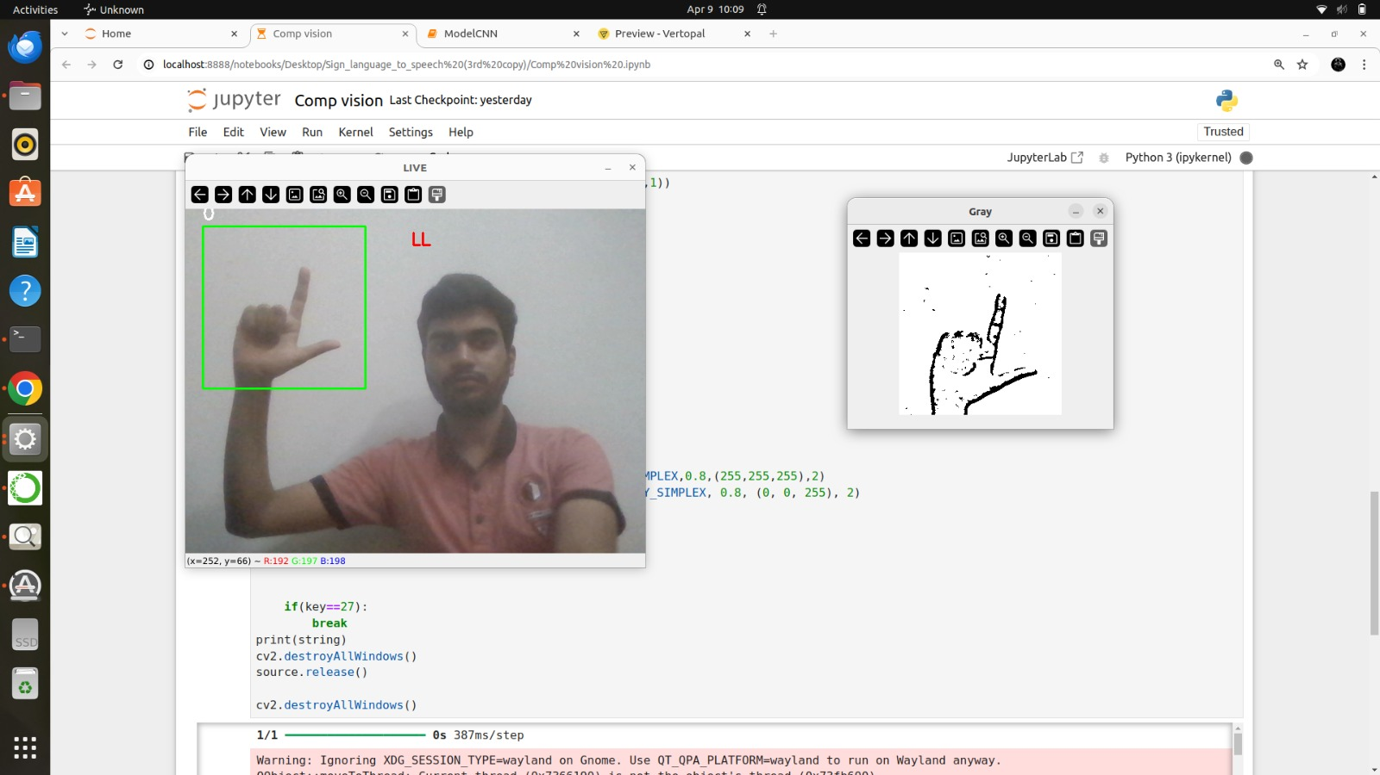
Implementing computer Vision
Defines a dictionary mapping class indices to corresponding characters and initializes a video capture object (source) from the default camera (index 0) with a loop to continuously capture frames. Extract a Region of Interest within the grayscale frame and apply Gaussian blur and adaptive thresholding to enhance hand gesture- features further followed by resizing and normalizing the region. Load the CNN model and make predictions to extract the labels. Update a string variable with the predicted character, forming a sequence of recognized characters and display it.

Slide 15
Limitation
Model work under good light condition.
Plain background is needed for the model to detect.
Challenges Faced
Data set refining
Application of computer vission

Slide 16
Conclusion
In conclusion, the development of a deep learning model for generating finger spelling from American Sign Language using CNN and computer vision techniques represents a step forward in bridging communication barriers for individuals who are deaf or hard of hearing. Through this project, we have demonstrated the potential of AI technology to facilitate inclusive communication environments. Moving forward, there are numerous opportunities to further enhance the accuracy and efficiency of the model, as well as explore additional applications in education, accessibility, and assistive technology. Ultimately, the goal being to leverage technology to create a more inclusive and accessible world for all individuals, regardless of their abilities or communication preferences

