Slide 1


Hack-BVP
ENVIROMENT
SECURITY
SMART HABITAT
URBAN LIFESTYLE
AIR QUALITY CONTROL
Team CaffeineCachers
SMART SENSING
INTERNET OF THINGS

Slide 2
WHAT ALL ARE WE UPTO??
> A u t o m a t e d L i g h t S e n s i n g
> F i n g e r p r i n t L o c k i n g S y s t e m
> I n n o v a t i v e A i r C o n d i t i o n i n g S y s t e m
> P r e d i c t i o n f o r A i r P u r i f i e r

Slide 3

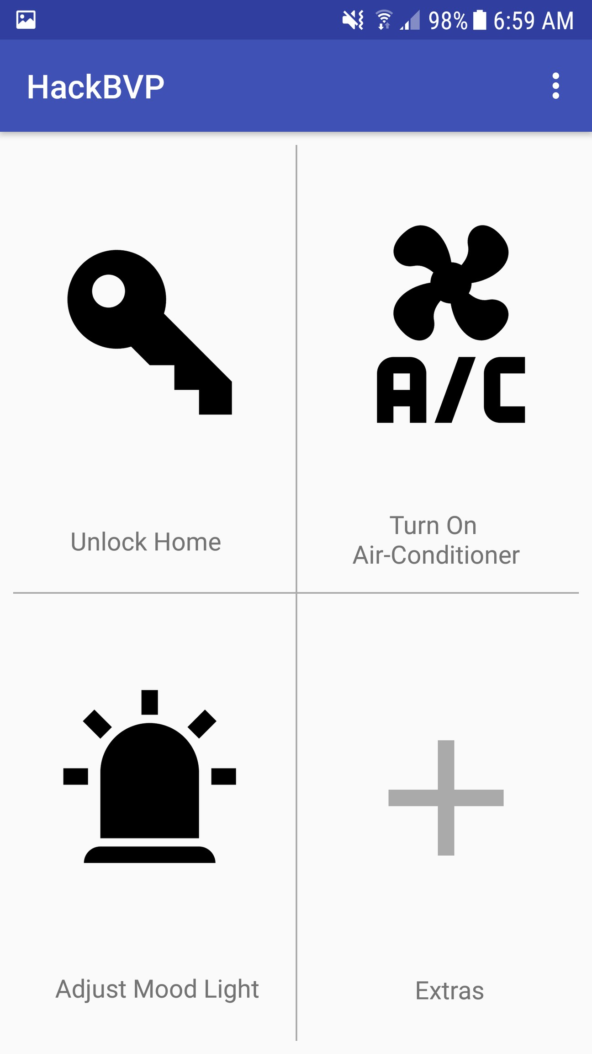
Our App

Slide 4


SECURITY(Smart Locking )
Locking system linked with fingerprint sensor of your phone!!
Next step to the old school approach of locking system, today almost every phone has fingerprint sensor, so why not use this resource to transform the tech.
Spoofing of this method is near to impossible with very few exceptions giving us a more reliable, effecient and user- friendly security system.

Slide 5
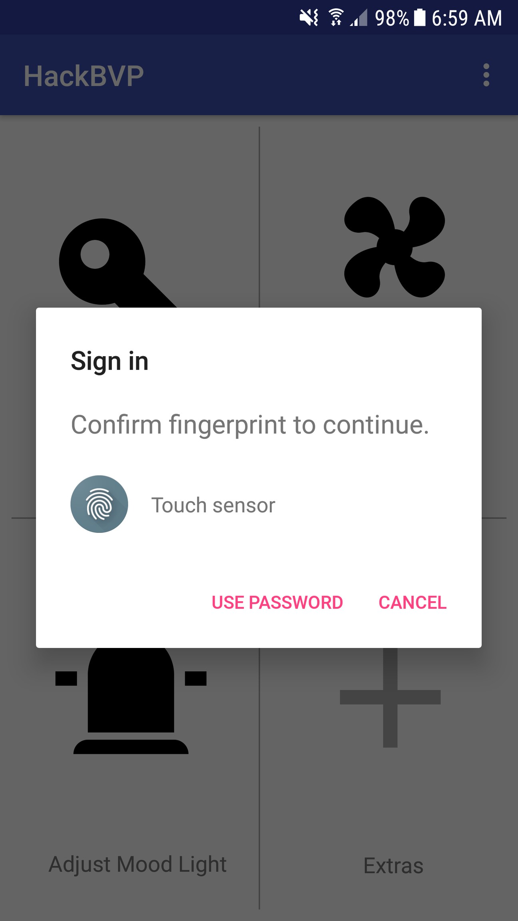
Fingureprint sensing process

Slide 6
Innovative Air Conditioning system
D o e s y o u r a i r c o n d i t i o n e r c o o l t h e r o o m i n s t a n t l y ? N o w w e h a v e t h e s o l u t i o n f o r t h a t t o o
A s m a r t s e n s o r ( s u p r i s i n g l y y o u r m o b i l e g p s ) w h i c h w o u l d s e n s e y o u r l o c a t i o n a n d u s i n g I o T i t a n d w o u l d t u r n i t o n
a u t o m a t i c a l l y a s s o o n a s y o u c o m e w i t h i n t h e s p e c i f i e d b o u n d a r y o f y o u r h o u s e

Slide 7
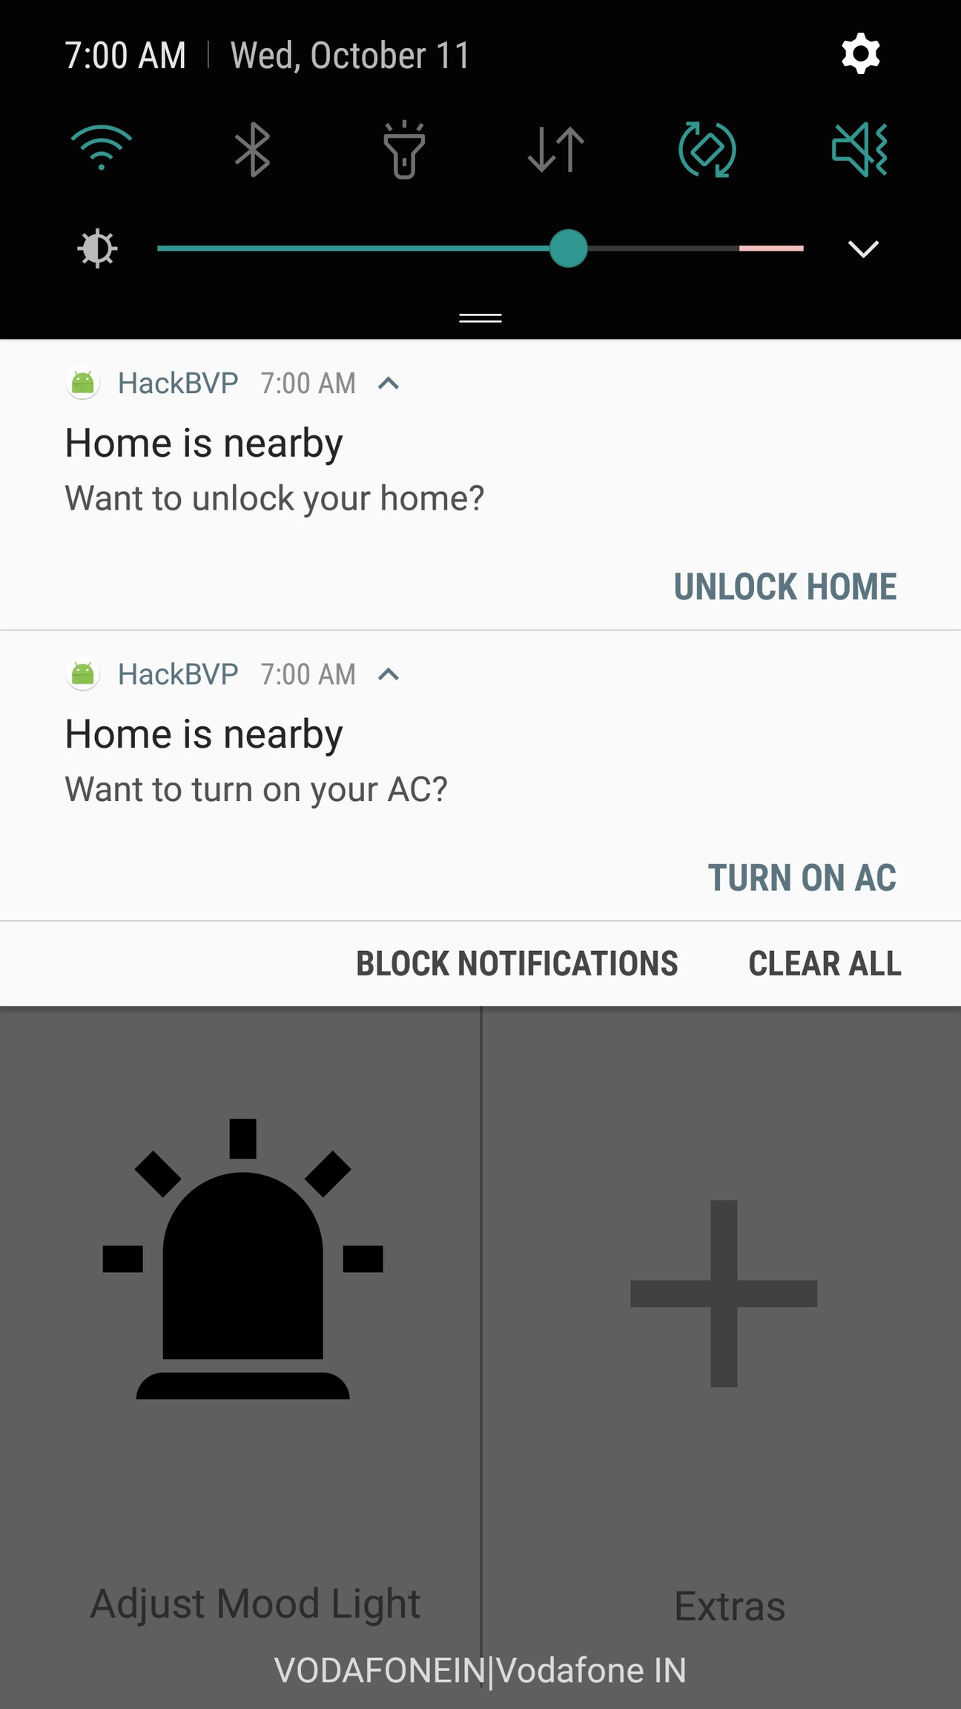
Location based suggestions

Slide 8

MOOD LIGHTING SYSYTEM
I n n o v a t i o n a n d A u t o m a t i o n l e a d i n g t o I n v e n t i o n ! ! !
A n d h e r e i s o u r n e x t a p p l i c a t i o n , t h e s m a r t
l i g h t i n g s y s t e m w h i c h m a k e s n o r m a l O N / O F F s w i t c h o b s o l e t e i n t h e m a r k e t t h u s p r o v i d i n g b e t t e r u s e r e x p e r i e n c e i n f e a s a b l e c o s t
l e a v i n g e n d u s e r w i t h n o c h o i c e t h a n t o c h o o s e i t ! !

Slide 9
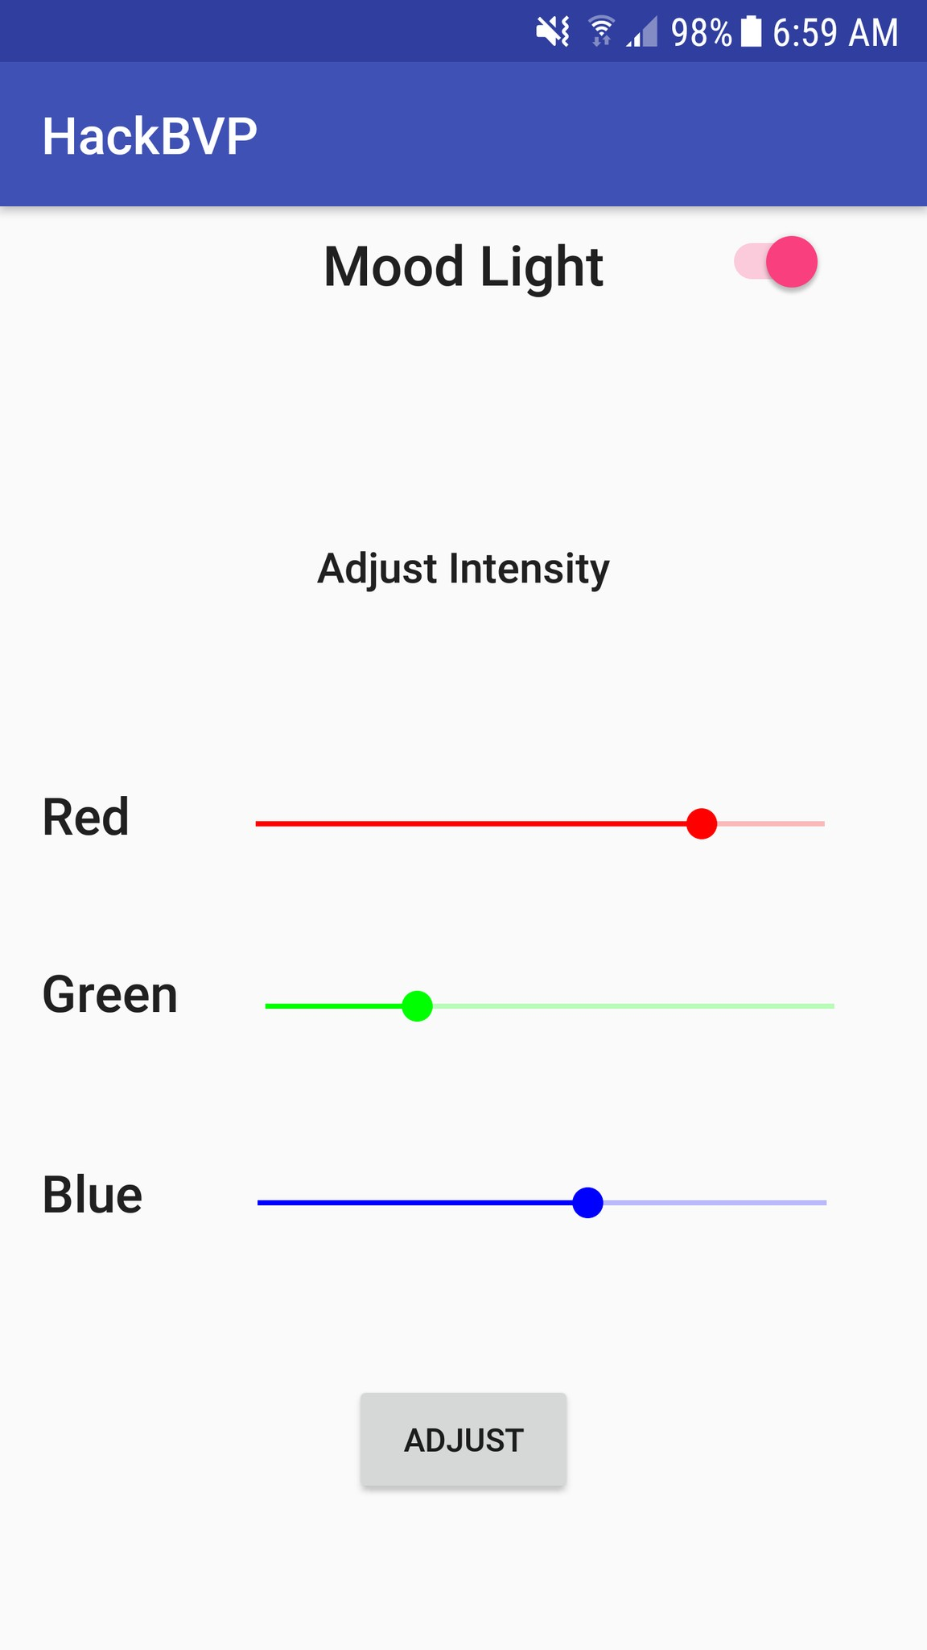
MOOD LIGHTING APP.INTERFACE

Slide 10
Machine Learning based Predictive Analysis for Air Purifier
S h o u l d y o u b u y a n A i r p u r i f i e r o r n o t ? ?
C o m p a n i e s t o d a y c l a i m t h a t a i r p u r i f i e r i s a n e c e s s a r y a p p l i a n c e ? ? i s i t ? ? F o r c h e c k i n g
t h i s a n d g e t i n g a b a s i c i d e a a b o u t
i n s t a l l a t i o n o f t h e p u r i f i e r , w e d e p l o y a m a c h i n e l e a r n i n g a l g o r i t h m w h i c h d o e s
p r e d i c t i v e a n a l y s i s a n d s h o w s u s t h e r e s u l t o r t h e a n a l y s i s w h e t h e r t o i n s t a l l t h e
d e v i c e o r n o t ! !

Slide 11
Smart Sensors
A w o r l d c o n s i s t i n g o f u s e o f o f I o T i n d a i l y u s e a p p l a n c e t o m a k e t h i s w o r l d a b e t t e r p l a c e t o l i v e i n
U s e o f s e n s o r s f o r g a r d e n i n g ( b a s c i a l l y s o i l m o i s t u r e a n d n u t r i e n t s e n s o r )
S m a r t p a r k i n g s e n s o r t o k e e p t a c k o f
p a r k i n g s p a c e s i n a r e a a n d a l s o a l a r m i n g o w n e r o f a n y u n a u t h o r i s e d a c e s s t o h i s
p a r k i n g s p a c e
S m a r t s w i t c h e s u s i n g r e a l t i m e c l o c k
( a u t o m a t i c o n o f f o n b a s i s o f r e a l t i m e o f a r e a ) t o s a v e n a t u r a l r e s o u r c e s

