Slide 1
Automatic Decision Making in Robotics with VLM Models and RL
How vision-language models turn perception into goal-directed robotic action
Scope: multimodal perception, language-grounded planning, and closed-loop robot control

Slide 2
Overview
Introduction
What is VLM?
What is RL?
Literature Review
SayCan – Ahn et al.,(2022)
RT2 – B.Zitkovich et al., (2023)
OpenVLA – M. J. Kim et al(2023)
Limitations
Key challenges and current constraints
Pipeline
End-to-end workflow and system architecture
References
Sources and supporting materials
Introduction
02

Slide 3
Introduction
This project focuses on enabling robots to make autonomous decisions using Vision-Language Models (VLMs) and Reinforcement Learning (RL). VLMs provide visual understanding and interpret high-level task instructions. RL learns effective actions through interaction with the environment. The combined approach aims to achieve adaptive and context-aware robotic behavior in 3D simulation.
What is Vision-Language Model (VLM)?
A multimodal model that combines a vision encoder with a language model to map images or video into representations that can be understood and reasoned over in natural language.(Eg: Llama 3.2-Vision,QWEN 2.5-VL,etc.)
What is Reinforcement Learning (RL)?
A learning paradigm where an agent learns a policy by interacting with an environment, receiving rewards or penalties, and optimizing its behavior to maximize long-term cumulative reward.
Background & Key Concepts
04

Slide 4
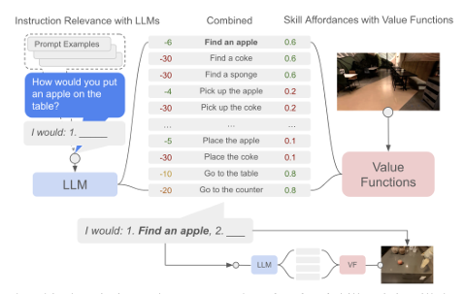
Literature Review
SayCan (2022) - Ahn et al.
The paper discusses on LLMs are being grounded so that it can generate feasible actions that the robot can perform.
The goal is to accurately predict whether a skill in the skillset space of the robot is feasible at current state by using temporal difference-based methods.
The affordance function estimates how feasible a robot skill is in the current environment. It assigns a score to each candidate action based on the robot’s ability to execute it successfully.
Literature Review
05

Slide 5
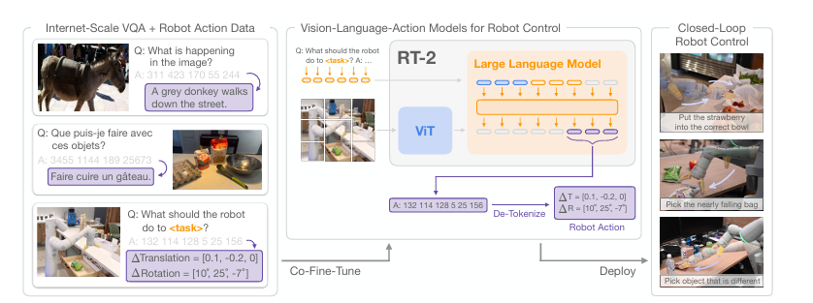
Literature Review
RT2 (2023) - B. Zitkovich et al.,
The pretrained VLM models are trained directly to act as instruction following robotic policies. These type of models are called Vision Language Action (VLA) models.
Robot actions are represented as discrete tokens and incorporated into the language-model output space. The model is then co-fine-tuned on large-scale vision-language data and robot trajectories, enabling it to map visual and language inputs directly to robot actions.
Literature Review
05

Slide 6
Literature Review
RT2 (2023) - B. Zitkovich et al.,
The pretrained VLM models are trained directly to act as instruction following robotic policies. These type of models are called Vision Language Action (VLA) models.
Robot actions are represented as discrete tokens and incorporated into the language-model output space. The model is then co-fine-tuned on large-scale vision-language data and robot trajectories, enabling it to map visual and language inputs directly to robot actions.
Literature Review
05

Slide 7
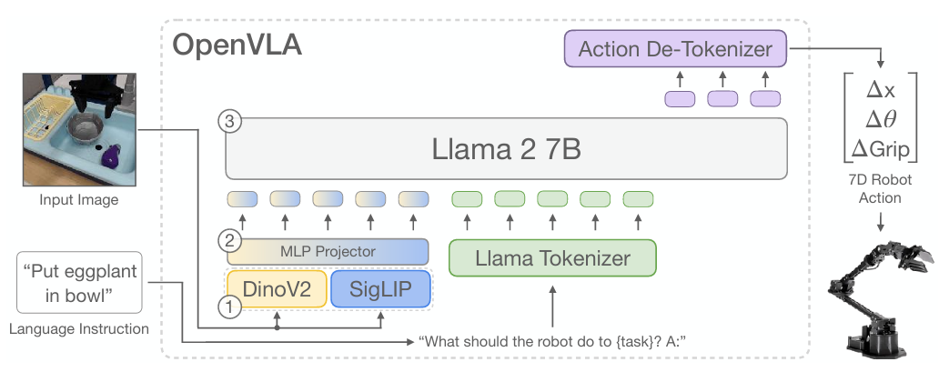
Literature Review
OpenVLA (2024) - M. J. Kim et al.,
While RT2 established the concept that directing employing robotic policies through models is possible, OpenVLA opened the paradigm more accessible and reproducible for research purposes.
OpenVLA is trained on a large, diverse dataset of ~970K real-world robot demonstrations across multiple embodiments, enabling one model to learn and transfer manipulation skills across different robots and tasks.
Literature Review
05

Slide 8
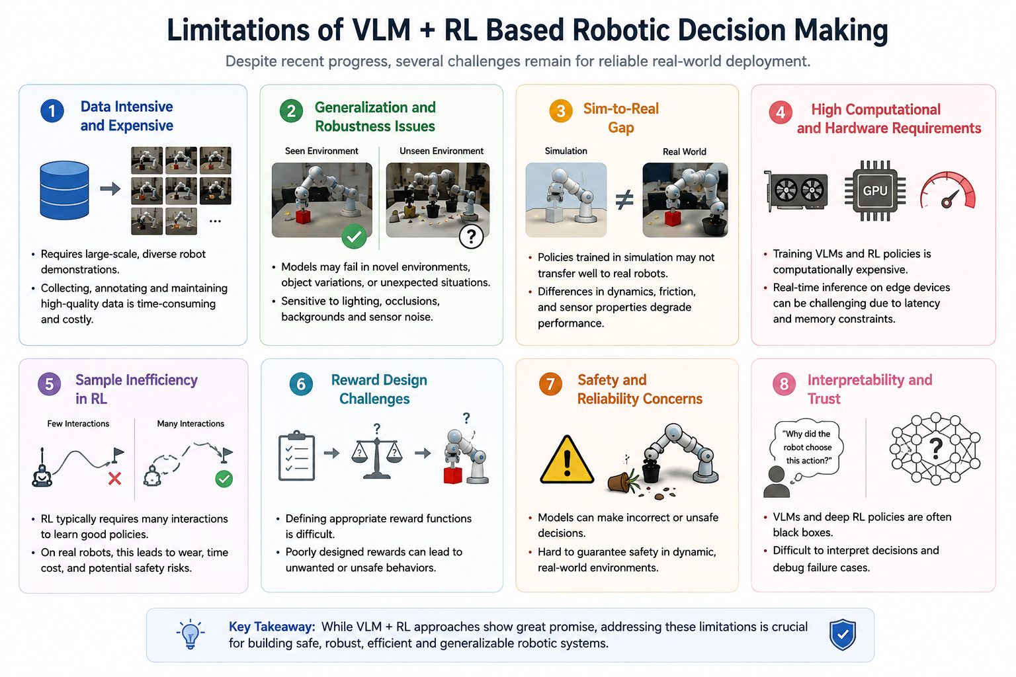
07

Slide 9
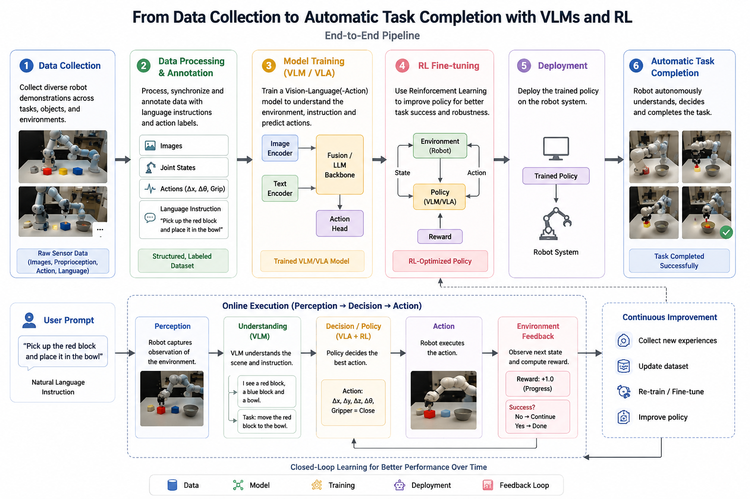
06

Slide 10
Comparing Approaches
Aspect | CLIP | VLM | VLA
Full form | Contrastive Language–Image Pre-training | Vision-Language Model | Vision-Language-Action Model
Primary purpose | Align images and text | Understand and reason about vision + language | Connect vision + language to robot actions
Input | Image + text | Image/video + text | Image/video + language instruction
Output | Similarity score / embeddings | Text, answers, reasoning | Actions / action tokens
Main capability | Image–text matching | Visual understanding & reasoning | Perception → decision → action
Robotics role | Mainly perception/representation | Scene understanding & task reasoning | Direct robotic control
Example | “Which text matches this image?” | “What objects are on the table?” | “Pick up the red block.” → robot action
Representative models | CLIP | GPT-4o, Gemini, LLaVA | RT-2, OpenVLA
08

Slide 11
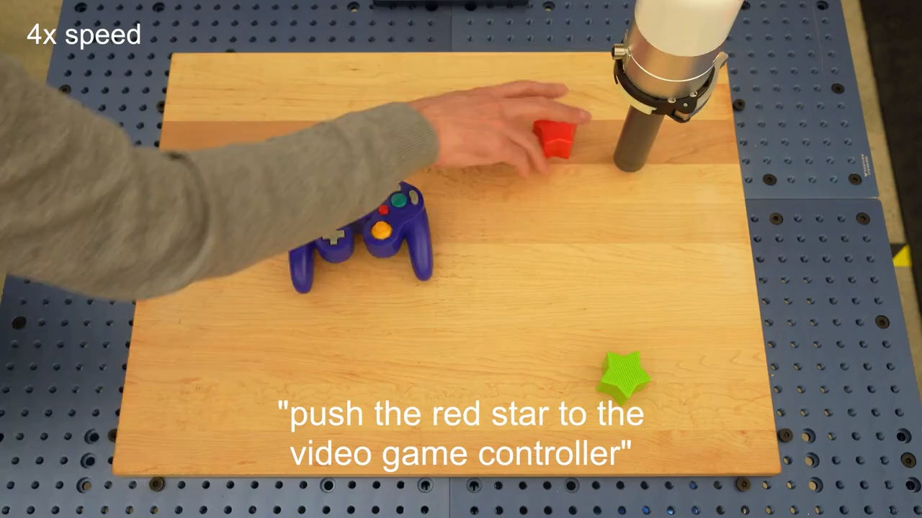
Roboting Is Moving Based on RT2 Model
Robotic Movement with RT-2
RT-2 connects visual perception and language understanding directly to robot actions, enabling a robot to follow instructions and adapt learned concepts to new objects and tasks.
Perceives the scene through camera-based visual inputs
Interprets instructions with a vision-language-action model
Generates actions to move and manipulate the target object
Source: Google DeepMind, RT-2 project overview
10

Slide 12



Key Takeaways
Perception to Action
Learning Closes the Loop
Deployment Gaps Remain
VLMs interpret scenes and instructions; VLA models such as RT-2 and OpenVLA translate that understanding into action tokens for direct robot control.
Reinforcement learning uses rewards and environment feedback to refine the policy, improving task success and adaptation through repeated interaction.
Reliable real-world use still requires diverse data, stronger generalization, sim-to-real transfer, efficient compute, safety controls, and interpretable decisions.
Summary & Q&A
11

Slide 13
References
Ahn, M., et al. (2022). Do As I Can, Not As I Say: Grounding Language in Robotic Affordances. arXiv:2204.01691.
Brohan, A., et al. (2023). RT-2: Vision-Language-Action Models Transfer Web Knowledge to Robotic Control. arXiv:2307.15818.
Kim, M. J., et al. (2024). OpenVLA: An Open-Source Vision-Language-Action Model. arXiv:2406.09246.
13

Slide 14
References
Brohan, A., et al. (2022). RT-1: Robotics Transformer for Real-World Control at Scale. arXiv:2212.06817.
Radford, A., et al. (2021). Learning Transferable Visual Models From Natural Language Supervision. Proceedings of ICML.
Singh, I., et al. (2023). ProgPrompt: Generating Situated Robot Task Plans using Large Language Models. Proceedings of ICRA.
14

Slide 15
References
Liang, J., et al. (2022). Code as Policies: Language Model Programs for Embodied Control. arXiv:2209.07753.
Vaswani, A., et al. (2017). Attention Is All You Need. Advances in Neural Information Processing Systems, 30.
Huang, W., et al. (2022). Inner Monologue: Embodied Reasoning through Planning with Language Models. Proceedings of CoRL.
15

Slide 16
Thank You
12

