Slide 1
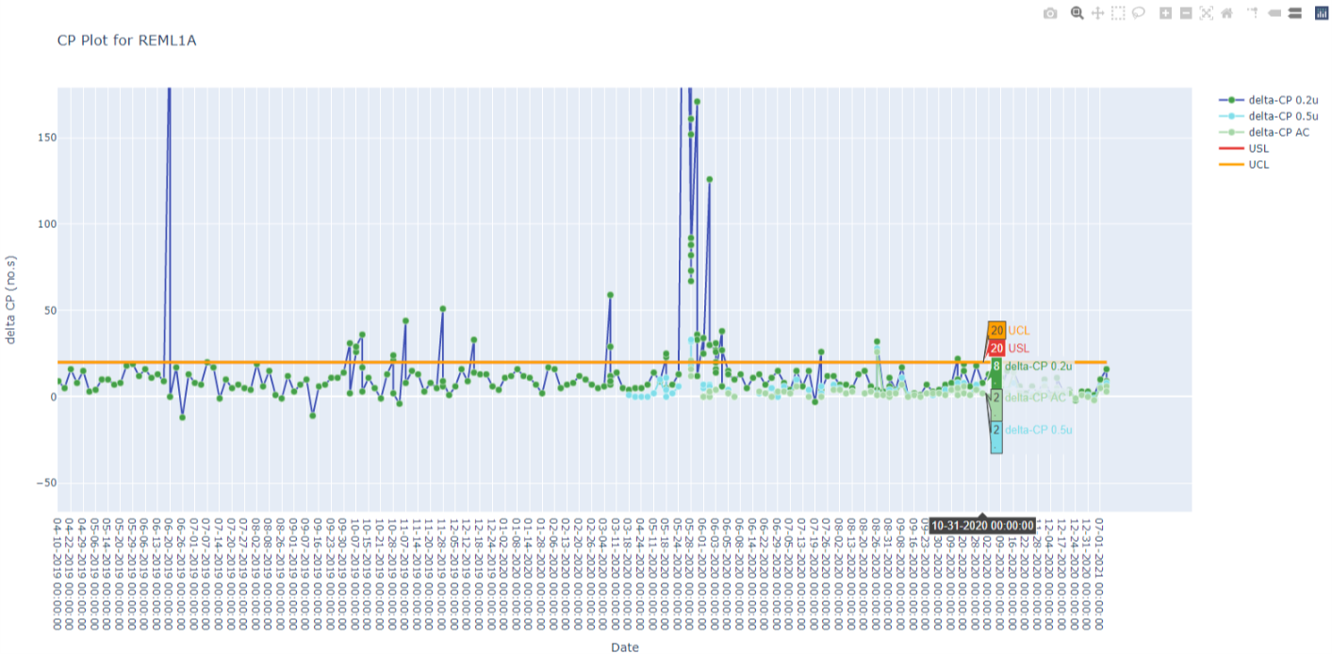
AutoPlot
FAB QC Monitor |
Dry Etch
ASFE1 | ASBE1 | REML1 | REOX1 | REPL1 | RESP1
Ch A
Ch C
CP Chart
ER Chart
Unif Chart

