Slide 1

AutoPlot
Generate Plots Automatically

Slide 2
Content
Background
Problems
Features
Demo: DE, Diffu., WE
Scripting/Coding

Slide 3
Background

Slide 4
Problems

Slide 5
Demo: Dry Etch

Slide 6
Demo: Diffusion

Slide 7
Demo: Wet Etch

Slide 8
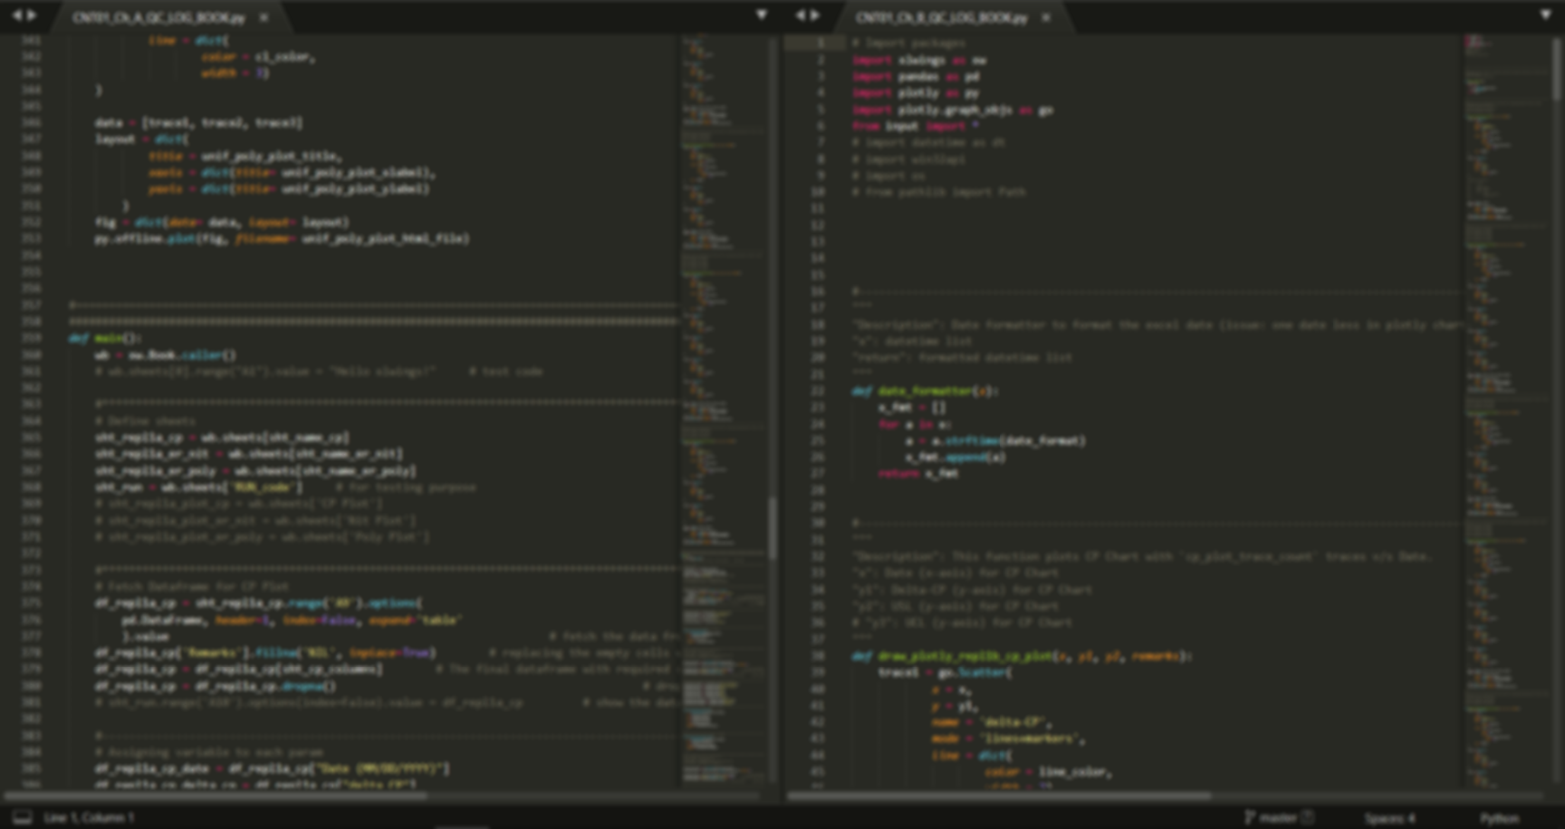
Scripting/Coding

