Slide 1

AutoPlot
Generate Automatic Plots

Slide 2

Content
Background
Problems
Features
Demo: DE, Diffu., WE
Scripting/Coding
Coding Essentials
Modules: CP, ER, Uniformity
Utilities

Slide 3
Background
AutoPlot is an Indigenous Software created for generating plots automatically from the data (especially QC) maintained in all the sections of VFD.
applicable for any type of data –
CSV,
TSV,
Excel (with single/multiple sheets)

Slide 4
Problems
In order to generate Plots for QC data (maintained in Excel), currently we drag each parameter (like Date, Control limits, Spec limits, Etch Rate/Thickness/CP, etc.) manually to create/update the charts. And this consumes a good amount of valuable time in Engineer's data analysis job.
In some sections, they are dependent on plots created in DMIS, which is not that satisfactory as it doesn't contain 'Remarks' column feature and more.

Slide 5
Features
It has 3 operation modes => Button, Shell & Auto.
It shows the 'Remarks' column while hovering on the data points in the Plot.
It is very Interactive (zoom-in/out) and is quite Modern.
A button is built-in within, for saving the plot's snapshot and can be attached in PPTs, Mail, etc.
FYI, the entire codebase is written in Python, Bash (for automation) programming languages.
There is no need of learning a programming language. All the modules/functions will be provided in form of packages and hence can be applied (with little parameter tweaks) for any form of data (in CSV, Excel).
ViEW (another Indigenous Software) is also integrable with AutoPlot for adding "Version Control" feature to the Codebase, Excel, Word, Image (or any other format) files. Here, ViEW acts as the foundation layer for AutoPlot.
It can also be used in applications where JMP software is normally preferred, here in SCL. In this, there are separate modules/functions which can replace the scripts written in JMP Scripting Language (JSL).

Slide 6
Testing
Fully implemented in DRY ETCH and successfully tested for more than 2 months now.
A sample QC data of PRS01 Equipment, WET ETCH has also been successfully tested as well.
A sample QC data of FRST1 Equipment, DIFFUSION has also been successfully tested as well.

Slide 7
Demo: Dry Etch

Slide 8
Demo: Diffusion

Slide 9
Demo: Wet Etch

Slide 10
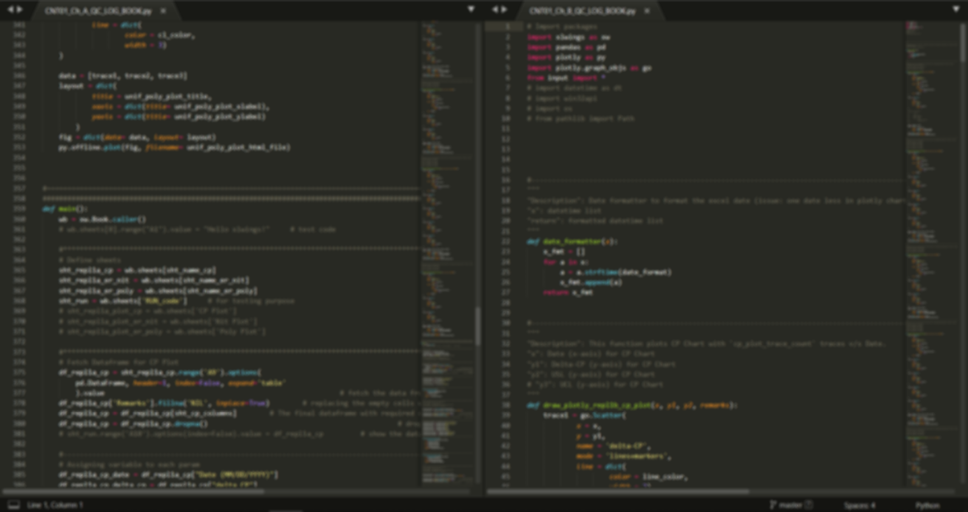
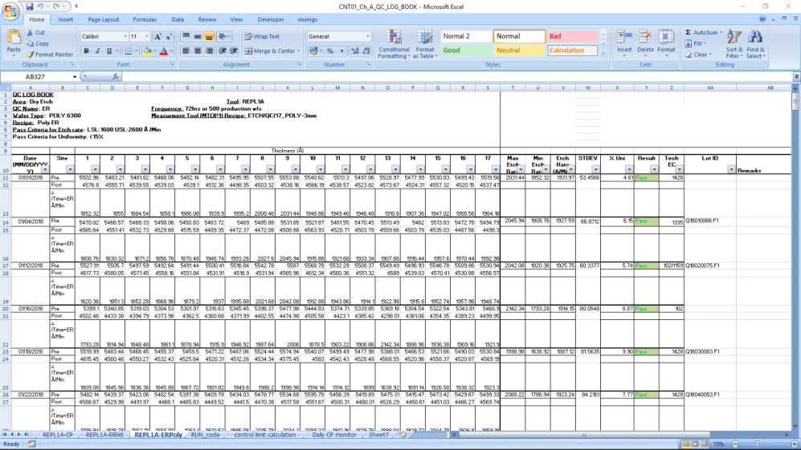
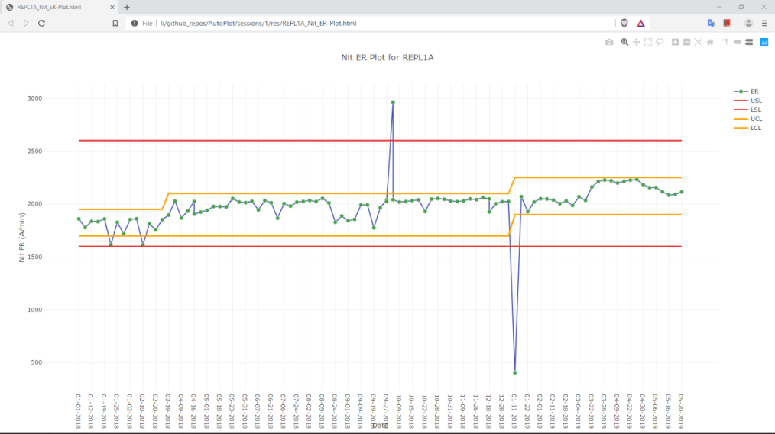
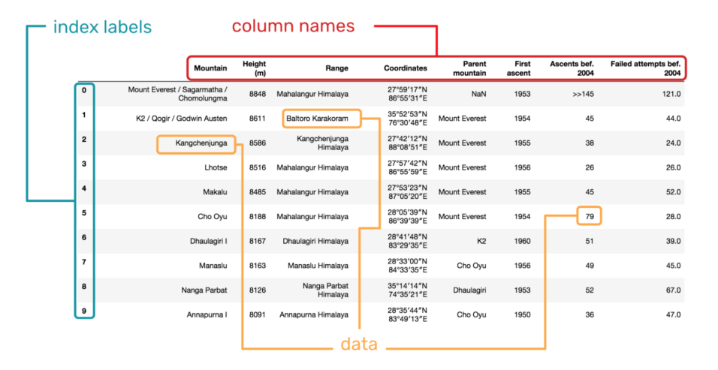
Design Model
Generate Plots
Cleaning,
Filtering,
Re-structuring
Button
Shell
Auto

Slide 11
Coding Essentials
Editor, Compiler

Slide 12
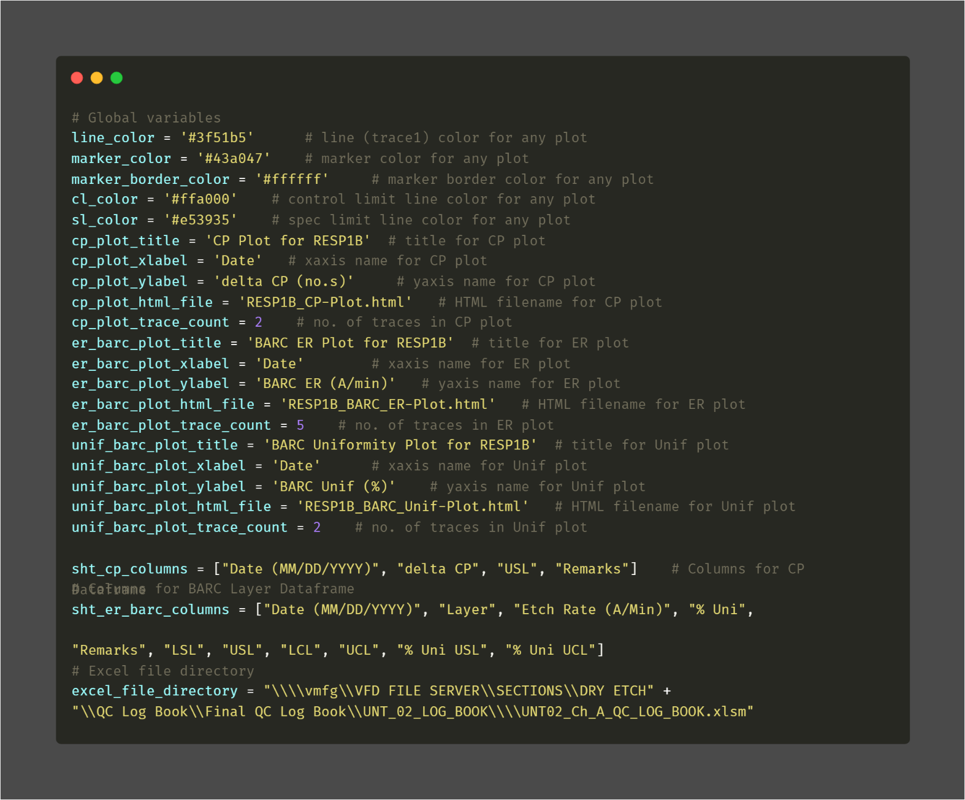
Modules: Global variables

Slide 13
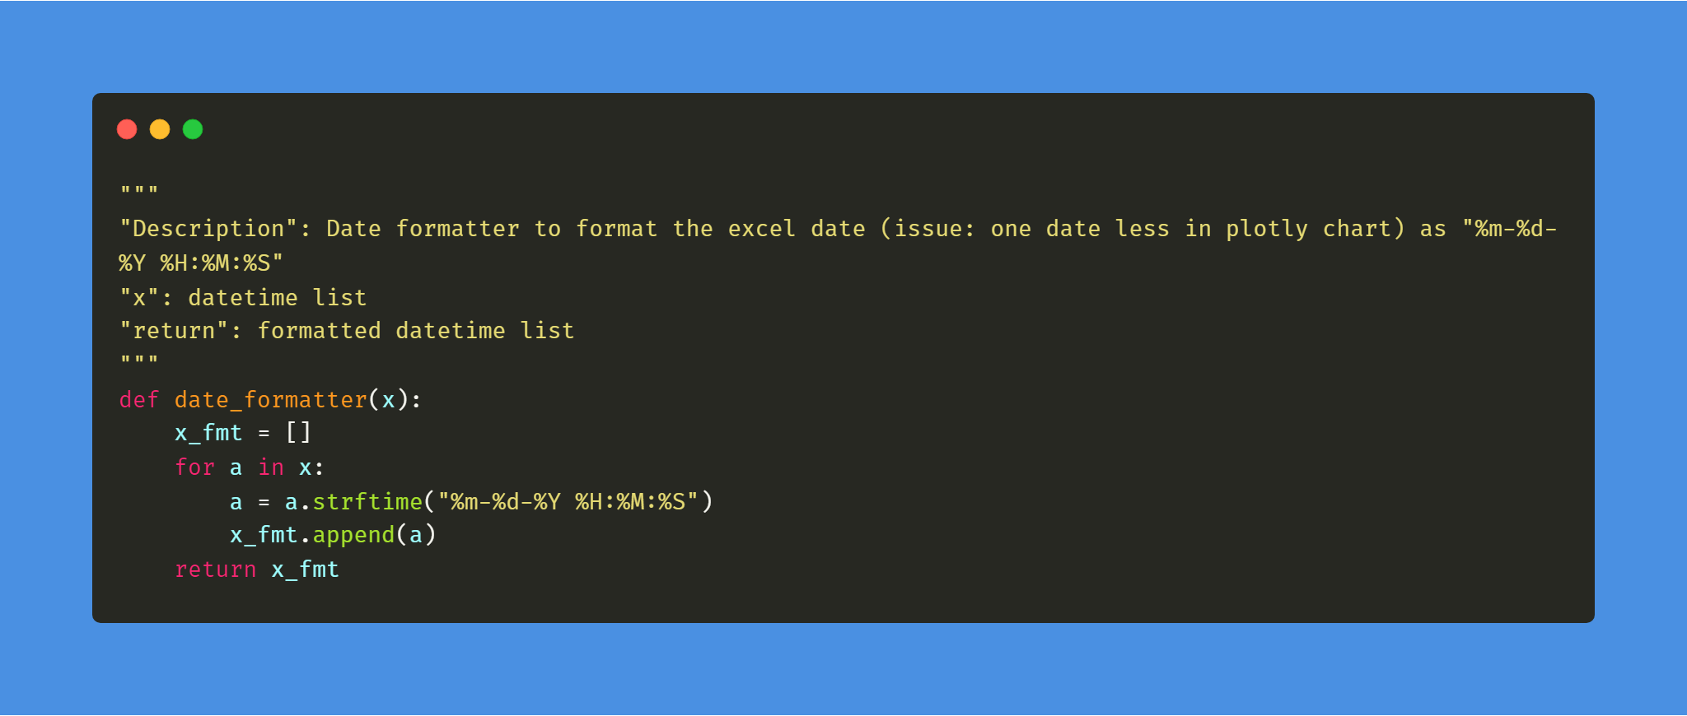
Modules: Date Formatter

Slide 14
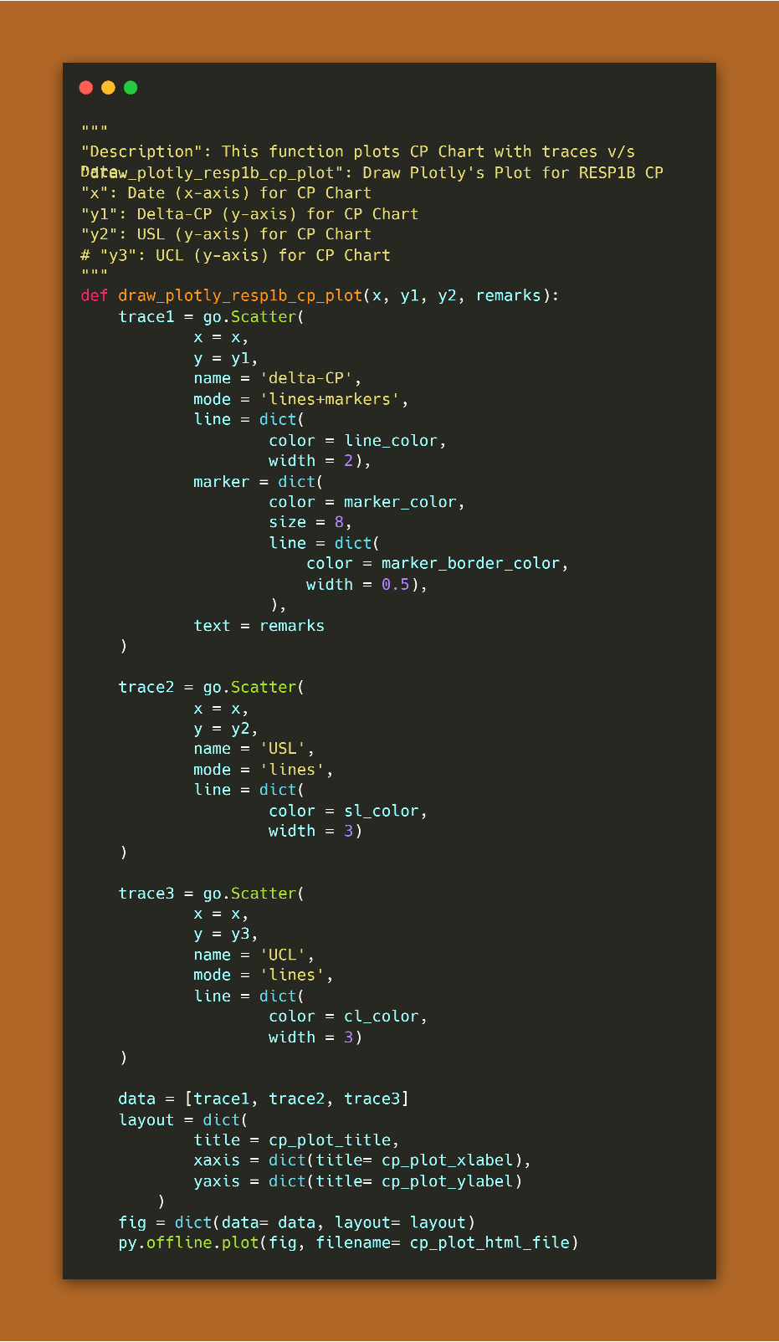
Modules: CP Plot

Slide 15
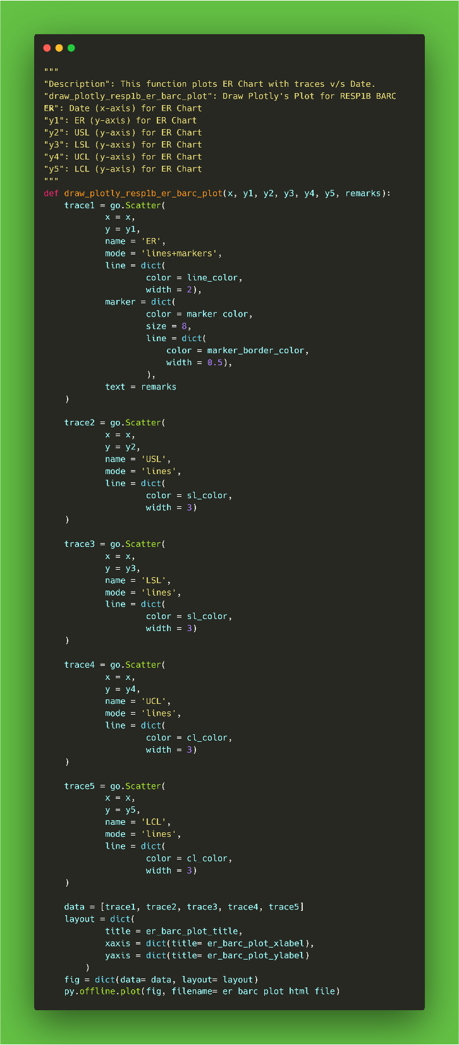
Modules: ER Plot

Slide 16
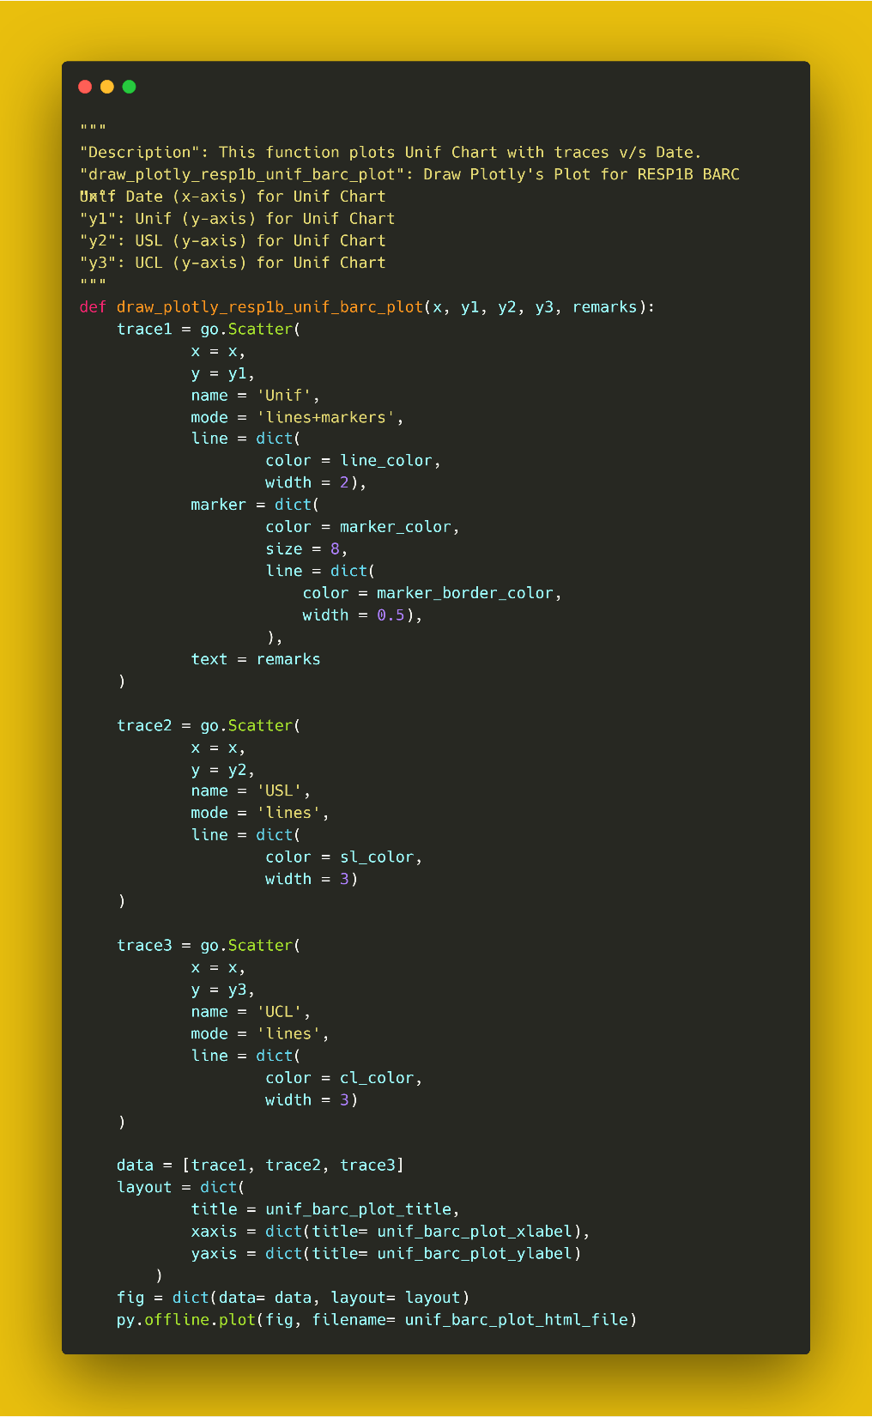
Modules: Unif Plot

Slide 17
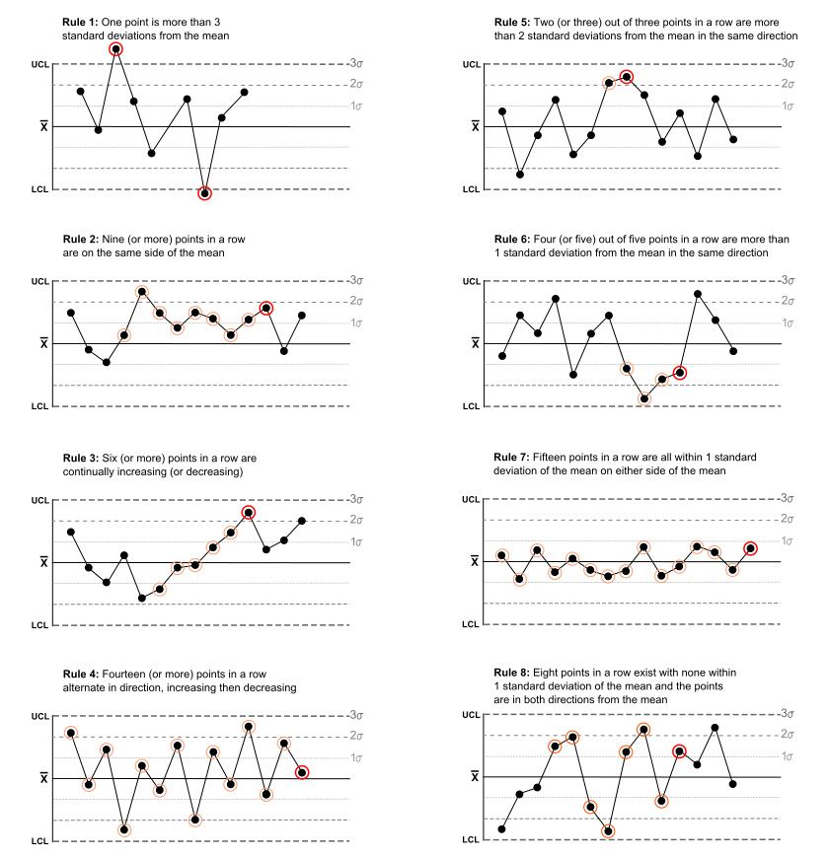
Utilities
Stage-2: Applying Nelson rules (Under development)
Like in JMP, one can write custom script to generate plots out of data (in any format).
Various types of plots can be created – Line, Scatter, Box, Qiver, Contour (2-D, 3-D), Heatmap,

