Slide 1

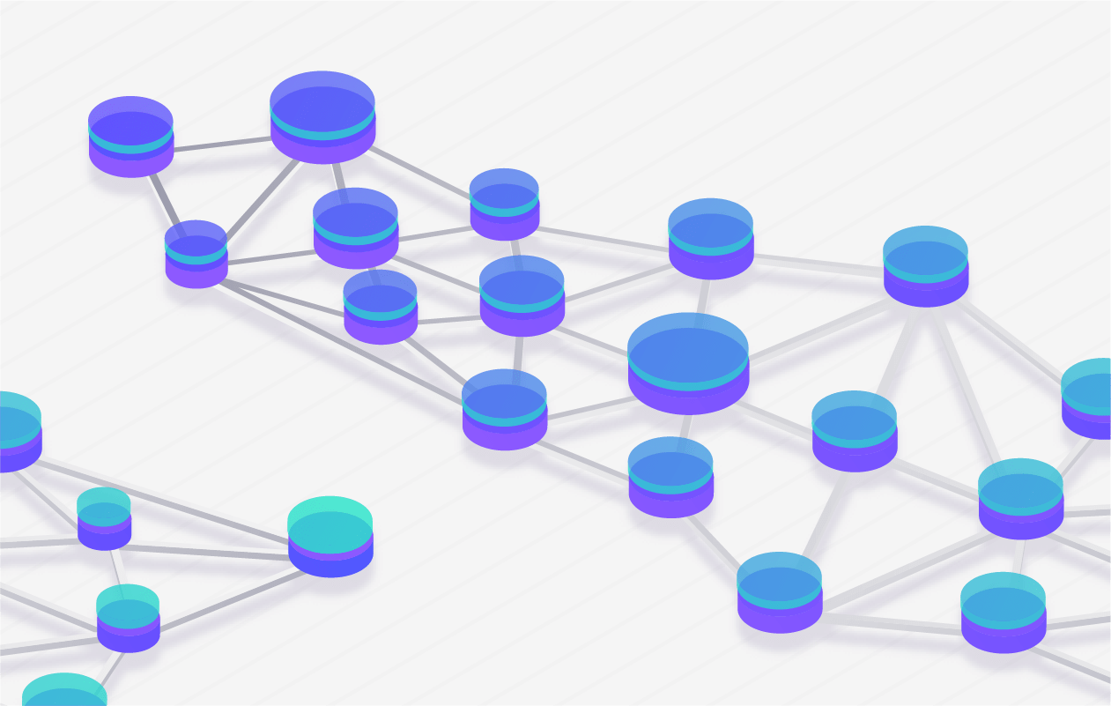
Blockchain, CRYPTOCURRENCY & MORE
Decentralize Everything

Slide 2
Contents
Overview - Two General’s Problem - Blockchain - Consensus - Cryptocurrency - ETH vs EOS - Why EOSIO?
Block Explorer - Producer/Miner/Validator - Blocks - Transactions - Activity - Incentives
Applications - Banking - Real Estate - Logistics - Healthcare - Food delivery - Cab request - E-commerce

Slide 3
Overview

Slide 4
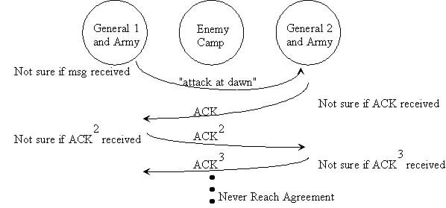
Two General’s Problem
Basically, there is a problem of consensus b/w the 2 armies.
Therefore, no sync ever.
Also, there is a problem of attack of messenger by 3rd party.

Slide 5





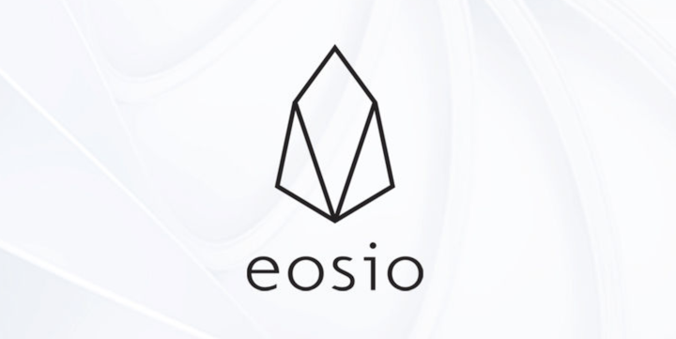








Blockchain
Bitcoin is the first Blockchain launched in 2009 just after “global financial crisis”. It’s only use case was to transfer money. It’s also the slowest out of all networks.
The 1st general purpose Blockchain – Ethereum (whitepaper shown in 2013 & released in 2015). Here, multiple Dapps can be deployed on top of it like Google’s Playstore, Apple’s Appstore.
Currently, the fastest Blockchain is EOSIO protocol based launched in 2018.

Slide 6
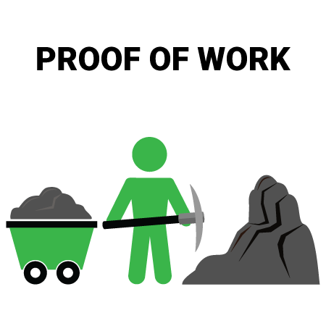
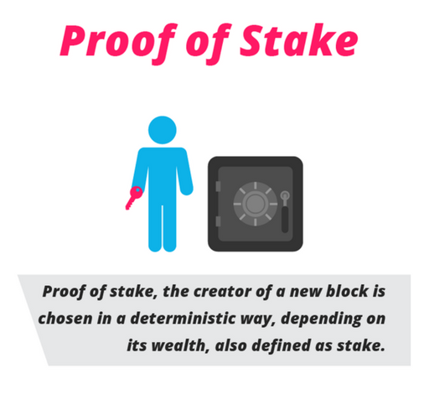
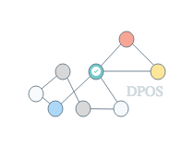
Consensus
Every Blockchains have different types of consensus algorithms followed like: - Proof of Work (PoW), - Proof of Stake (PoS), - Delegated Proof of Stake (DPoS), - Proof of Authority (PoA), - Hybrid PoW/PoS,

Slide 7
types
Public, permissionless, private, permissioned

Slide 8
Cryptocurrency/COIN/TOKEN
EOS Launched in June 2018.
EOS use EOS.IO Software which is open-sourced on Github.
Using EOS.IO Software, many Blockchains like TELOS, WAX, Proton, BOS, Worbli, FIO, MEET.ONE, Europechain, COFEE, Remme have been launched so far and many others will be in future.

Slide 9


ETH
EOS
Zero account creation fee.
Has transaction fee (static or variable).
Resulting into losing of good portion of ETH tokens as txn-fee after multiple transactions.
Transaction fee + mined tokens becomes the earning for Miners/Block Producers.
Each account is identified by public address/key. E.g. 0x5AeE428438376A87d2FEd1De3920D105465926bB
Every pub_key starts with ‘0x’
One-time account creation fee (based on min. EOSIO resources needed & its marketplace price).
Has no transaction fee. Instead follows staking model.
Exit can be made at anytime by unstaking the EOS tokens & resulting into no loss of EOS tokens as there is no txn fee.
mined tokens (from inflation per year) becomes the earning for Block Producers.
Each account is identified by human readable name. e.g. abhieosindia
Every pub_key starts with ‘EOS’. E.g. EOS5cjMNJETNS8HrKBRZ4zC3PDYHRUhpmje1j21JQfz7FE3QueaiF

Slide 10
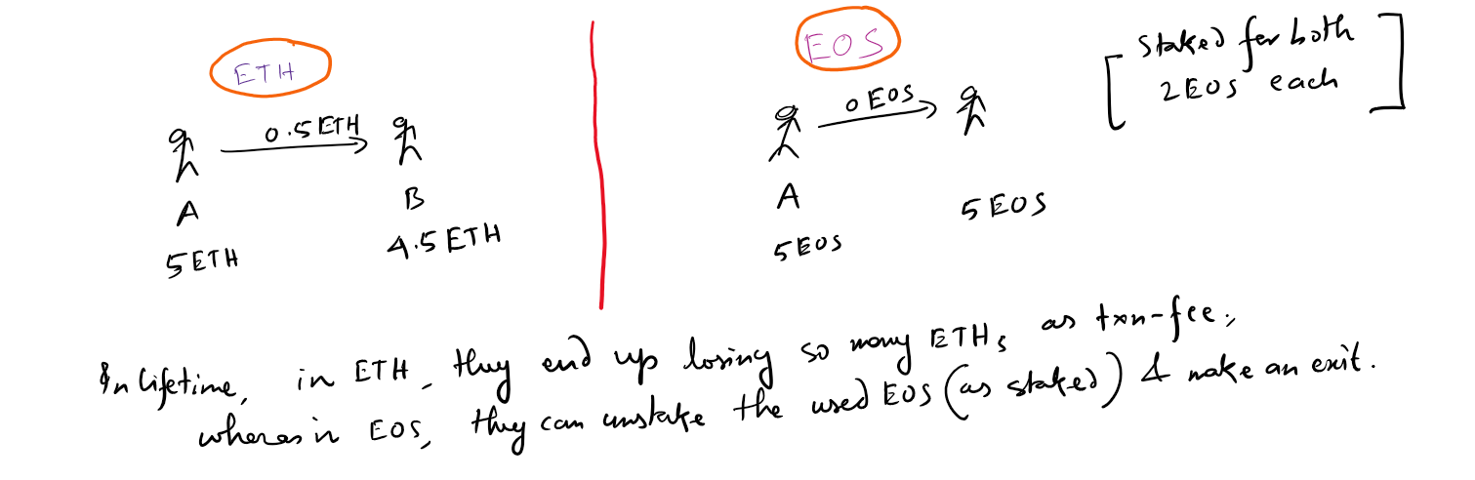
ETH vs EOS
Example

Slide 11
Why EOSIO?
The protocol can be used as either of the 4 different types of Blockchain i.e. for any type of industry use cases, in order to power their own cloud servers.
Both the business models can be implemented → “Pay as per use” & “One time investment by investors”

Slide 12
Block Explorer

Slide 13
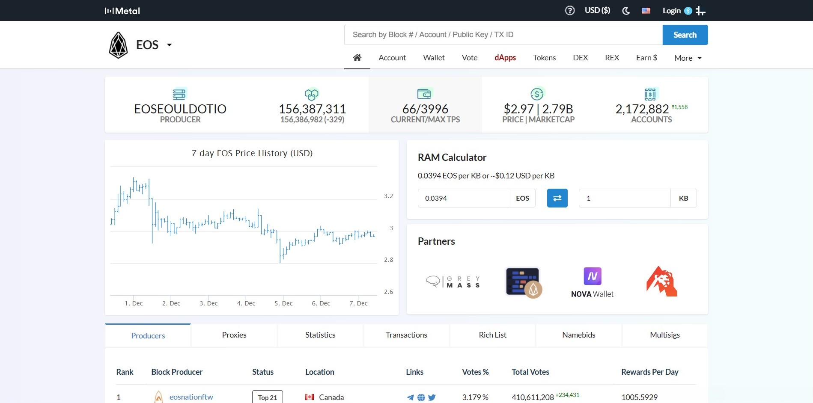

Slide 14
Applications

Slide 15

THANKS

