Slide 1

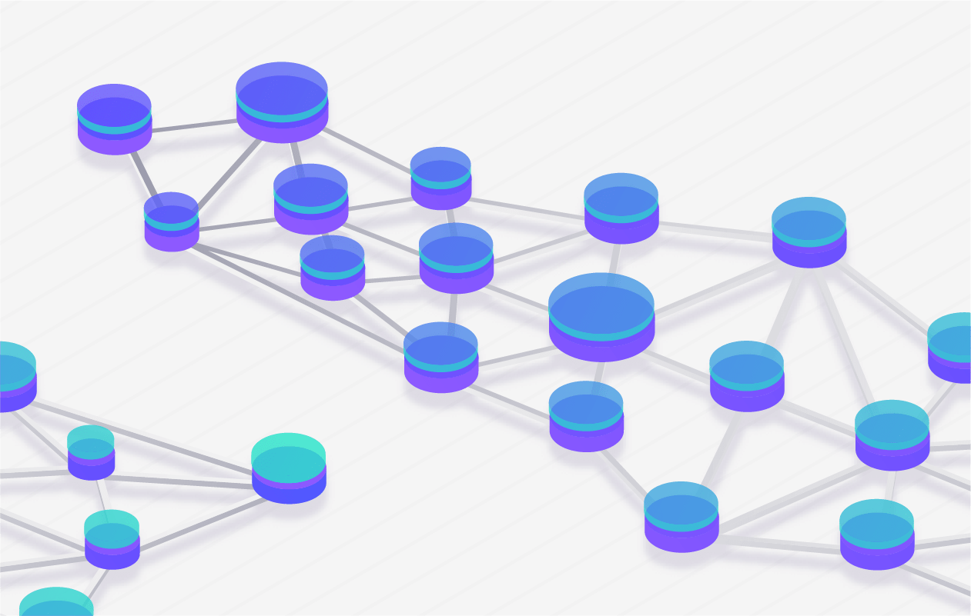
Learn Blockchain CRYPTOCURRENCY & MORE
BUSINESS ASPECT

Slide 2
Contents
Overview
Block Explorer
Chains
Key
Wallet
EOSIO Components
EOSIO Contract Development Toolkit (CDT)
Source code language (C++)
Binary output (WASM)
ABI output (ABI)
EOSIO Resources

Slide 3
Overview

Slide 4

About
EOS Launched in June 2018.
EOS use EOS.IO Software which is open-sourced on Github.
Using EOS.IO Software, many Blockchains like TELOS, WAX, Proton, BOS, Worbli, FIO, MEET.ONE, Europechain, COFEE, Remme have been launched so far and many others will be in future.

Slide 5


ETH
EOS
Zero account creation fee.
Has transaction fee (static or variable).
Resulting into losing of good portion of ETH tokens as txn-fee after multiple transactions.
Transaction fee + mined tokens becomes the earning for Miners/Block Producers.
Each account is identified by public address/key. E.g. 0x5AeE428438376A87d2FEd1De3920D105465926bB
Every pub_key starts with ‘0x’
One-time account creation fee (based on min. EOSIO resources needed & its marketplace price).
Has no transaction fee. Instead follows staking model.
Exit can be made at anytime by unstaking the EOS tokens & resulting into no loss of EOS tokens as there is no txn fee.
mined tokens (from inflation per year) becomes the earning for Block Producers.
Each account is identified by human readable name. e.g. abhieosindia
Every pub_key starts with ‘EOS’. E.g. EOS5cjMNJETNS8HrKBRZ4zC3PDYHRUhpmje1j21JQfz7FE3QueaiF

Slide 6
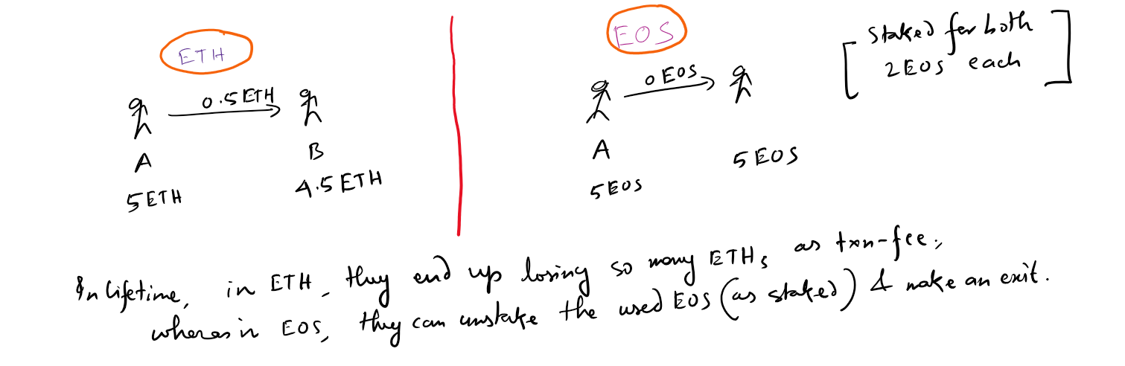
ETH vs EOS
Example

Slide 7
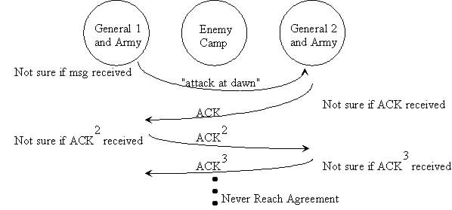
Why EOSIO?
Free Rate Limited Transactions
Low Latency Block confirmation (0.5 seconds)
Low-overhead Byzantine Fault Tolerant Finality. Byzantine Fault Tolerance
Smart contract platform powered by WebAssembly (explained later)
Designed for Inter Blockchain Communication (IBC)

Slide 8
Block Explorer

Slide 9
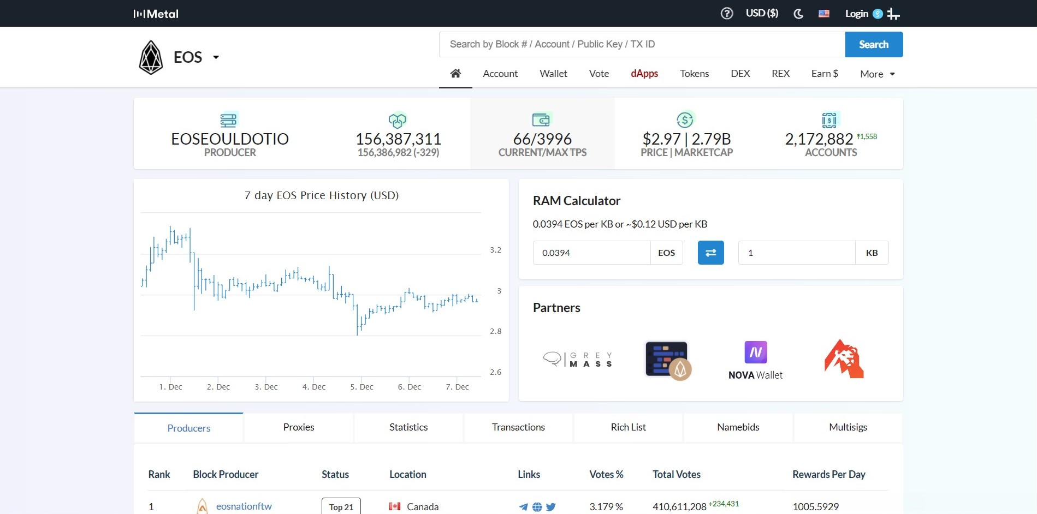

Slide 10
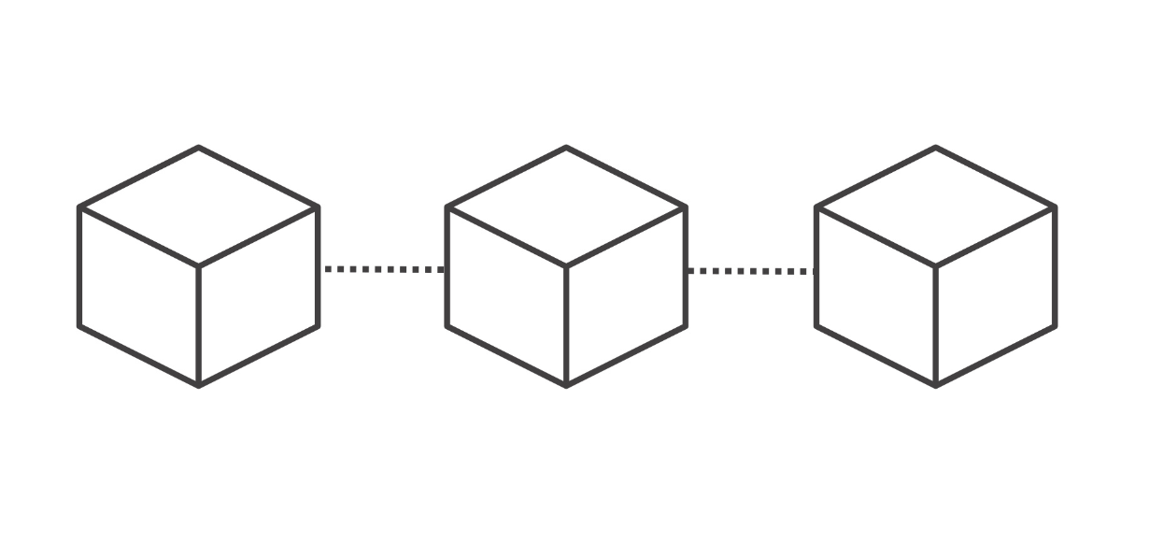
CHAINS

Slide 11
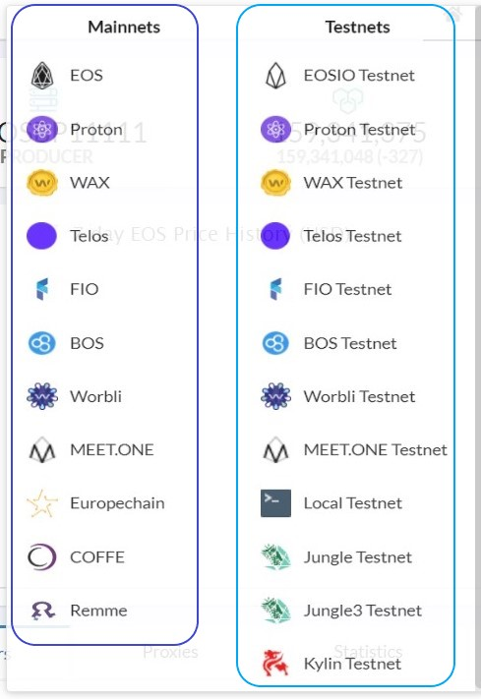
Types
Mainnet
Testnet
Used for testing Smart contracts in this course

Slide 12
Difference
Mainnet
Testnet
Chain Tokens hold value in the real market.
tokens can be issued based on your expenditure in fiat currency.
All the production DApps are released here.
Chain Tokens hold no value in the real market.
Any no. of tokens can be issued.
Mainly used for testing the smart contracts.
A DApp can run here as production only if there is no involvement of EOS tokens in incentivizing users.

Slide 13

KEY

Slide 14
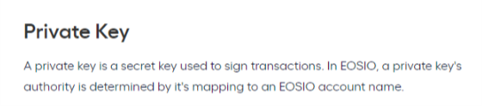
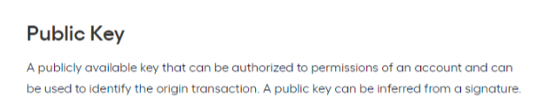
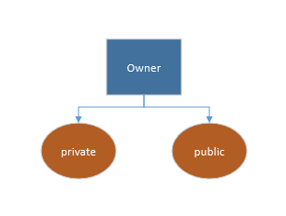
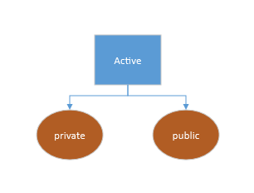
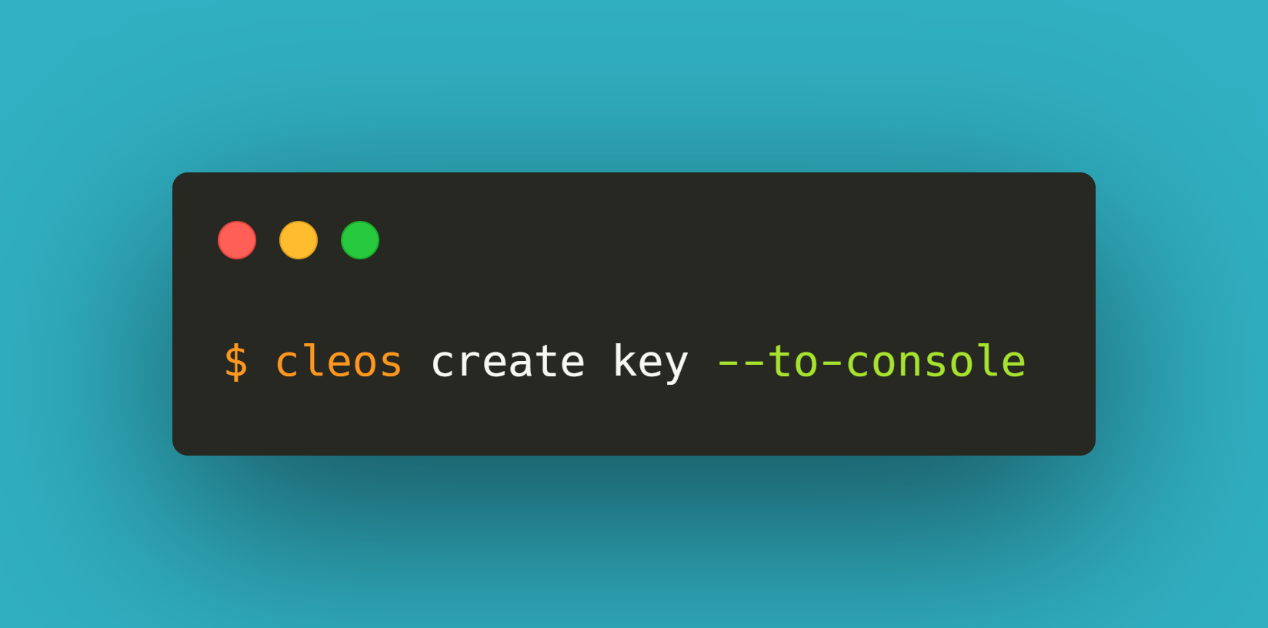
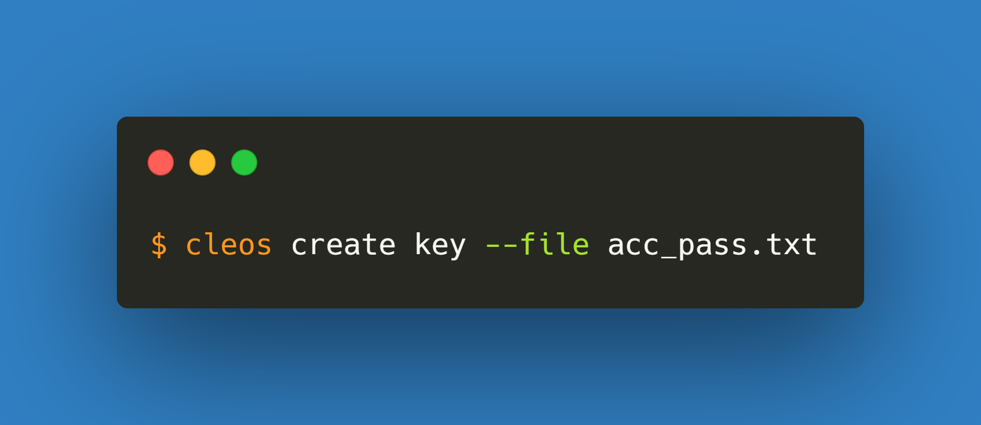
Permission
Owner - private key - public key
Active - private key - public key
Activity with permission
Token transfer
buy/sell ram
stake/unstake CPU, NET
Vote Block Producer
Show key generation using browser tool
Show key generation using cleos tool
M-1
M-2

Slide 15

wallet

Slide 16
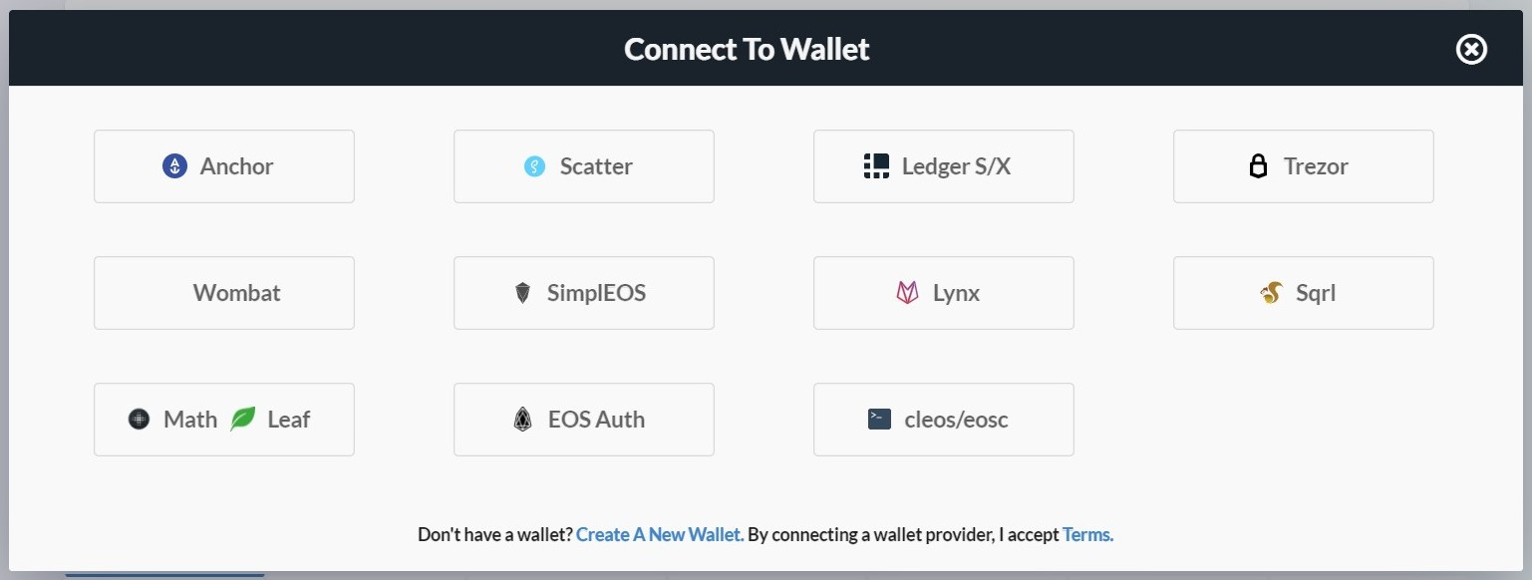
Types
Software
Hardware
Click here to login to all wallets.
Demo: Show Anchor desktop wallet

Slide 17

Account

Slide 18
Name
An account identifies a participant in an EOSIO blockchain.
A participant can be an individual or a group depending on the assigned permissions within the account.
Each account is identified by a human readable name between 1 and 12 characters in length. (a-z 1-5)

Slide 19
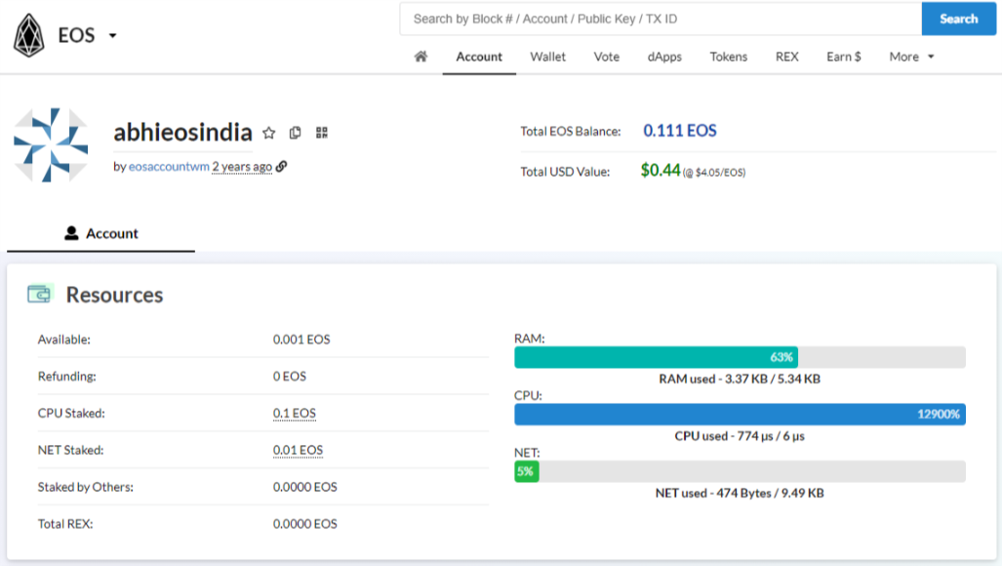


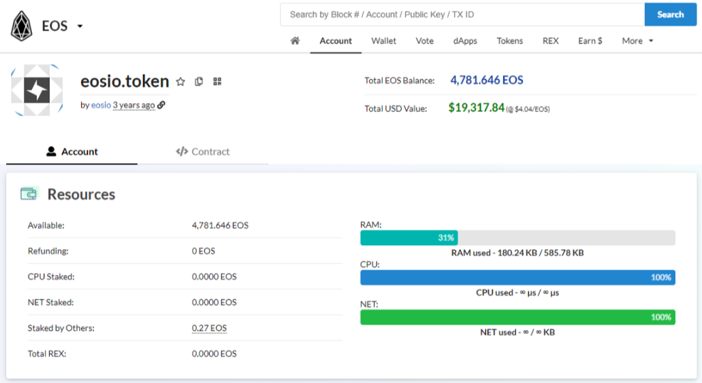
types
User account
Smart Contract account
DEMO
DEMO

Slide 20

EOSIO Stack

Slide 21
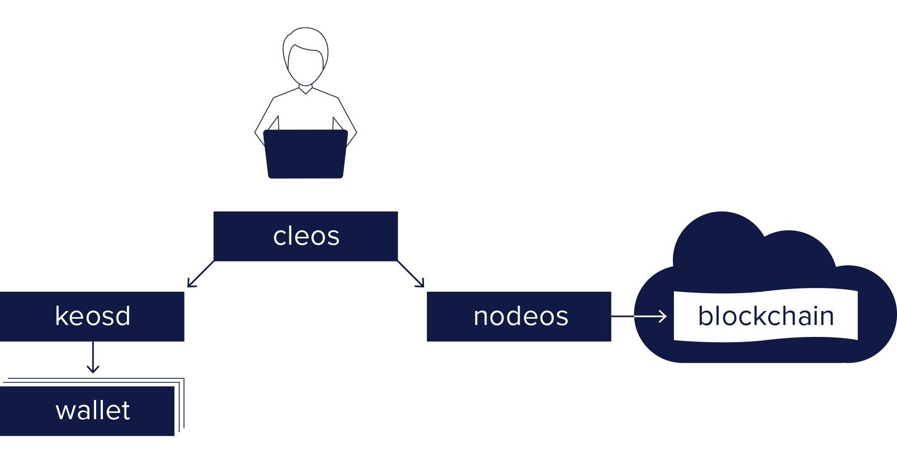
COmponents
nodeos: The core service daemon that runs on every EOSIO node
cleos: A command line interface (CLI) to interact with the blockchain and manage wallets
keosd: A key manager service daemon for storing private keys and signing digital messages

Slide 22
DEMO
CLEOS
KEOSD
cleos: Transfer money from ‘toecom111111’ to ‘toecom111112’
cleos: Show token balance of users in accounts table
Show list of wallets
Show keys in a wallet
Import a private key in a wallet

Slide 23
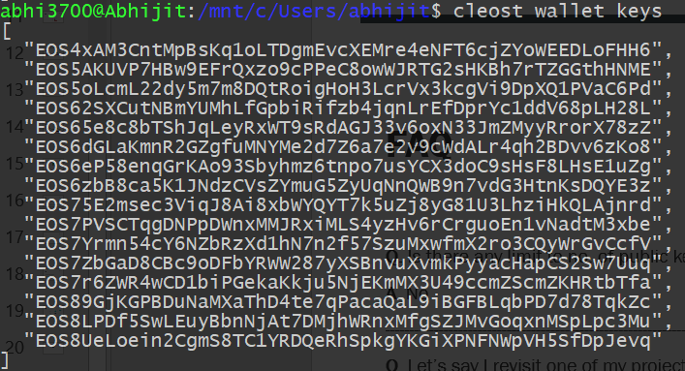
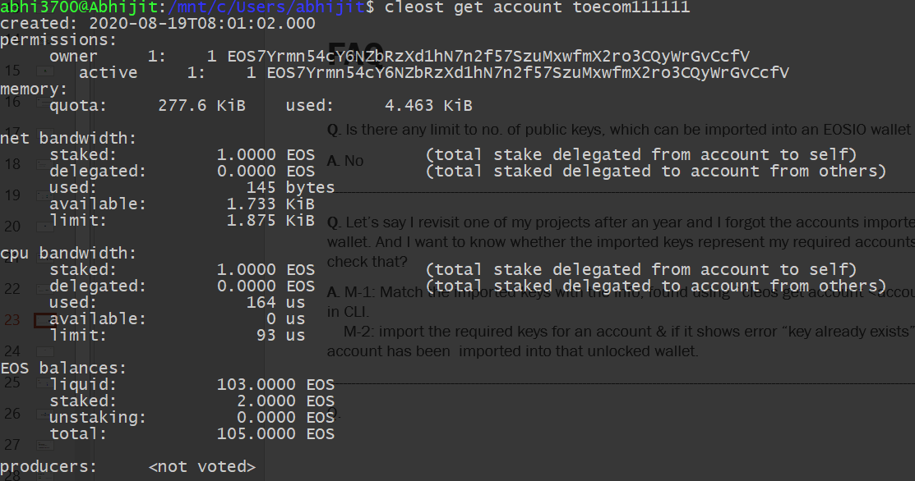
FAQ
Q. Is there any limit to no. of public keys, which can be imported into an EOSIO wallet in CLI?
A. No
-------------------------------------------------------------------------------------------------------------------------------------------------------------------
Q. Can 10 (say) no. of public keys imported into an eosio wallet represent single eosio account?
A. Yes. When an eosio account has many permissions like owner, active, custom1, custom2, …custom8, then those 10 imported public keys might represent a single eosio account. & in order to confirm that, follow the next Q.
-------------------------------------------------------------------------------------------------------------------------------------------------------------------
Q. Let’s say I revisit one of my projects after an year and I forgot the accounts imported into the project’s wallet. And I want to know whether the imported keys represent my required set of accounts. How to check that?
A. M-1: Match the imported keys with the info, found using `cleos get account <account-name>` in CLI. M-2: import the required keys for an account or multiple accounts one by one & if it shows error-- “key already exists”, then the account has been imported into that unlocked wallet.

Slide 24
Assignment
Q. "Transfer token from one account (with low CPU i.e. mostly new account) to another"

Slide 25

EOSIO Contract Development Toolkit (CDT)

Slide 26
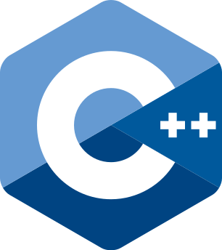

About
Compile code (in C/C++)
Generate deployable files: ABI, WASM
ABI

Slide 27
Source code language (C++)

Slide 28
Why C++?
The whole EOS blockchain infrastructure is written in C++.
Low-level language. Good for managing resources
Hence, immensely powerful & performant language being used a lot in performance critical Apps like games, computer graphics, hardware with low resources like embedded systems.
Cons: Hardest language to learn for developers.
Smart contract is also written in C++, which then compiled to WebAssembly.
Currently, C++ is the only official language supported for SC codes
Yes, C++ is scary. Good news: most of C++ features is not needed to write smart contracts.

Slide 29
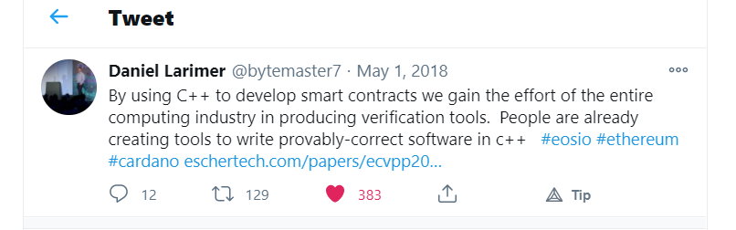
Features others don’t have
Statically typed (but comes with automatic type inference)
Preprocessor Macros
Explicit call-by-reference, call-by-value
Memory pointers
Operator overloading
Generic programming through templates
typedefs or using

Slide 30
Output Files (WASM)

Slide 31
What & Why?
EOSIO smart contracts are just simple WebAssembly files.
EOSIO WASM Virtual Machine (WAVM) is based on Andrew Scheidecker's standalone WAVM.
Some people are working on writing EOSIO SCs using python, solidity which can be converted into WASM & run into EOSIO WAVM.
So, the WAVM doesn’t need to know the high level programming languages – C++, Python, Solidity. All it needs to know is how to execute WebAssembly.

Slide 32
WASM?
Fast: Able to execute at near native speed
Safe: code executes in a sandboxed environment and eliminating dangerous features
Hardware independent: Implementable by web browsers and other completely different execution environments such as datacenters, IoT devices, mobile/desktops etc
Not break the web (allow calls/bindings to JavaScript)
A human-editable text format that is convertible to/from the binary format
A great choice because the entire browser community is working to continuously improve it.
Apart from EOSIO, Ethereum is planned to implement WASM

Slide 33
Output Files (ABI)
ABI

Slide 34
define
The Application Binary Interface (ABI) is a JSON-based description on how to convert user actions between their JSON and Binary representations.
The ABI also describes how to convert the database state to/from JSON.
Once you have described your contract via an ABI then developers and users will be able to interact with your contract seamlessly via JSON.
ABI can be bypassed when executing transactions. Messages and actions passed to a contract do not have to conform to the ABI. The ABI is a guide, not a gatekeeper.

Slide 35
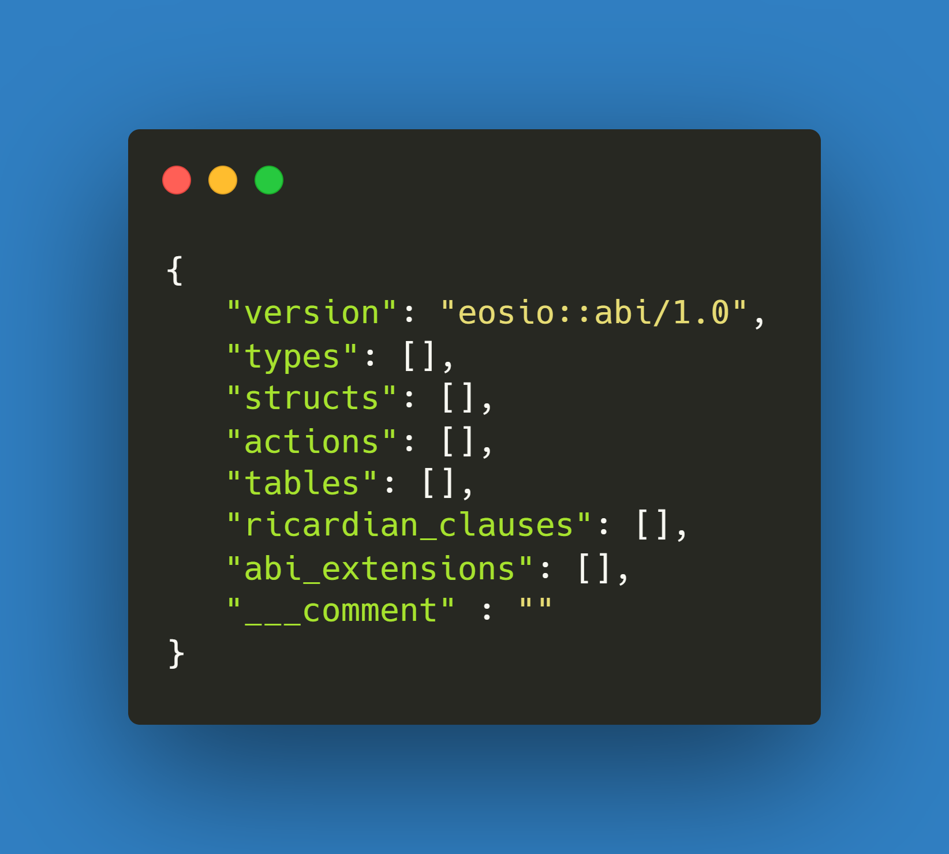
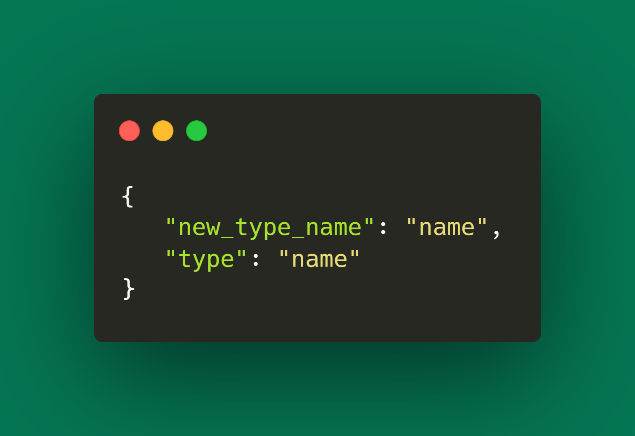
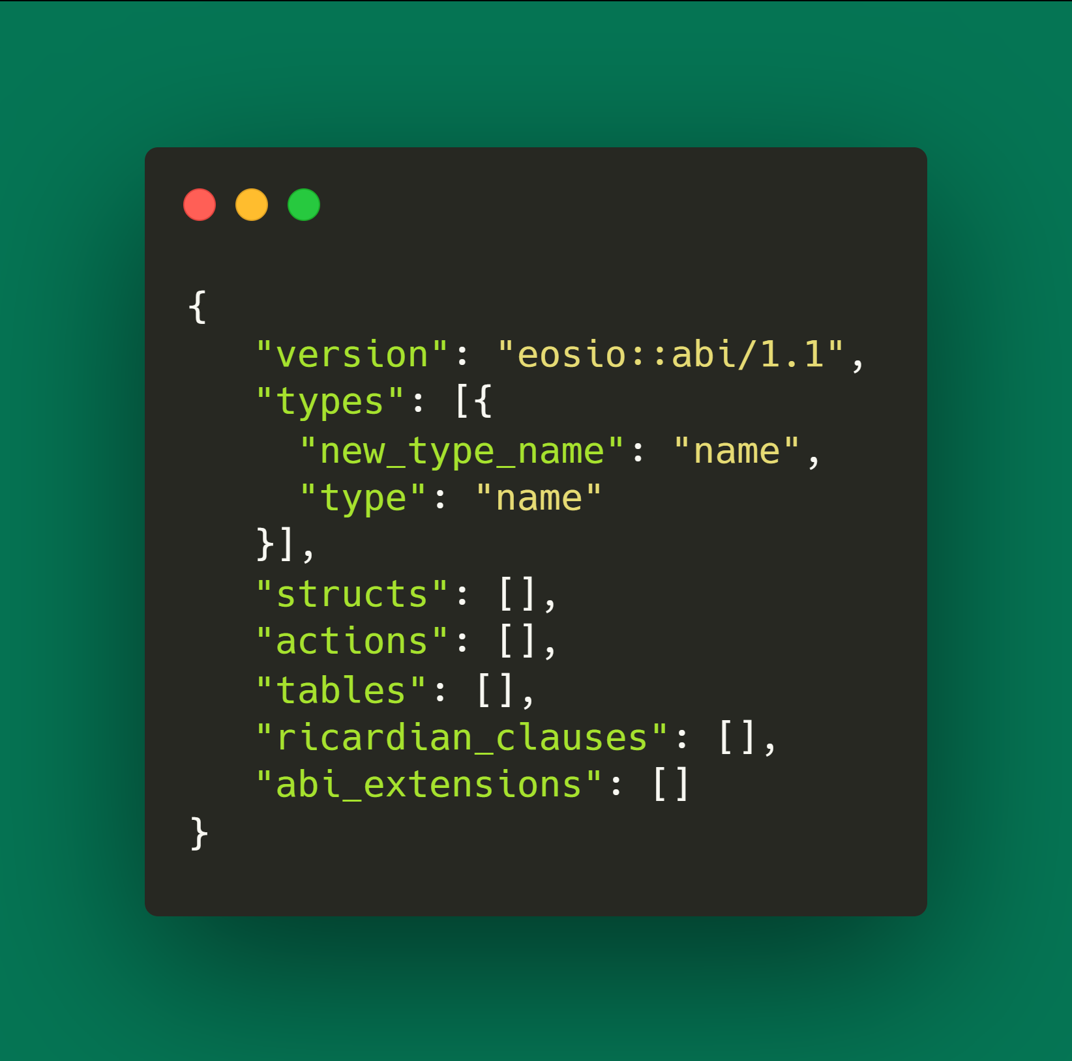
Empty ABI File
Types

Slide 36
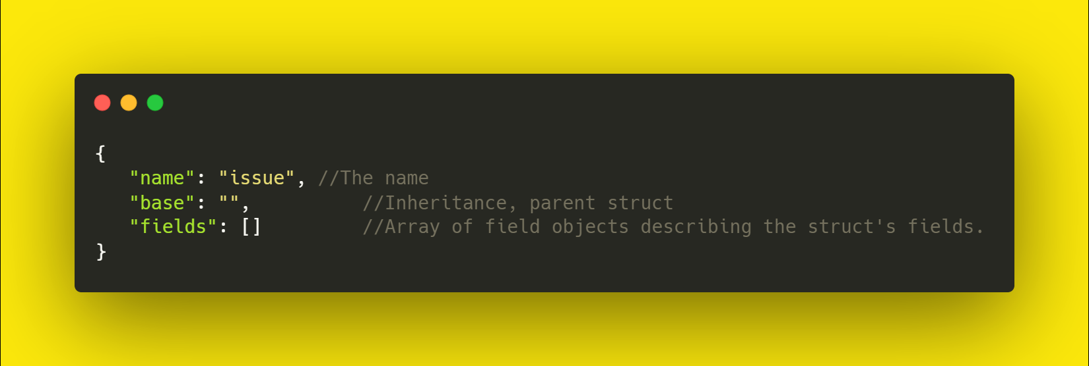
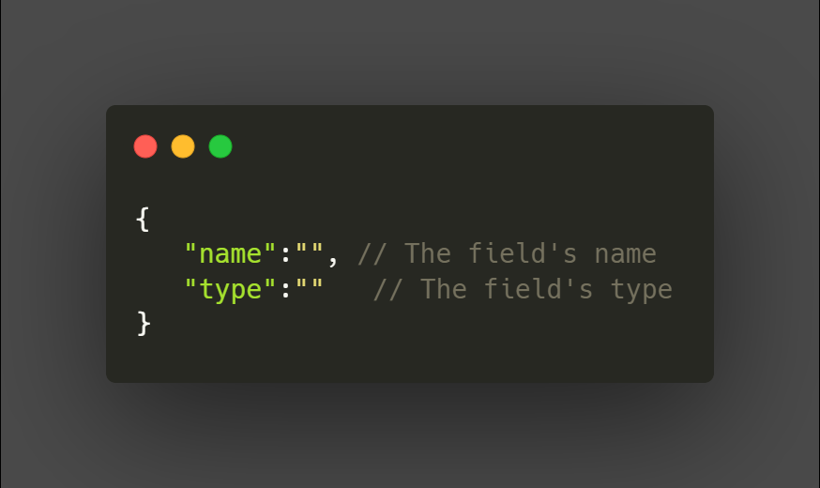
Implicit
Structs
Fields
Explicit
NOTE:
Structs can be actions or tables.

Slide 37
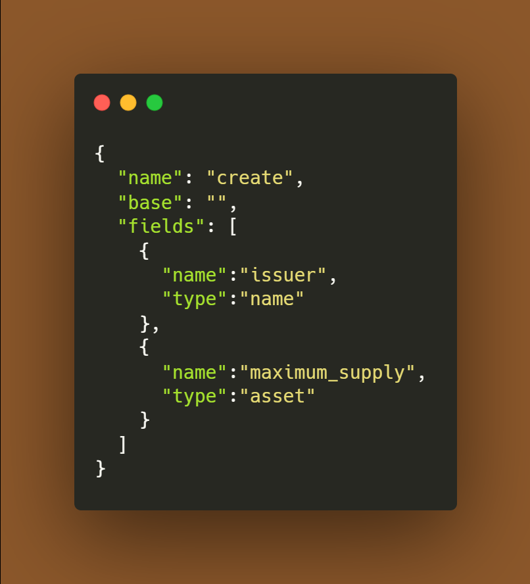
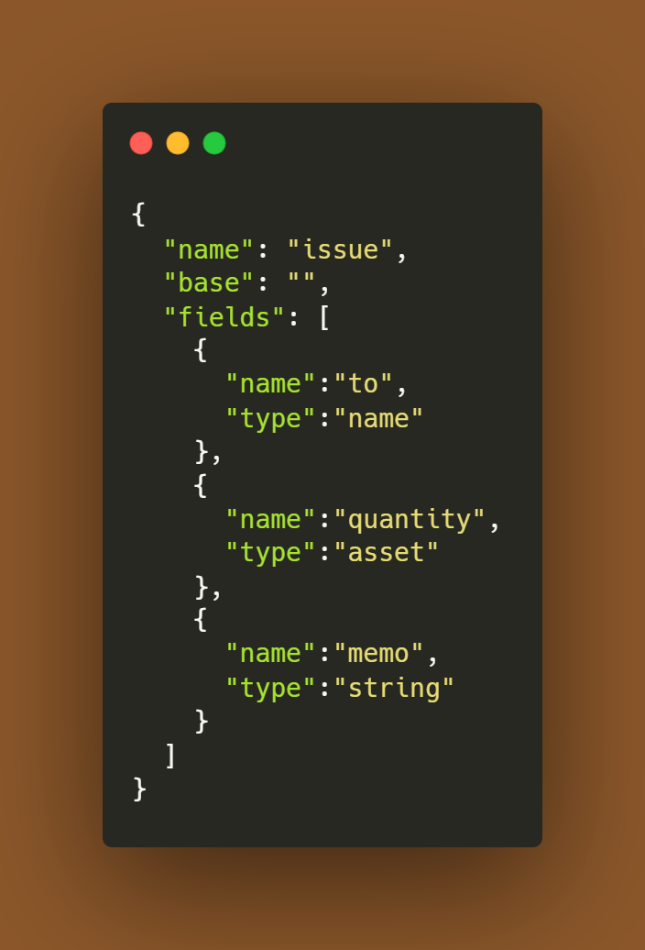
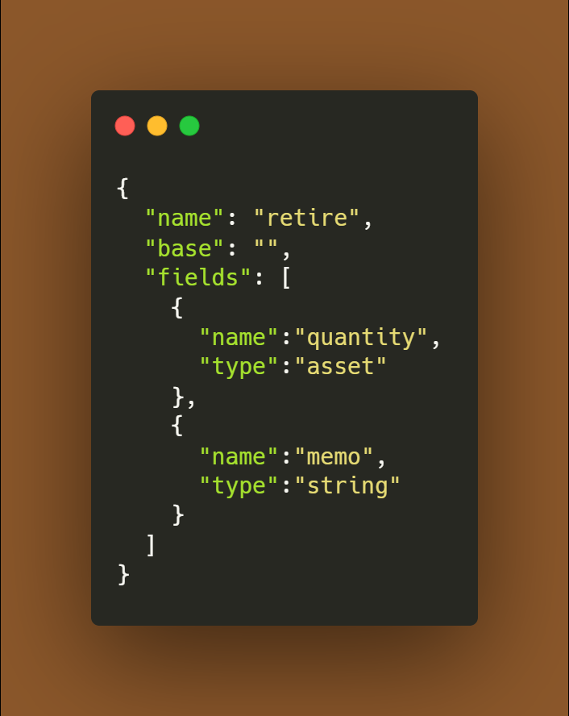
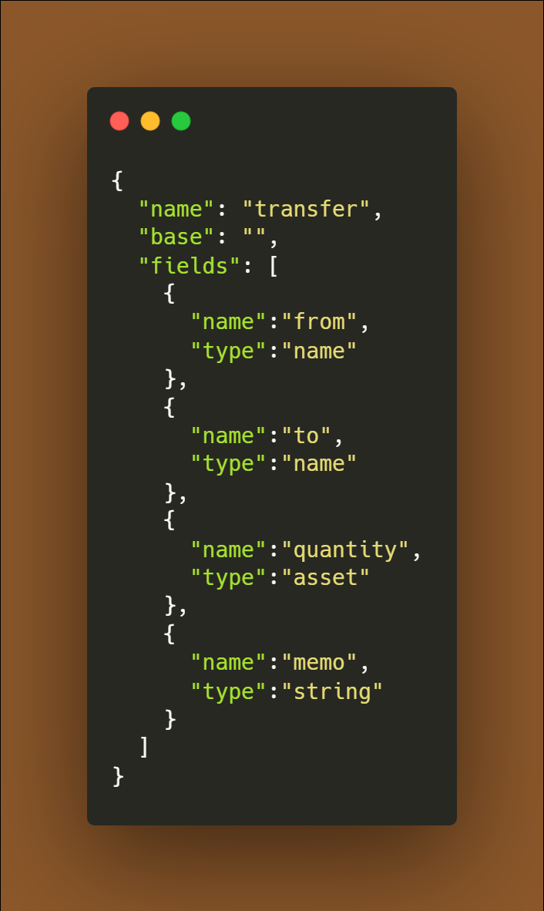
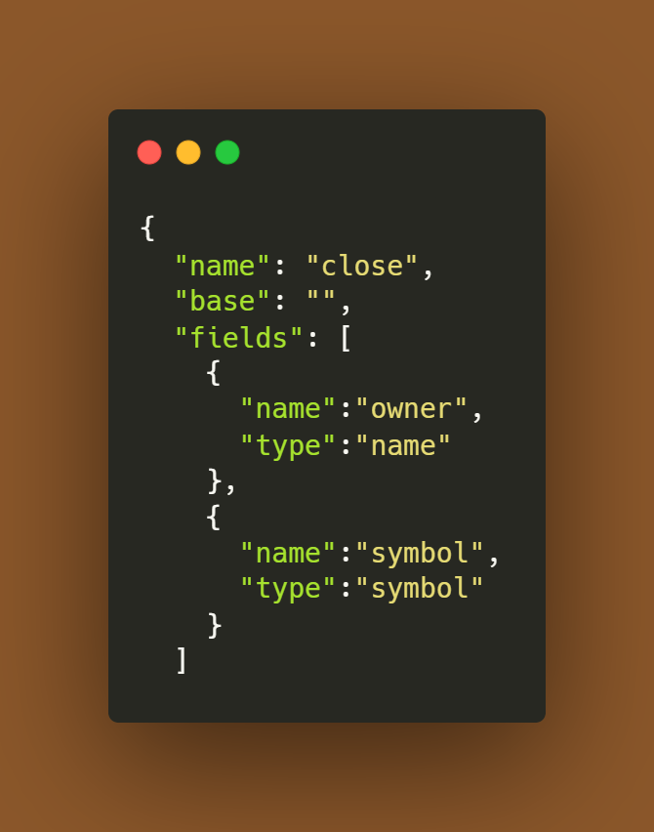
Implicit
Implicitly defined.
For Actions.
create
issue
retire
transfer
close

Slide 38
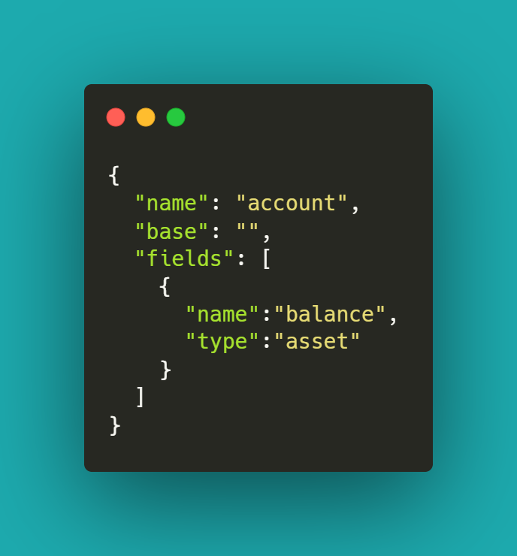
Explicit
accounts
Explicitly defined.
Needed to instantiate a multi-index table

Slide 39
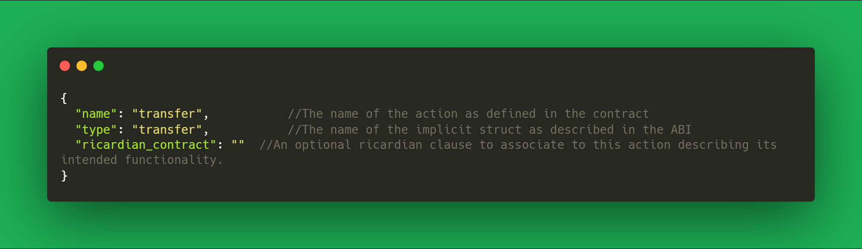
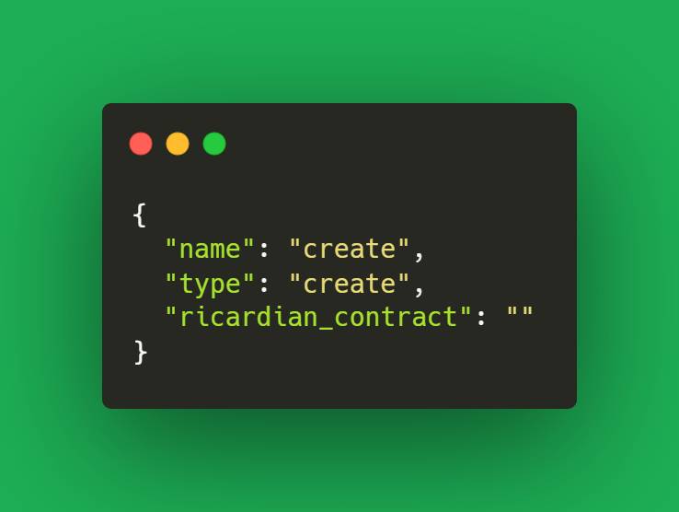
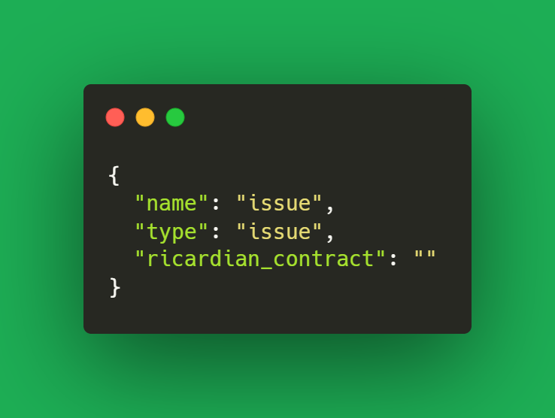



Actions
In most situations, the function name and the struct name will be equal, but are not required to be equal.
create
issue
retire
transfer
close

Slide 40
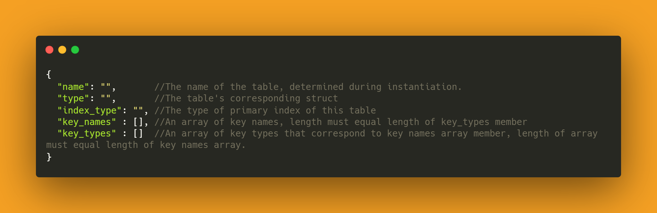
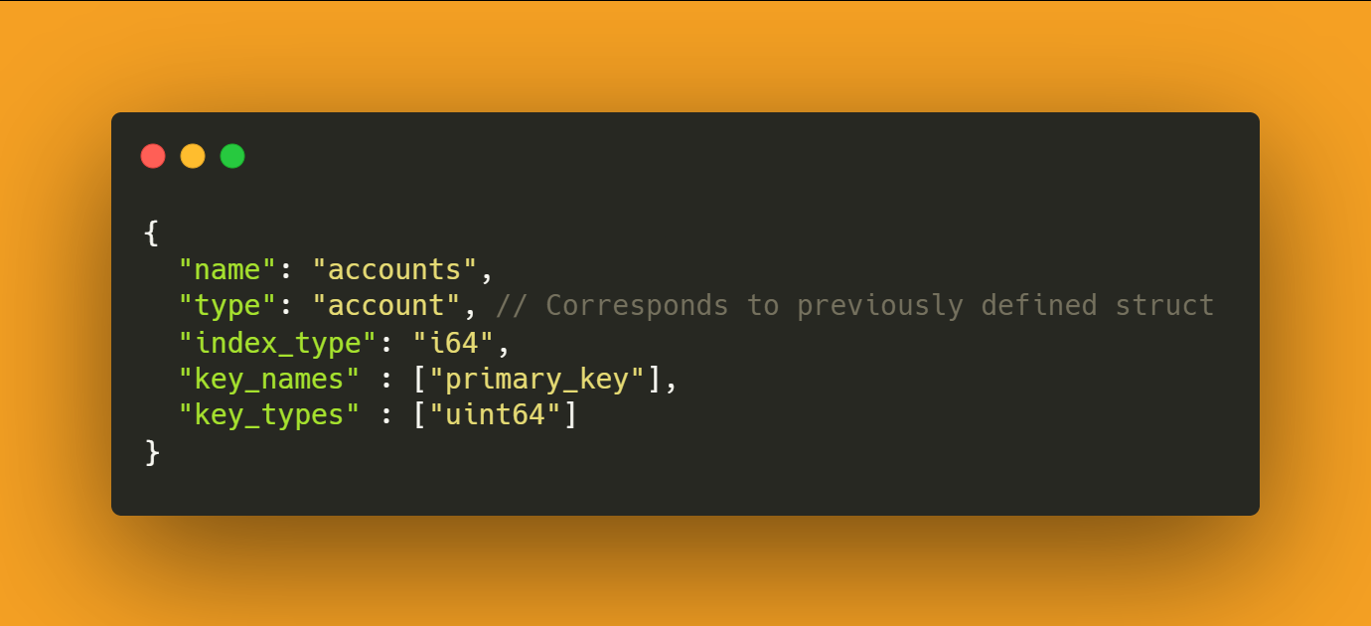
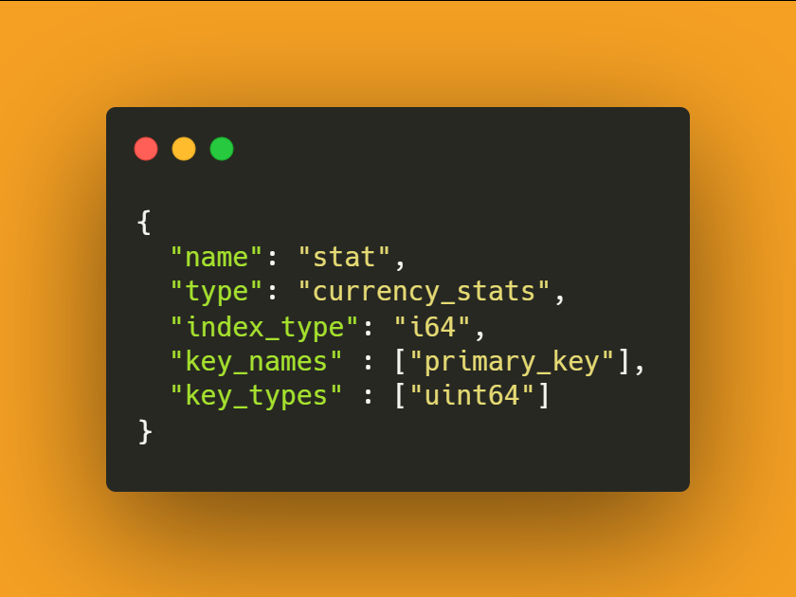
Tables
The eosio.token contract instantiates two tables, accounts and stat.
The accounts table is an i64 index, based on the account struct, has a uint64 as it's primary key
The stat table is an i64 index, based on the currency_stats struct, has a uint64 as it's primary key
accounts
stat

Slide 41
Extras
Vectors: When describing a vector in your ABI file, simply append the type with [ ], so if you need to describe a vector of permission levels, you would describe it like so: permission_level[ ]
Struct Base: It's a rarely used property worth mentioning. You can use base ABI struct property to reference another struct for inheritance, as long as that struct is also described in the same ABI file. Base will do nothing or potentially throw an error if your smart contract logic does not support inheritance.
Extra ABI Properties: A few properties of the ABI specification were skipped here for brevity, however, there is a pending ABI specification that will outline every property of the ABI in its entirety.
Ricardian Clauses: Ricardian clauses describe the intended outcome of a particular actions. It may also be utilized to establish terms between the sender and the contract.
Maintenance: Every time you change a struct, add a table, add an action or add parameters to an action, use a new type, you will need to remember to update your ABI file. In many cases forgetting to update your ABI file will not produce any error.

Slide 42
Further Studies

Slide 43
Resources
Founding Company of EOS - https://block.one/
EOSIO Developer Portal - https://developers.eos.io/
How EOSIO Works - https://developers.eos.io/welcome/latest/
The EOSIO Stack - https://developers.eos.io/welcome/latest/manuals/index
Join the Telegram group for EOSIO developers - https://t.me/joinchat/EaEnSUPktgfoI-XPfMYtcQ
Join the StackExchange - https://eosio.stackexchange.com/

Slide 44

THANKS

