Slide 1

Learn Rust
Powering the Next Generation of Software Development
Session: Traits
Primitives
Functions
Collections
Pointers
Modules
Struct
Traits
Concurrency
Generics
Associated Types

Slide 2
Objectives
Architecture & Comparo
Why Traits?
What are Traits?
How to Define Traits?
Implementing Traits
Default Methods in Traits
Trait Bounds
Code Walkthrough
Quiz

Slide 3
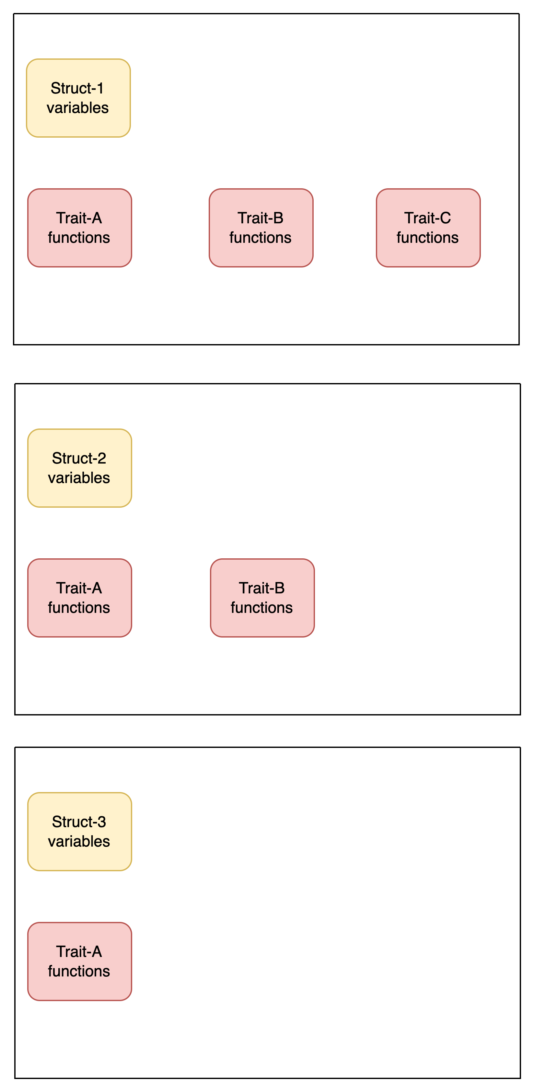
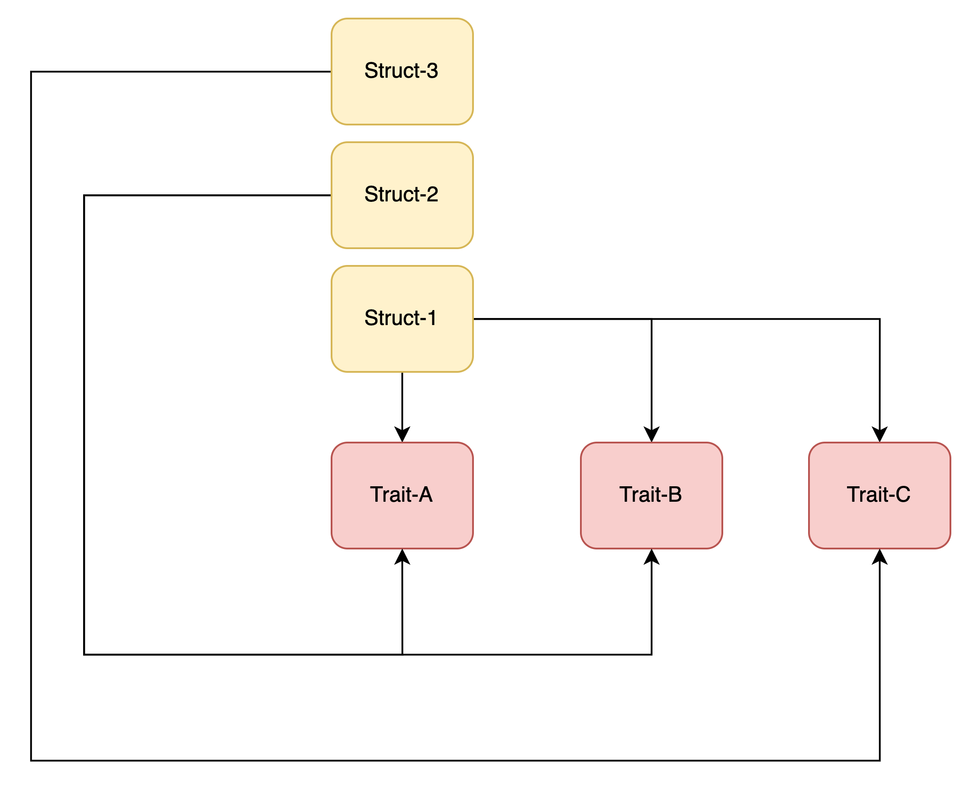
Architecture & Comparo
Other languages
Rust

Slide 4

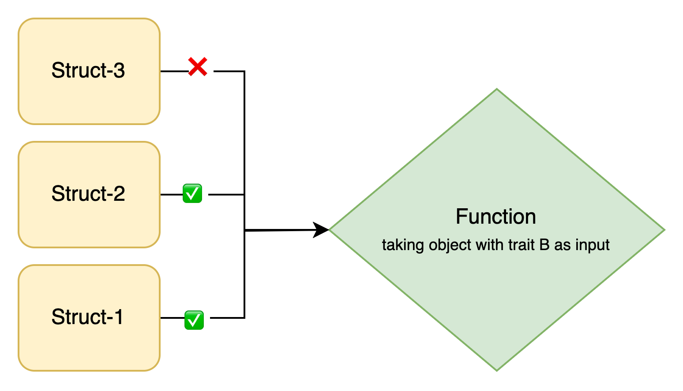
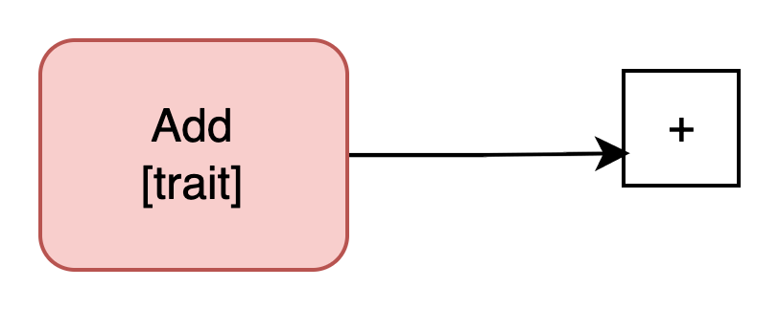
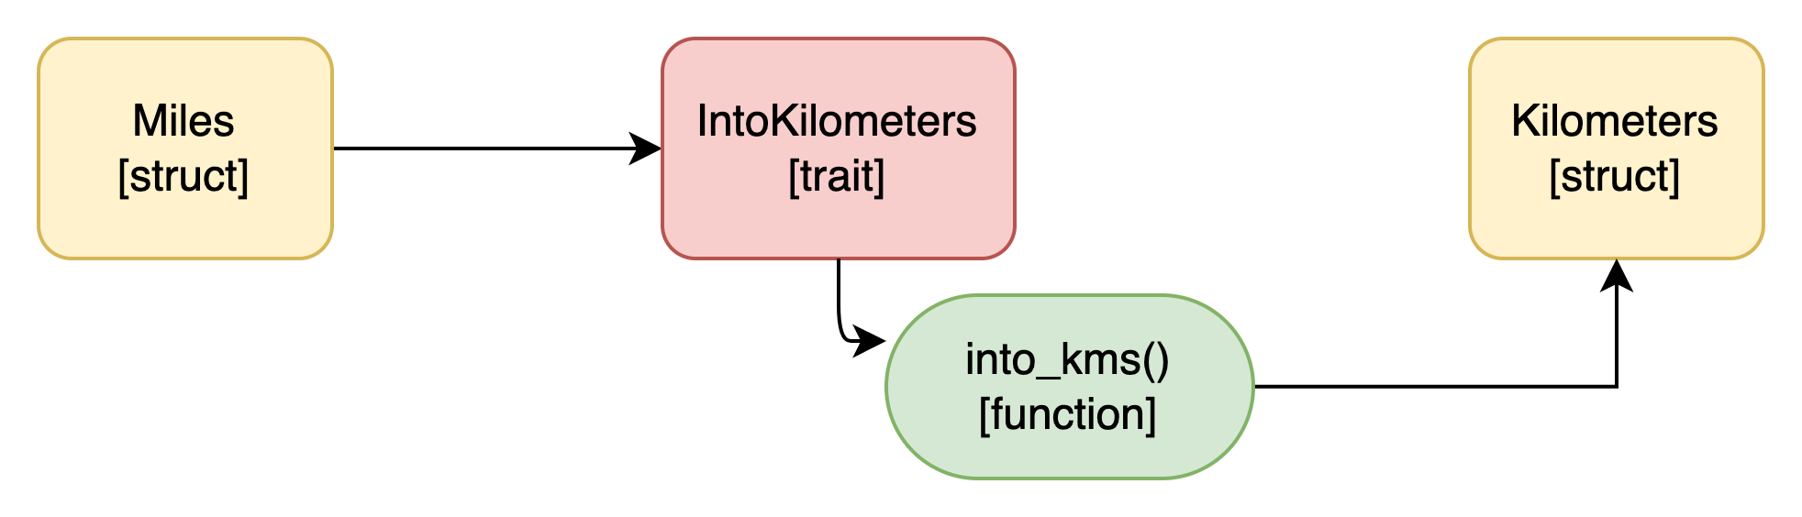
Why Traits
Code Reusability
Polymorphism
Default methods
Operator overloading
Interoperability
Why Rust

Slide 5
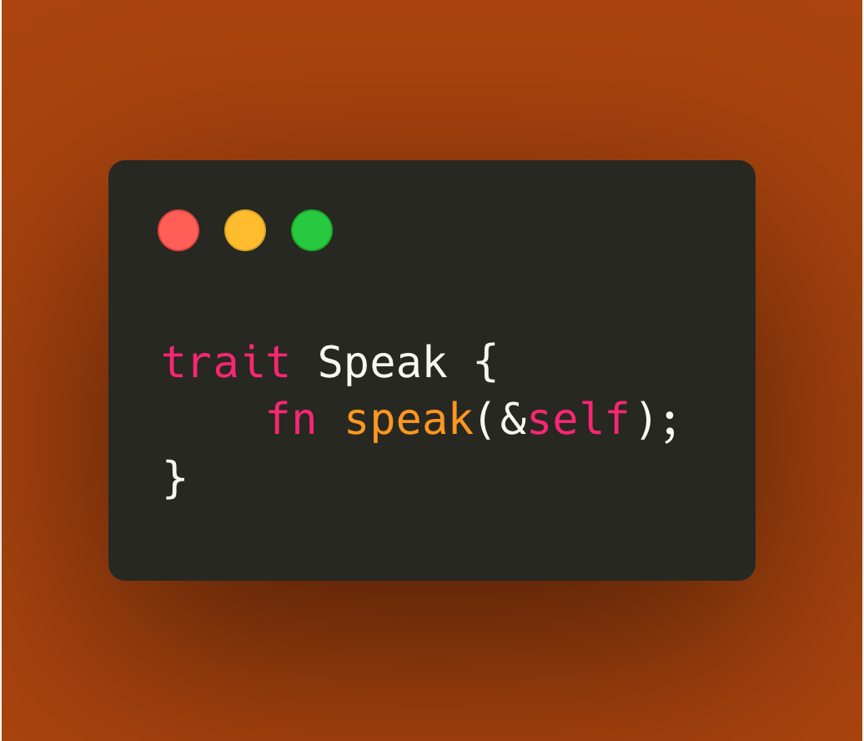
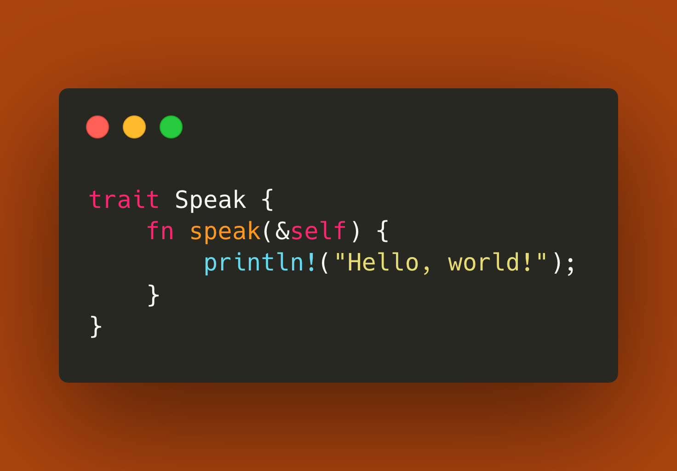
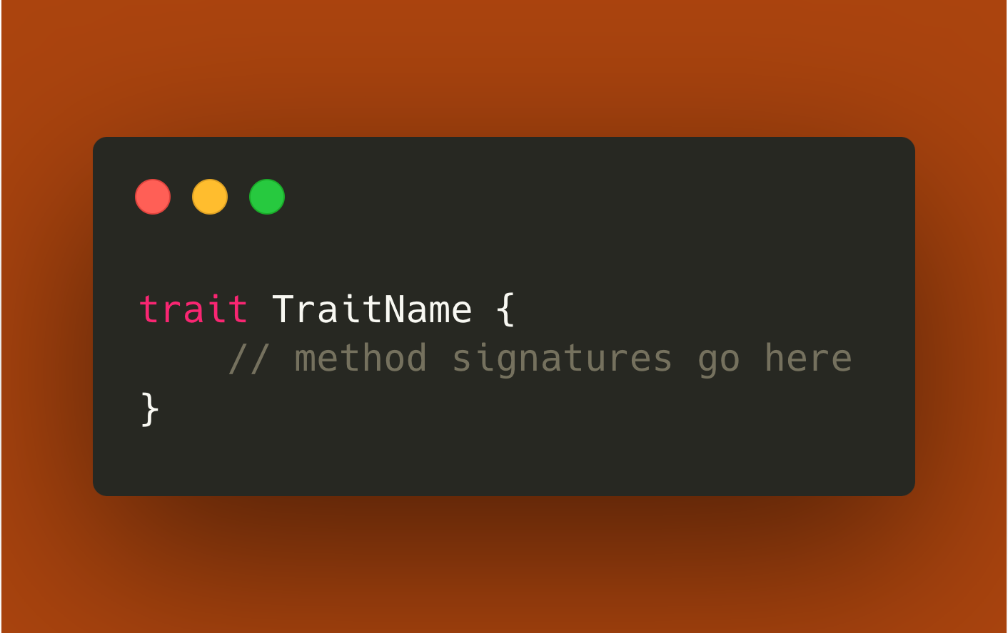
How To define a trait?
Default Implementation

Slide 6
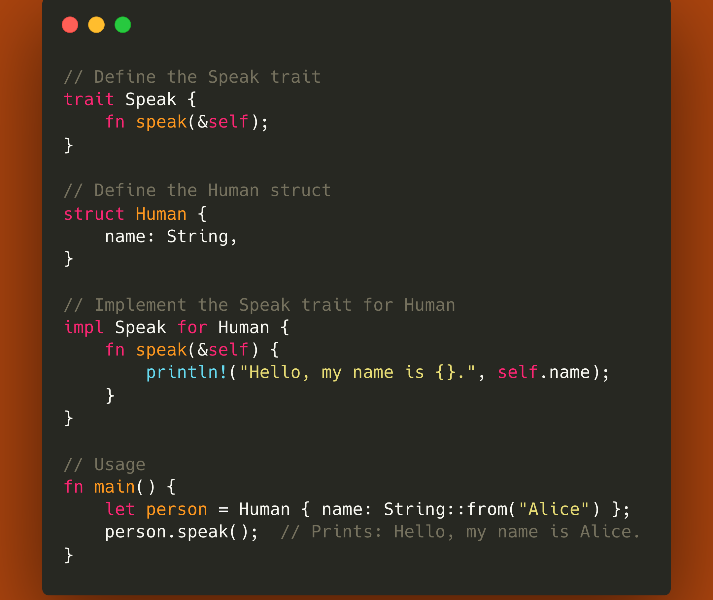
Implementing Trait

Slide 7

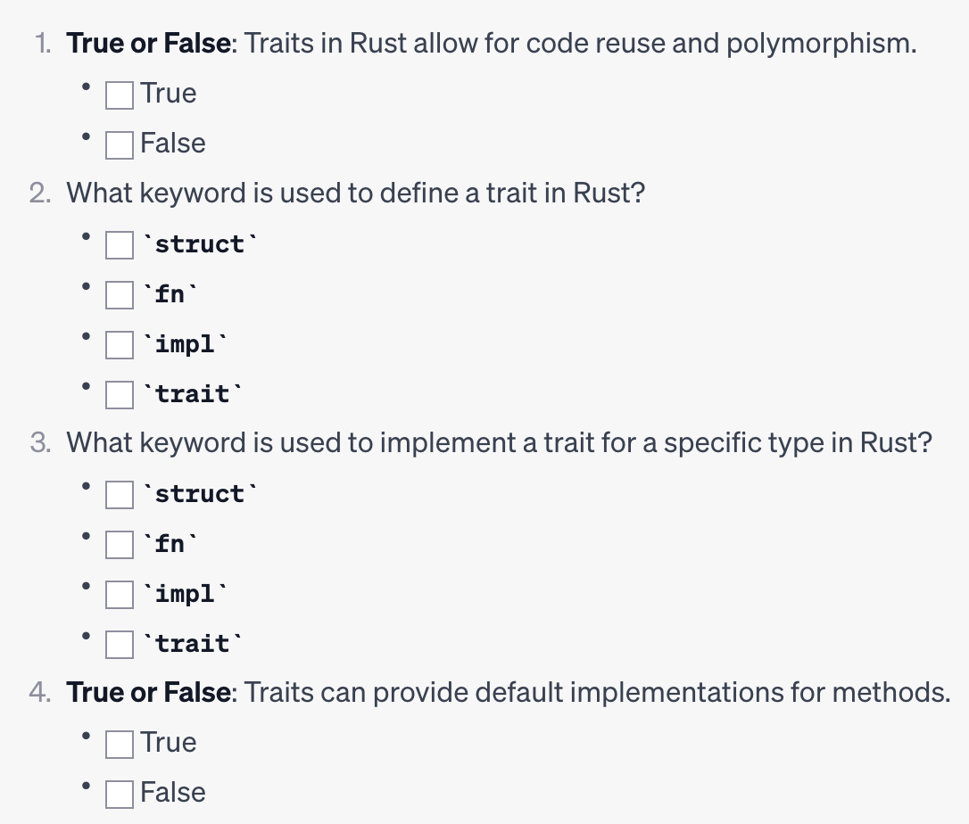
Quiz

Slide 8

Thanks

