Slide 1

Demystifying Rust Packages Part-1
Borsh Serializer/Deserializer

Slide 2

Overview
Borsh stands for Binary Object Representation Serializer for Hashing. It is meant to be used in security-critical projects as it prioritizes consistency, safety, speed, and comes with a strict specification.
Developed by Near Foundation.

Slide 3
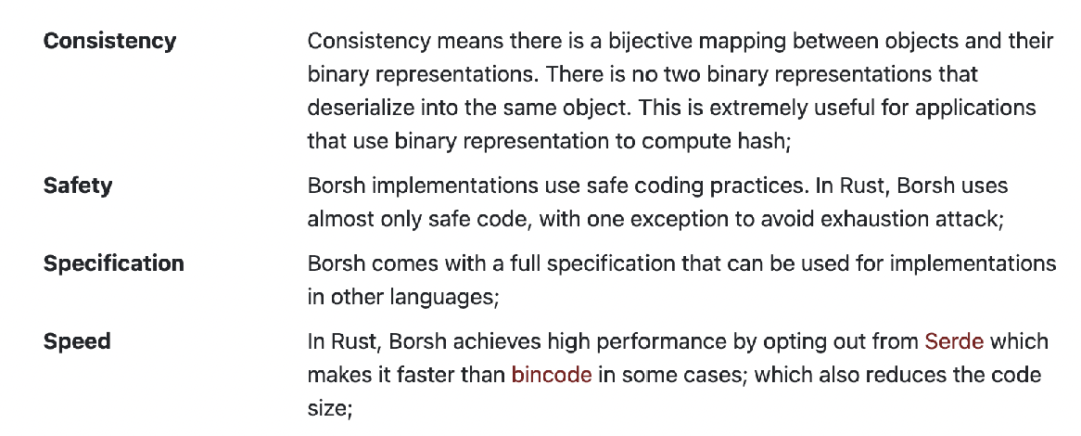
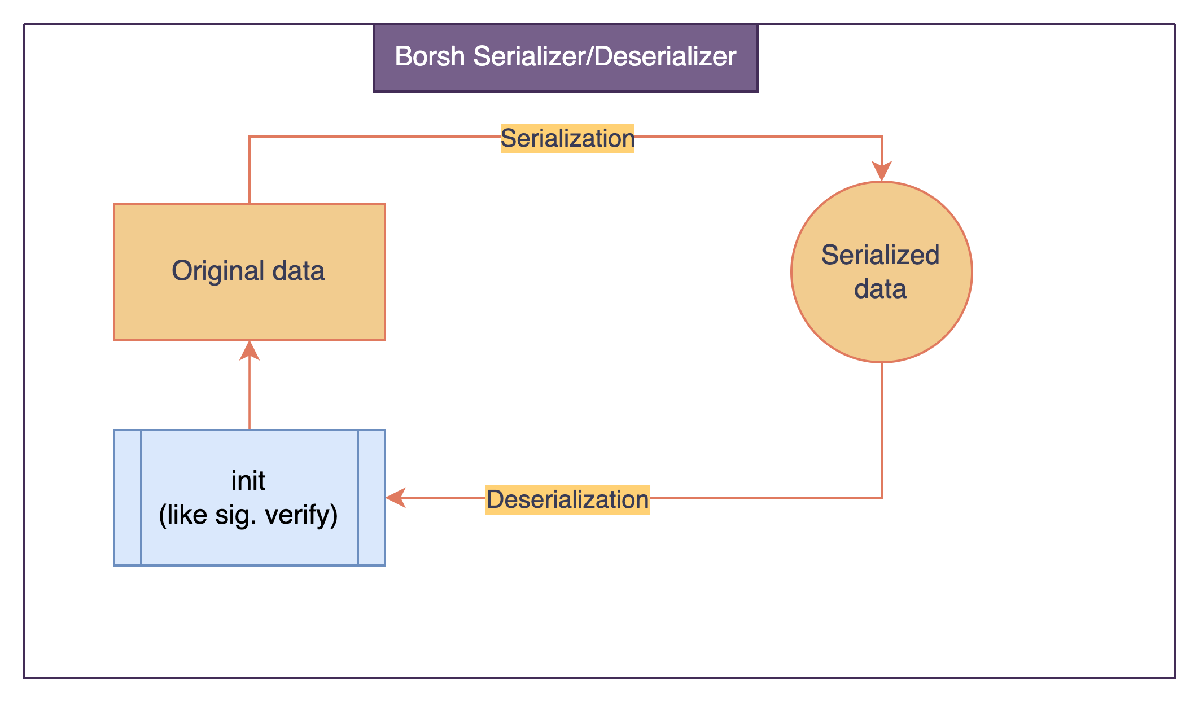
Better than Serde?
Serde lacks an auto-initialization feature, which is significant in terms of usability for any application that needs to use deserialized data. The absence of this feature means that additional steps may be required to prepare the data for further use after it is deserialized, which can potentially increase complexity and reduce efficiency.
In order to enable this, we just need to add a macro `#[borsh_init(init)]` on top of the struct.

Slide 4
Used in Blockchains
Near
Solana

Slide 5
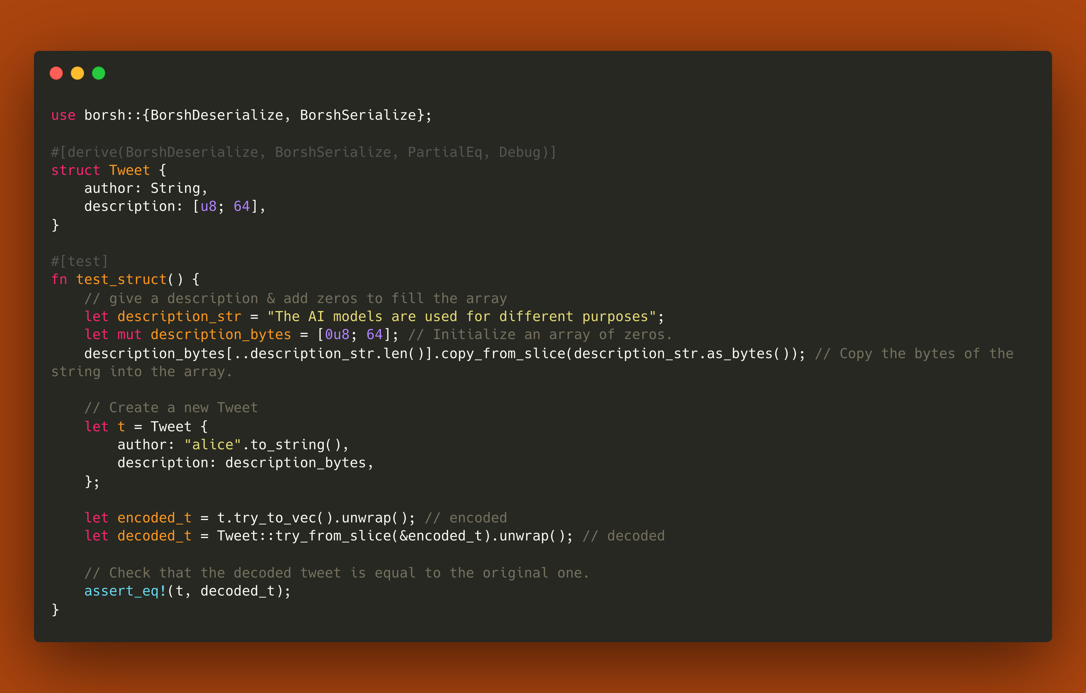
Let’s Code!

Slide 6
How to serialize & deserialize data?

Slide 7
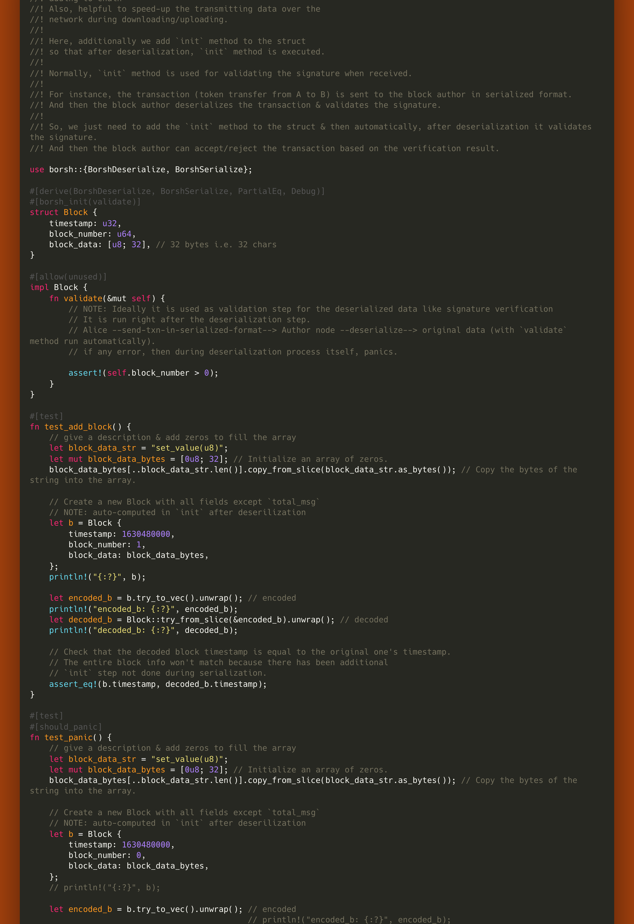
Add `init` function after deserialization

Slide 8

Conclusively, the absence of an auto-initialization feature in a serialization/deserialization library such as `Serde` might present a challenge in terms of usability and efficiency. Particularly in the context of blockchain technology, where data immutability and integrity are paramount, this feature could streamline the process of preparing deserialized data for further use. Consequently, incorporating such a feature could simplify development, reduce boilerplate code, and align more closely with the principles of blockchain systems. Future enhancements to serialization/deserialization libraries should consider incorporating this feature to better support the needs of blockchain applications and other data-intensive environments.

