Slide 1

Rust Tips #5
Why Associated Types in Traits?

Slide 2
Associated types in Rust are a powerful feature that allow you to express more complex relationships between types in your trait definitions. They are a type of "type-level function" that can express a one-to-one mapping between types.
In Rust, traits define a set of methods that a type should implement. But sometimes, the methods you want to define in a trait might need to work with or return types that are related to the implementing type in some way. This is where associated types come in.
Here's an example. Let's say you have a `Vehicle` trait that represents different vehicles which might have different kinds of parts. For instance, a `Car` might have a `CarEngine` and a `Bike` might have a `BikeEngine`.
Understanding Associated Types in Rust Through a Vehicle Trait Example

Slide 3
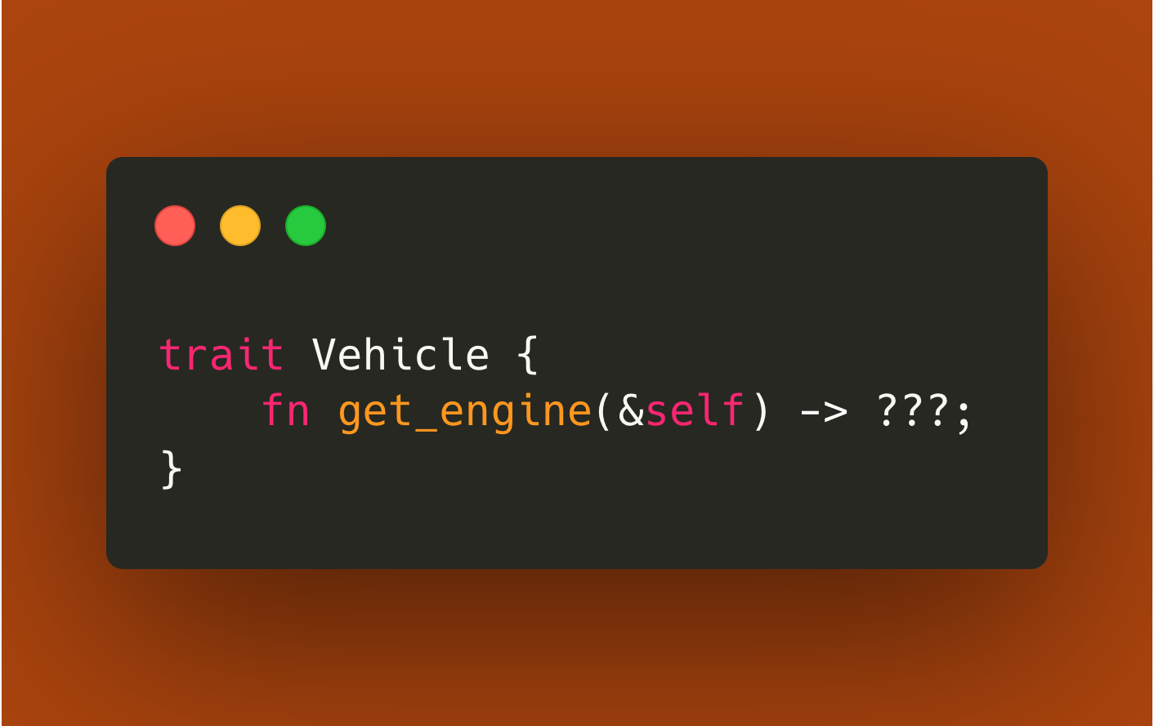
Without associated types, you might try to define your trait like this:

Slide 4
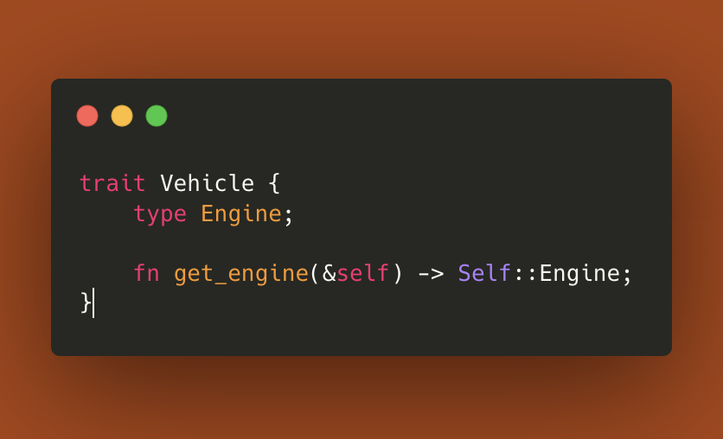
But what type should go in place of `???`? It should be a type that's somehow related to the implementing type. With associated types, you can express this relationship like so:

Slide 5
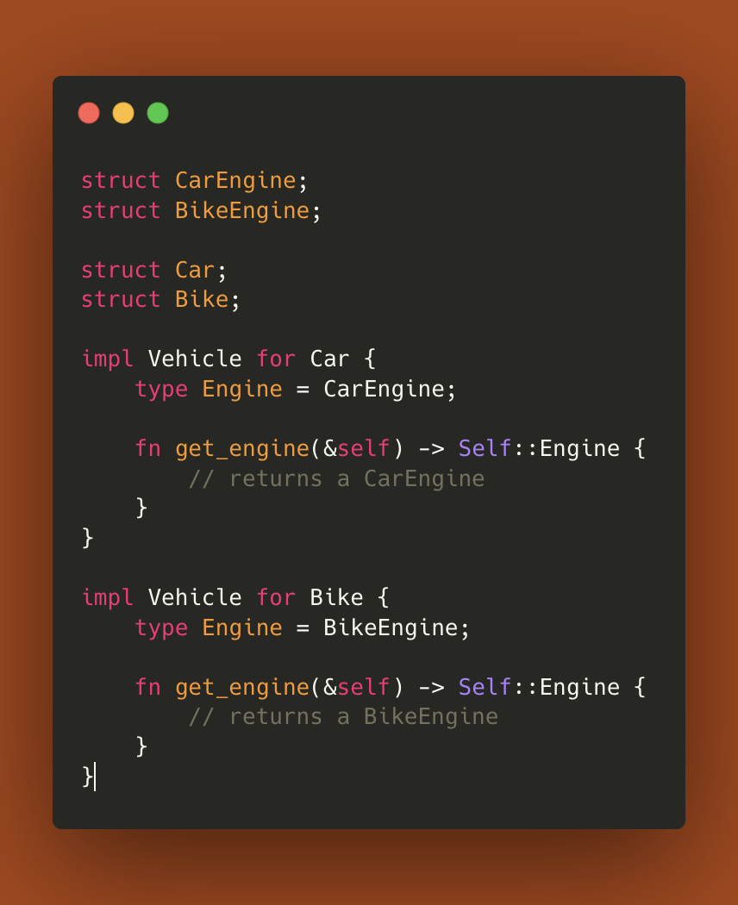
Now, when you implement the `Vehicle` trait for `Car` and `Bike`, you can specify the associated `Engine` type:

Slide 6

As you can see, associated types allow you to express complex relationships between types and make your trait definitions more flexible and expressive. They are a key part of Rust's powerful and flexible type system.

