Slide 1

Rust PRACTICE PROBLEMS
PROBLEM
Filter even numbers: Write a function that takes an iterator over integers and returns a new iterator that yields only the even numbers. Test your function with a range of numbers and a vector of integers.

Slide 2
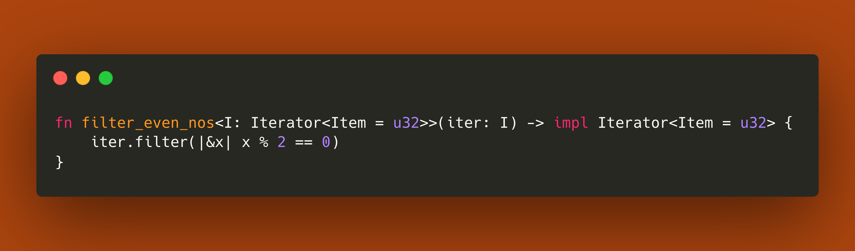
Solution

Slide 3
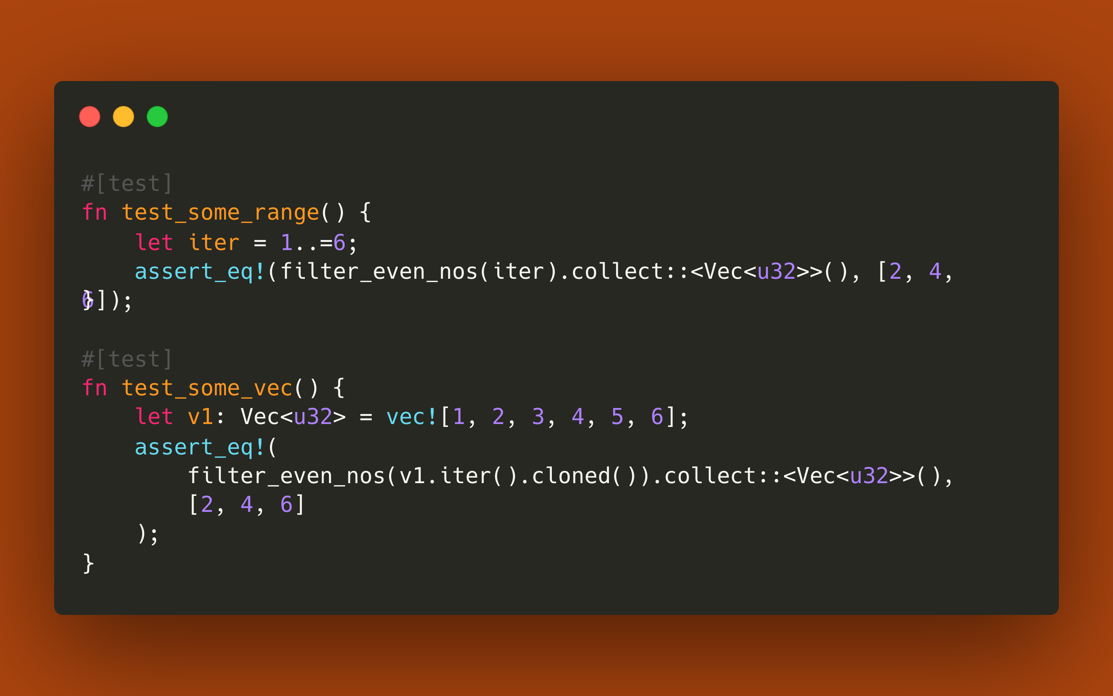
TESTING

Slide 4
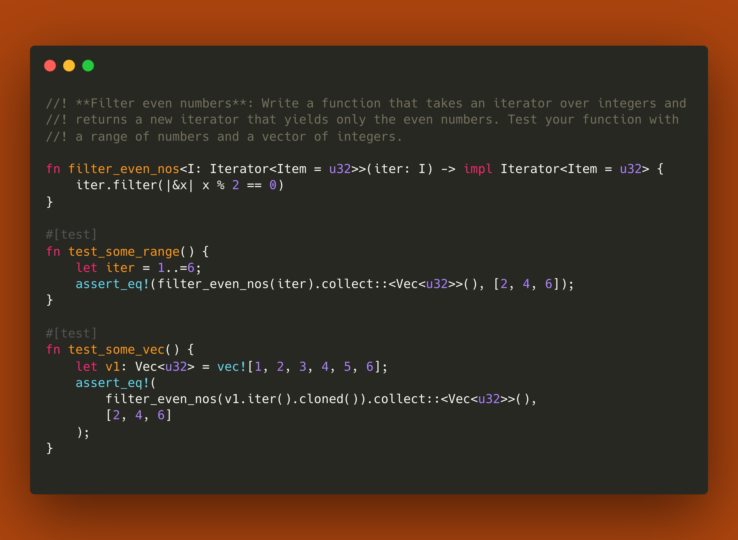
Entire CODE

Slide 5

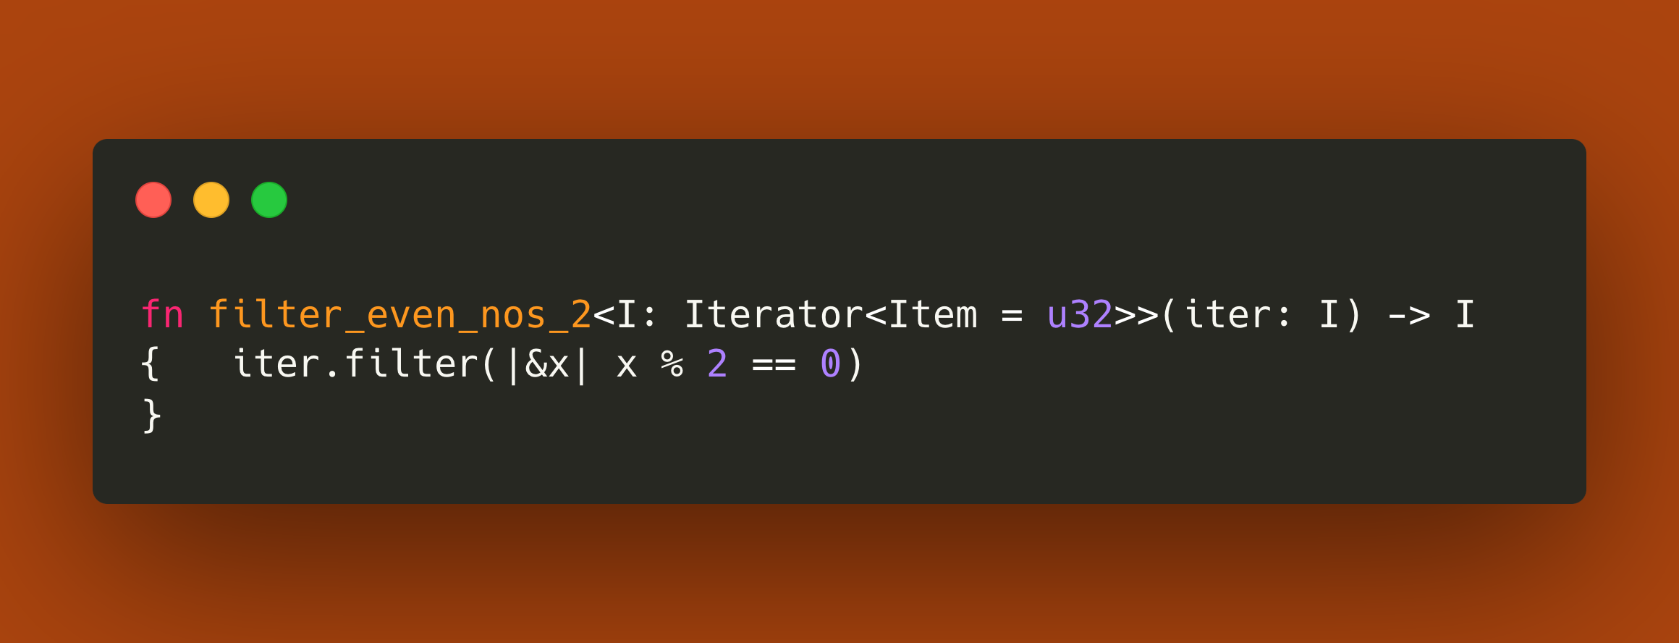
POINT TO PONDER 🤔
Q. Why can't we use this function with return type as Iterator??
The Filter iterator is a struct that wraps the original iterator and
applies the filtering predicate.
Since the return type of the filter method is different from the input iterator type,
you cannot use I as the return type.

