Slide 1













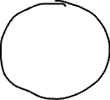

What is MakerDAO?

Slide 2






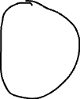



Why create DAI?

Slide 3









Why hold MKR?

