Slide 1
Swap

Slide 2


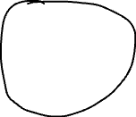
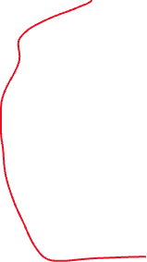



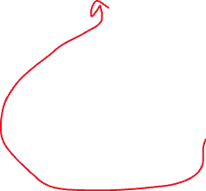


Slide 3


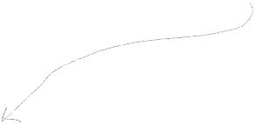
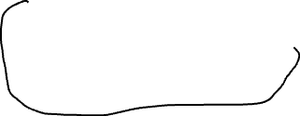

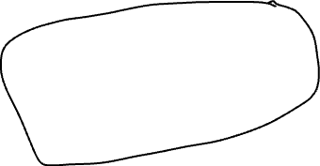
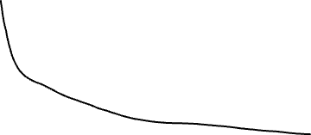

Here, the due to trade, the price is moved from point A to point B.
L->R (horizontal movements) => amount spent by the Trader
T->B (vertical movements) => amount gained by the Trader
Hence, the points A, B are shown like that. If it goes like this, the pool will end up having only X tokens. And the price of Y would be ∞.

Slide 4
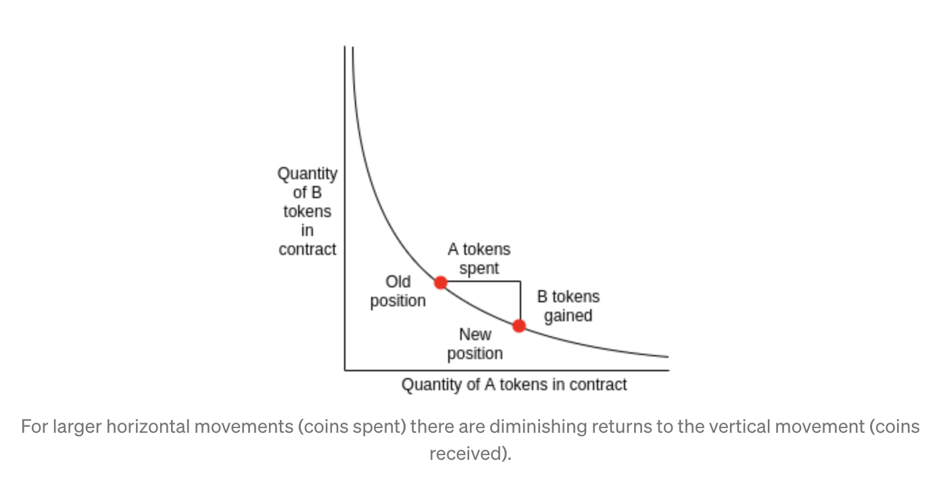
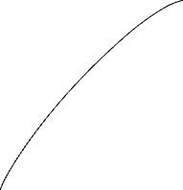
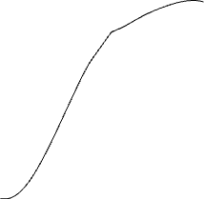
You can see the curve matches with the one shown here:
By the Trader
(+ve) Added to
the reserve
(-ve) Reduced from
the reserve

Slide 5
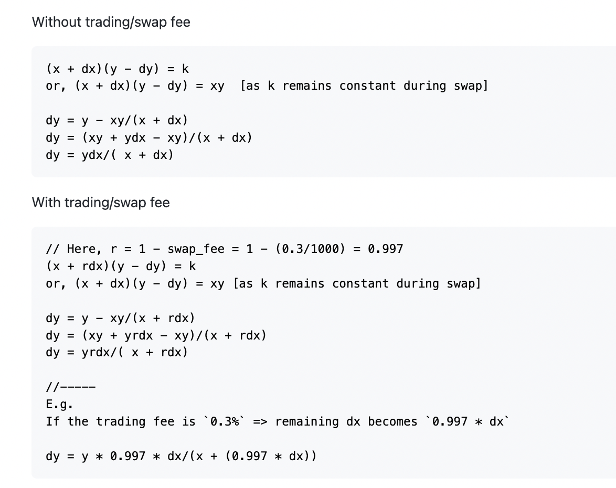
REFERENCE

Slide 6
Add Liquidity

Slide 7
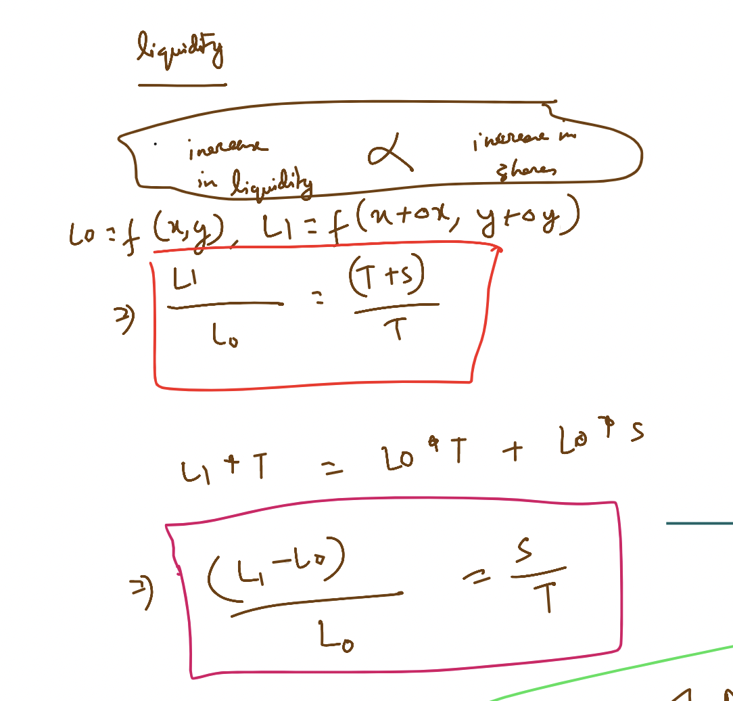
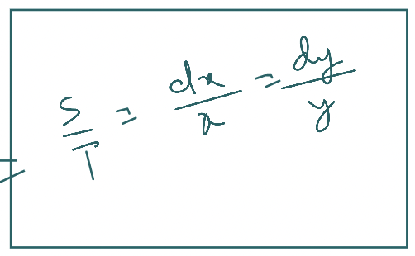
REFERENCE

Slide 8
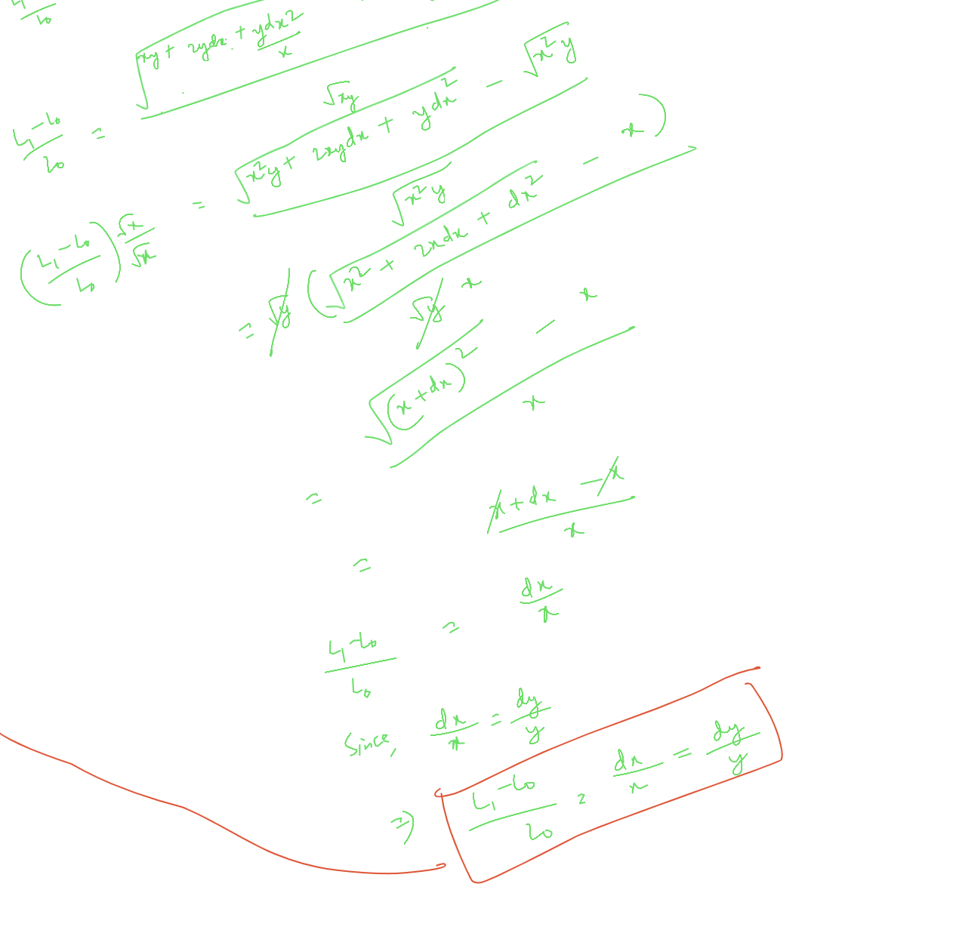
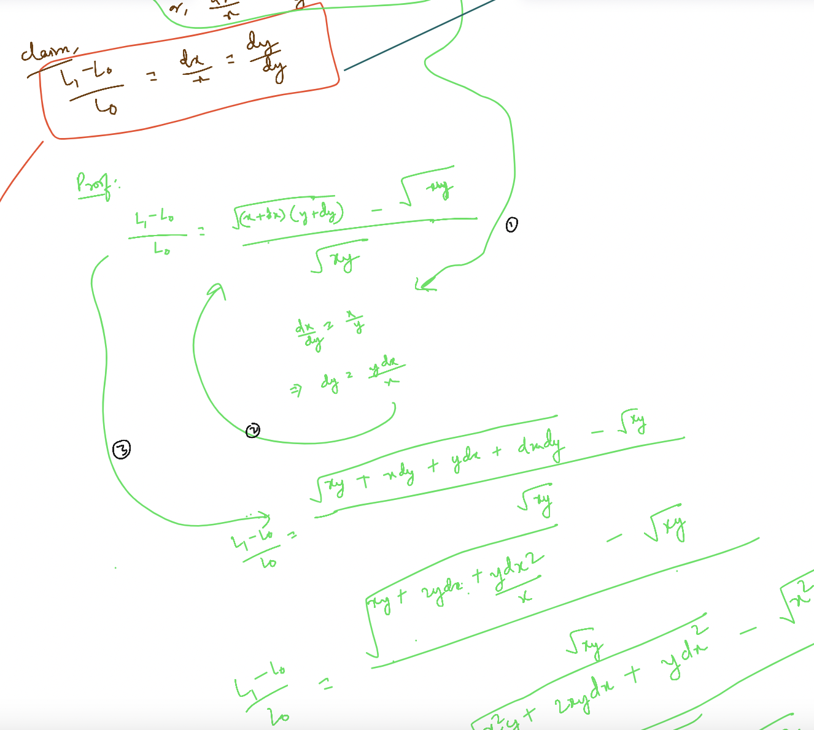

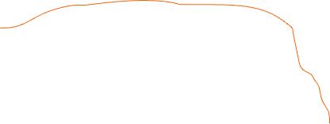


Slide 9
Remove Liquidity

