Slide 1
Design Skills
By
Abhijit Roy

Slide 2
1 Snip an image out of many

Slide 3
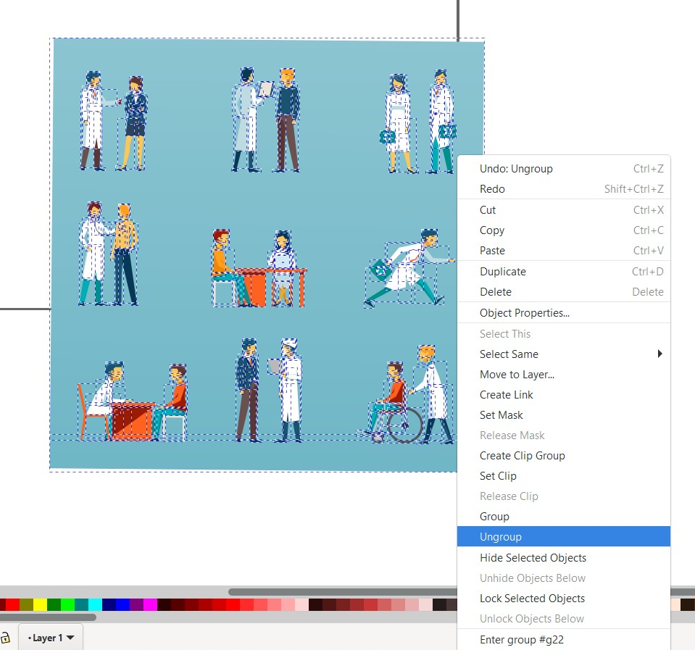
Snip this
Steps:
Open .eps file in Inkscape
Ungroup like shown on left
Copy the entire image in that state & Paste into a PPT slide and then again ungroup here.
Just draw a rectangle over the required image like here 9th img.
Copy the required img & Paste into a PPT slide.
Right click & click group.
Done.

Slide 4
2 Animate object

Slide 5






Slide 6


Slide 7

Start/Restart
Instructions:
Press ‘Start’ to move along the straight line.
Press ‘Restart’ to move along the straight line again.

Slide 8

Instructions:
Press ‘Start’ to move along the path line.
Press ‘Restart’ to move along the path again.
Start/Restart

