Slide 1

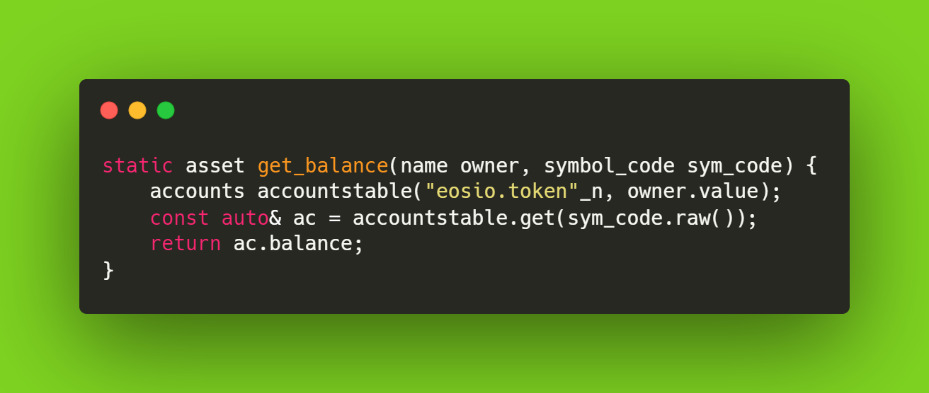
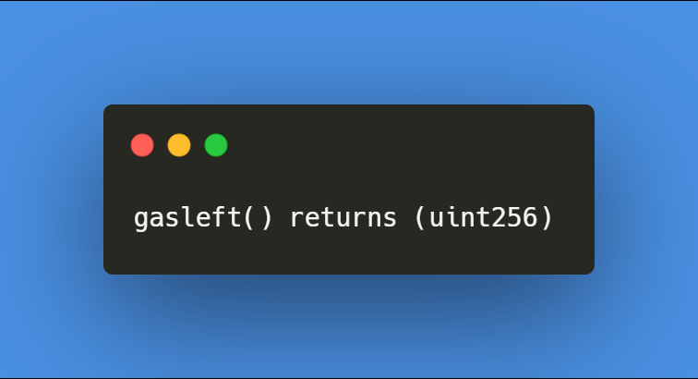
EOSIO
ETH

Slide 2
#eosio #eos #wax #telos #eth #blockchain #polygonmatic #bsc #cryptojobs #blockchainjobs #blockchaintechnology #smartcontracts #ethereum #crypto #cryptocurrency #bitcoin
EOSIO - 21BBD3
ETH - 21BBD3

