Slide 1
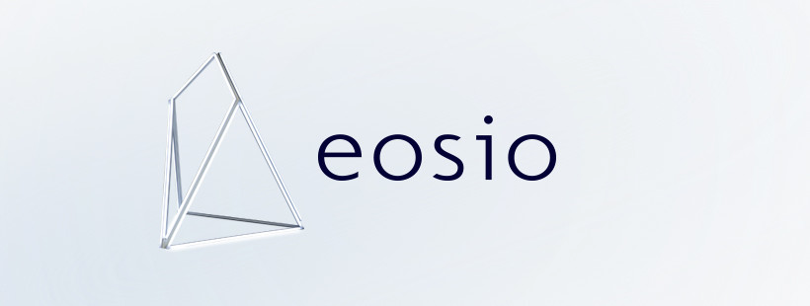

eth
&

Slide 2
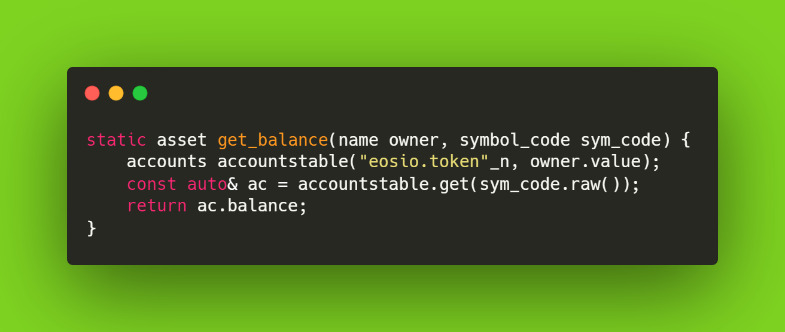
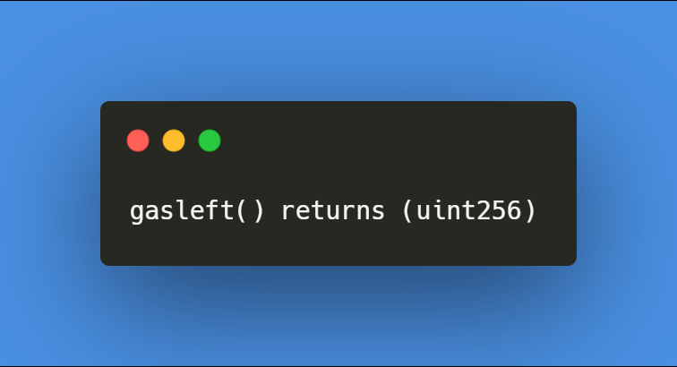
EOSIO
ETH

Slide 3
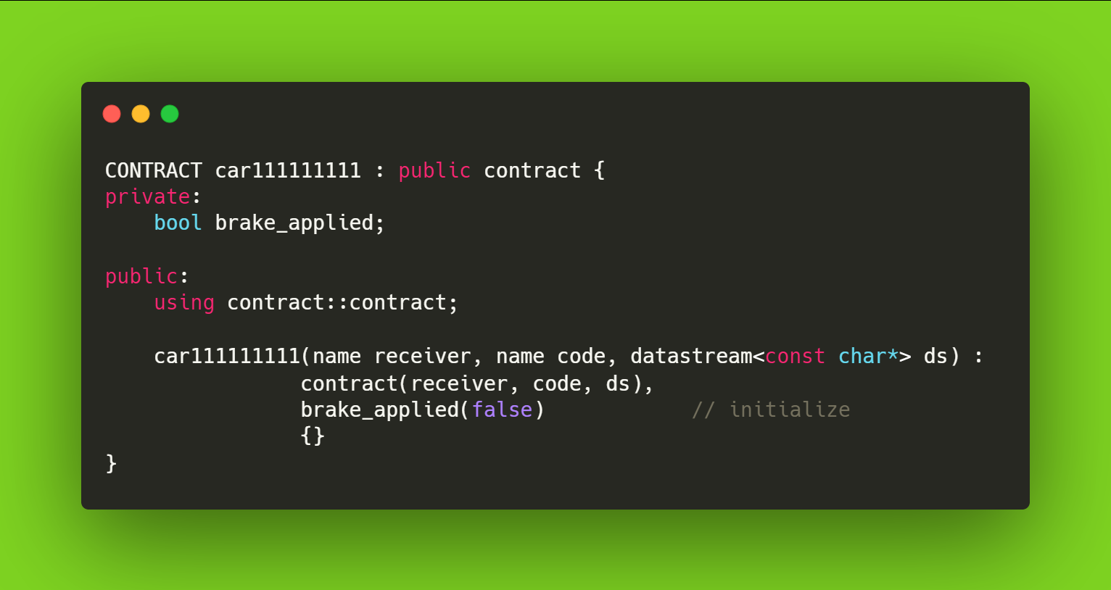
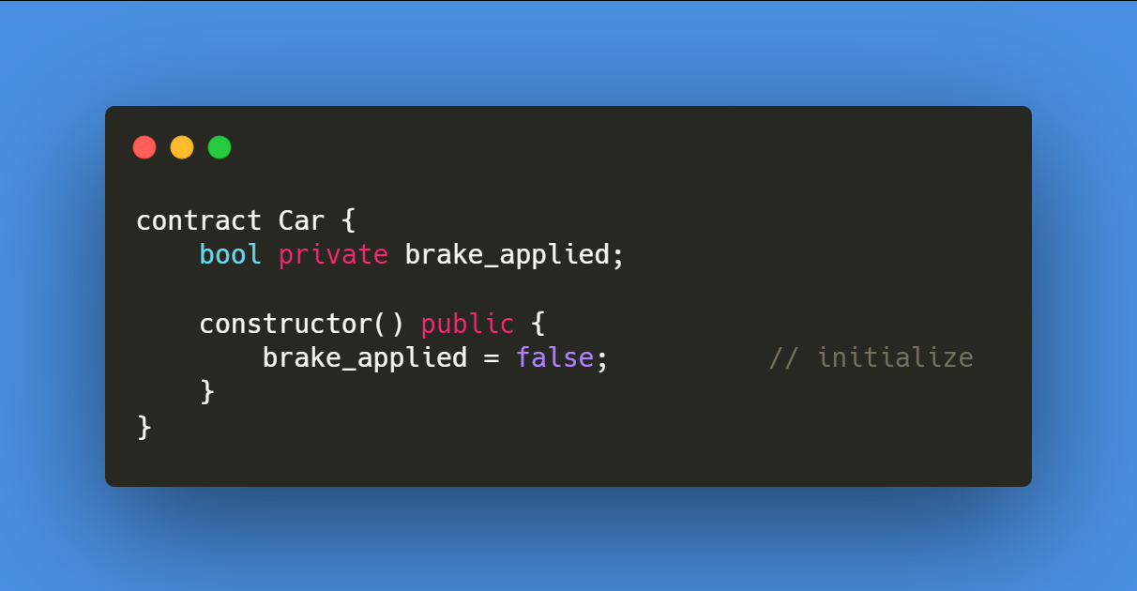
EOSIO Blockchain account name must be of 12 chars
car111111111.cpp
Car.sol
EOSIO
ETH

Slide 4
#eosio #eos #wax #telos #eth #blockchain #polygonmatic #bsc #cryptojobs #blockchainjobs #blockchaintechnology #smartcontracts #ethereum #crypto #cryptocurrency #bitcoin #medium
EOSIO - 21BBD3
ETH - 21BBD3

