Slide 1



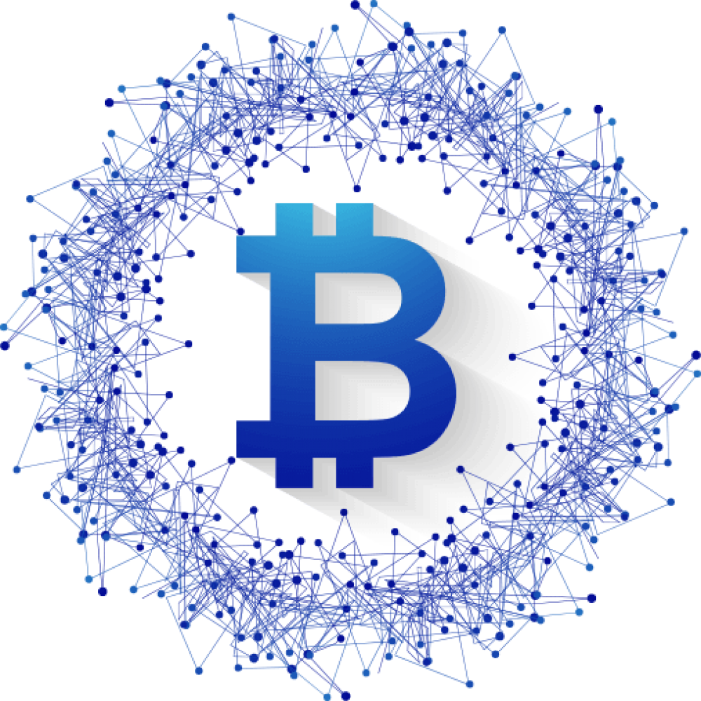













ABHIJIT ROY
Blockchain Developer, Architect
Kolkata, India
PERSONAL
INFO
ABOUT ME
EDUCATION
I am a Blockchain Developer with 6+ years of experience as CTO, Lead/Senior Smart contract Developer in multiple crypto startups, projects related to NFT, DeFi, Betting game and in utility category. I hold multi-chain development experience with leading Blockchain protocols like EVM, EOSIO, Solana.
2014
IIST, Trivandrum
BIRTH DATE
B. Tech Avionics
28 March 1993
NATIONALITY
Indian
YEARS OF EXPERIENCE
~7 years
LANGUAGE
Solidity, C/C++, Rust, Python, Vyper, Javascript, Typescript, Java, Bash, Batch, Markdown
CONTACT
INFO
CAREER TIMELINE
PHONE
2016-2017: Full-stack development of an All-in-One Android App – “BitInfoCoin”.
2017-2021: Blockchain Developer with multiple roles and projects.
2018: Founding CTO at DRIFE.
2019-2020: Freelancing projects done with multiple clients.
2021: Lead Blockchain Developer at DeFi start-up - “Boot Finance”.
2021-2022: Senior Blockchain Engineer at Master Ventures
2021-2022: CTO at Theia Labs
2022: Lead Blockchain Developer at Mojo, Polygon’s native stablecoin.
+91-9474501583
Github
abhi3700
EMAIL
dalvath3700@gmail.com
LinkedIn
abhi3700
Medium
abhi3700
LANGUAGES
EXPERTISE
SKILLS
ENGLISH
GIT
Hindi
EVM SOLIDITY Language
Bengali
Technical DOCUMENTATION
EOSIO C/C++
HOBBIES
Blockchain
Data Science
PYTHON
Product
MIRO

Slide 2

EXPERIENCE
Blockchain
Smart Contract Development
Worked on a CDP based stablecoin using Diamond Standard at Mojo, inspired from Liquity, Yeti Finance projects.
Created a Vault contract with Deposit & Reward tokens with custom APY for EVM Blockchain.
Worked as a CTO on Crowdfunding platform v1, v2, based on DeFi AMM curve at Theia Labs. Developed the upgradeable EVM smart contracts using Diamond Standard & also released the two versions there as a product.
Written NodeJS scripts for automatic deployment of Generative & Manual art on IPFS (Pinata), Arweave.
Worked on Escrow contract with payer, payee, releaser, Staking (with single, multiple tokens) contract, Vault contract with deposit/withdraw of ETH & mint/burn of native tokens, Computationally efficient contract for calculating on-chain average token price for DeFi protocols for EVM Blockchains.
Contributed to open-source projects – OpenZeppelin, Uniswap v2.
Also worked on Cross-chain Bridge for implementation of token & vesting (single, multiple) contracts with timelock functionality for the tokens transferred from DEX during swap.
Other than writing contracts, I am experienced with Unit testing, Deployment, Flattening, Verification, Get contract size of smart contracts using Hardhat, Truffle with Javascript or Typescript. Also, familiar with Slither to find contract vulnerabilities and monitor the gas consumption for each contract methods.
Worked as Lead Blockchain Developer at Boot Finance on writing contracts for DEX, inspired from Curve, Saddle protocol with custom-swap AMM.
Designed & Developed the Smart Contract System Design with suite of smart contracts for a Ride Sharing DApp – “TOE” and wrote the technical whitepaper at DRIFE. Also incorporated a ‘free Rides’ trading AMM based marketplace with all-time liquidity using DeFi’s Bancor Algorithm.
Worked on a smart contract for a project “Providing a digital identity for parks to enable humans to interact with and take care of them” in SNI Hackathon.
Built Escrow, Game contracts (featured with Oracle RNG service for end result) along with the architecture developed for a Betting Game – ‘GPK.Battles’ on WAX Blockchain.
Built contracts – ICO (single, multi phase), Staking, Token for EOSIO Blockchains.
Contributed to documentation titled – “Setting up Telos Validator Nodes” for Validators for the Telos (EOSIO) Blockchain.
Notes:
## Smart Contract
Combine eosio, evm
Substrate Blockchains
### Open-Source Contributions
## Product

Slide 3
Worked as Senior Blockchain Developer at Master Ventures on crowdsale program codebase (using Rust) on Solana Blockchain. Also, worked in launching parachain with Substrate via CLI on Polkadot relaychain. Honestly, I have got beginner level experience with Rust for Solana, Substrate now.
Product
Worked on a NFT project – “Bowled” where I build the architecture for their sports-based Metaverse with play-to-earn gamification model using player, stadium card types.
Created a Tipping Bot Dapp, integrated with EOSIO tipper contract for handling p2p token transfer with just Telegram user ID.
Developed a KYC Bot Dapp, integrated with EOSIO kyc contract along with the hybrid storage model (Blockchain + Redis Cloud DB) for submission of personal data and validation through its cryptographic hash.
Full Stack development of an Android App – ‘BitInfoCoin’ (now delisted on playstore) for Crypto users.
Worked on a DeFi Chatbot – ProFi, which gives Analytical visual charts for maximizing yield in fiat currency using different cryptocurrencies in multiple liquidity pools.
Designed the architecture for an incentivized travel platform with activity-dependent AI community Bot on Steem/Hive Blockchain.
Data Science
Created a software called ‘AutoPlot’ for generating interactive plots (with hovering feature) automatically from the big data maintained in Excel and reduced the time from 30 mins (earlier) to 3 seconds (now). Also, created a corresponding dashboard for data analytics on web browser.
Automatic rent agreements (Deposit Deduction, Rent Increase) generation for different tenant's data (like name, startdate, address, postcode) from Excel data.
Renaming thousands of files based on 5 parameters available inside the file at a particular directory.
Extract a specific data from a file (format: msr) and replace a specific line in another file (format: .001). Replace coordinates in a file with a desired value and repeat the same for thousands of files present in a directory.
Fetching of accounts & timestamp of Twitter posts with tag #libya.
Prepared a data analysis report on updating an Excel form from datasets fetched from Outlook mail.
Image files (formats: dot, png) generation from fetched data in Excel file.
Created a custom 3D Plot for data analytics related to Semiconductor devices with yield, which is visualizable with interactive modern-UI level.

Slide 4

Bot
Built a Key Generator Bot called ‘KeyHub’, where a user can buy license key for a set of products. The key usage is continuously monitored along with exact location obtained through reverse-geocoding of coordinates.
Created a Bot called ‘LEO’ which allows a user to get dog images based on their saved breed as preference or to load random dog images. A donation programme feature was also added which then allowed dog lovers to donate money directly to the Dog Welfare centres.
Created a general-purpose Quiz bot with types - MCQ, Image, Audio, GIF, Video for any topic where a teacher/School/College can conduct online exams for their students. Addition of proper evaluation of subjective types of exam is to be added into the Bot.
LEADERSHIP AND ACHIEVEMENTS
Bagged the 2nd rank in SNI Hack 2021 competition as a EOSIO Blockchain Developer for a project “Ceven.Parks”, which provides a digital identity for parks to enable humans to interact with and take care of them.
In 2018, I was the founding team member as CTO of a blockchain-based mobility platform that seeks to decentralize the ride-hailing ecosystem. I managed 10 core team members with developers, designers, content writers successfully.
I was sponsored to represent DRIFE as CTO in World Blockchain Summit (WBS) held at Dubai in October 2018, where I pitched to around 35 investors from worldwide and ranked as the best start-up in utility tokens category.
I am managing the largest Semiconductor community over Telegram via a channel. In future, a blockchain-based Chatbot – ‘SEMION’ with customized user experience, is promised to be released on Telegram and a subscription fee will be charged for which feedbacks is taken via polls conducted within the community.
I provide online education services through my Udemy account – Block.Hub Academy which has a total of 170 students enrolled for 4 courses to date.
I am also available as a mentor for topics related to Blockchain (EOS, NFT, DeFi, Ethereum) via Fiverr for 4 people as of now.
Maintain one of the highest starred GitHub repositories in EOSIO Ecosystem. Repo
I have published many thoughtful articles related to Blockchain, Data Science on Medium
I was a regular technical content creator for a community called Utopian on Steemit– An incentivized social platform on Steem Blockchain.

