Slide 1
Tip User Bot
Testing Report
Abhijit Roy

Slide 2
Content
pre-requisites
deposit
withdraw
withdrawmemo
tip

Slide 3
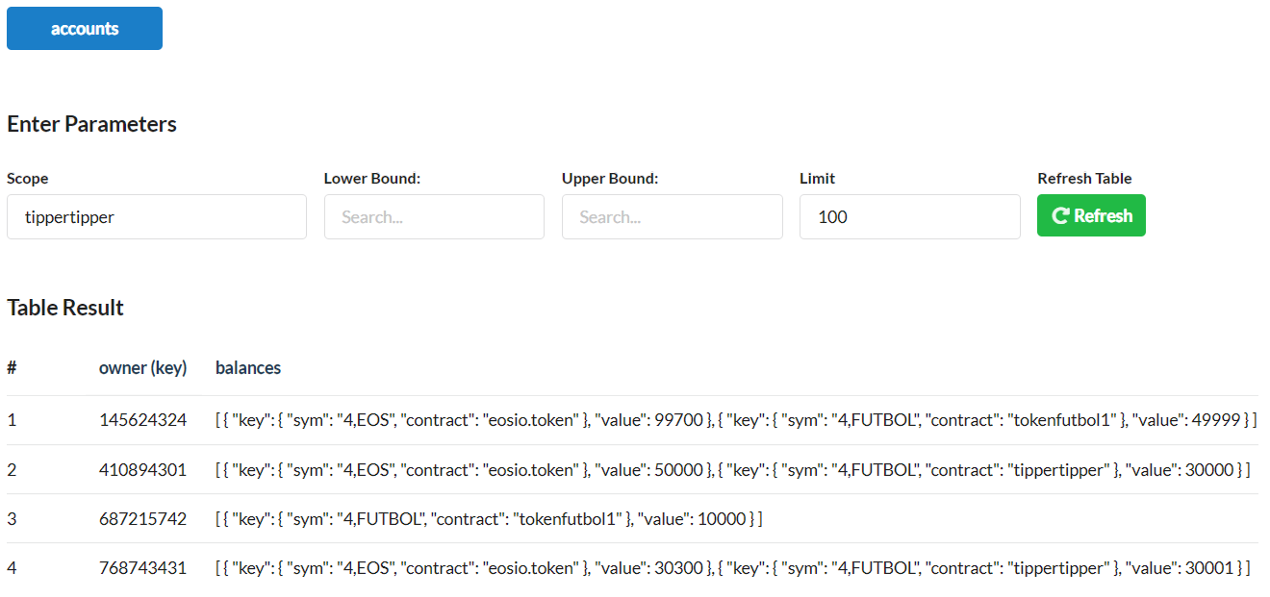
Pre-requisites
For testing purpose, “telegram_id – 145624324” donate some tokens (5 EOS, 3 FUTBOL) to
“telegram_id – 410894301”.
For production, user shall have balances in either owned EOSIO account or in Exchanges EOSIO account.

Slide 4
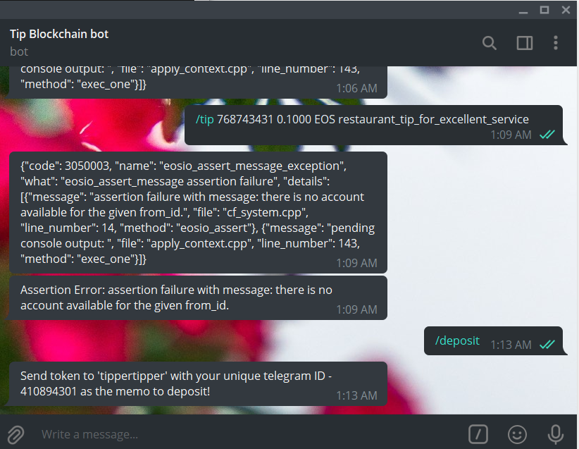

deposit

Slide 5
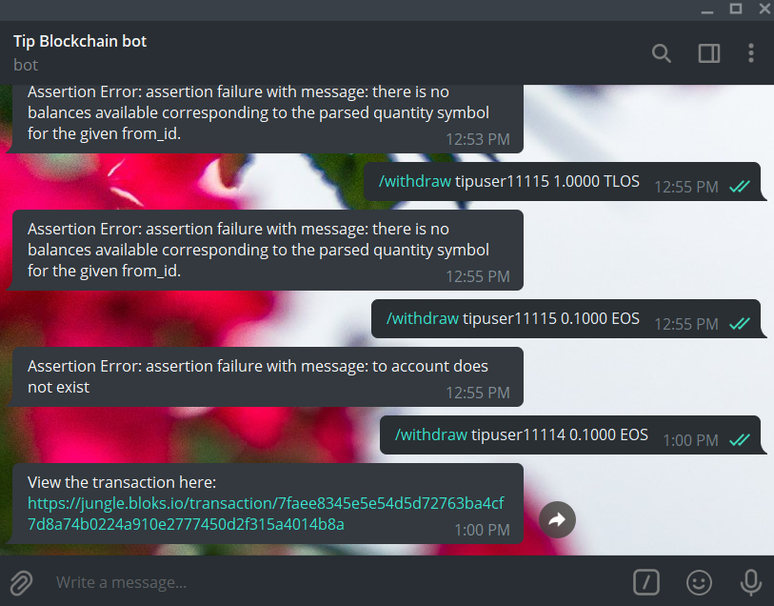
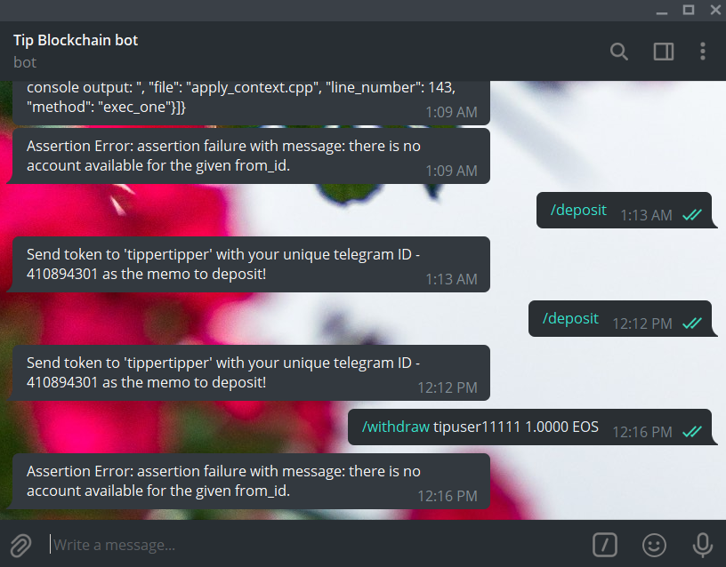
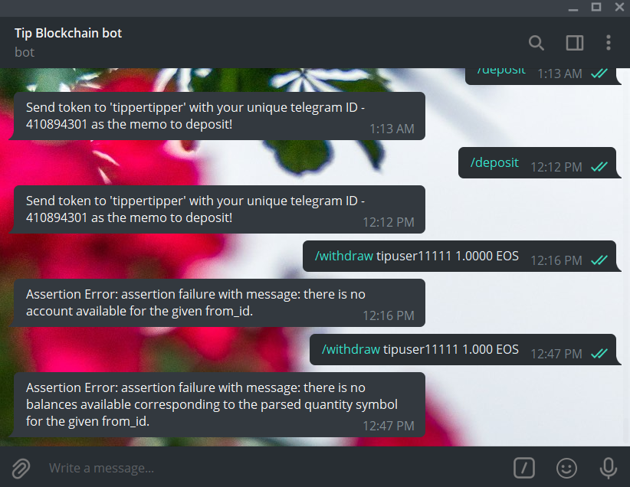
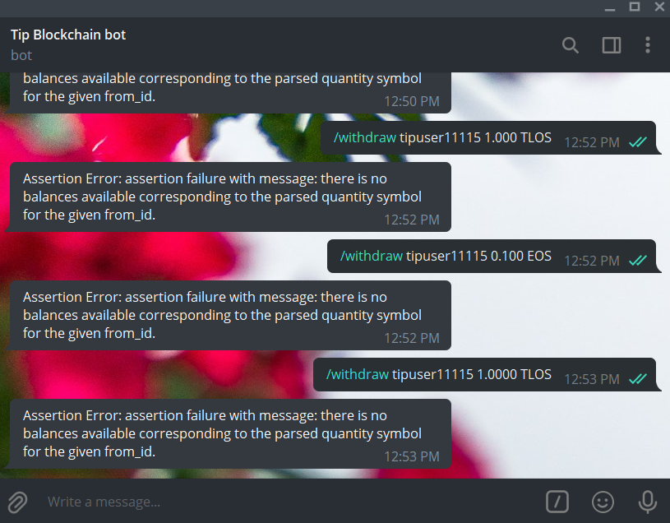
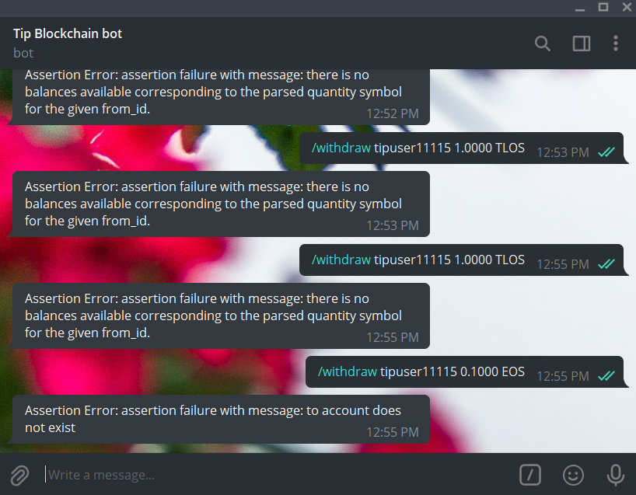
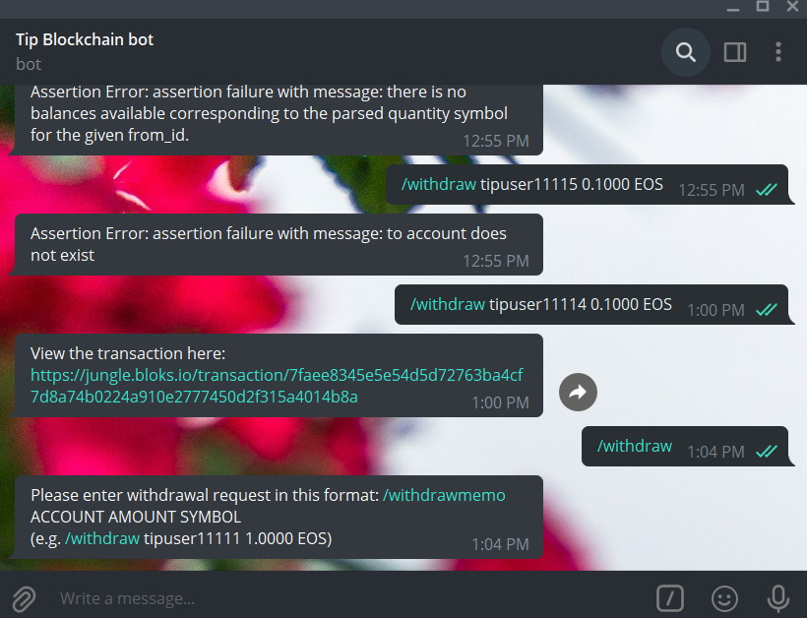
withdraw
SUCCESS
ERROR

Slide 6
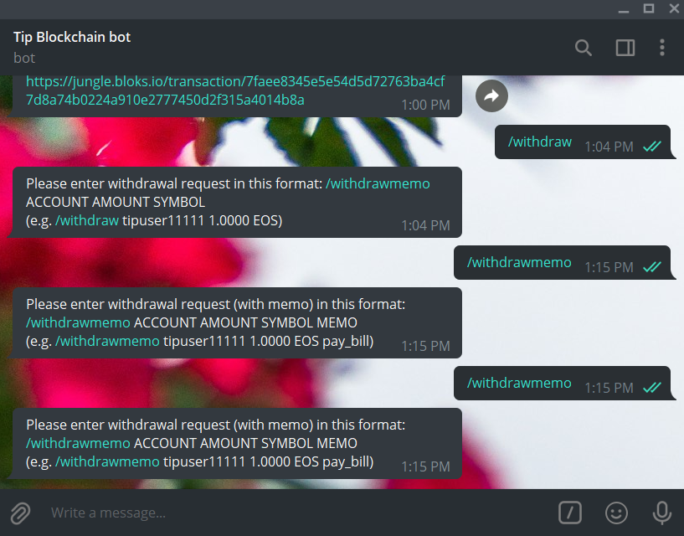
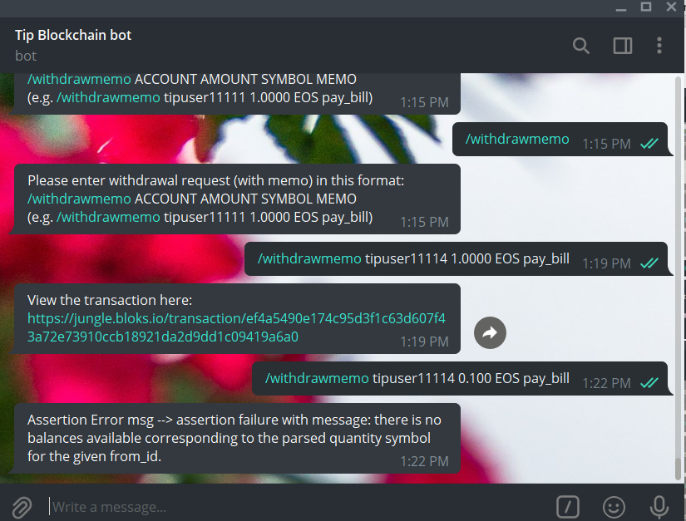
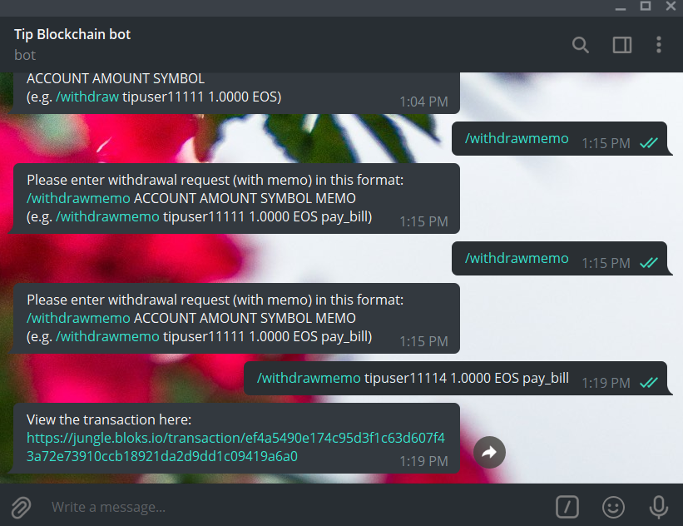
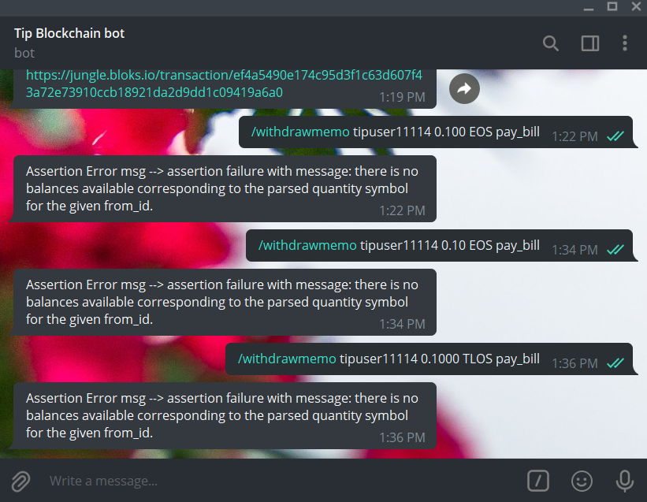
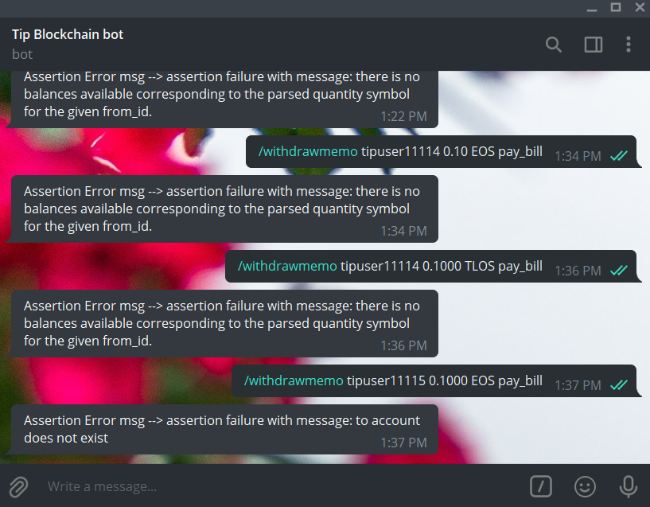
withdrawmemo
SUCCESS
ERROR

Slide 7
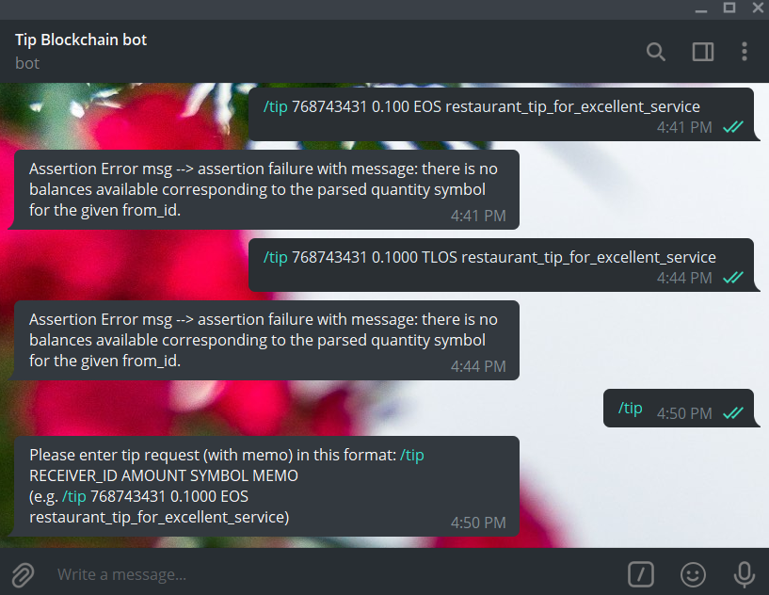
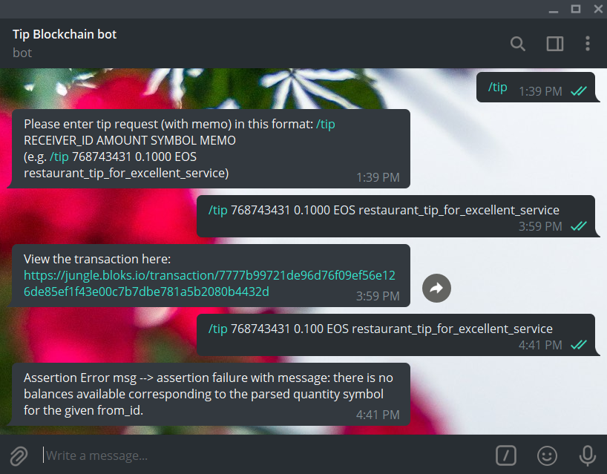
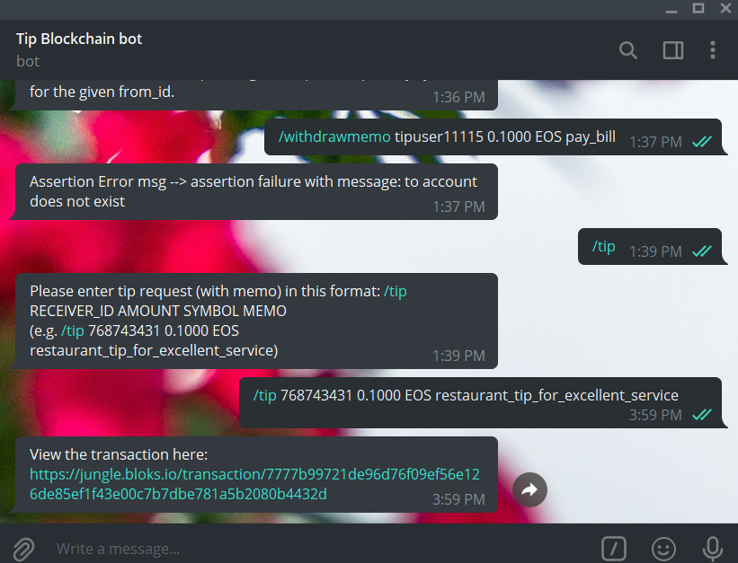
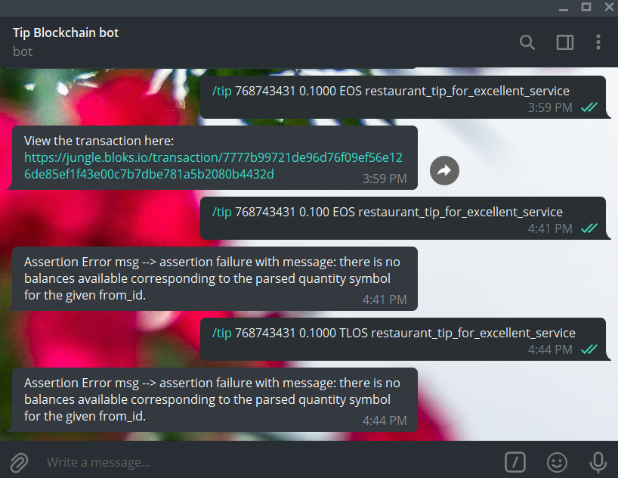
tip
SUCCESS
ERROR

Slide 8

THANKS

