Slide 1
Dry Etch
Recipes run in Equipments
Abhijit Roy
Sci./Engr. - ‘SD’
CL00102
VFD, Dry Etch
31-Mar-2021

Slide 2
Background
The shared raw data contains the recipes used for running lots in equipment(s)/chamber(s) with datetime.

Slide 3
Objective
List down the unique recipes run in respective equipment(s)/chamber(s).
Show the frequency of each recipe run in respective equipment(s)/chamber(s).

Slide 4
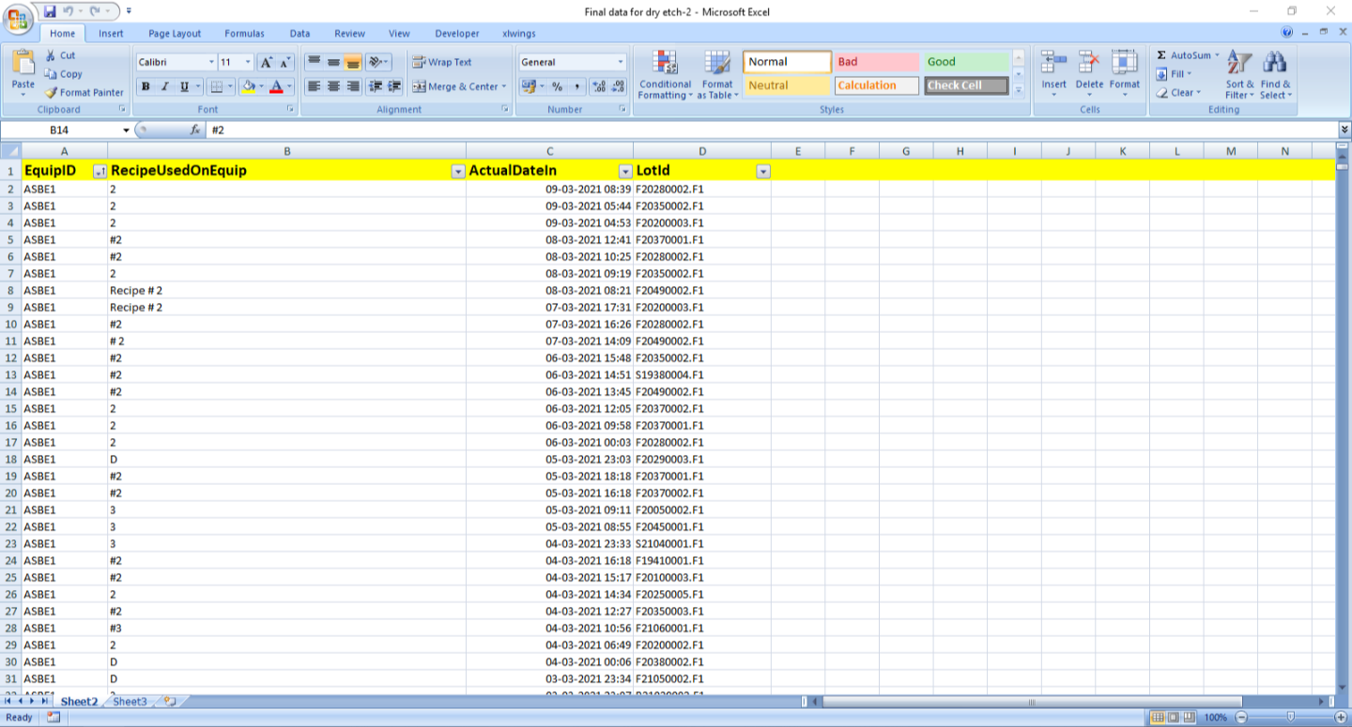
Raw Data
It contains 17,284 rows & 4 columns. So, the only procedure to extract meaningful information is using scripts.

Slide 5
Data Analysis Procedure
Cleaning: strip whitespaces in each cell data from front & rear side.
Wrangling: filter out the recipes of each equipment/chamber by name in “EquipID” column.

Slide 6
ASBE1

Slide 7
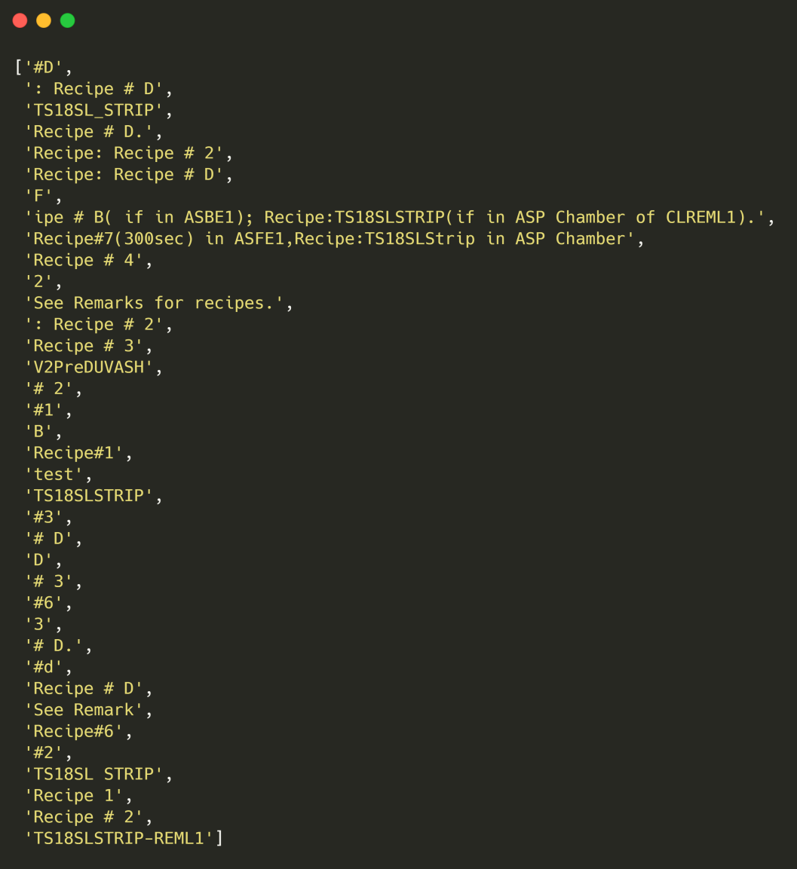
Recipes

Slide 8
Frequency

Slide 9
ASFE1

Slide 10
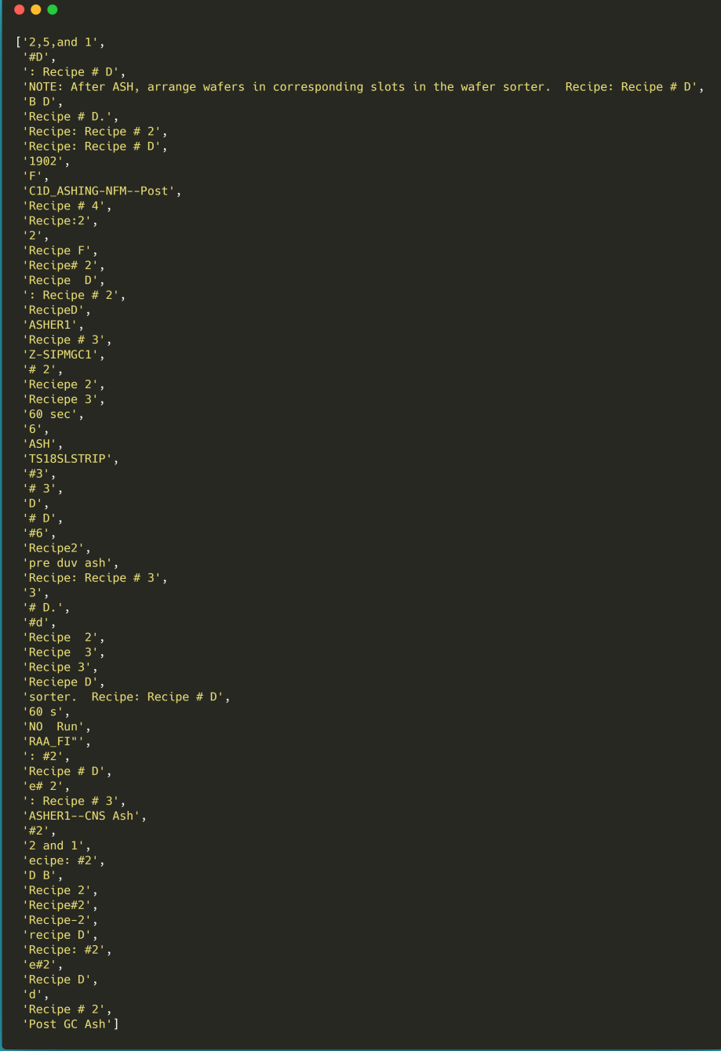
Recipes

Slide 11
Frequency

Slide 12
REML1

Slide 13
Recipes

Slide 14
Frequency

Slide 15
REOX1

Slide 16
Recipes

Slide 17
Frequency

Slide 18
REPL1

Slide 19
Recipes

Slide 20
Frequency

Slide 21
RESP1

Slide 22
Recipes

Slide 23
Frequency

Slide 24

THANKS

