Slide 1
Dry Etch
Recipes run in Equipments
Abhijit Roy
Sci./Engr. - ‘SD’
CL00102
VFD, Dry Etch
31-Mar-2021

Slide 2
Background
The shared raw data contains the recipes used for running lots in equipment(s)/chamber(s) with datetime.

Slide 3
Objective
List down the unique recipes run in respective equipment(s)/chamber(s).
Show the frequency of each recipe run in respective equipment(s)/chamber(s).

Slide 4
ASBE1

Slide 5
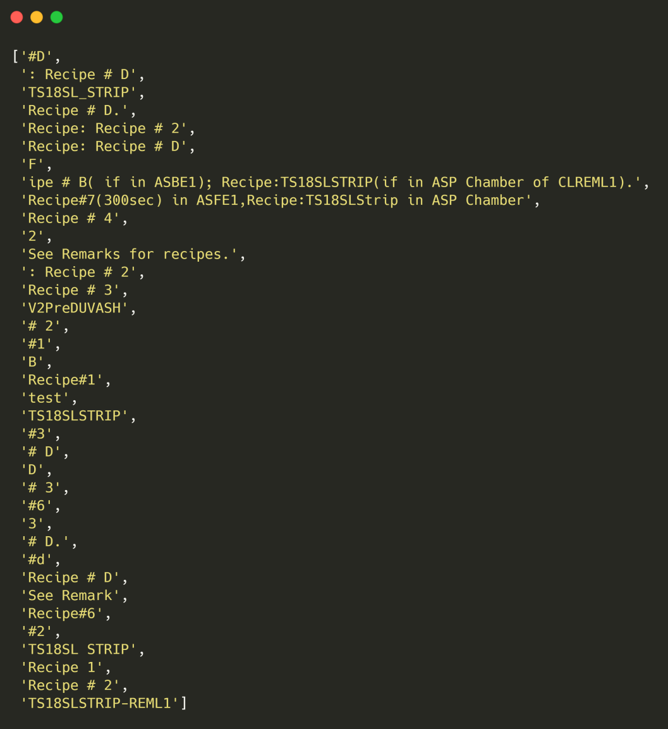
Recipes

Slide 6
Frequency

Slide 7
ASFE1

Slide 8
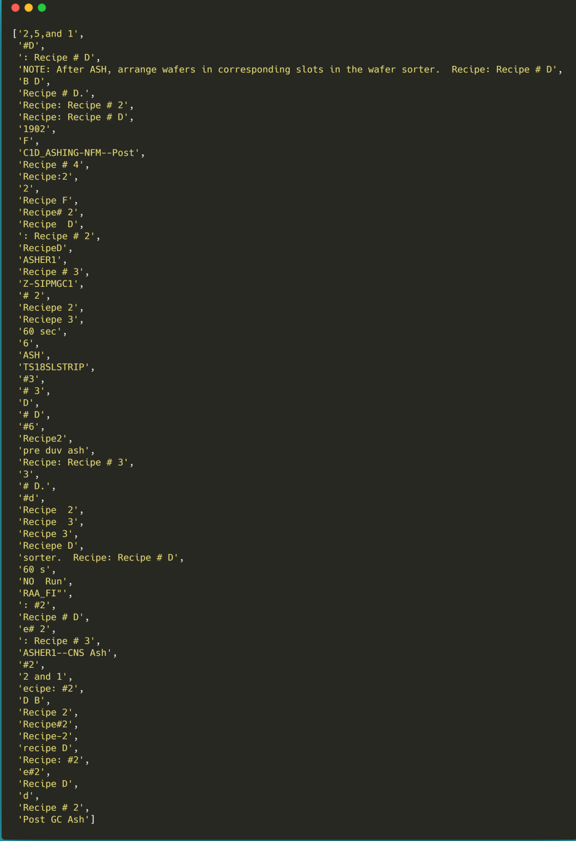
Recipes

Slide 9
Frequency

Slide 10
REML1

Slide 11
Recipes

Slide 12
Frequency

Slide 13
REOX1

Slide 14
Recipes

Slide 15
Frequency

Slide 16
REPL1

Slide 17
Recipes

Slide 18
Frequency

Slide 19
RESP1

Slide 20
Recipes

Slide 21
Frequency

Slide 22

THANKS

