Slide 1
LATENT SEMANTIC ANALYSIS
Team : Triangle

Slide 2
DEFINITION
Latent semantic analysis (LSA) is a technique in natural language processing, in particular distributional semantics, of analysing relationships between a set of documents and the terms they contain by producing a set of concepts related to the documents and terms.

Slide 3
Steps involved in the implementation of LSA
Tokenising and stemming each synopsis
Data preprocessing and cleaning
Transforming the corpus into vector space using tf-idf
Clustering the documents using the k-means algorithm
Applying LSA to the tf-idf matrix
Using multidimensional scaling to reduce dimensionality within the corpus
Plotting the clustering output using matplotlib and mpld3 and Umap

Slide 4
Data Preprocessing
We will try to clean our text data as much as possible.
Remove the punctuations, numbers, and special characters.
Remove shorter words.
Removing stop words. Stop words are words like "a", "the", or "in" which don't convey significant meaning.
Make all the text lowercase to nullify case sensitivity.

Slide 5
Document-Term Matrix (Tf-Idf)
Define term frequency-inverse document frequency (tf-idf) vectorizer parameters and then convert the synopses list into a tf-idf matrix.
We will use sklearn’s TfidfVectorizer to create a document-term matrix
vectorizer = TfidfVectorizer(stop_words=stop_words,max_features=10000, max_df = 0.5, use_idf = True, ngram_range=(1,3))

Slide 6
A couple things to note about the parameters defined below:
max_df: this is the maximum frequency within the documents a given feature can have to be used in the tfi-idf matrix. If the term is in greater than 80% of the documents it probably cares little meanining (in the context of film synopses)
min_idf: this could be an integer (e.g. 5) and the term would have to be in at least 5 of the documents to be considered. Here I pass 0.5; the term must be in at least 50% of the document.
ngram_range: this just means I'll look at unigrams, bigrams and trigrams.

Slide 7
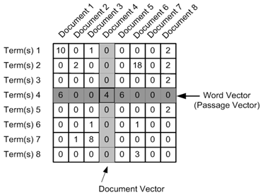
Tf-idf matrix

Slide 8
K-means clustering¶
Using the tf-idf matrix, you can run a slew of clustering algorithms to better understand the hidden structure within the synopses.
K-means initializes with a pre-determined number of clusters.
Each observation is assigned to a cluster (cluster assignment) so as to minimize the within cluster sum of squares. Next, the mean of the clustered observations is calculated and used as the new cluster centroid. Then, observations are reassigned to clusters and centroids recalculated in an iterative process until the algorithm reaches convergence.

Slide 9
Topic Modeling
Represent each and every term and document as a vector.
We will use the document-term matrix and decompose it into multiple matrices.
We will use sklearn’s randomized_svd to perform the task of matrix decomposition.
U, Sigma, VT = randomized_svd(X, n_components=5, n_iter=100, random_state=123)

Slide 10

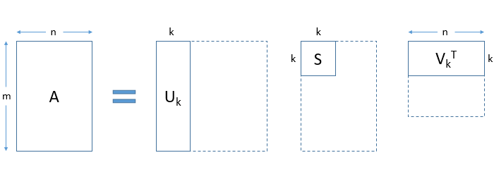
Steps involved in the implementation of LSA

Slide 11
Printing Topics:
VT is a term-concept matrix.
We enumerate VT to get the topics
Ex : Concept 1: romney, gingrich, santorum, iowa, hampshire, south carolina, campaign
Concept 2: game, season, points, team, wizards, games, play

Slide 12
Topics Visualization
To find out how distinct our topics are, we should visualize them.
We cannot visualize more than 3 dimensions, but there are techniques like PCA and t-SNE which can help us visualize high dimensional data into lower dimensions.
We have used technique called UMAP (Uniform Manifold Approximation and Projection).

Slide 13
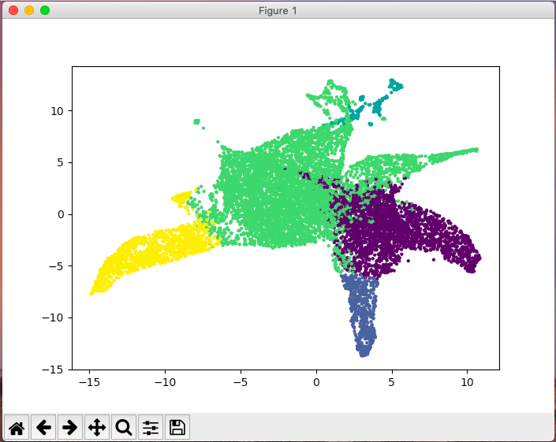
Sample plot (for 10000 documents)

Slide 14
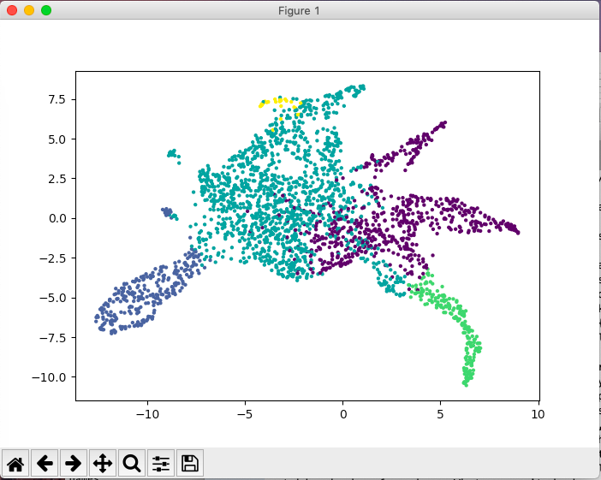
Sample plot (for 2500 documents)

Slide 15
Pros and Cons of LSA
PROS:
LSA is fast and easy to implement.
It gives decent results, much better than a plain vector space model
CONS:
Since it is a linear model, it might not do well on datasets with non-linear dependencies.
LSA assumes a Gaussian distribution of the terms in the documents, which may not be true for all problems.
LSA involves SVD, which is computationally intensive and hard to update as new data comes up.

