Slide 1
Improving Influenza Prediction Rate by Combining Traditional, Search and Social Media Data sources
Gaurav U D 16IT113
Abhilash V 16IT201
Shrinivas V Shanbhag 16IT244

Slide 2
Agenda
Introduction
Literature Survey
Outcome of Literature Survey
Issues and Challenges
Motivation
Problem Statement
Research Objectives
Methodology
Work done
Result and analysis
Conclusion and Future work
Individual Contribution

Slide 3
Introduction
Influenza outbreak poses a great challenge for medical professionals as each year they claim around half a million lives worldwide
Predicting when an outbreak might occur is crucial so that the preventive measures can be taken at the right time
Accurate predictions can help the health officials to properly prepare and respond to Influenza like illness ( ILI ) outbreaks
The US Centers for Disease Control and Prevention (CDC) provides an estimate of influenza activity in the population, its availability has a known lag-time of at least 7 to 14 days
This project proposes a methodology which uses an ensemble of different machine learning algorithms and uses data from different real time sources like Twitter, Google Flu Trends and Athena Data

Slide 4
Literature Review
Authors | Methodology | Advantages | Limitations
Lamb A, Paul Mj, and Dredze M. [1]] | Two phase approach to find flu infection rates from twitter data: first labeled tweets as related/not-related and then classified the related tweets as awareness/infection and self/others. | It was successful to differentiate between reports of actual infection and Twitter chatter. | Inherent deficiency of twitter data - underrepresentation of elderly , children and internet deprived areas
Generous N, Fairchild G, Deshpande A, Del Valle SY, and Priedhorsky R [2] | Wikipedia article access logs and official disease incidence reports, were used to build linear models to analyze and forecast on 14 diseases context | Finds wikipedia source as successful disease surveillance method and finds the forecast value to be significant upto 28 days | Does not perform well with fast changing diseases pattern like influenza/flu , better selection of article among millions is needed
Ginsberg J, Mohebbi MH, Patel RS, Brammer L, Smolinski MS, and Brilliant L. [3] | The google search volume of specific terms is used to predict ILI through linear models | It continuously provides real time estimates of ILI based on geographical boundaries | Google flu trends overestimated the flu over certain time periods due to extreme media coverage and attention i.e. was not able to seperate hype from actual infection rate [5 ]
Smolinski MS, Crawley AW, Baltrusitis K, Chunara R, Olsen J, Wojack O, et al. [4] | Participatory flu surveillance system (FNY) used to gather data, segregate based on symptoms and make estimation through sampling | Fairly clean data collection with lesser noise | It is limited by samples , geography locations, ability to forecast for extended period of days

Slide 5
Outcome of Literature Review
Social media based surveillance go awry at the peak of flu season by making higher estimation than ground truth , whereas government and voluntary based estimation has delayed estimation, and lesser coverage. Combination of the data sources may complement the advantages of one method over others disadvantage, thereby giving accurate forecast prediction.

Slide 6
Issues and Challenges
1) Proper clean data was not available easily, manual cleaning is the main challenge.
2) Proper synchronisation of data is not there among data from five sources.
3) Difficulty in collection of present data

Slide 7
Problem Statement
Machine learning-based methodology to combine Search, Social Media, and
Traditional Data Sources to Improve
Influenza Surveillance.

Slide 8
Motivation
The recent influenza prediction systems do not give accurate results of flu rate for two to four weeks ahead. These prediction systems do not consider information from other data sources. In order to extract information from all the data sources, this project uses ensemble models to provide real-time predictions (“now cast”) and forecast estimates.

Slide 9
Research Objectives
Data collection (five types)
Data preprocessing
Machine-learning model for each type of data
Ensemble models
Visualisation of results

Slide 10
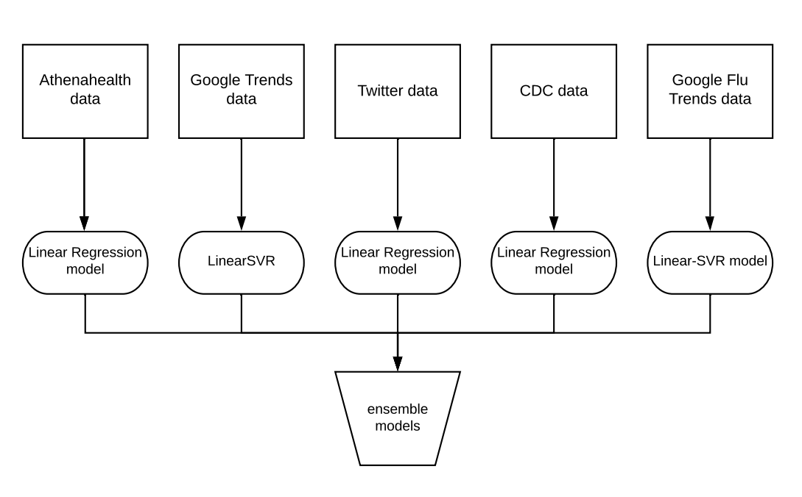
Proposed Model

Slide 11
Methodology
To enhance Influenza surveillance we extract complete information from five different data sources using ensemble techniques
CDC data : considered as a ground truth data
Athenahealth data : medical reports
GT data : Google Trends data
Twitter data : Social media data
Google Flu Trends data : estimation by Google
Ensemble methods use multiple learning algorithms to obtain better predictive performance than could be obtained from any of the constituent learning algorithms alone.
Here machine learning model will be trained for each type of data, and results are combined to produce final result.

Slide 12
Cont. Methodology
Different models used :
Stacked linear regression :
Linear regression performs the task to predict a dependent variable value based on a given independent variable
LASSO regression :
LASSO regression is a type of linear regression that uses shrinkage. Shrinkage is where data values are shrunk towards a central point, like the mean
Linear SVR model :
Two boundary lines are defined on both sides of the regression line, and it is made sure that maximum of all the data points will fit within the boundary lines
AdaBoost Regression with Decision-Trees :
Adaptive Boosting (AdaBoost) regression fits a sequence of weak learners (in this case decision trees) on sequentially re-weighted versions of the training data
Random Forest Regressor:
Random forest is an ensemble model using bagging as the ensemble method and decision tree as the individual model

Slide 13
Work done
Data collection: Data from 5 different sources were collected from 2011 to 2015
CDC data
Athena data
Google Trends Data
Google Flu Trends
Twitter data set
Data preprocessing:
Genetic algorithm is used as one of the optimization techniques to extract good features from Google Trends and Google Flu Trends
Manual row elimination to remove whole row if any of the variable of data point is not available
If data from one source is missing, its last observation is carried forward

Slide 14
Work done
3. Model building:
Algorithms | for
Linear Regression | CDC data, Twitter data, Athena data, Ensemble model
Linear SVR | G. Trends data, G. Flu Trends data, Ensemble model
LASSO regression | Ensemble model
Random Forest Regressor | Ensemble model
AdaBoost Regression with Decision Trees | Ensemble model

Slide 15



Results and Analysis
RMSE (Root Mean Squared Error):
RMSE=
where yt - True value
yp - predicted value
Accuracy :
Accuracy ( )= , where
residual sum of squares (u)=
Total sum of squares (v)=

Slide 16
Results and Analysis
Ensemble Models | Accuracy |  |  |  | RMSE
 | 0-lag | 1-lag | 2-lag | 3-lag | 0-lag | 1-lag | 2-lag | 3-lag
L R | 0.725 | 0.763 | 0.602 | 0.581 | 0.608 | 0.565 | 0.737 | 0.757
LASSO | 0.735 | 0.764 | 0.602 | 0.581 | 0.602 | 0.565 | 0.737 | 0.757
SVR | 0.757 | 0.773 | 0.621 | 0.545 | 0.572 | 0.554 | 0.719 | 0.789
AdaBoost | 0.709 | 0.599 | 0.411 | 0.552 | 0.626 | 0.735 | 0.897 | 0.782
Random Forest | 0.759 | 0.636 | 0.464 | 0.632 | 0.569 | 0.705 | 0.856 | 0.71
SVM [5] | 0.694 | 0.753 | 0.659 | 0.541 | 0.176 | 0.352 | 0.527 | 0.507
AdaBoost[5] | 0.635 | 0.624 | 0.518 | 0.529 | 0.251 | 0.334 | 0.446 | 0.503
Table 1. Comparison of Ensemble

Slide 17
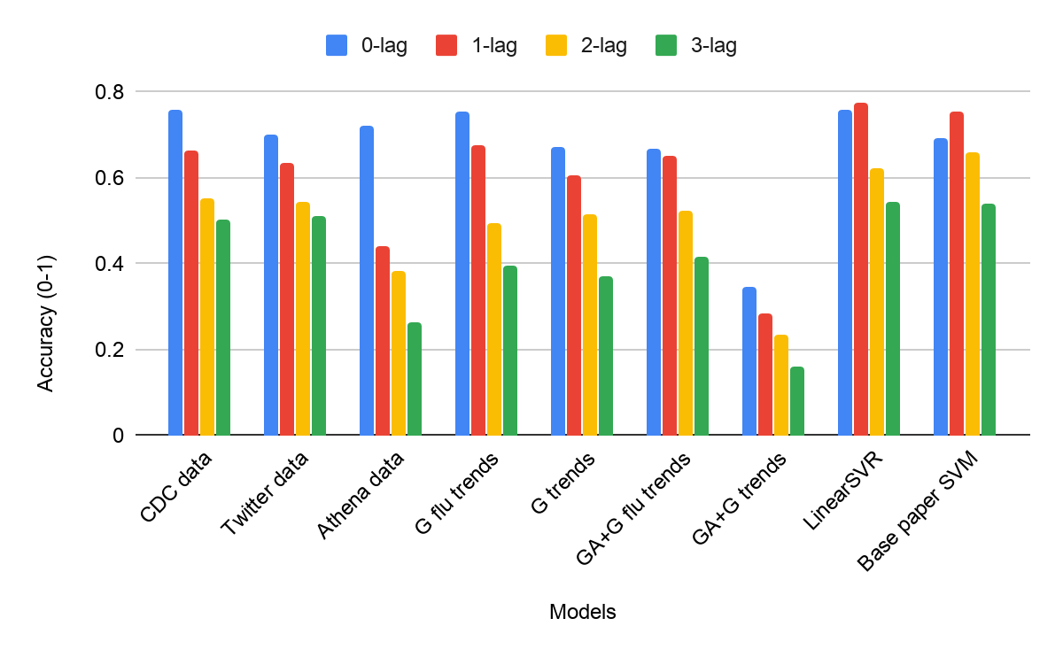
Results and Analysis
Fig 1. Comparing weak predictors with ensemble predictors

Slide 18
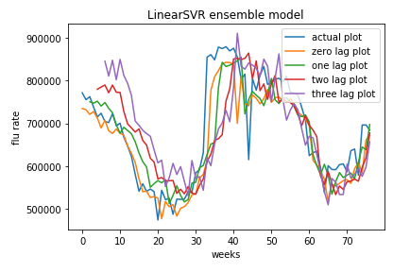
Results and Analysis

Slide 19
Innovative Work
Application of GA to Google Trends data.
Application of different preprocessing techniques like last observation is carried forward.
Application of different ensemble models like Random Forest and LASSO Regressors.

Slide 20
Conclusion and Future work
We have presented five prediction models and used ensemble models to overcome the weak-ness of each model and make efficient model by using information from five data sources.
Proposed ensemble Linear SVR performs better in accuracy in all weeks except for lag-2 week which the SVM[5] performs better.
Search for other available data sources for present time and build model to real-time prediction
We would like to extend this study with deep learning time series models.

Slide 21
Individual Contribution
Everyone contributed to Data Collection, and Preprocessing
Abhilash : AdaBoost regression with decision-trees, Random-Forest Regressor
Gaurav : Linear Regressor and Results.
Shrinivas : Linear SVR, LASSO Regressor

Slide 22
References
[1] https://www.aclweb.org/anthology/N13-1097
[2]https://journals.plos.org/ploscompbiol/article?id=10.1371/journal.pcbi.1003892
[3] https://www.nature.com/articles/nature07634
[4] https://ajph.aphapublications.org/doi/10.2105/AJPH.2015.302696
[5]BasePaper:https://journals.plos.org/ploscompbiol/article?id=10.1371/journal.pcbi.1004513

